Slide 1

Bangladesh University of Business and Technology(BUBT)
Dept. of Computer Science & Engineering
Presentation
On
Hotel Management System
Presented By:
Md Mehedi Hassan
(ID: 17181103059)
Md Shakil Khan
(ID: 171811136)
Submitted To:
Project Supervisor
Ali Azgar
Assistant Professor
Department of Computer Science & Engineering

Slide 2

Introduction
Hotel Management System
Comprehensive Solution
Intuitive Interface
Streamlines operations, improves guest experiences, and enhances business efficiency.
Enables hotel staff to quickly access and manage key functionalities.
Automated Workflows
Handles routine tasks, freeing up staff to focus on customer service.

Slide 3
Project Objectives
Streamline Operations
Enhance Guest Experience
Automate and optimize key processes like reservations, check-in/out, and billing.
Provide a user-friendly platform for booking, reservations, and hotel services.
Improve Data Management
Increase Efficiency
Centralized database for efficient data storage, retrieval, and analysis.
Automate administrative tasks and optimize staff productivity.

Slide 4
Motivation
1
Streamlining Operations
2
Boosting Productivity
Improve efficiency in managing bookings, customer data, and staff scheduling.
Automate routine tasks to enhance productivity and reduce operational costs.
3
Enhancing Guest Experience
4
Gaining Competitive Edge
Provide guests with a seamless booking and stay management experience.
Implement a modern, feature-rich system to stand out in the industry.

Slide 5
System Architecture
Frontend
Database
HTML, CSS, JavaScript for user interface
MySQL for data storage and management
1
2
3
Backend
PHP for server-side logic
The hotel management system provides an overview of the system architecture, detailing the technologies used in the frontend, backend, and database

Slide 6
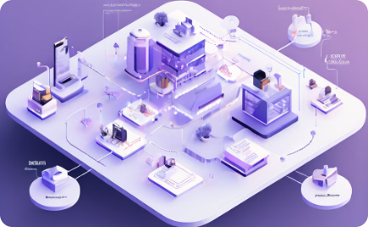

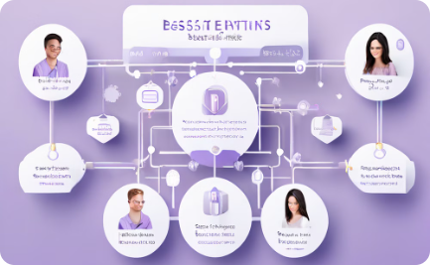
Database Design
Use Case Diagram
Class Diagram
Data-flow Diagram
The system uses a relational database with interconnected tables for rooms, guests, reservations, and financials.
Each table has well-defined attributes and relationships to support hotel management functions.
The Reservations table links guests, rooms, and financials, enabling comprehensive booking management.

Slide 7
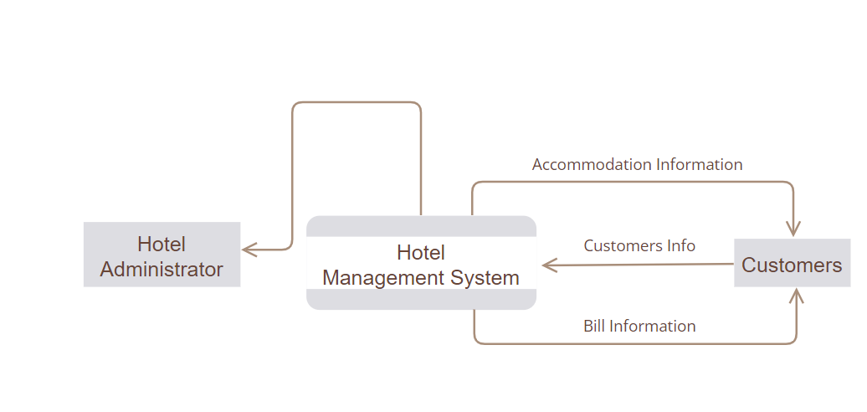
Data-flow Diagram

Slide 8
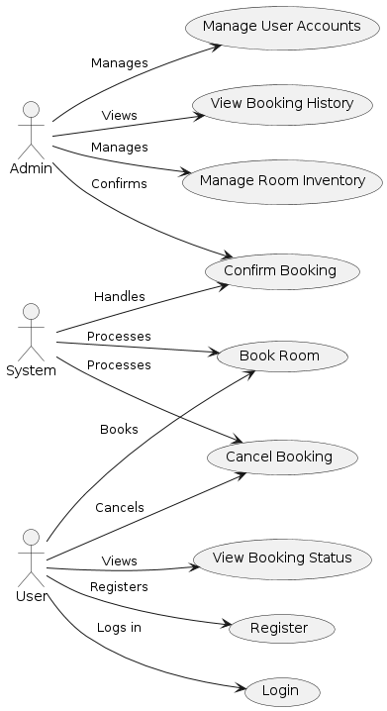
Use Case Diagram

Slide 9
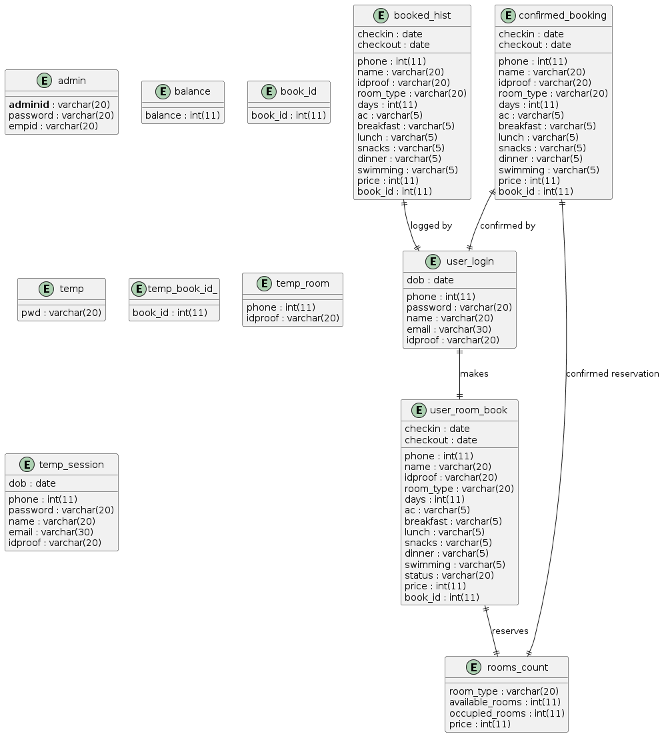
Class Diagram

Slide 10



User Interface and Functionalities
User-Friendly Interface
Booking Management
Reporting and Analytics
Intuitive and easy-to-navigate UI for staff and guests.
Efficient reservations, room availability, and guest details.
Insightful data-driven reports on hotel performance and metrics.

Slide 11
Modules and Features
1
Reservation Management
2
Payment Processing
Allows guests to easily book rooms, view availability, and manage their reservations. Includes features like real-time room status, cancellation policies, and guest history.
payment processing within the Hotel Management System, focusing on the supported payment gateways, key features, implementation details, user experience, and security measures.
3
Guest Management
4
User Authentication
Handles guest profiles, preferences, and check-in/check-out processes. Provides tools for up-selling, loyalty programs, and personalized guest experiences.
secure login mechanisms for the Hotel Management System, session management, and other security measures to protect user data and system integrity.

Slide 12


Results
Show key output screens:
USER
ADMIN

Slide 13
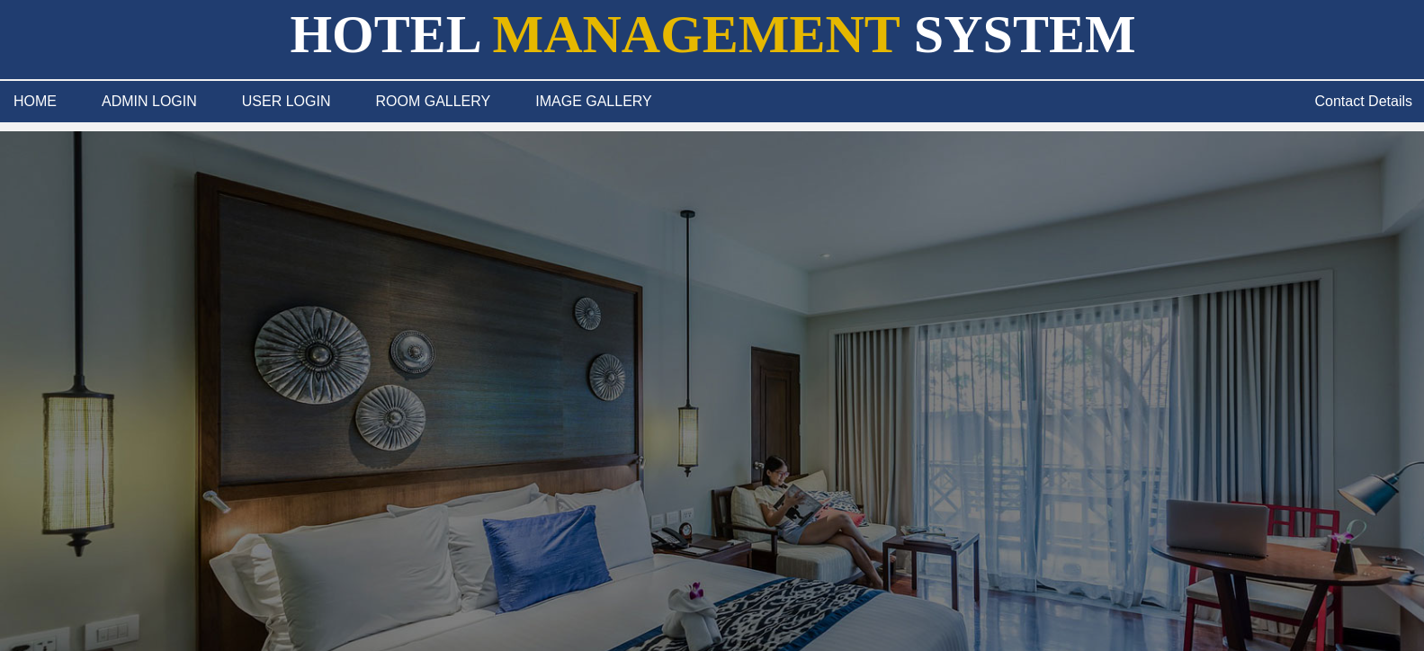
Home Page

Slide 14
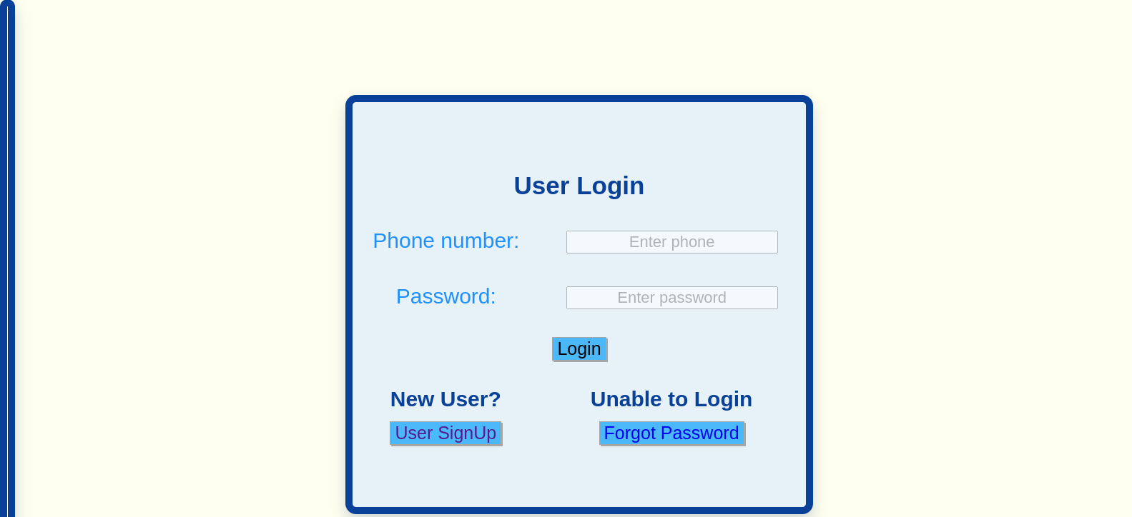
USER

Slide 15
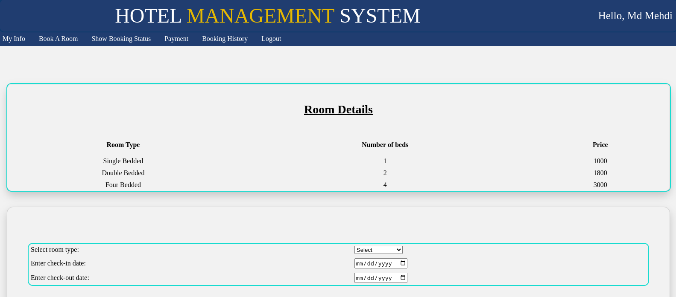

Slide 16
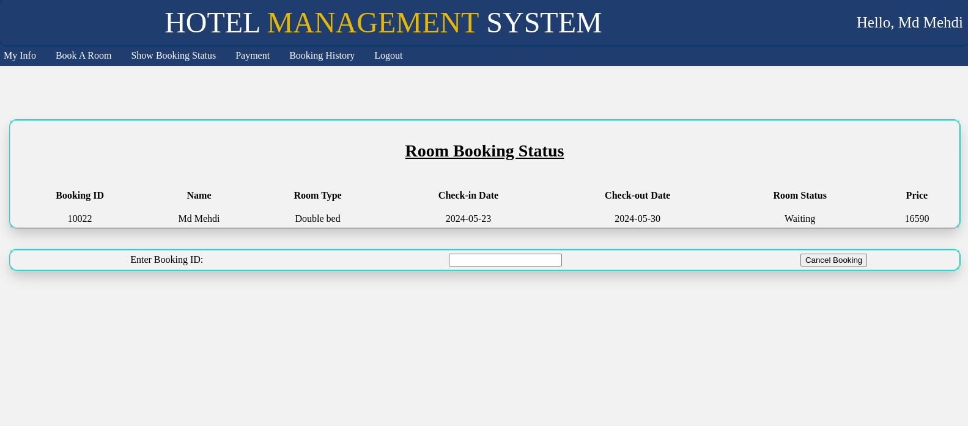

Slide 17
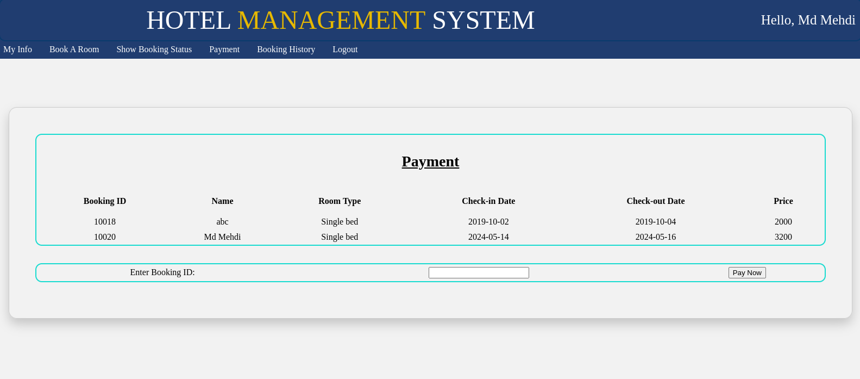

Slide 18
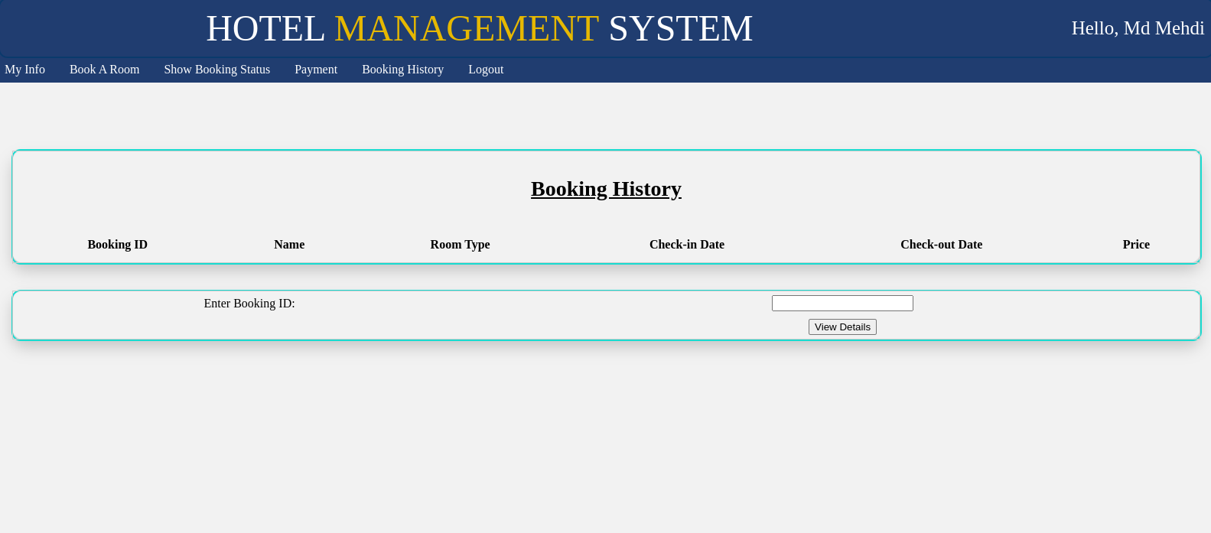

Slide 19
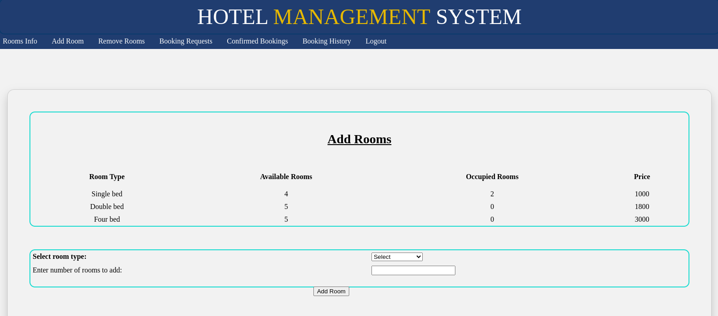
Admin Page

Slide 20
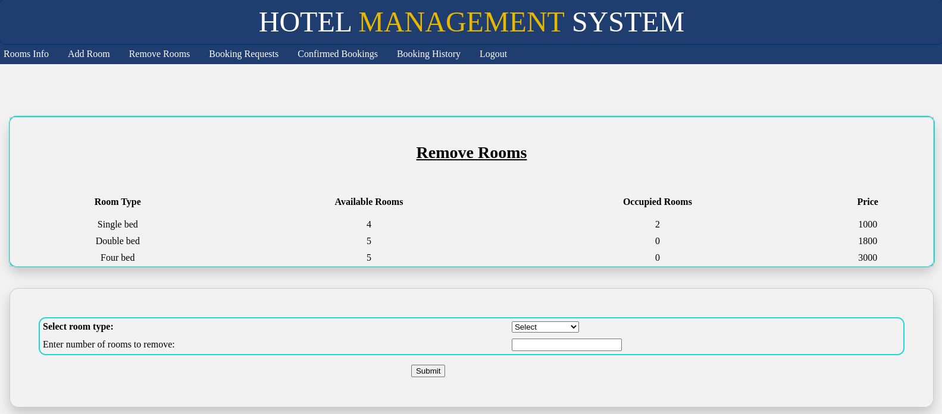

Slide 21
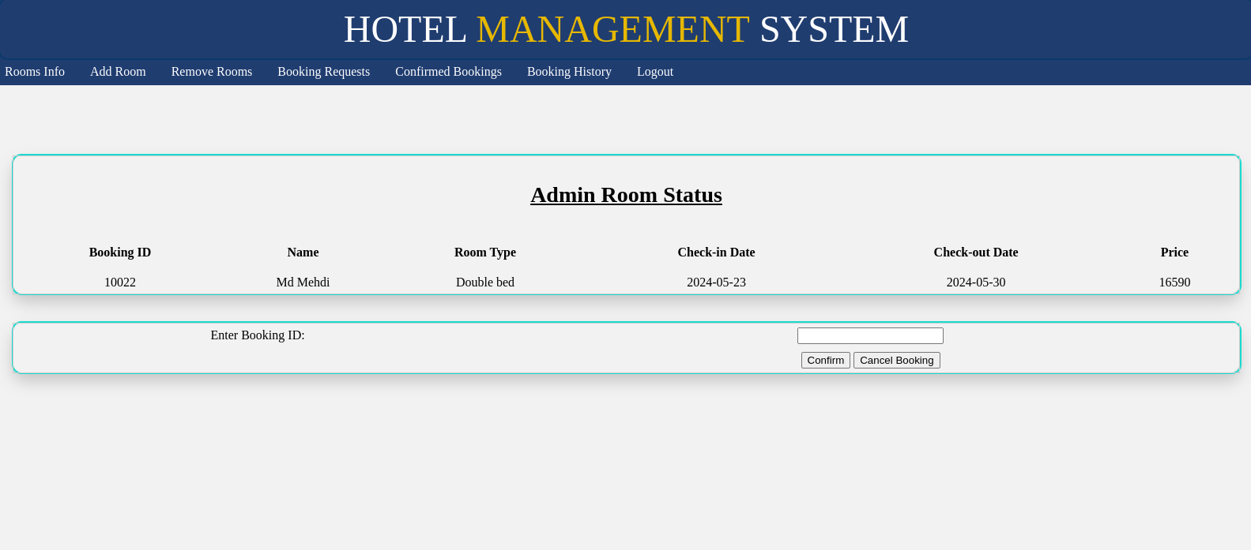

Slide 22
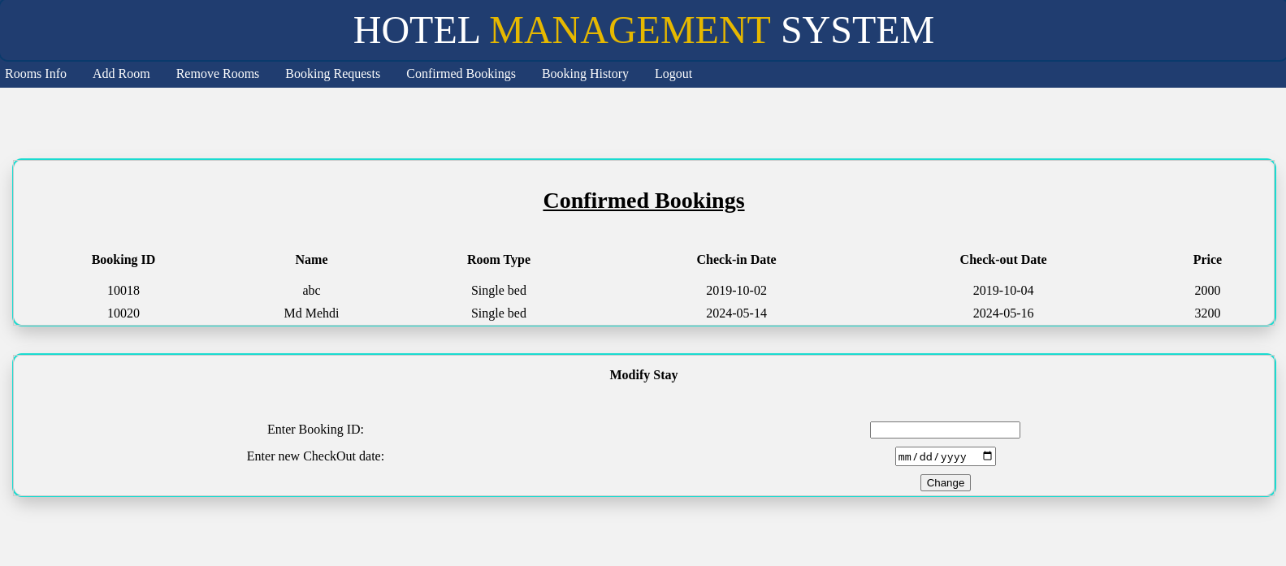

Slide 23
Conclusion
Developed a comprehensive Hotel Management System using PHP and MySQL.
Implemented key features such as booking automation, customer data management, secure payment processing, and detailed reporting.
Improved decision-making with real-time data and analytics.

Slide 24
Future Work
Future Enhancements
Continuous Innovation
Acknowledgments
Planned improvements include advanced analytics, AI-powered recommendations, mobile apps, and loyalty programs.
We remain committed to innovating and enhancing the system to meet the evolving needs of the hospitality industry.
We thank the hotel management team for their valuable input throughout the development process.

Slide 25
Reference
"PHP and MySQL Web Development" by Luke Welling and Laura Thomson, Pearson Education, 2020.
"Learning PHP, MySQL & JavaScript: With jQuery, CSS & HTML5" by Robin Nixon, O'Reilly Media, 2018.
"Modern PHP: New Features and Good Practices" by Josh Lockhart, O'Reilly Media, 2015.
"MySQL Cookbook: Solutions for Database Developers and Administrators" by Paul DuBois, O'Reilly Media, 2014.
"Web Development with MySQL and PHP" by Hugh E. Williams and David Lane, Addison-Wesley Professional, 2015.
"Building Secure PHP Apps: Authentication and Authorization" by Ben Edmunds, Leanpub, 2017.
"PHP Objects, Patterns, and Practice" by Matt Zandstra, Apress, 2016.
"Mastering PHP 7" by Branko Ajzele, Packt Publishing, 2017.

Slide 26
Thank You

