Slide 1


Mehdi Khaleghian
Senior Software Developer

Slide 2


Team
Bria Madgen - Product Owner
Kristy Sachse – UX Design
Internal Systems

Slide 3
Audience
Readify in General
Kloud
Interested In Onboarding process
Angular and Responsive Design

Slide 4

Content
User Experience
Management view
Employee View
New Starter View
Angular Responsive Design
The very benefits of involving UX/UI design
Bootstrap 3 vs 4 vs Material Design
Very approaches to responsive Design
FlexBox
ScreenService

Slide 5
User Experience
Access Through Readdit
The way we work
Self-Service

Slide 6








General Access
Joining Readify
New Starter / Read-Only View
Employee View
Automation
Readify Support

Slide 7
Admin Access
Management Vew
Controlled by Azure AD Roles

Slide 8
DEMO
Notes:
https://onboardeasy.readifycloud.com/management
Employee View
*Adding Activity
*Providing feedback
*ManagementView
Adding Activity
Reading through feedbacks

Slide 9




Angular Responsive Design

Slide 10
Challenges
Application written in Angular v4
Extensive use of Bootstrap 3, make it hard to switch to Boostrap 4
Some folks suggested to use material design but lack of experience there would make it difficult
We could create a whole new application but
All the authentication code needed to be duplicated
Many Services in the app needed to get duplicated
Boostrap Grid Layout did help with horizontal design but making the app to work in full screen mode on all different devices was still a challenge

Slide 11
Lessons Learnt
Discussion with UX Design team helped to see their ideas about tools to be used
Taking time and deadlines into consideration
Use existing tools as much as possible
Taking browser requirements is essential
Approaching the help channels is a great source of technical and non-technical support
Timeboxing a course on responsive design also gave me new ideas
OnboardEasy lacked tests for Angular services and components. Adding them as part of the CI/CD has greatly reduced the possibility of mistakenly break the functionalities

Slide 12

CSS Flexible box Layout Module
a W3C Candidate Recommendation as of October 2017
providing a more efficient way to lay out, align and distribute space among items in a container
give the container the ability to alter its items' width/height (and order) to best fill the available space
A flex container expands items to fill available free space, or shrinks them to prevent overflow
Consist of a bunch of properties, some intended for the container and some for the items inside the container
No additional package required, it is part of CSS

Slide 13
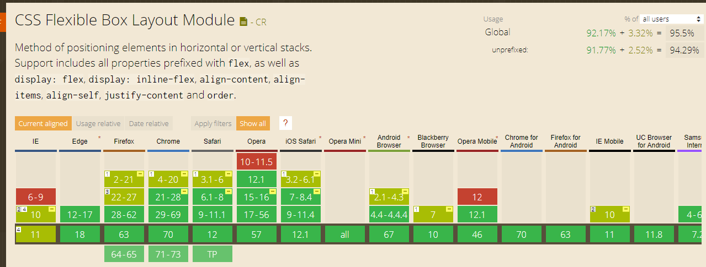
Browser Support

Slide 14
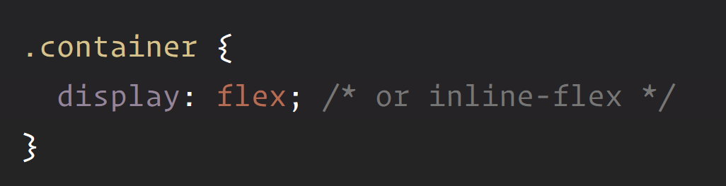
Flexbox CSS Classes
Turns the container into a flex box that can be inline or block

Slide 15
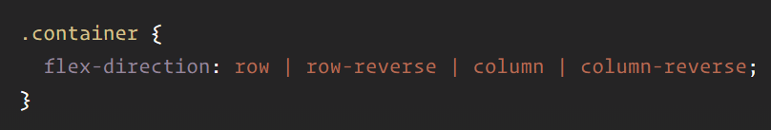
Flexbox CSS Classes

Slide 16
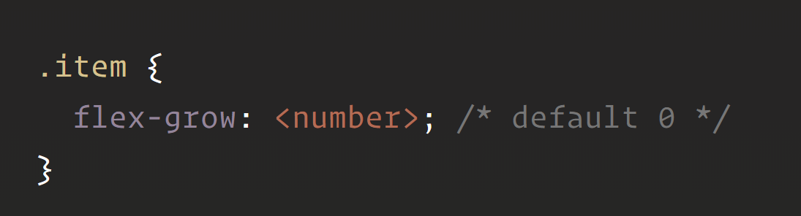
Flexbox CSS Classes
Defines the ability for a flex item to grow if necessary
Unitless value that serves as a proportion

Slide 17
Flexbox CSS Classes
1
1
1
If flex-grow is set to 1 for all of the items, the remaining space will be spread equally between them
1
2
1
If flex-grow is set to 2 for one of them, the remaining would take up twice for that item

Slide 18

Flexbox CSS Classes
flex-start
flex-end
center
Space-between
Space-around
Space-evenly

Slide 19
Screen Service
Determine whether we are on a mobile screen or a desktop screen
Defines a breakdown pixel-based break-point
Listens to resize event of the window object to broadcast changes to the screen size
Can also be useful in case iPad changes from horizontal to vertical or vice versa
Is used by components to decide some business logics and behavior

Slide 20
DEMO
Notes:
https://onboardeasy.readifycloud.com/management
Employee View
*Adding Activity
*Providing feedback
*ManagementView
Adding Activity
Reading through feedbacks

Slide 21
Questions? Comments

Slide 22



Links
https://readify.sharepoint.com/the-way-we-work/Pages/OnBoard%20Easy.aspx
Support@readify.net
https://css-tricks.com/snippets/css/a-guide-to-flexbox/
https://github.com/mehdikhaleghian/StudyNotes/blob/master/OnboardEasy.pptx

