Slide 1
Evolution of viral strains Predictive models and simulations

Slide 2
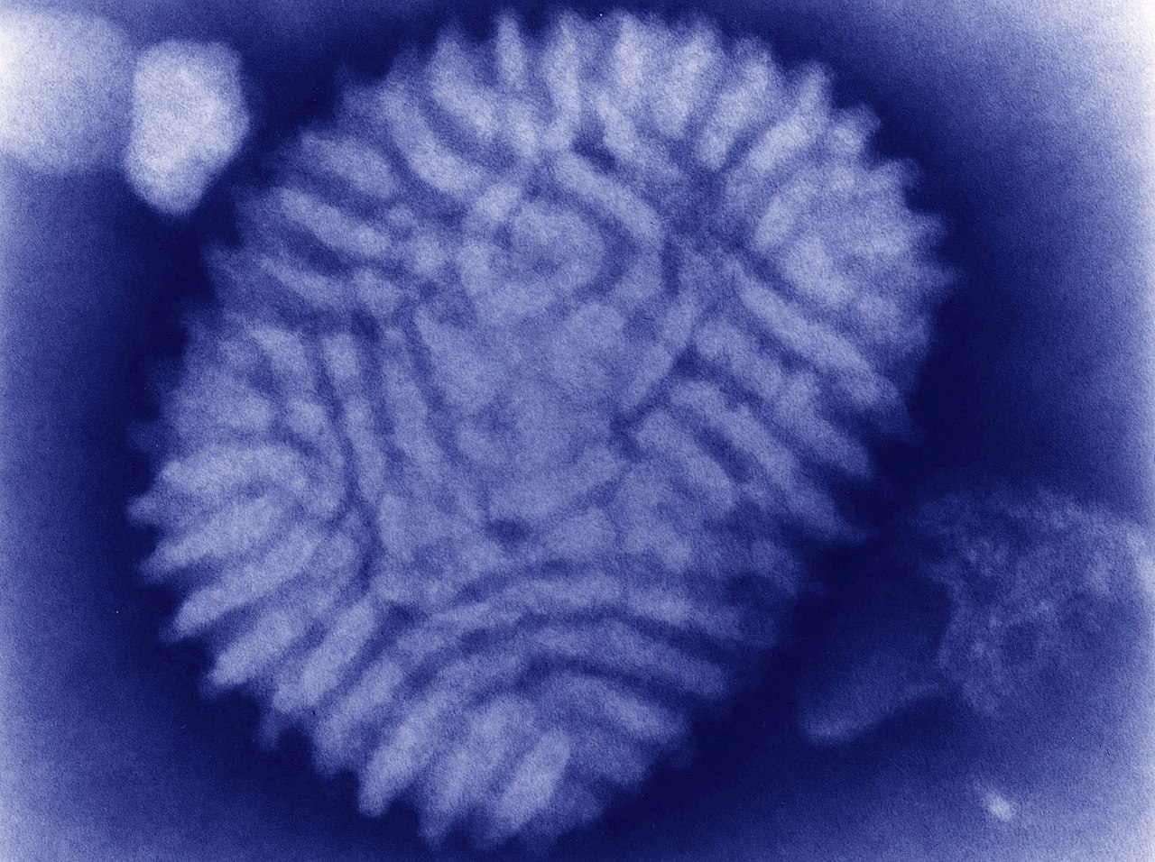
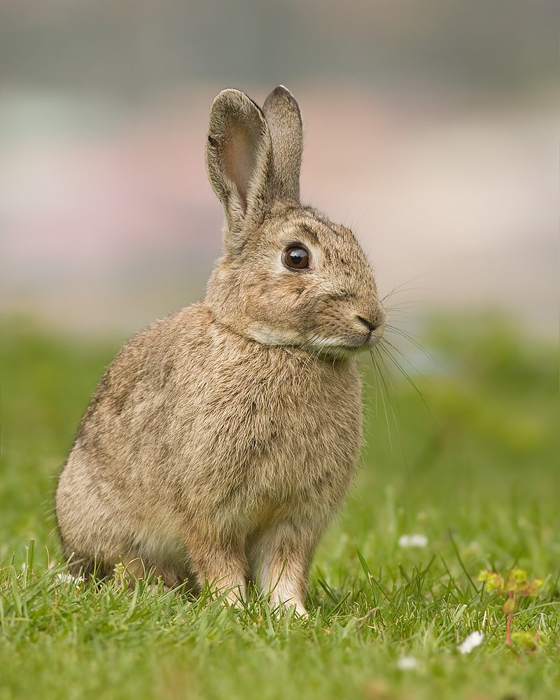
Myxoma virus
Rabbit

Slide 3
Myxoma virus
Rabbit

Slide 4
A first model
Infected
Transmissiblity
Virulence
Susceptible
Deceased

Slide 5
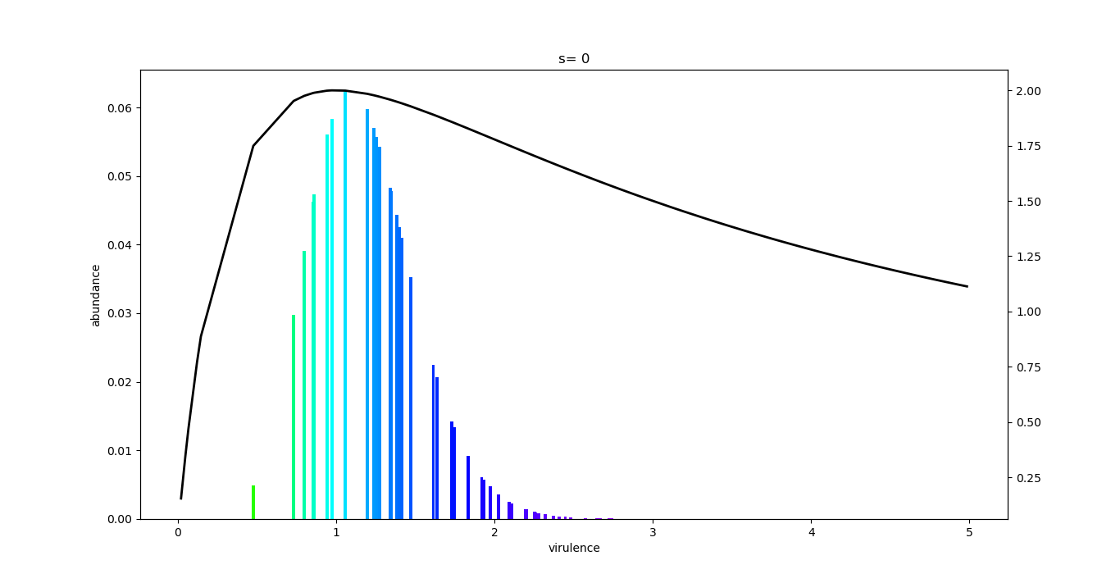
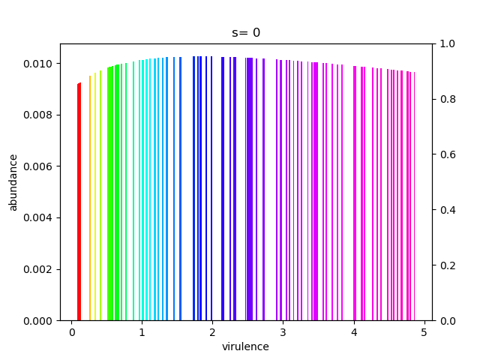
A first model
At t = 0
A few months later

Slide 6
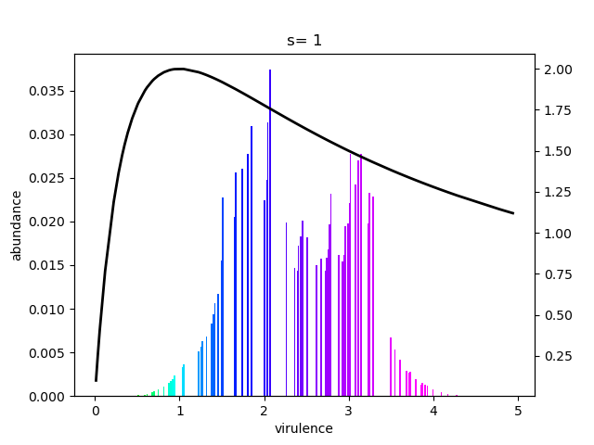
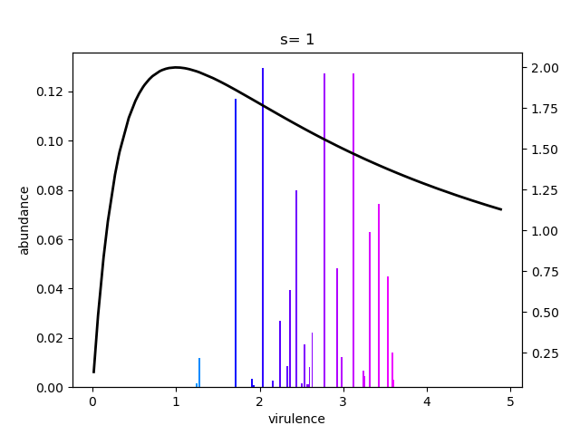
Coexistence
Months later
Years later

Slide 7
Pros
General model
Only epidemiology, no biology
Cons
Link between transmissibility and virulence?
Coexistence factor between strains must be measured

Slide 8
Thank you for your attention!

