Slide 1
Recommender Systems
Singular Value Decomposition (SVD)

Slide 2
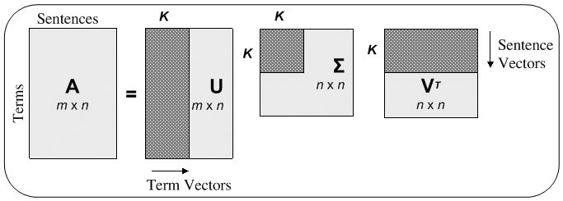
SVD

Slide 3
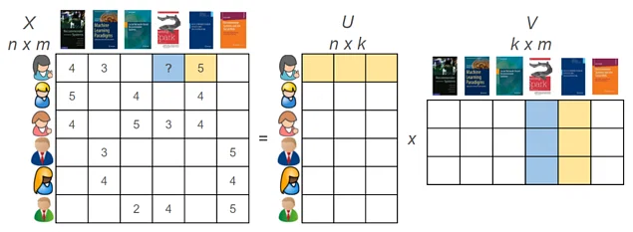
Truncated SVD in Rec Sys

Slide 4
How to make recommendation?
Estimate U and V matrices
Multiply them to estimate null values of the rating matrix
For each user, sort the estimated values descendingly
Recommend the items with top m largest estimated values

Slide 5
Challenges of Estimating U and V
Missing values
Huge matrix, memory issues
Slow and costly matrix decomposition algorithms
Can’t do batch learning; all data is needed for decomposition
It’s an unsupervised problem
No control over complexity (e.g. via regularization type tuning)
Can’t take into account other interactions (such as implicit interactions)

Slide 6

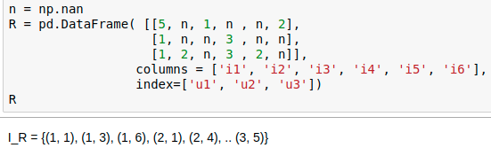
An iterative algorithm
Perform decomposition via loss-minimization
where
r_ij are ratings that user i gave to item j
I_R is the set of tuples of row and column indecies from matrix R that is not null
p’s are rows of user matrix (U)
q’s are columns of item matrix (V)
Note how the issues in the
previous page can be addresses.

Slide 7
Iterpretations
p and q are user and item embeddings for each user and item on the k-dimentional space
Inner product of p and q:
  Larger values of inner product mean they’re closer to each other (corresponding to larger value of rating)
  Smaller values mean they’re far apart (corresponding to smaller value of rating)

Slide 8

Regularization
Can control the complexity via controlling the size of p and q and the regularization hyperparameter
The noise in p or q will not be increases/ propagated by keeping the size of the vectors small
Extreme cases:
  Lambda tends to infinity -> Nothing will be learned (low variance, large bias)
  Lambda is zero -> Might overfit (not generalize well; large variance, low bias)

Slide 9
Training
Define the right matrices, and right dimensions, and define the model: outcome = p^tq
  Note the number of parameters in this model (=(n+m)*k)
Define the loss function (with the right regularization)
Define an optimizer such as gradient descent
Convert your huge data to batches of data with size like 32, 128, or 512, ...
Define the number of epochs
Put the model in the training mode (vs. Evaluation mode)
Put the matrices in GPU for faster matrix operations
Train the model:
  In each epoch, go through all iterations (batches of data) and repeat the following
  Equate
Visualize the loss through steps (iterations or epochs)

Slide 10
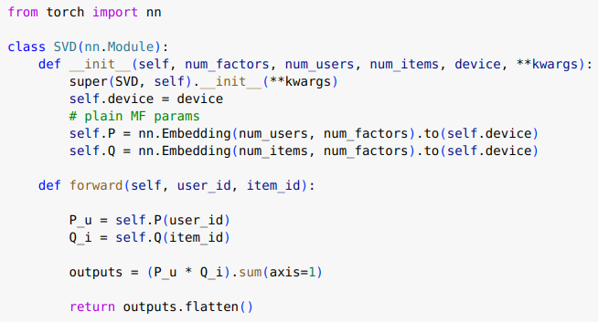
Pytorch implementation

Slide 11
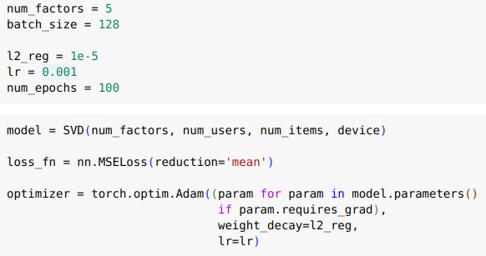
Model, optimization, and hyperparameters

Slide 12
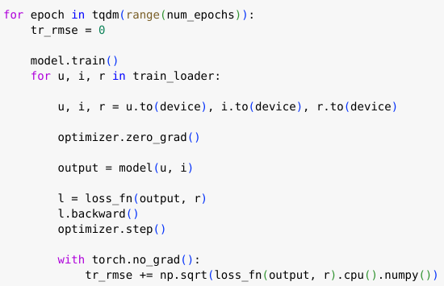
Training

Slide 13
SVD in NLP
We have a huge corpus of |S| sentences or reviews
Need to vectorize sentences
Create a sentence-word matrix:
  Define vocabulary V, with size |V|
  For each sentece, we create a vector of size |V|, all zero except certain indices get the frequency of words in that sentence
  Now we have a huge matrix with |S| rows and |V| columns
  Rows are sentences and columns are words and cell values are freqeuncy of words in sentences
Now apply SVD to get a vectorization for each sentence with in a lower dimensional space, say k
The cell values can be zero-one or TF-IDF values

Slide 14
gensim
Gensim is python library for NLP
LSI, NFM, LDA, efficient LDA, word2vec, doc2vec
https://radimrehurek.com/gensim/models/lsimodel.html

Slide 15
Attentive Asymmetric SVD
Reduce number of parameters
Define a person based their attention to items – like a steriotype

Slide 16
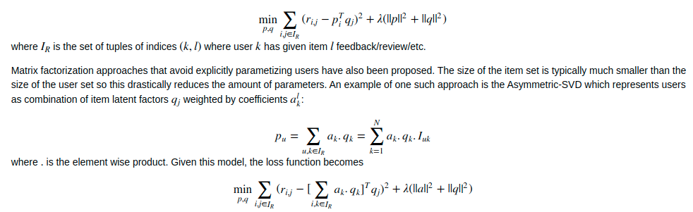

Slide 17
SVD ++
Remove constant bias across users, items and user-item interactions
Address the limitation of SVD that can’t take implicit interactions into account

Slide 18
