Slide 1
Appliances Energy Prediction
Nonlinear Regression with Ensemble Methods
Machine Learning | Final Project
Mehdi Talebi
February 2026
1 / 12

Slide 2
Agenda
01
Problem Statement & Dataset
02
Exploratory Data Analysis
03
Preprocessing Pipeline
04
Models & Hyperparameter Tuning
05
Results & Model Comparison
06
Feature Importance
07
Error Analysis & Discussion
08
Conclusions & Future Work
2 / 12

Slide 3
1
Problem Statement & Dataset
Objective
Dataset at a Glance
Predict household appliance energy consumption (Wh per 10-min interval) using environmental sensor data from a low-energy house in Belgium.
Source: UCI ML Repository
19,735 observations (10-min intervals)
29 columns (25 predictors + target)
~4.5 months of data collection
Target: Appliances (energy in Wh)
Missing values: None
Candanedo et al., 2017
Why Nonlinear?
Energy patterns are driven by occupancy thresholds, comfort zones, and time-of-day effects — inherently nonlinear relationships.
3 / 12

Slide 4
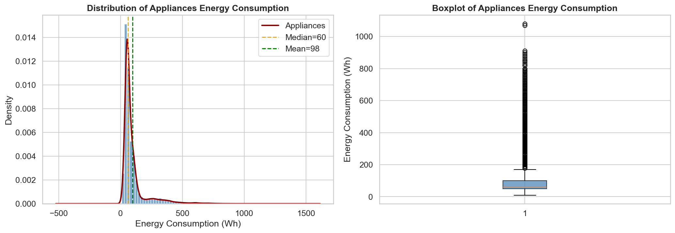
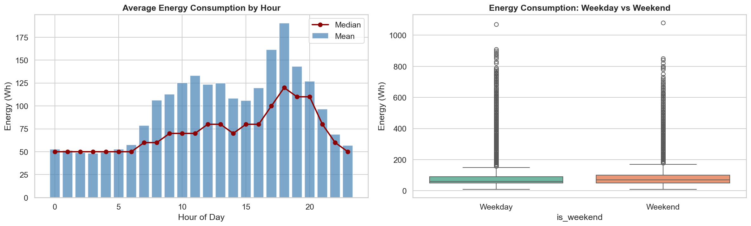
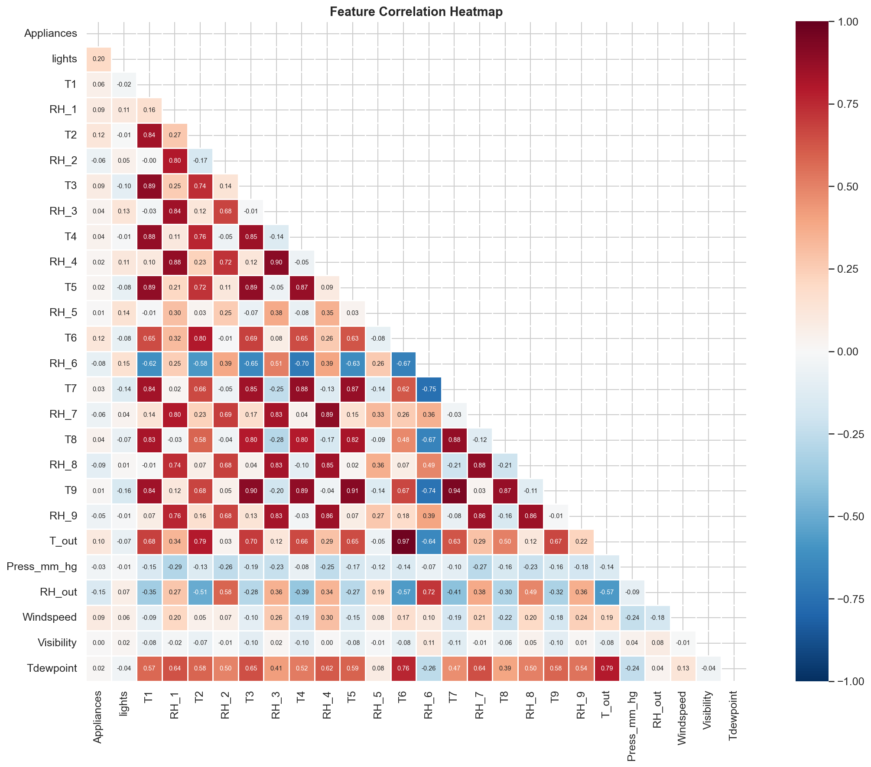
2
Exploratory Data Analysis
Target Distribution (right-skewed)
Temporal Consumption Patterns
Feature Correlation Heatmap
Key Insights
Skewness ~3.6: most readings < 100 Wh, spikes up to 1,080 Wh
Weak individual correlations (max |r| < 0.3) suggest nonlinear dependencies
Clear morning/evening peaks; weekday vs weekend differences
4 / 12

Slide 5
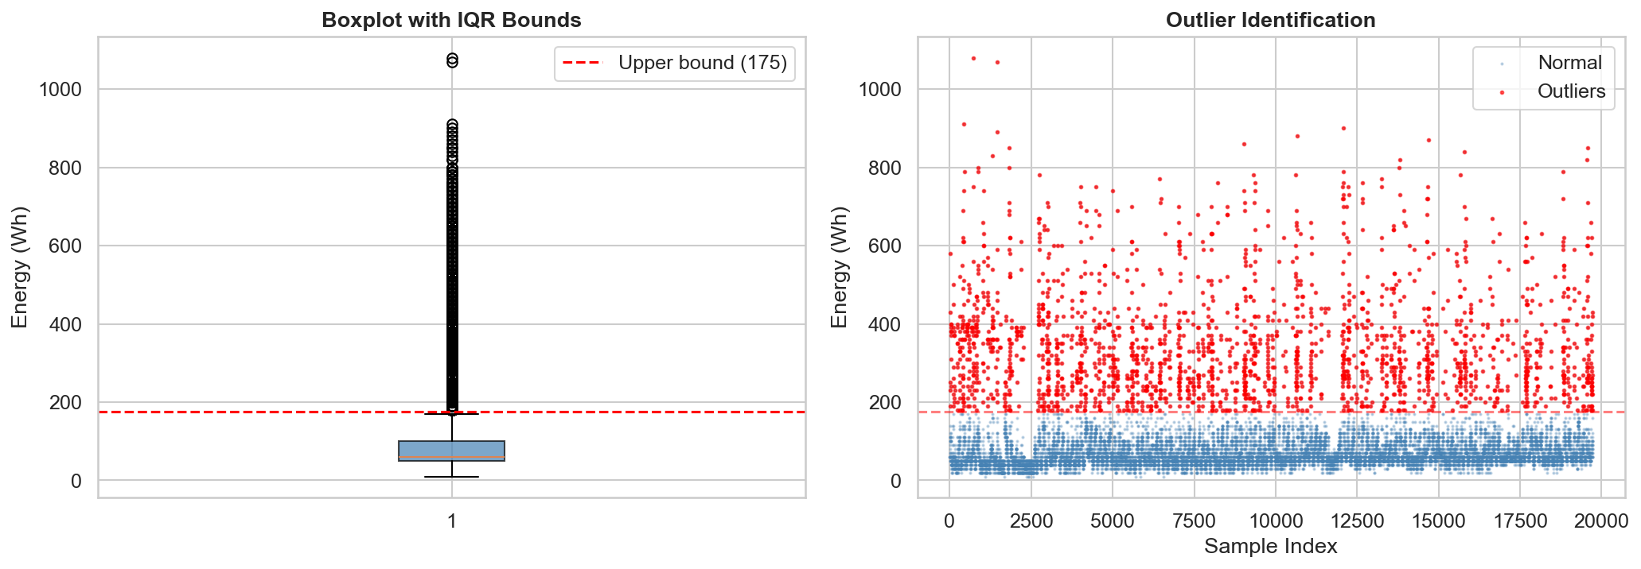
3
Preprocessing Pipeline
1
2
3
4
Feature Engineering
Column Removal
Outlier Treatment
Feature Scaling
Extracted hour, day_of_week, month, is_weekend from timestamp
Dropped date (after extraction), rv1, rv2 (random noise variables)
IQR-based capping on target variable (winsorize, not remove)
StandardScaler fitted on train data only (prevents leakage)
Train-Test Split: 80/20 | 5-Fold Cross-Validation | Random State = 42
5 / 12

Slide 6
4
Models & Hyperparameter Tuning
Baseline
Nonlinear
Nonlinear
Linear Regression
Polynomial Ridge
Decision Tree
Best params:
Best params:
Best params:
No tuning
degree=2, alpha=0.1
depth=20, min_leaf=5
Nonlinear
Ensemble
Ensemble
SVR (RBF)
Random Forest
Gradient Boosting
Best params:
Best params:
Best params:
C=100, gamma=0.1, eps=0.5
200 trees, min_leaf=2
200 est., depth=7, lr=0.1
Tuning: GridSearchCV | Scoring: neg_mean_squared_error | CV: 5-fold (3-fold for SVR)
6 / 12

Slide 7
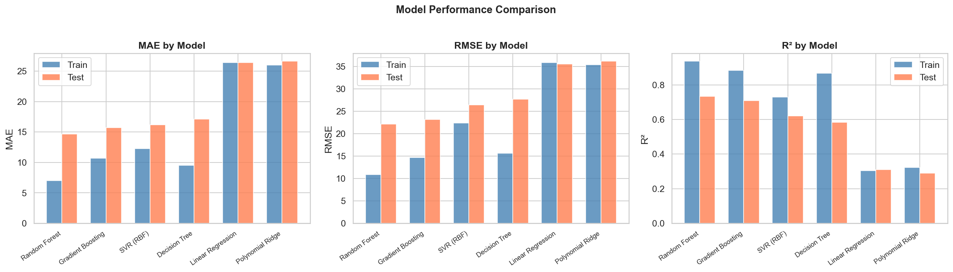
5
Results & Model Comparison
Model | Train MAE | Test MAE | Train RMSE | Test RMSE | Train R² | Test R²
Random Forest | 7.02 | 14.66 | 10.89 | 22.11 | 0.936 | 0.734
Gradient Boosting | 10.70 | 15.71 | 14.68 | 23.16 | 0.883 | 0.708
SVR (RBF) | 12.29 | 16.16 | 22.38 | 26.44 | 0.729 | 0.620
Decision Tree | 9.53 | 17.13 | 15.62 | 27.66 | 0.868 | 0.584
Linear Regression | 26.41 | 26.42 | 35.86 | 35.58 | 0.304 | 0.311
Polynomial Ridge | 26.00 | 26.62 | 35.38 | 36.15 | 0.322 | 0.289
Key Takeaway
Random Forest = best model (R² = 0.734)
Nonlinear improves R² from 0.31 to 0.73
Decision Tree overfits (train 0.87 vs test 0.58)
7 / 12

Slide 8
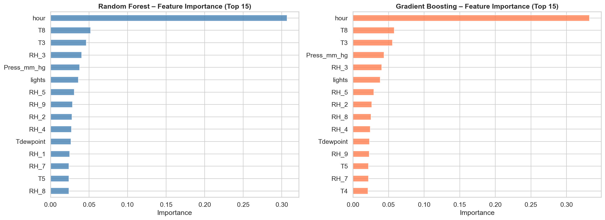
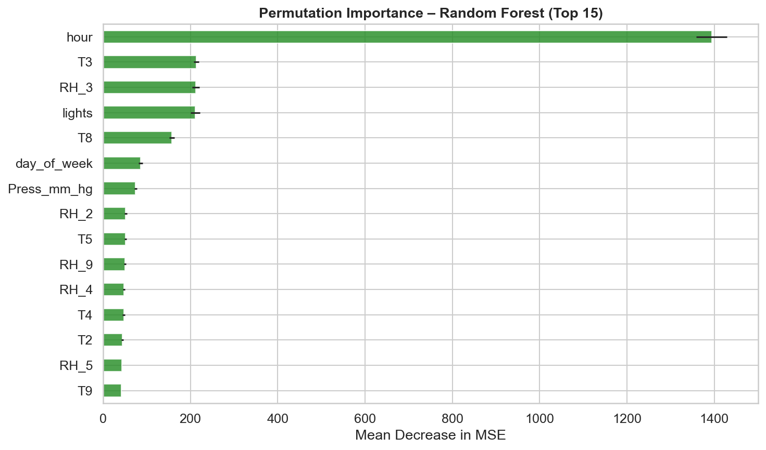
6
Feature Importance
Random Forest Feature Importance
Permutation Importance
Top features: lights (occupancy proxy) | T6, T3, T8 (indoor temps) | hour, day_of_week (temporal)
8 / 12

Slide 9
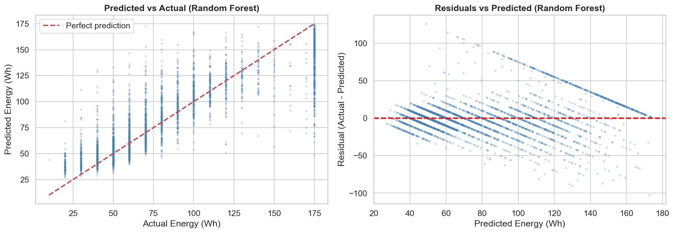
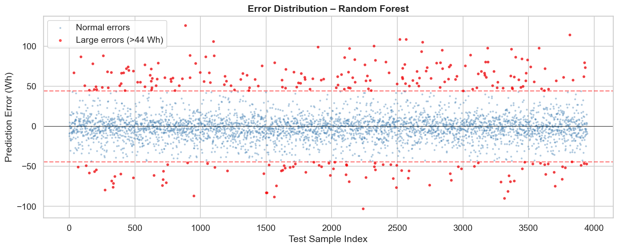
7
Error Analysis & Discussion
Residual Plots (Best Model)
Large-Error Case Analysis
Near-zero mean residuals (unbiased predictions)
Struggles with high-consumption spikes (~5% large errors)
Mild heteroscedasticity at higher predicted values
9 / 12

Slide 10
8
Conclusions & Future Work
Conclusions
Limitations
Random Forest is the best-performing model (R² = 0.734, MAE = 14.66 Wh)
Nonlinear & ensemble methods substantially outperform linear approaches (+130% R²)
Feature importance aligns with domain knowledge: lights, temperature, and temporal features dominate
Trade-off: RF achieves best accuracy but is less interpretable than linear models
Single building (Belgium, low-energy house)
4.5-month window (incomplete seasons)
No explicit occupancy data
Ignores temporal autocorrelation
Future Work
LSTM / GRU for temporal dependencies
Real-time occupancy sensor integration
Multi-building transfer learning
10 / 12

Slide 11
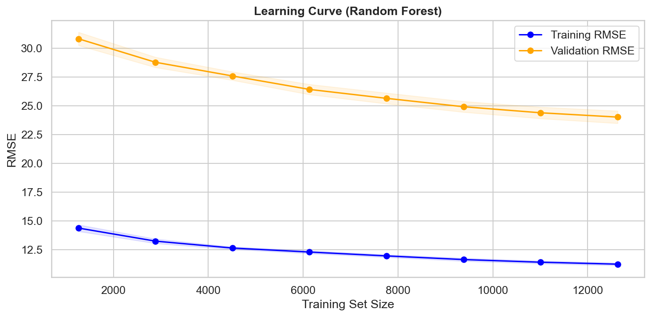
Overfitting Analysis
Learning curve of the best model
Training and validation scores converge, indicating the model generalizes well without severe overfitting.
11 / 12

Slide 12
Questions & Answers
Thank you for your attention!
Mehdi Talebi
github.com/mehditalebi01/Appliances-Energy-Prediction
12 / 12

