Slide 1
CPU Scheduling

Slide 2
Group Information :
        Name : ID :
———— ———-
Md. Mehedi Hasan 0242220005101432
Sumaiya Akter 0242310005101149
Forhad Alam Sourav 0242310005101853
Abdullah Bin Arif Apon 0242310005101850

Slide 3
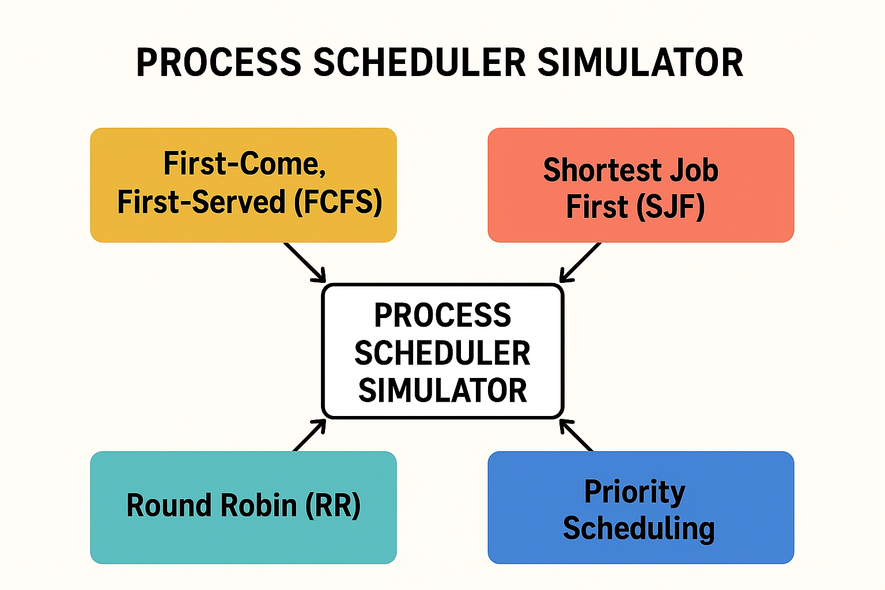
Introduction
CPU scheduling manages process execution order.
Simulator demonstrates effects on waiting time & execution.
Algorithms implemented: FCFS, SJF, RR, Priority.

Slide 4
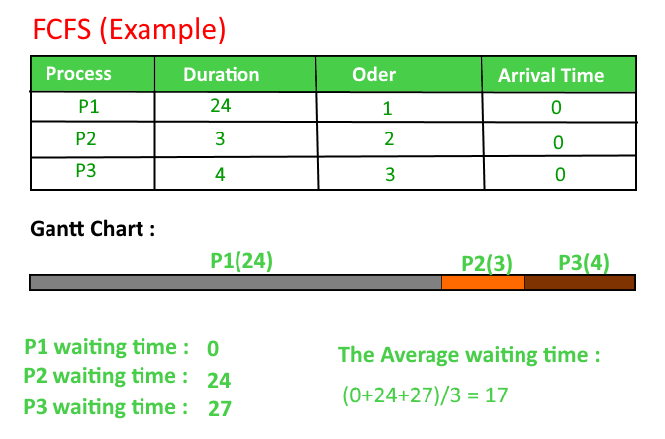
First-Come, First-Served (FCFS)
The First-Come, First-Served (FCFS) scheduling process is a simple, non-preemptive algorithm that executes processes in the exact order they arrive in the ready queue.

Slide 5
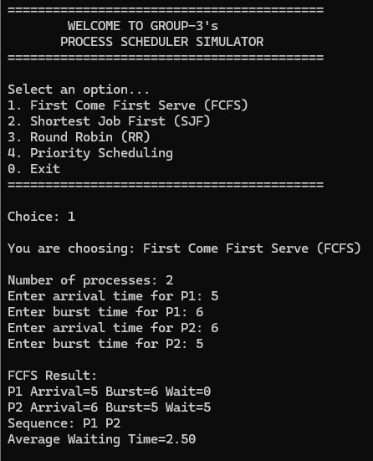
FCFS implementation
void fcfs() {
int n;
printf("Number of processes: ");
scanf("%d", &n);
int arrival[n], burst[n], start[n], finish[n], wait[n], seq[n];
for(int i=0;i<n;i++){
seq[i] = i+1;
printf("Enter arrival time for P%d: ", i+1);
scanf("%d", &arrival[i]);
printf("Enter burst time for P%d: ", i+1);
scanf("%d", &burst[i]);
}
int t = 0;
for(int i=0;i<n;i++){
if(t < arrival[i]) t = arrival[i];
start[i] = t;
t += burst[i];
finish[i] = t;
wait[i] = start[i] - arrival[i];
} }
float avg = 0;
for(int i=0;i<n;i++) avg += wait[i];
avg /= n;
printf("\nFCFS Result:\n");
for(int i=0;i<n;i++){
printf("P%d Arrival=%d Burst=%d Wait=%d\n", seq[i], arrival[i], burst[i], wait[i]);
}
printf("Sequence: ");
for(int i=0;i<n;i++) printf("P%d ", seq[i]);
printf("\nAverage Waiting Time=%.2f\n\n", avg);

Slide 6
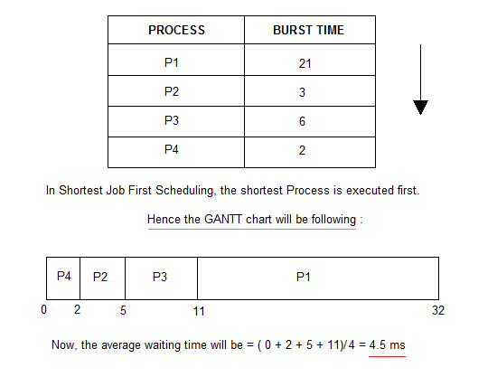
Shortest Job First (SJF)
Shortest job first (SJF) or shortest job next, is a scheduling policy that selects the waiting process with the smallest execution time to execute next.

Slide 7
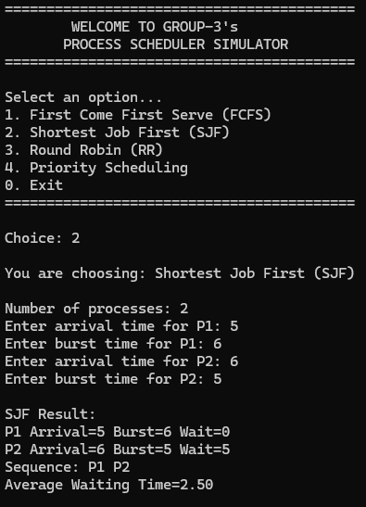
SJF implementation
void sjf() {
int n;
printf("Number of processes: ");
scanf("%d", &n);
int arrival[n], burst[n], done[n], wait[n], seq[n];
for(int i=0;i<n;i++){
printf("Enter arrival time for P%d: ", i+1);
scanf("%d", &arrival[i]);
printf("Enter burst time for P%d: ", i+1);
scanf("%d", &burst[i]);
done[i] = 0;
}
int t = 0, completed = 0, s = 0;
while(completed < n){
int idx = -1, best = 999999;
for(int i=0;i<n;i++){
if(!done[i] && arrival[i] <= t){
if(burst[i] < best){
best = burst[i];
idx = i;
}
}
}
if(idx == -1){ t++; continue; }
seq[s++] = idx+1;
wait[idx] = t - arrival[idx];
t += burst[idx];
done[idx] = 1;
completed++;
}
float avg = 0;
for(int i=0;i<n;i++) avg += wait[i];
avg /= n;
printf("\nSJF Result:\n");
for(int i=0;i<n;i++){
printf("P%d Arrival=%d Burst=%d Wait=%d\n", i+1, arrival[i], burst[i], wait[i]);
}
printf("Sequence: ");
for(int i=0;i<s;i++) printf("P%d ", seq[i]);
printf("\nAverage Waiting Time=%.2f\n\n", avg);
}

Slide 8
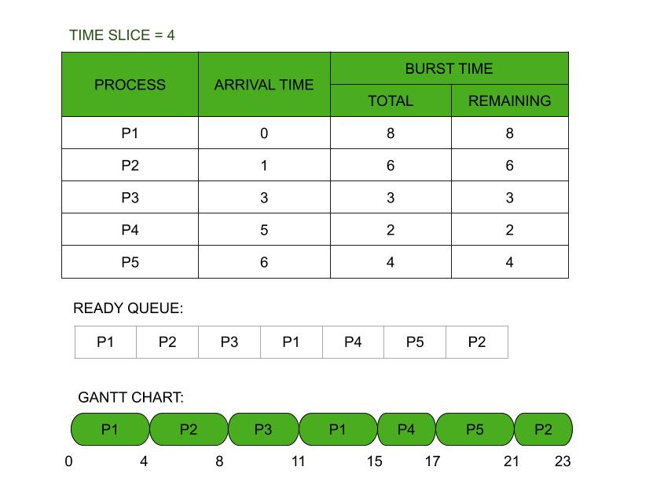
Round Robin Scheduling
Round robin scheduling is a preemptive CPU scheduling algorithm that allocates a fixed time slice, or "quantum," to each process in a circular queue

Slide 9
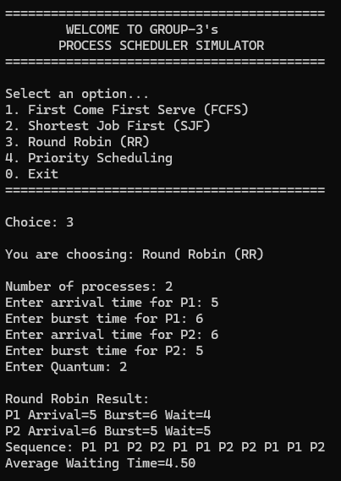
Round Robin implementation
if(arrival[i] <= t && rem[i] > 0){
int run = rem[i] < q ? rem[i] : q;
rem[i] -= run;
for(int k=0;k<run;k++) seq[s++] = i+1;
t += run;
if(rem[i] == 0){
finish[i] = t;
done++;
}
used = 1;
}
}
if(!used) t++;
}
for(int i=0;i<n;i++){
wait[i] = finish[i] - arrival[i] - burst[i];
}
float avg = 0;
for(int i=0;i<n;i++) avg += wait[i];
avg /= n;
printf("\nRound Robin Result:\n");
for(int i=0;i<n;i++){
printf("P%d Arrival=%d Burst=%d Wait=%d\n", i+1, arrival[i], burst[i], wait[i]);
}
printf("Sequence: ");
for(int i=0;i<s;i++) printf("P%d ", seq[i]);
printf("\nAverage Waiting Time=%.2f\n\n", avg);
}
void rr() {
int n, q;
printf("Number of processes: ");
scanf("%d", &n);
int arrival[n], burst[n], rem[n], finish[n], wait[n];
for(int i=0;i<n;i++){
printf("Enter arrival time for P%d: ", i+1);
scanf("%d", &arrival[i]);
printf("Enter burst time for P%d: ", i+1);
scanf("%d", &burst[i]);
rem[i] = burst[i];
}
printf("Enter Quantum: ");
scanf("%d", &q);
int t = 0, done = 0;
int seq[999], s = 0;
while(done < n){
int used = 0;
for(int i=0;i<n;i++){

Slide 10
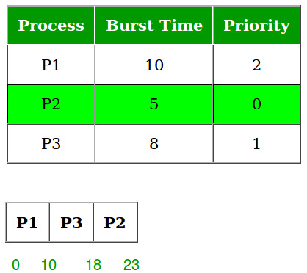
Priority scheduling
Priority scheduling is an operating system process that selects and executes processes based on their priority level, with higher-priority processes running first.

Slide 11
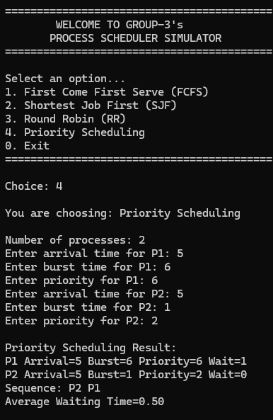
Priority Scheduling implementation
void priority_sch() {
int n;
printf("Number of processes: ");
scanf("%d", &n);
int arrival[n], burst[n], priority[n], done[n], wait[n], seq[n];
for(int i=0;i<n;i++){
printf("Enter arrival time for P%d: ", i+1);
scanf("%d", &arrival[i]);
printf("Enter burst time for P%d: ", i+1);
scanf("%d", &burst[i]);
printf("Enter priority for P%d: ", i+1);
scanf("%d", &priority[i]);
done[i] = 0;
}
int t = 0, s = 0, completed = 0;
while(completed < n){
int idx = -1, best = 999999;
for(int i=0;i<n;i++){
if(!done[i] && arrival[i] <= t){
if(priority[i] < best){
best = priority[i];
idx = i;
}
}
}
if(idx == -1){ t++; continue; }
seq[s++] = idx+1;
wait[idx] = t - arrival[idx];
t += burst[idx];
done[idx] = 1;
completed++;
}
float avg = 0;
for(int i=0;i<n;i++) avg += wait[i];
avg /= n;
printf("\nPriority Scheduling Result:\n");
for(int i=0;i<n;i++){
printf("P%d Arrival=%d Burst=%d Priority=%d Wait=%d\n", i+1, arrival[i], burst[i], priority[i], wait[i]);
}
printf("Sequence: ");
for(int i=0;i<s;i++) printf("P%d ", seq[i]);
printf("\nAverage Waiting Time=%.2f\n\n", avg);
}

Slide 12


