Slide 1
Smart House Weather Simulation Using OpenGL
Submitted By:
Md Mehedi hasan
ID:0242220005101432

Slide 2
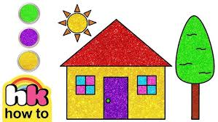
Introduction
• 2D smart house simulation
• Built using OpenGL
• Interactive weather control

Slide 3
Motivation
• Move beyond static scenes
• Real-time simulation
• Improve learning experience

Slide 4
Objectives
• Simulate weather (rain, cloud, normal)
• User interaction
• Day/Night mode

Slide 5
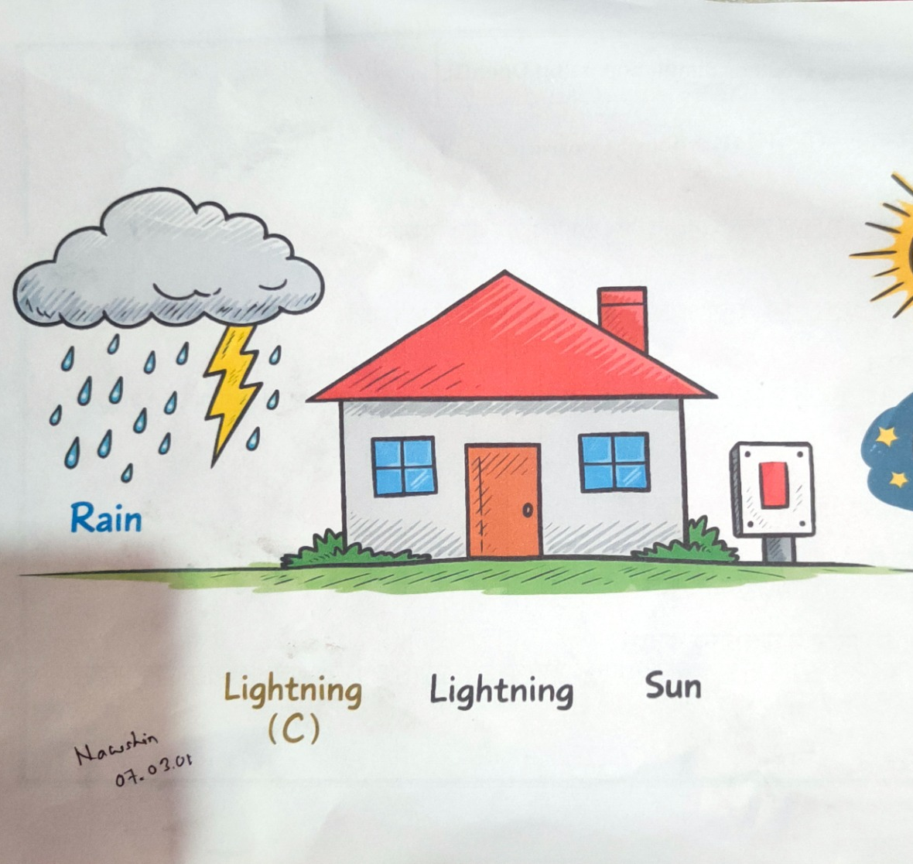
System Features
• Rain effect
• Cloudy sky
• Normal weather
• Window color change

Slide 6
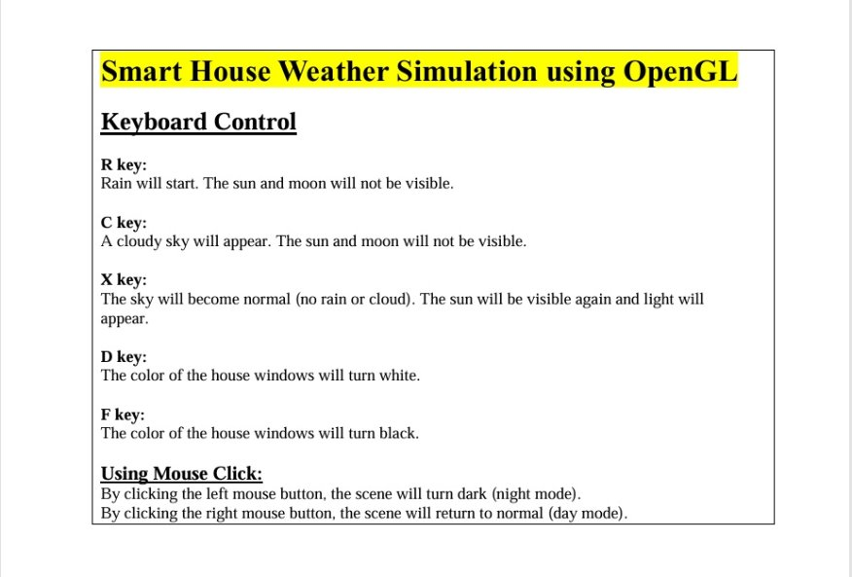
Controls
R: Rain
C: Cloud
X: Normal
D/F: Window color
Mouse: Day/Night

Slide 7
Methodology
• Rendering Layer
• Weather Control
• Interaction Layer
• Animation Loop

Slide 8
Implementation
• Language: C++
• Library: OpenGL (GLUT)
• Shapes: Polygon, Circle, Line

Slide 9
Results
• Smooth animation
• Real-time response
• Interactive environment

Slide 10
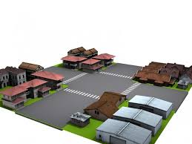
Future Work
• Add snow, storm
• 3D environment
• Sound effects

Slide 11
Conclusion
• Successful simulation
• Educational tool
• Easy to extend

Slide 12



