Slide 1

Breaking Bad: Detoxification & Model Safety in NLP
Uncovering Adversarial Vulnerabilities, Toxic Tokens & Activation Steering in LLMs
Submitted By:
Md Mehedi Hasan
ID: 0242220005101432
Department of CSE
Daffodil International University

Slide 2


The Dark Side of Language Models
Emergence of Toxicity: Large Language Models (LLMs) can generate harmful, toxic, or biased outputs despite post-training alignment.
Adversarial Vulnerability: Attackers construct specific prompt vectors ("Jailbreaks") to bypass model safety guardrails.
The "Bad Token" Problem: Specific internal activations correlate directly with toxic output generation in deep layers.
Research Objective: Identify, isolate, and steer toxicity directions without degrading general benchmark capabilities.

Slide 3







How Bad Behaviors Manifest in NLP
Jailbreak Prompts
Corpus Poisoning
Hallucinated Toxicity
Adversarial prompts exploit roleplay scenarios or suffixed strings to override system prompt safety instructions and force unsafe responses.
Pre-training datasets contain unfiltered web text, embedding implicit demographic bias, profanity, and misinformation deep into model weights.
Models trigger inappropriate content during long-context generation when conditioned on ambiguous or adversarial prefix context.

Slide 4

Anatomy of "Bad Tokens" in Latent Space
Residual Stream Vectors
Sparse Autoencoders (SAE)
Toxicity is not localized in a single layer or neuron. Instead, harmful generation corresponds to specific high-dimensional direction vectors propagating through the model's residual stream during forward passes.
Standard neurons suffer from polysemanticity (neurons firing for multiple unrelated concepts). SAEs disentangle these features into individual, highly interpretable "toxic feature directions."

Slide 5

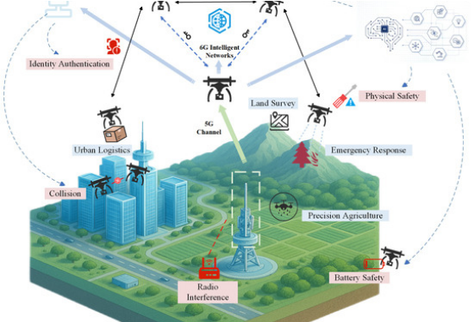
Detoxification via Activation Steering
Targeted Subtraction: Subtracting decoder vectors of toxic features from activation streams during inference.
Surgical Precision: Intervening only when toxicity thresholds fire, preventing over-refusal on benign prompts.
Zero Retraining Required: Modifies internal hidden states dynamically without changing model parameters.

Slide 6
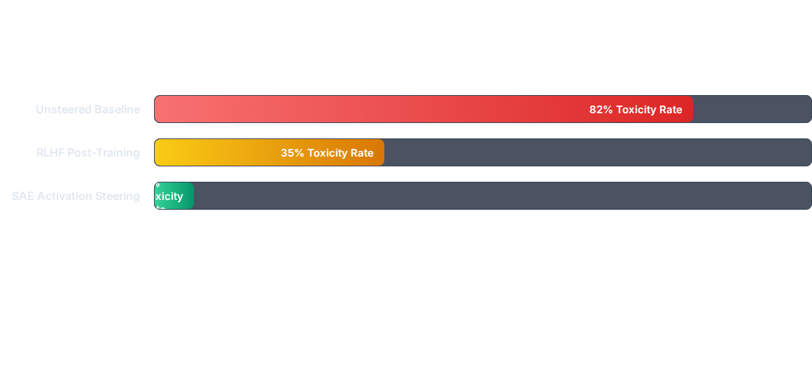
Toxicity Reduction vs. Model Knowledge

Slide 7








Building Future-Proof AI Guardrails
Feature Extraction
Toxicity Tagging
Real-time Steering
Safety Auditing
Train Sparse Autoencoders on residual stream activations across target LLM layers.
Isolate SAE latent features that correlate significantly with toxic dataset prompts.
Apply dynamic activation clamping during live inference token generation.
Continuously benchmark against red-teaming datasets to prevent regression.

Slide 8

Have you any Questions?
Thank you for attending our NLP presentation on Breaking Bad.

Slide 9


