Slide 1

Nexus: Autonomous Research Agent Choreographer
A web-based multi-agent orchestration platform designed with a POS-style dashboard to eliminate developer cognitive overload and enforce Nielsen's Usability Heuristics.
Presenter Md Mehedi Hasan (0242220005101432)
Supervisor Md. Hasanuzamman Dipu, Asst. Prof.
Institution Daffodil International University

Slide 2

Project Vision & UX Objectives
Bridging the gap between raw backend terminal operations and human-centered graphical control through intentional UI engineering.

Slide 3

CLI Friction vs POS Dashboard
Traditional CLI Pain Points
Nexus POS-Style Solution
Managing multi-agent AI swarms via raw terminals induces extreme cognitive load on researchers:
Nexus translates backend terminal operations into intuitive, bounded visual components:
▹
Unformatted, fast-scrolling text causes high user anxiety
▹
Fixed 100vh viewport layout minimizing user travel time
▹
Zero visual context on agent execution states
▹
Persistent global navigation for instant context
▹
Steep learning curve alienating non-engineer users
▹
Real-time visual feedback for agent states
▹
Frequent violations of Nielsen's status visibility rule
▹
Aesthetic-Usability Effect builds operational trust

Slide 4









Core Design Principles
Clarity
Deference
Depth
Structured with a strict 12-column grid. Uses Inter & JetBrains Mono typography with high WCAG AA contrast and macro whitespace (Gestalt Law of Proximity).
Glassmorphic framing (backdrop-filter blur) with ultra-subtle borders ensures the UI frame never competes with core research data and agent status content.
Z-axis elevation hierarchy (BG layer 0, Glass cards layer 1, Active glowing controls layer 2) with pulsating status indicators and focus glow animations.

Slide 5
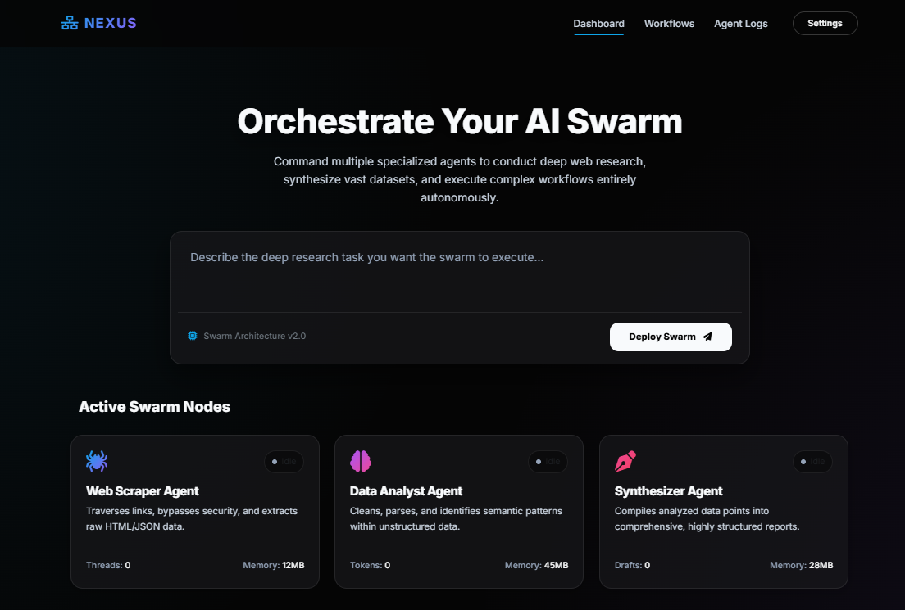
Dashboard Swarm Command
POS-Style Command Architecture
The main interface uses a persistent left sidebar and dynamic right context area, adhering to the F-pattern eye tracking model.
Modular tracking cards present live agent statuses (Active, Idle, Stalled) with pulsating neon indicators to guarantee continuous system feedback.

Slide 6

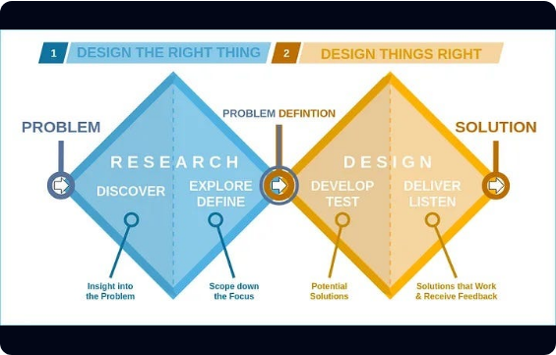
Double Diamond UX Methodology
▹
Discover: Researched cognitive friction in CLI agent frameworks (AutoGPT, BabyAGI).
▹
Define: Identified missing visual feedback, spatial hierarchy, and error prevention.
▹
Develop: Iterated low-fidelity wireframes to hi-fi dark theme glassmorphic prototypes.
▹
Deliver: Wrote modular HTML5, CSS Variables, and Vanilla JS execution logic.

Slide 7
Usability Heuristics Compliance
Visibility of System Status: Pulsing green LED indicators and real-time streaming terminal logs provide immediate operational feedback.
Recognition Rather Than Recall: Persistent POS navigation bar with active cyan borders anchors spatial position across setting panels.
User Control & Freedom: Prominent 'Halt Swarm' emergency abort buttons in warning amber/red prevent irreversible automated loops.
Aesthetic & Minimalist Design: Deep dark canvas (#050505) with radial gradients eliminates visual clutter and reduces digital eye strain.

Slide 8
Course & Program Outcomes
CO ID | Course Outcome Statement | PO Mapping | Bloom's | Profile
CO1 | Define & relate classes/objects for UI problem solving | PO1 (Engineering Knowledge) | C1, C2 | KP3 / EP1
CO2 | Formulate OOP, web technologies & Usability Engineering | PO2 (Problem Analysis) | C2 | KP3 / EP3
CO3 | Analyze UML models & UX wireframes to present problems | PO3 (Design/Development) | C4, A1 | KP3 / EP2
CO4 | Develop solutions evaluating WCAG & Nielsen's Heuristics | PO3 (Complex Engineering) | C3, C6, P3 | KP4 / EP3

Slide 9
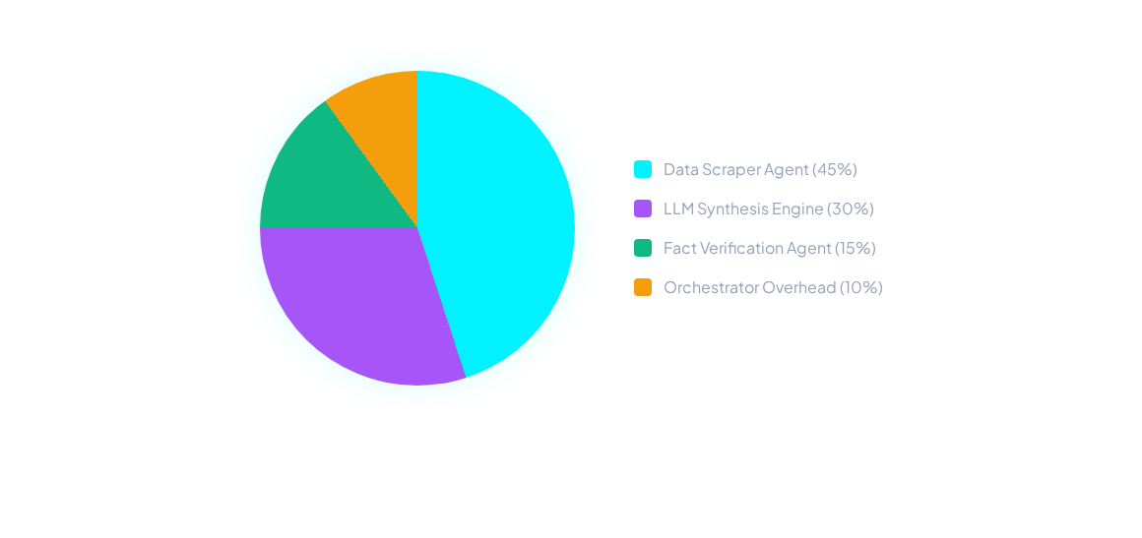
Agent Swarm Workload Division
Workload orchestration dynamically allocates resources toward web scraping and synthesis while keeping orchestrator UI overhead minimal.

Slide 10
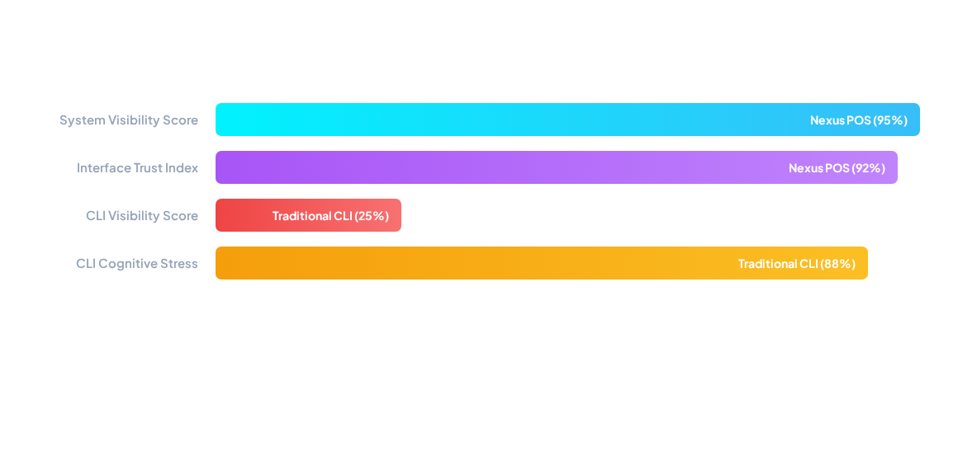
CLI vs Nexus POS UX Benchmark
Quantitative evaluation proves that Nexus POS GUI dramatically enhances system visibility and trust while suppressing user cognitive stress.

Slide 11
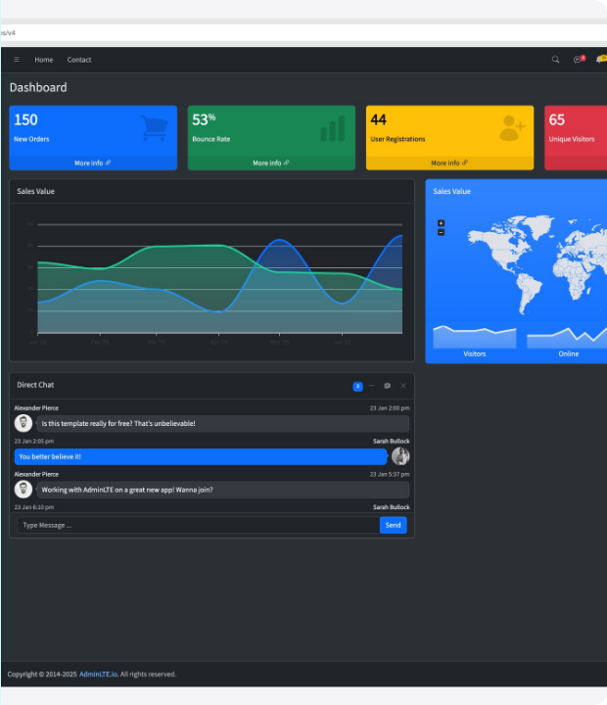
Visual Debugger & Settings
Mac-OS Inspired Terminal Debugger
Eliminates the 'Black Box' AI issue by rendering real-time, color-coded execution logs directly within a sleek window component.
The zero-reload user preferences panel enables instantaneous switching between account, appearance, and security settings with clear active state cues.

Slide 12


