Slide 1
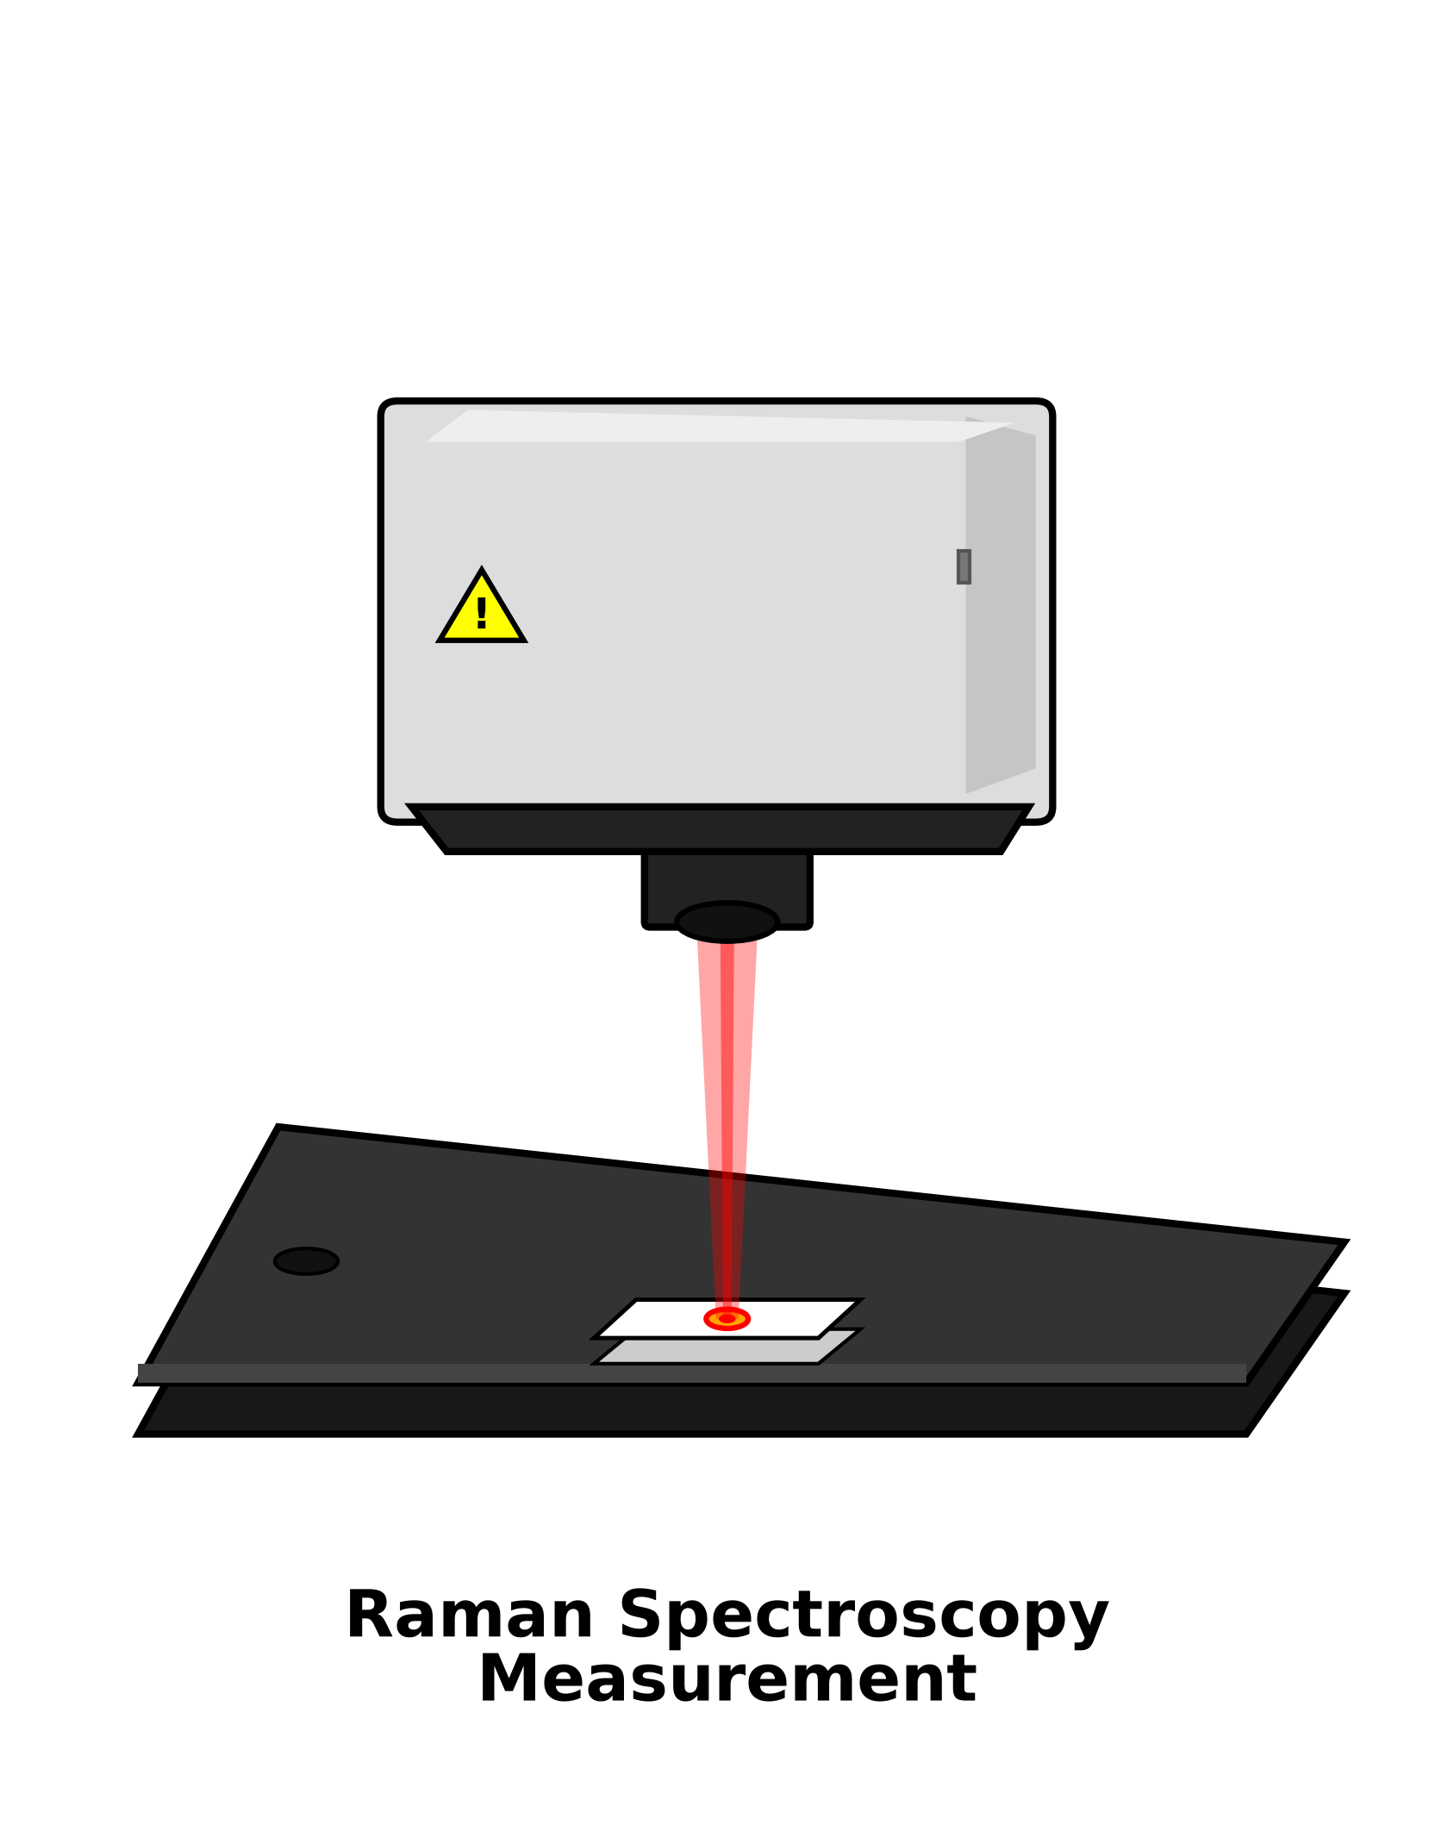
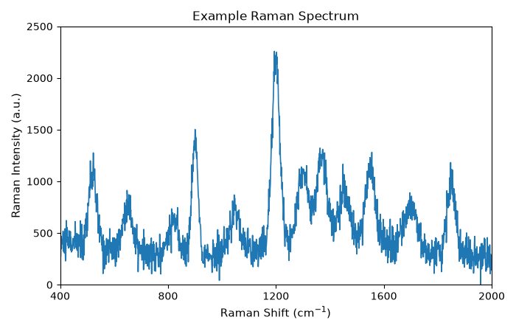
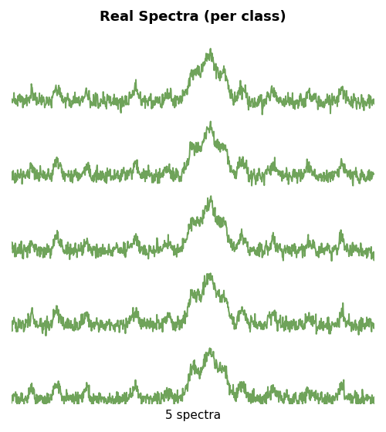
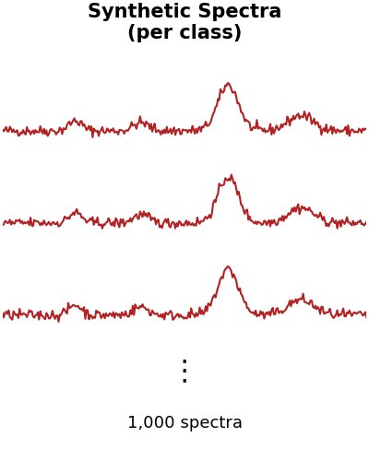
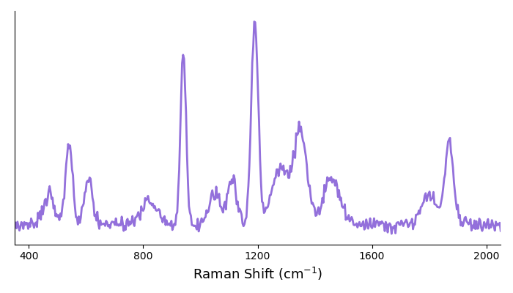
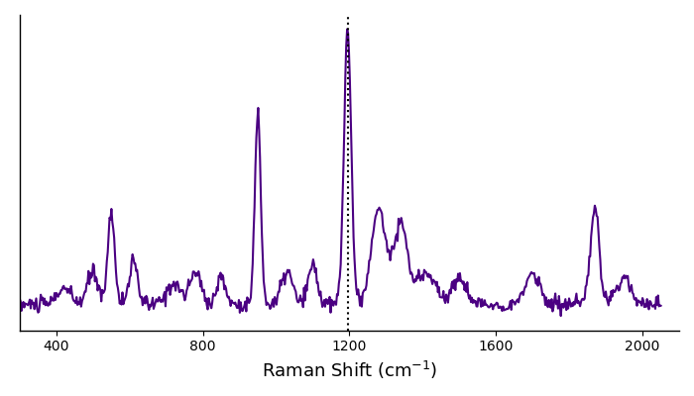
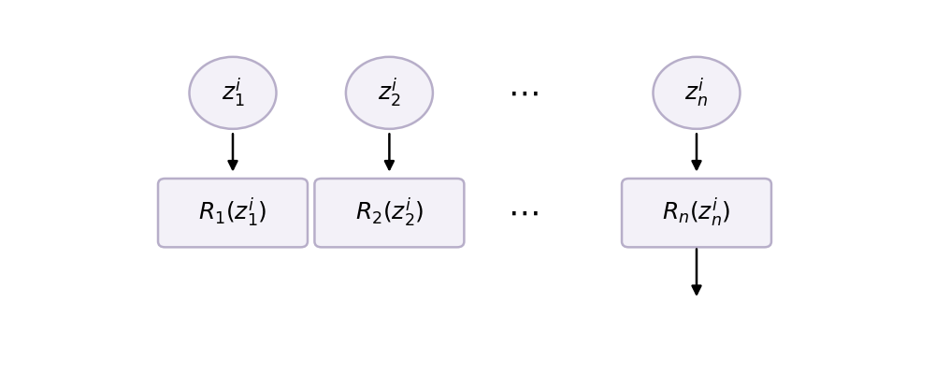




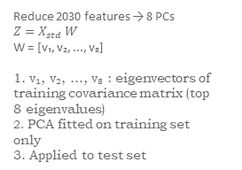
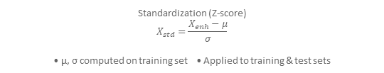



Class-Specific Synthetic Spectrum Generation
1
Raman Spectral Acquisition
2
Spectral Preprocessing
3
Log Transformation
Gradient Enhancement
Synthetic Generation (in log-domain)
$$X_{\left\{log\right\}}= log(X+ε)$$
$$X_{\left\{enh\right\}}=X_{\left\{log\right\}}+γ |∇ X_{\left\{log\right\}}|$$
$S_{\left\{syn\right\}}=μ_{c}+αR+βz$
$α∼N\left(1, σ_{α}^{2}\right)$
$z∼N\left(0,σ_{ε}^{2}\right)$
Feature-wise diagonal noise model
• 70 spectra • 14 glucose concentration classes • 5 spectra per class • 2030 intensity features per
spectrum
Inverse transform to intensity domain Xₛᵧₙ = exp(Sₛᵧₙ) − 1 • Clip negative values • Remove non-finite samples
Standardization (Z-score)
$$X_{std}=\frac{X_{enh}−μ}{σ}$$ • μ, σ computed on training set • Applied to training & test sets
Augmented Training Set (Real + 1,000 synthetic spectra per class)
4
Iteration 1
PCA-Based Qubit Mapping and Angle Encoding
Machine Learning Models
6
5
Model Training and Performance Evaluation
PCA Dimensionality Reduction
Angle Encoding to [0, π]
Baseline Models (7)
Stratified 5-Fold Cross-Validation
Reduce 2030 features → 8 PCs $Z=X_{std} W$ W = [v₁, v₂, ..., v₈]
1. v₁, v₂, ..., v₈ : eigenvectors of training covariance matrix (top 8 eigenvalues) 2. PCA fitted on training set only 3. Applied to test set
Performance Metrics
$$z_{i}^{′} =π\frac{\left\{z_{i} −z_{min}\right\}}{z_{\left\{max\right\}} −z_{min}}$$ for i = 1,2,...,8
DT
SVM
KNN
LR
RF
AB
CB
Iteration 1
Iteration 2
Iteration 3
Iteration 4
Iteration 5
Fold 1
Fold 2
Fold 3
Fold 4
Fold 5
Fold 1
Fold 2
Fold 3
Fold 4
Fold 5
◎ Accuracy ↗ Precision ◯ Recall ▥ F1-score ╲ ROC-AUC
Ensemble Models
Soft Voting Ensemble (Base: RF, KNN, CB)
Proposed Stacking Ensemble (Base: RF, KNN, CB)
Fold 1
Fold 2
Fold 3
Fold 4
Fold 5
RF KNN CB ↓ ↓ ↓ Average Probability ↓ ŷ = $\arg{\max_{c}{P\left(y=ε \right|x) }}$
RF KNN CB
↓ ↓ ↓
Metal-features
$$[f_{RF}\left(x\right), f_{KNN}\left(x\right), f_{CB}\left(x\right)]$$ ↓ Logistic Regression
Fold 1
Fold 2
Fold 3
Fold 4
Fold 5
Fold 1
Fold 2
Fold 3
Fold 4
Fold 5
Quantum-Inspired Feature $Q= \{\left(z_{i}, y_{i}\right)\}_{\left\{i=1\right\}}^{\left\{N_{Q}\right\}}$ , zᵢ ∈ [0, π]⁸ (8-dimensional qubit-ready representation)
Training (80%) Testing (20%)
Results Reported as Mean ± Std Across 5 Folds (Comprehensive and Unbiased Evaluation)
Abbreviations: DT: Decision Tree SVM: Support Vector Machine KNN: K-Nearest Neighbors LR: Logistic Regression RF: Random Forest AB: AdaBoost CB: CatBoost
───► Workflow Progression ⋯⋯► Data/Information Flow
Data
Process
Model
Output

