Slide 1
HUMAN ACTIVITY RECOGNITION USING SMART WATCH
Group Members:
Kamal Nayan
Shreyas Lakhe
Sudarshan K
Venkata Sasank

Slide 2
Problem Statement
Human Activity Recognition from smartwatch sensor data.
Smartwatch contains data from various sensors: accelerometer, gyroscope, gravity, orientation, etc.
Modeled as a time series problem
4 Activity classes:
Walking
Standing
Sitting
Laying Down

Slide 3
Data Collection and preprocessing
2 hours of data for each activity.
Equal contribution (30 min each) from 4 users.
Main focus on Accelerometer and Gyroscope sensor readings.
Data from both the sensors is combined following the closest timestamp scheme.
Windowing of data done using timestamp rather than grouping instances.
Overlapping Windows are considered for the experiments.

Slide 4
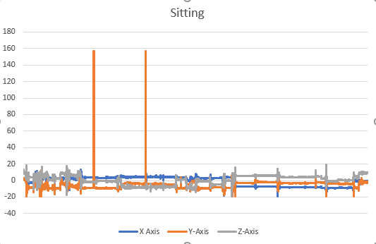
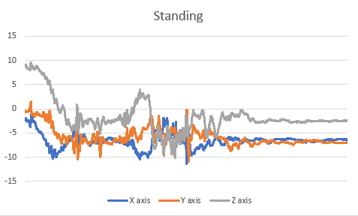
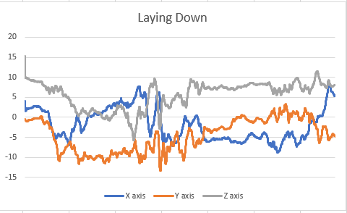
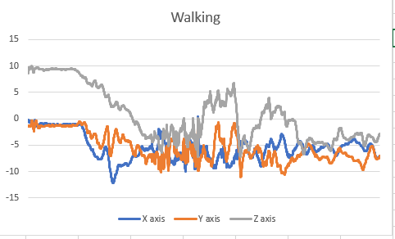

Slide 5
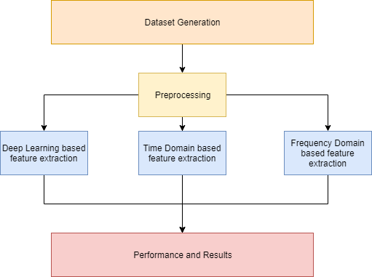
Overview

Slide 6
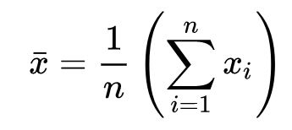
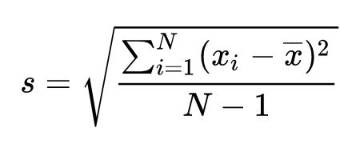
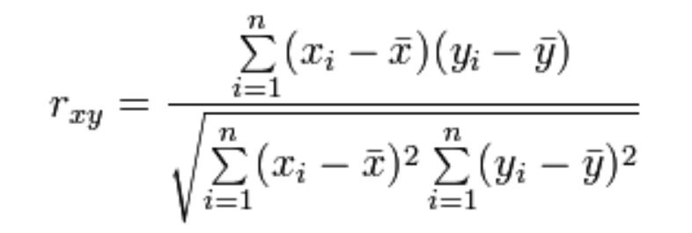
Features Extracted
Basic Time Domain Features:
Mean
Standard Deviation
Correlation between axis.

Slide 7

All features are extracted on SMV (Signal Magnitude Vector)
Frequency Domain Features
Dominant frequency in each of the window segment
Power of the dominant frequency
Second dominant frequency
Power of second dominant frequency
Dominant frequency between 0.6 and 2.5 Hz
Power corresponding to the dominant frequency between 0.6 and 2.5Hz
Ratio of power of the dominant frequency to total power.
Ratio between dominant frequency at the current segment and the segment before.

Slide 8
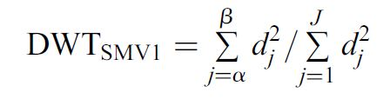
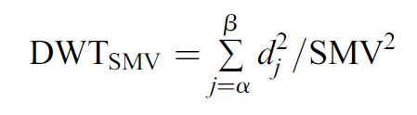
Wavelet Features
DWT_{SMV} represents the ratio of detail signals between levels α and Ꞵ to the total power of SMV.
DWT_{SMV1} represents the ratio detail signals between levels α and Ꞵ to the total power of details between levels 1 and J (we choose J = 8)

Slide 9
Methodology
Experiments on different window size: 4,8,12 seconds.
Overlap of 2, 4 ,4 Seconds respectively.
Train and Test splits:
Same Person Evaluation.
Train on all 4 users data
Test on a new session of any user from the training set .
Cross Person Evaluation.
Train on 3 users data.
Test on the other user data.

Slide 10
Learning Techniques
Machine Learning Methods:
Random Forest
J48
Support Vector Machine
Logistic Regression
Deep Learning Methods
Convolutional Neural Networks (1D CNN and 2D CNN)
Recurrent Neural Networks (LSTMs, GRUs)

Slide 11
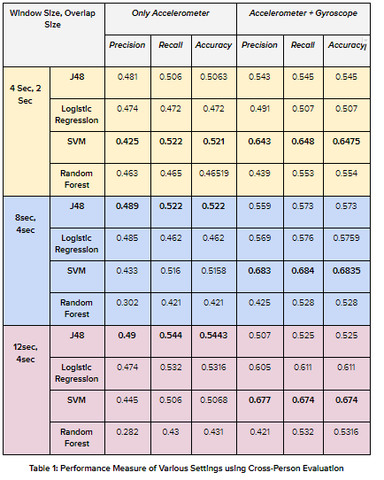
Results

Slide 12
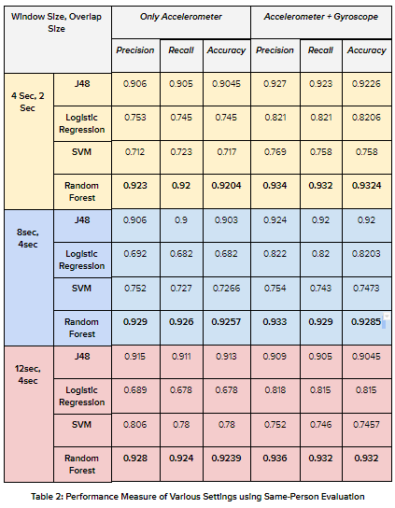

Slide 13
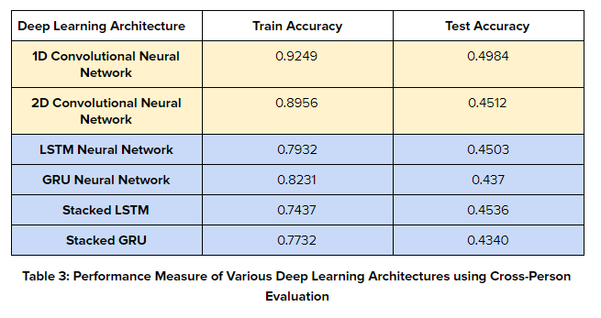

Slide 14
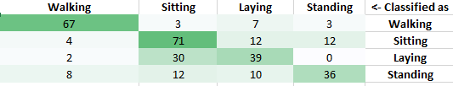
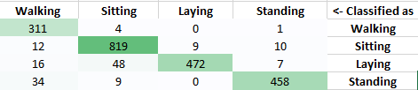
CONFUSION MATRICES FOR BEST MODEL
Figure: Confusion Matrix for SVM on Cross Person Evaluation
Figure: Confusion Matrix for Random Forest on Same Person Evaluation

Slide 15
Discussion
We observe that on combining sensor data from gyroscope provides better performance.
We also observe that the same person models perform significantly better as compared to cross-person evaluation.
We also observe that in general the accuracy of the models increases with the size of the window.
For same-person evaluation, decision trees perform very good! (Overfits the Training data)
For cross-person evaluation, SVM perform very good! (Better Generalization Performance)

Slide 16
Deep Learning models are data hungry!
No Free Lunch Theorem: The “No Free Lunch” theorem states that there is no one model that works best for every problem. The assumptions of a great model for one problem may not hold for another problem, so it is common in machine learning to try multiple models and find one that works best for a particular problem.
Future Work:
Feature Importance and Selection
Different types of Windows other than rectangular
More data collection and computing power for Deep Learning Models
Extend the work to an online active learning system.

Slide 17
RELATED WORK
Physical Activity Classification Using the GENEA Wrist-Worn Accelerometer, Zhangi et al.
Machine Learning Methods for Classifying Human Physical Activity from On-Body Accelerometers, Andrea Mannini et al.
Activity recognition from accelerometer signals based on Wavelet-AR model, Zhenyu He

