Slide 1

Markdown
Md. Mehedi Hasan
M.Sc. Student (Thesis)
Department of Statistics(RU)
Intern (icddr,b)

Slide 2
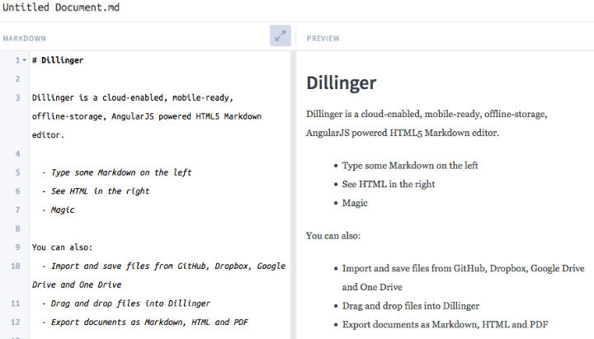
Markdown
Markdown is a lightweight markup language that you can use to add formatting elements to plaintext text documents. Created by John Gruber in 2004, Markdown is now one of the world’s most popular markup languages.
Markup Language
- is a computer language that consists of easily understood keywords, names, or tags that help format the overall view of a page and the data it contains.
Markup languages are designed for the processing, definition and presentation of text.
The language specifies code for formatting, both the layout and style, within a text file.
Some examples of a markup language are BBC, HTML, SGML, and XML.
Tags : The code used to specify the formatting are called tags.
To find more : https://www.markdownguide.org/getting-started/

Slide 3
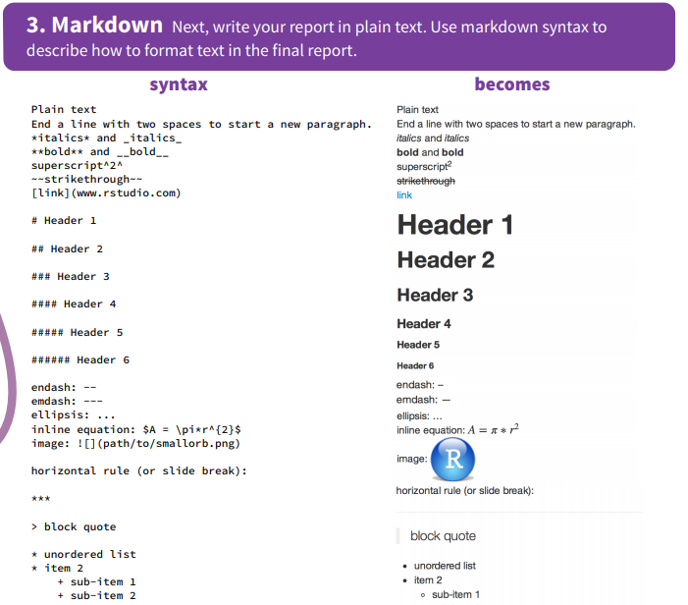
Why Use Markdown?
There are a couple of different reasons why people use Markdown instead of WYSIWYG (What You See Is What You Get) editors.
Markdown can be used for everything. People use it to create websites, documents, notes, books, presentations, email messages and technical documentation.
Markdown is platform independent. You can create Markdown-formatted text on any device running any operating system.
Markdown is everywhere. Websites like Reddit and GitHub support Markdown, and lots of desktop and web-based applications support it.

Slide 4
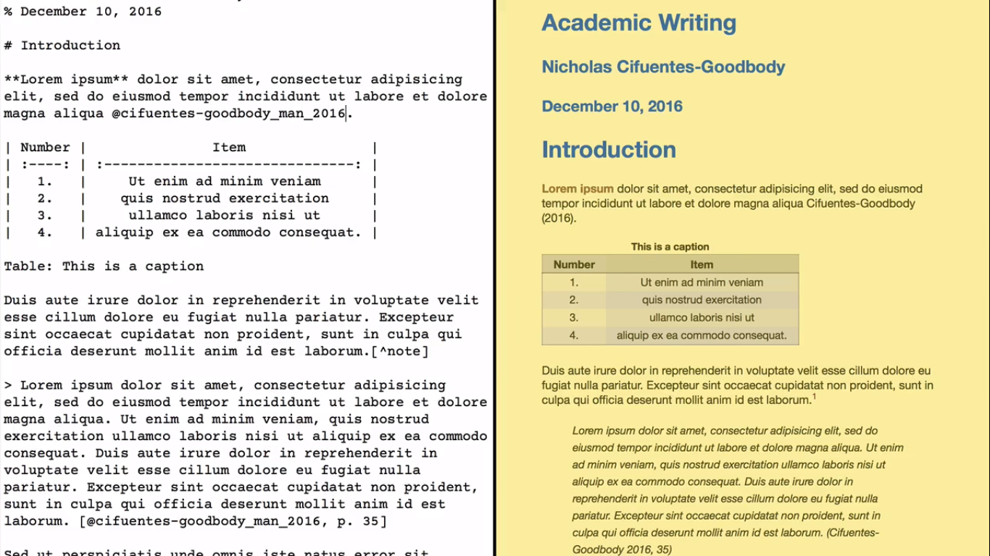
Example :
There are many online editor for practice : https://dillinger.io/
http://aaronbeveridge.com/markdown/try-markdown.html
For syntax : https://www.markdownguide.org/cheat-sheet/
https://guides.github.com/pdfs/markdown-cheatsheet-online.pdf

