Slide 1

Regular Expression
Md. Mehedi Hasan
M.Sc. Student (Thesis)
Department of Statistics(RU)
Intern (icddr,b)

Slide 2
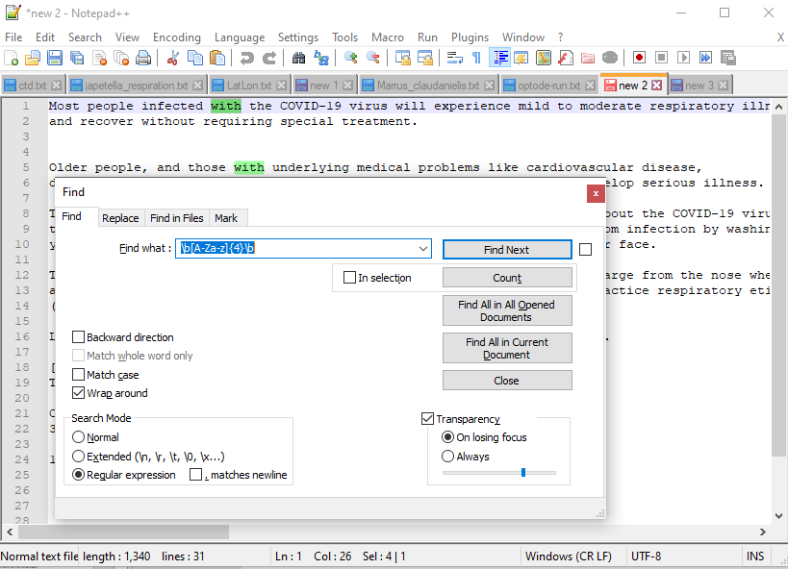
Regular Expression (RegEx)
Regex is a special text string for describing a search in a text.
Mainly used for pattern-matching and "search-and-replace" on text.
Extracting information from text such as code and log files
It is vastly used for text mining
RegEx can be use in software such as notepad++ or in programming such as R, Python
Important links:
https://webagility.com/posts/the-basics-of-regex-explained
https://docs.microsoft.com/en-us/dotnet/standard/base-types/regular-expression-language-quick-reference

Slide 3
Some Important Elements in RegEx
Wildcard : A wildcard is a special character that represents a specific variety of characters in our searches. In our query searches, it can match more than one particular character in the text. This greatly extend the utility of a search and replace tool. For example, for any numeric digit the wildcard is “\d” or for tab character it’s “\t” etc.
Quantifiers : Methods of adjusting the number of times an element such as a wildcard matches are called quantifiers. “+”, “*”, “^” or “?” etc. are known as quantifiers in regex. For example, Plus (+) immediately after a character indicates that the term should match one or more times in succession.
Brackets : Brackets/Parentheses are used almost every time while using regex. Three types of parentheses e.g. (), {} & [] are used for different purposes. For example : [0-9]{4} - Match any number for exactly four times in a row.

Slide 4
Hands-on
“Most people infected with the COVID-19 virus will experience mild to moderate respiratory illness and recover without requiring special treatment.”
In the above sentence we want to find only the words having 4 letters so we can simply do : \b[A-Za-z]{4}\b
(Here “\b” indicates boundary and inside the box bracket we specify the range from A to Z both upper and lowercase and using curly bracket we fixed our selection to 4 letters.)
If we want to select just COVID-19 in the same sentence we apply : \b[A-Z]+\-\d+\b
Start | Search | Replace with | Result
CTAAAAGCATAAAAAAAAAAAA | A{8,} | - | CTAAAAGCAT-
32.23456978413 | (\d+)\.(\d{3})\d+ | \1.\2 | 32.234
157 58'13.70"W 10 24'47.84"N 51 21'54.61"E 22 52'41.65"S | (\d+)\s(\d+.\d+).\d+.([WE]) | \1 \2 \3 | 157 58'13 W 10 24'47.84"N 51 21'54 E 22 52'41.65"S
You’ll find wildcards, quantifiers and a lot more about regex here : http://www.rexegg.com/regex-quickstart.html#ref

