Slide 1
TEXAS TECH UNIVERSITY · Whitacre College of Engineering
Quantum Kernel-Based
Stock Market Regime Detection
using QSVM
Rushikesh Reddy Bayyapu · Md Mehedi Hasan · Afahan Javed
Quantum Computing Course Project · Spring 2026

Slide 2
1 · THE PROBLEM
What are we solving and why use quantum?
THE PROBLEM
WHY QUANTUM?
Three-class daily regime detection on Apple (AAPL) returns:
Pairwise interactions
Upward trends
Downward trends
Flat consolidation
The reason quantum is interesting for this problem is that the ZZ feature map can encode pairwise interactions between features through entanglement, which is something RBF can't really capture.
Exponential feature space
Compare a QSVM with a ZZ-feature-map kernel against a classical SVM with an RBF kernel using same engineered features.
Four qubits give us a Hilbert space of dimension 16, which is a richer feature space than what RBF works with.
AAPL daily OHLCV · 2019–2024 · ~1,238 trading days
QSVM Stock Regime Detection
1 / 11

Slide 3
2 · RELATED WORK
What others have done – three foundational papers
SCOPUS-INDEXED REFERENCES
Havlíček et al. Nature 567 · 2019 [1]
“Supervised learning with quantum-enhanced feature spaces”
Foundation for our circuit
which introduced the ZZ feature map circuit we use in this project. They demonstrated it on actual IBM quantum hardware, and their circuit is the direct foundation for our implementation.
Schuld & Killoran Phys. Rev. Lett. 122 · 2019 [2]
Justifies precomputed-kernel SVM
“Quantum machine learning in feature Hilbert spaces”
They showed that quantum circuits can map data into a high-dimensional Hilbert space, and the overlap between two quantum states becomes a kernel value — which is exactly why we can feed our quantum kernel matrix directly into a standard SVM.
Rebentrost, Mohseni & Lloyd Phys. Rev. Lett. 113 · 2014 [3]
“Quantum support vector machine for big data classification”
Anchors the QSVM-vs-classical comparison
They were the first to propose that quantum computers could train SVMs significantly faster than classical ones, and this paper is really what anchors our whole classical versus quantum comparison.
All three are Scopus-indexed; each exceeds 1,000 citations on Google Scholar.
INFORMAL SOURCES
· QisKit ML documentation [4]
· Yahoo Finance [5]
QSVM Stock Regime Detection
2/ 11

Slide 4
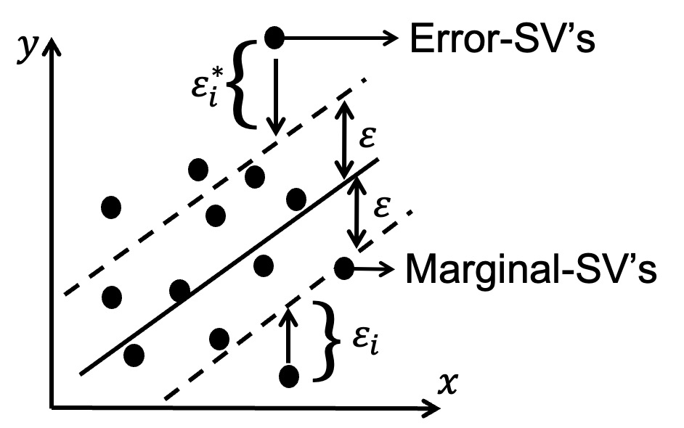
3 · METHODOLOGY
Pipeline: from raw prices to quantum kernel
1
Download
2
Features
3
Label
4
Scale
5
Classify
AAPL OHLCV
2019–2024
yfinance
Rolling Return
Volatility
RSI
Momentum
Up / Down / Flat
0/1/2
MinMax → [0, 2π]
matches Rz period
on each qubit
QSVM (ZZ kernel)
vs.
Classical SVM (RBF)
FOUR ENGINEERED FEATURES → FOUR QUBITS
CLASSICAL BASELINE (SVM)
Rolling return
daily price change relative to recent days
volatility
standard deviation of returns
RSI (Relative Strength Index)
bounded 0–100 momentum oscillator
Momentum
price difference
Decision boundary and margin band; the points on the boundary are the support vectors that define the classifier.
QSVM Stock Regime Detection
3/ 11

Slide 5
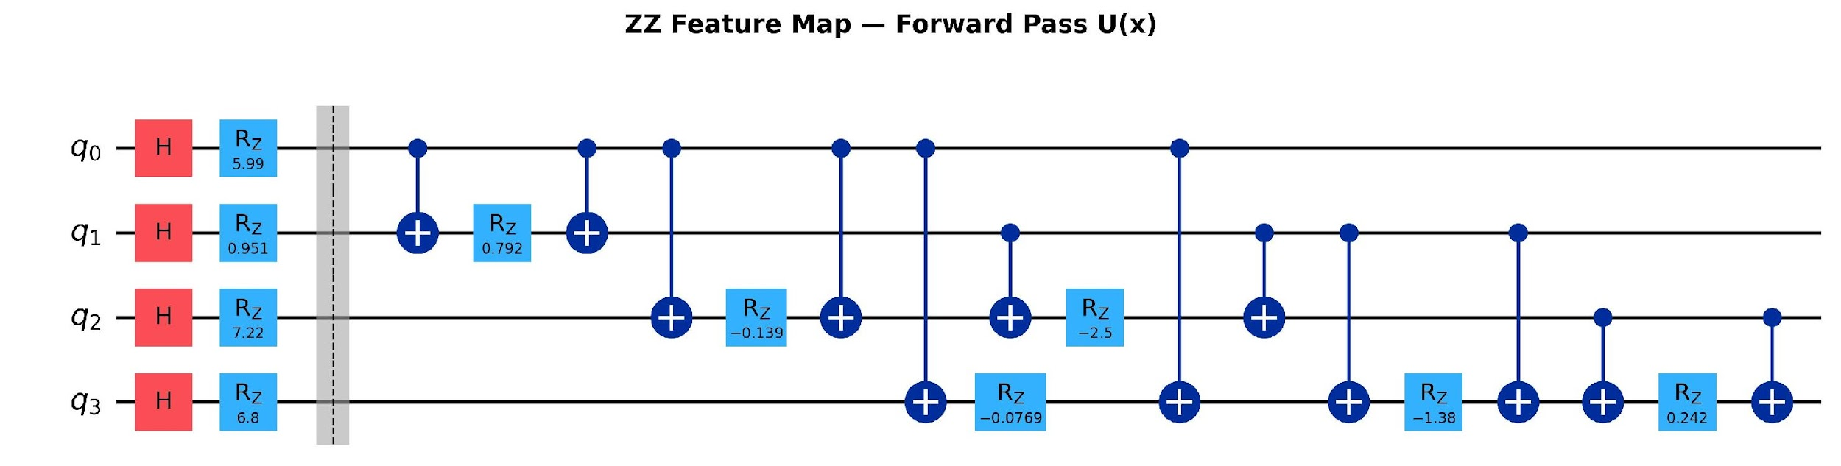
3 · METHODOLOGY
ZZ feature map: encoding data into qubits
ENCODING IN TWO STAGES
CIRCUIT (4 QUBITS, FORWARD PASS U(x))
1
Single-qubit encoding
Apply Hadamard, then a Z-rotation by 2·xᵢ
on each of the 4 qubits — one qubit carries one feature.
2
Pairwise entanglement
For every qubit pair (i,j): CNOT, then Rz by angle 2·(π−xᵢ)·(π−xⱼ), then CNOT.
The angle depends on both features — the entangled interaction.
Each qubit gets H + Rz, then six entangling blocks across all 4 pairs.
Read right-to-left: encode each feature on its own qubit (Stage 1), then entangle every pair with feature-dependent angles (Stage 2).
Six pairs × CNOT–Rz–CNOT = where the “quantum” actually happens.
QSVM Stock Regime Detection
4/ 11

Slide 6
3 · METHODOLOGY
From the encoding to a kernel a classical SVM can use
THE QUANTUM KERNEL
The probability that encoding x₁ and un-encoding x₂ to return the qubits to all-zeros.
STEP 1
STEP 2
STEP 3
Run circuit
Estimate K (Probability)
Train SVM
Apply U(x₁) then U†(x₂) on |0000⟩.
Measure all 4 qubits.
4,000 shots per kernel entry.
Kernel = fraction of shots that returned 0000.
The more similar x₁ and x₂, the higher this is.
Build the full kernel matrix.
SVM trained with kernel='precomputed' and balanced class weights.
ENVIRONMENT
PACKAGES
· Macbook Air (8GB RAM, M1 Processor)
· Anaconda navigator
· Python 3
· Qiskit BasicSimulator
· qiskit · sklearn
· yfinance · numpy
· pandas · matplotlib
QSVM Stock Regime Detection
5/ 11

Slide 7
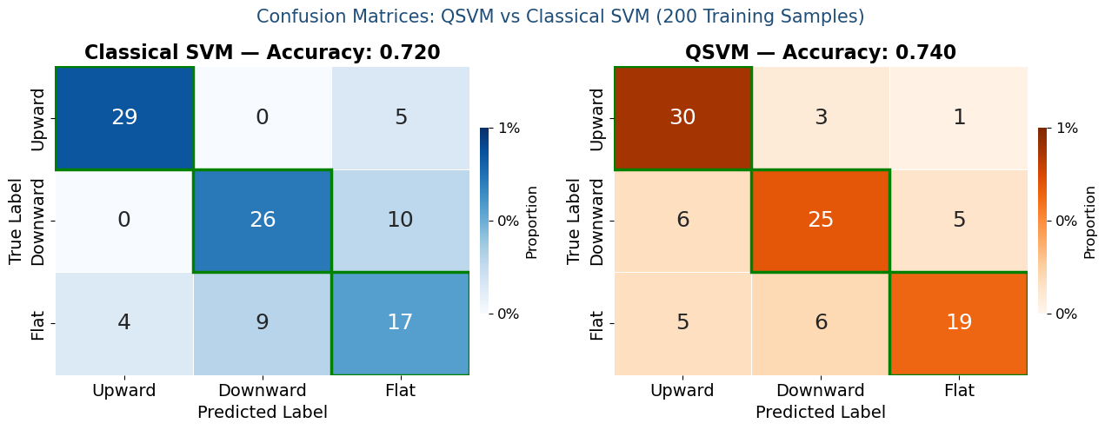
4 · RESULTS
QSVM vs classical SVM results
QSVM TEST ACCURACY
FLAT-CLASS F1 GAIN
TRAINING SAMPLES
0.740
+0.14
200
vs. 0.720 classical
0.55 → 0.69
100 test · 4k shots/kernel
CONFUSION MATRICES — CLASSICAL SVM vs QSVM (200 train)
QSVM Stock Regime Detection
6/ 11

Slide 8
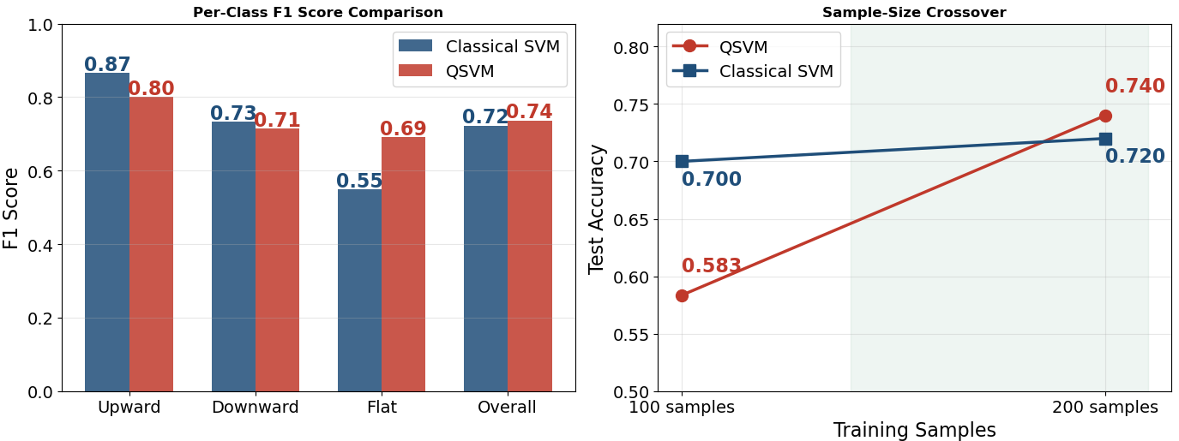
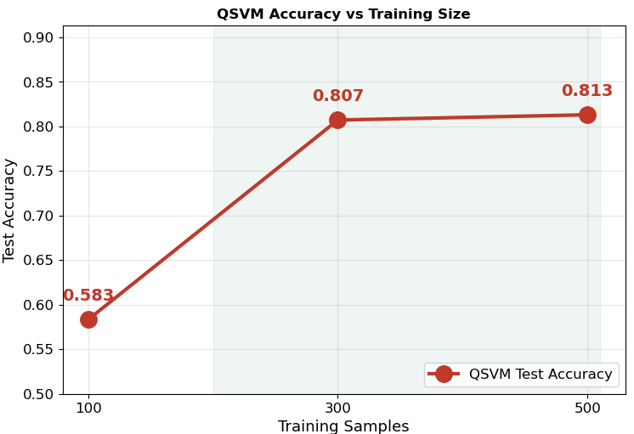
4 · RESULTS
Where QSVM wins and when
WHY QSVM WINS
SAMPLE-SIZE CROSSOVER
Classical SVM handles Up/Down class well but breaks on Flat (F1=0.55).
QSVM handles Flat class more because the entangled feature interactions separate samples that look identical to RBF in raw Euclidean space.
100 samples: QSVM 0.583 < classical 0.70.
200 samples: QSVM 0.74 > classical 0.72.
The richer quantum feature space needs enough support vectors before it pays off.
SOFTWARE
REPRODUCIBILITY
· Notebook: Github repo: quantum_class_qsvm_project
https://github.com/mehedi28/quantum_class_qsvm_project
· Runtime: ~15-20 minutes
random_sate = 42
QSVM Stock Regime Detection
7/ 11

Slide 9
5 · REFLECTIONS
Lessons learned and future work
LESSONS LEARNED
FUTURE WORK
1
Entanglement is not optional
Run on real hardware
Without CNOTs, the quantum kernel did not work
Move from BasicSimulator to IBM Quantum to measure noise impact.
2
Inverse circuits are tricky
More Qubits with more features
To undo encoding, reverse gate order and flip every rotation sign.
8+ qubits with more features for better regime detection
3
QNNs didn't work, kernels did
Richer kernels
Both QNN attempts collapsed; kernel methods worked better
Test advanced quantum kernels for better expressivity.
4
Quantum needs enough data
Test other market stocks
QSV classifies better with 200 samples compared to 100 samples. Always test multiple sample sizes.
We tried only daily Apple Inc. data. Test more on different stocks, and crypto markets.
QSVM Stock Regime Detection
8/ 11
Notes:
Entanglement: entanglement like teamwork between qubits. If you remove it, each qubit works alone.No entanglement = no advantage. It's the whole point. Inverse: like a reversing video every detail has to be exactly reversed or the whole thing breaks. QNNs: When the fancy approach fails, a simpler one often works better. Use quantum for what it's good at, and let classical tools handle the rest. Quantum:Quantum models are like a powerful engine they need enough fuel (data) before they outperform a smaller, simpler engine.

Slide 10
6 · BONUS
Novelty and bonus contributions
(a) DOCUMENTED FAILURE DIAGNOSIS
(b) SAMPLE-SIZE CROSSOVER EVIDENCE
Seven attempts – all logged
We pinpoint where quantum starts to repay its cost
Shot-noise gradient collapse (QNN attempts 1–2)
Missing entanglement (Attempts 3–4): kernel gap < 0.10
Range mismatch (Attempt 5): Rx/Ry gates
Broken adjoint (Attempt 6): self-kernel = 0.07 instead of 1.00
100 samples: classical 0.70 vs. QSVM 0.583 → classical wins
200 samples: classical 0.72 vs. QSVM 0.74 → QSVM wins
Crossover localized between 100 and 200 training samples
Sample-size scaling need to be followed in QML benchmarks
QSVM Stock Regime Detection
9/ 11
Notes:
1–2: QNN collapsed: Too much shot noise — gradients became meaningless
3–4: Kernel gap too small: Missing entanglement — quantum behaved like classical
5: Features out of range: Data wasn't scaled to match the qubit rotation period
6: Adjoint circuit broken: Self-kernel gave 0.07 instead of 1.00 — circuit was reversed wrong
7th attempt we tried with 2 samples with 100 and 200 samples and with 200 samples it was higher qsvm

Slide 11
7 · CONTRIBUTIONS
Team Member Contribution
Rushikesh Reddy Bayyapu
Topic selection
Data acquisition
Feature analysis
Result analysis
Literature review
Background study
Md Mehedi Hasan
Split train/test/validation set
Quantum kernel design and implementation
Built the ZZ feature map
Result analysis
Literature review
Afahan Javed
Prepare project template
Project coordination
Team meeting management
Literature review
Writing and editing
Result analysis
QSVM Stock Regime Detection
10/ 11

Slide 12
7 · REFERENCES
References
Papers
Others
[1] V. Havlíček et al., “Supervised learning with quantum-enhanced feature spaces,” Nature, vol. 567, pp. 209–212, 2019. doi:10.1038/s41586-019-0980-2
[2] M. Schuld and N. Killoran, “Quantum machine learning in feature Hilbert spaces,” Phys. Rev. Lett., vol. 122, p. 040504, 2019. doi:10.1103/PhysRevLett.122.040504
[3] P. Rebentrost, M. Mohseni, and S. Lloyd, “Quantum support vector machine for big data classification,” Phys. Rev. Lett., vol. 113, p. 130503, 2014.
[4] Qiskit Contributors, “Qiskit: An Open-source Framework,” IBM Quantum, 2024.
[5] Yahoo Finance, AAPL daily OHLCV via yfinance, accessed 2024.
QSVM Stock Regime Detection
11/ 11

Slide 13
Thank you
Questions?
Quantum Computing Course Project · Texas Tech University · Spring 2026

