Slide 1



Prediction of Cardiovascular Disease using Machine Learning Techniques
Presented By:
Sanjeda Hossain Pria
ID : 20201073010
Ringshina Akter Tithi
ID : 20201085010
Mohua Roy
ID : 20201100010
S.M.Muhaimin
ID : 20201108010

Slide 2


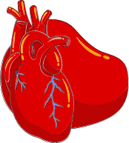
Overview
Background
Objectives
Literature Review
System Architecture
Methodology
Result & Discussion
Conclusion
Future Works
References
2

Slide 3
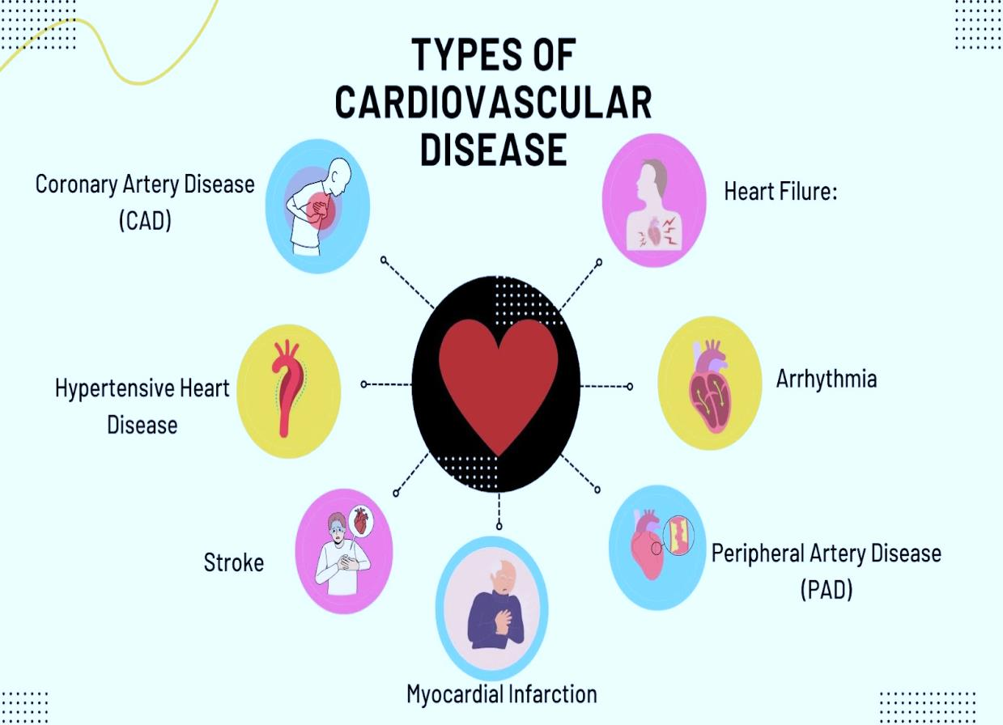

Background
Cardiovascular disease (CVD) is a general term for conditions affecting the heart or blood vessels
Cardiovascular disease describes a range of conditions that affect the heart.
Heart diseases include: Blood vessel disease, such as coronary artery disease, Irregular heartbeats (arrhythmias) Heart problems you're born with (congenital heart defects) and some other heart conditions.
Cardiovascular diseases (CVDs) are the leading cause of death globally. An estimated 17.9 million people died from CVDs in 2019, representing 32% of all global deaths. Of these deaths, 85% were due to heart attack and stroke.
Figure 1: Types of heart disease
3

Slide 4
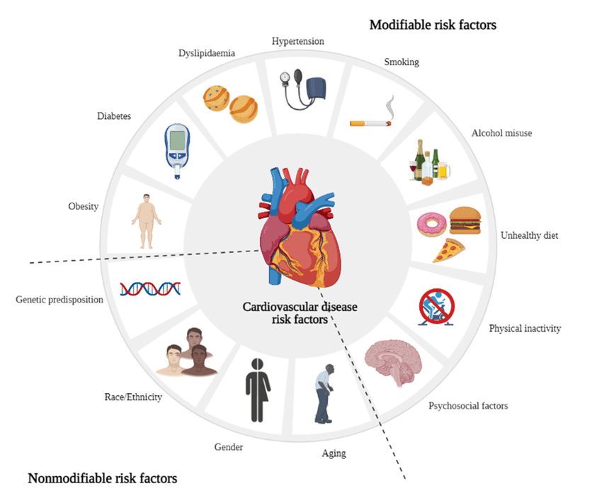
Background
Medical doctors' current techniques for predicting and diagnosing heart disease are primarily based on an examination of the medical history, symptoms, and physical reports of the patient.
Machine learning technique is really reliable for researcher for the analysis and detection of heart disease.
ML algorithms automates the steps needed for analysing the heart disease.
Figure 2: Risk Factor of Cardiovascular Heart Disease
4

Slide 5
Objectives
The main objectives of our thesis can be summarized as follows :
To identify if a person has heart disease or not.
Offering a validated predictive model.
To evaluate the model's performance in accurately predicting heart disease risk.
providing a valuable tool for healthcare practitioners to assess and stratify patients' cardiovascular health.
5

Slide 6
,
Literature Review
1. A classification and regression tree algorithm for heart disease modeling and prediction [16].
Results
Classification Technique | Performance metric | Values (%)
 | Accuracy | 88%
Classification and Regression Tree (CART) | sensitivity | 87%
 | specificity | 89%
 | Precision | 88%
Dataset was taken from IEEE Data port.
Five well-known heart disease data sets were utilized to generate the data set.
There were 12 features and 1190 records in the database.
ST Slope and Old peak are more important features to detect heart disease.
[16] Surveillance Research Program. Joinpoint Regression Program version 4.9.0.1. Bethesda, Maryland: National Cancer Institute, Statistical Research and Applications Branch; 2021.
6

Slide 7
Literature Review
2.An Optimized Neural Network Using Genetic Algorithm for Cardiovascular Disease Prediction [19].
Result
Dataset was taken from Kaggle.
In this paper, the cardiovascular disease dataset comprising 70,000 instances with 12 variables was used for training and testing using Artificial Neural Networks (ANN).
Prediction Model | Accuracy
GA-ANN | 73.43%
ANN | 68.35%
Logistic Regression | 72.35%
Decision Tree | 61.72%
Random Forest | 68.94%
Support Vector Machine | 72.16%
K- Nearest Neighbour | 61.34%
7
[19] Jan Carlo T. , Allemar Jhone P. Delima ; An Optimized Neural Network Using Genetic Algorithm for Cardiovascular Disease Prediction 2022.

Slide 8
Literature Review
3. Early detection of coronary heart disease using ensemble techniques [20].
The dataset from Kaggle on cardiovascular disease includes approximately 70,000 patient records that were used to determine the outcome.
Result
Prediction Model | Accuracy
KNN, RF and SVM | 75.1%
8
[20] Vardhan Shorewala ; Early detection of coronary heart disease using ensemble techniques. Circulation 2021.

Slide 9
System Architecture
Train-test split
Data Processing
Train 80%
Test-20%
Data Cleaning
Machine Learning Models
Dataset
Correlation Analysis
RF
SVM
XGB
DT
LR
GB
Data Standardization
KNN
Result Analysis and Visualization
Result Comparison
9
Figure 3: System architecture of the proposed model

Slide 10
Methodology
Dataset
The dataset contains a total of 70000 instances and 12 attributes; 34979 of these instances have CVD and 35021 do not.
Table 1: Description of the Attributes of the Dataset
Attribute | Code given | Unit | Data type
age | Age | in years | Numeric
height | Height | in cm | Numeric
weight | Weight | in kg | Numeric
gender | Gender | 0,1 | Binary
ap_hi | Systolic blood pressure | Less than 120 mm hg | Numeric
ap_lo | Diastolic Blood Pressure | Less than 80mm hg | Numeric
cholesterol | Cholesterol | 1,2,3 | Nominal
gluc | Glucose | 1,2,3 | Nominal
smoke | Smoking | 0,1 | Binary
alco | Alcohol intake | 0,1 | Binary
Active | Physical activity | 0,1 | Binary
Presence or absence of cardiovascular disease | cardio | 0,1 | Binary
10

Slide 11

Methodology
Data Preprocessing
Data Cleaning
Data Standardization
Data Preprocessing
Correlation Analysis
Figure 4: Data Preprocessing
11

Slide 12
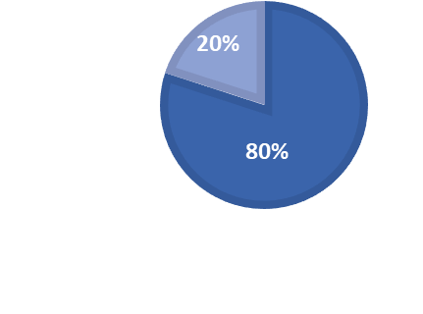

Methodology
Train test splitting
Train (80%)
Test (20%)
Figure 5: Train test split
12

Slide 13
Methodology
Implementation Models
Machine Learning Models
Random Forest
Support Vector Machine
Decision Tree
XGBoost
Logistic Regression
Gradient Boosting
k-Nearest Neighbors
Figure 6: Machine Learning Techniques
13

Slide 14
Methodology
The predicted value is positive but actually its negative
The predicted value is negative and actually its negative
Performance Metrics
Accuracy
Precision
Recall
F-1 score
ROC-AUC
Predicted Negative
Predicted positive
Actual Negative
TN
True Negative
FP
False Positive
Actually Positive
FN
False Negative
TP
True positive
The predicted value is negative but actually its positive
The predicted value is positive and actually its positive
Figure 7: Confusion Matrix
14

Slide 15
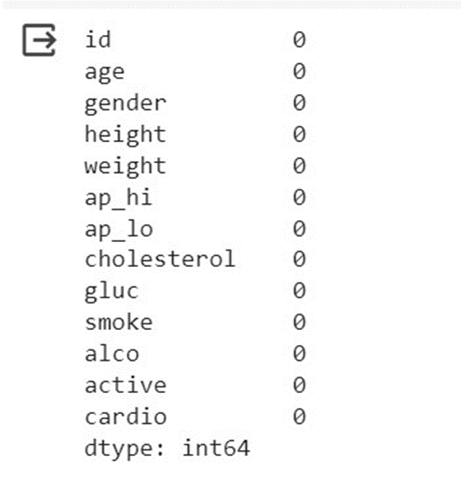

Experimental Results
Missing Data Analysis
15

Slide 16
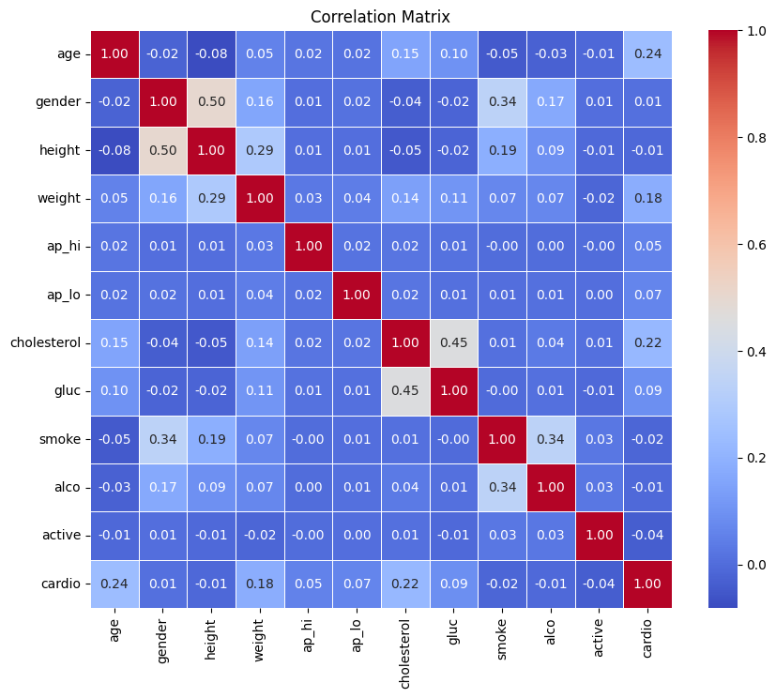
Experimental Results
Correlation Analysis
16
Figure 8: Correlation Matrix

Slide 17
Experimental Results
Table 2: Hyperparameter tuned values of the seven ML Techniques
Classifier RandomizedSearchCV Hyperparameter Tuned Values
RF max_depth=40, min_samples_leaf=18, min_samples_split=40, n_estimators=1000, random_state=42
XGB learning_rate: 0.1, max_depth: 3, n_estimators: 200
SVM C: 10, gamma: scale , kernel : rbf
DT criterion: entropy , max_depth: 5, min_samples_leaf : 1, min_samples_split : 2
GB learning_rate: 0.05, max_depth: 4, min_samples_leaf: 1, min_samples_split: 3, n_estimators: 150
KNN algorithm: auto, n_neighbors: 9, p: 1, weights: uniform
LR Solver: liblinear, penalty: l1, C:1
17

Slide 18
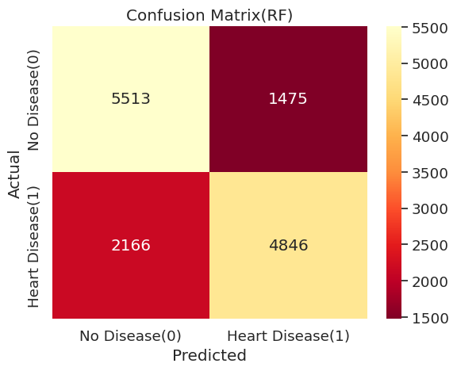
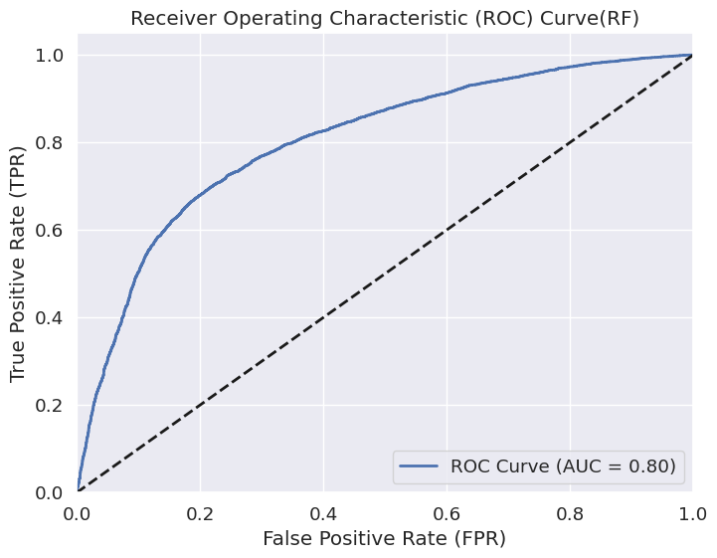
Experimental Results
Random Forest
Accuracy | Precision | Recall | F-1 Score | AUC
0.80 | 0.77 | 0.79 | 0.75 | 0.80
18
Figure 9: Confusion Matrix
Figure 10: ROC Curve

Slide 19
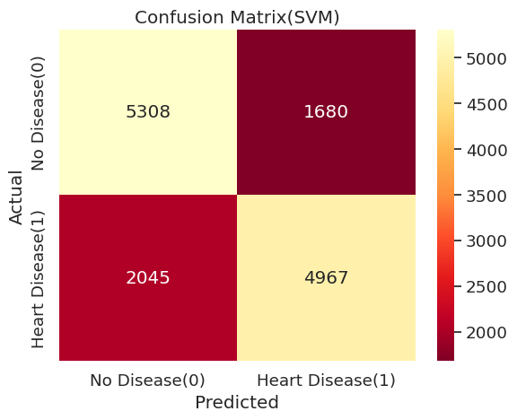
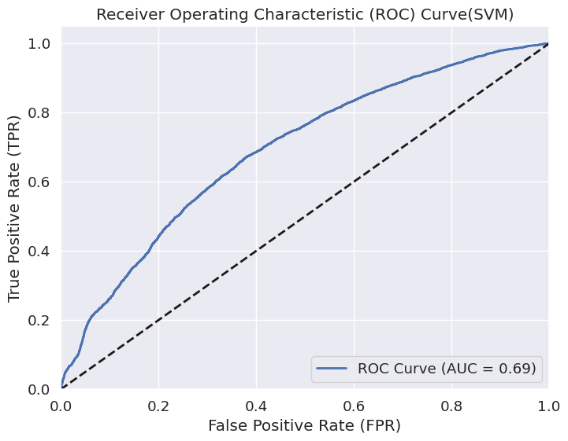
Experimental Results
Support Vector Machine
Accuracy | Precision | Recall | F-1 Score | AUC
0.73 | 0.75 | 0.76 | 0.74 | 0.69
19
Figure 11: Confusion Matrix
Figure 12: ROC Curve

Slide 20
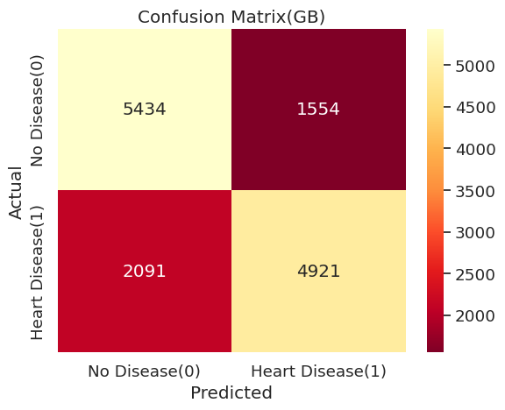
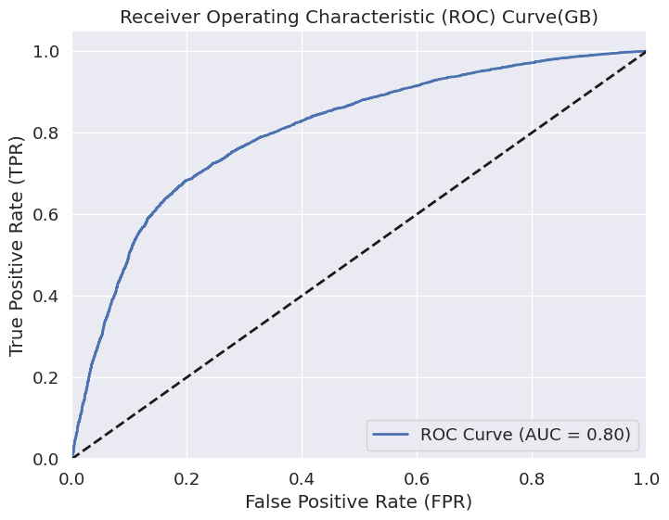
Experimental Results
Gradient Boosting
Accuracy | Precision | Recall | F-1 Score | AUC
0.74 | 0.76 | 0.78 | 0.75 | 0.80
20
Figure 13: Confusion Matrix
Figure 14: ROC Curve

Slide 21
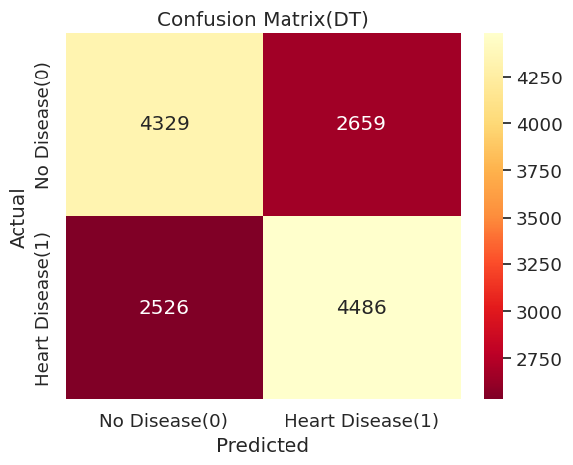
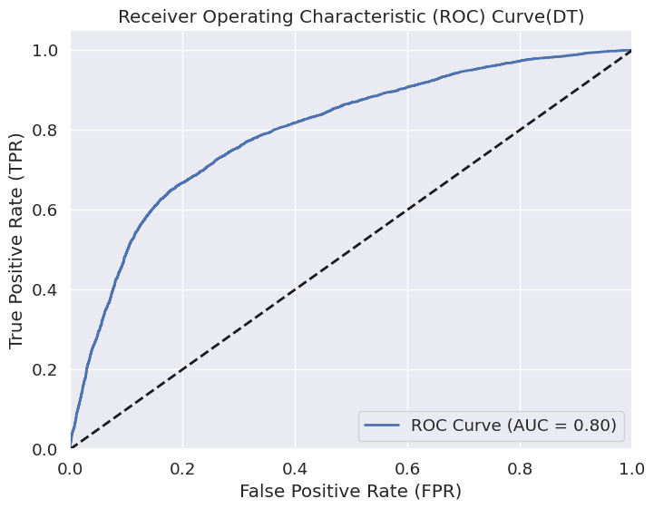
Experimental Results
Decision Tree
Accuracy | Precision | Recall | F-1 Score | AUC
0.73 | 0.77 | 0.80 | 0.75 | 0.80
21
Figure 15: Confusion Matrix
Figure 16: ROC Curve

Slide 22
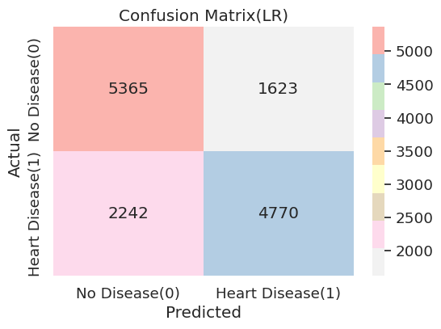
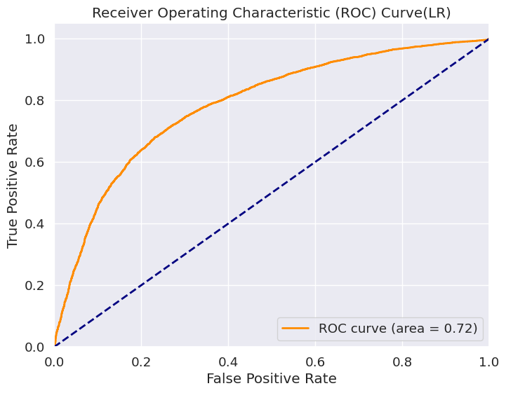
Experimental Results
Logistic Regression
Accuracy | Precision | Recall | F-1 Score | AUC
0.72 | 0.75 | 0.77 | 0.74 | 0.72
Figure 17: Confusion Matrix
Figure 18: ROC Curve
22

Slide 23
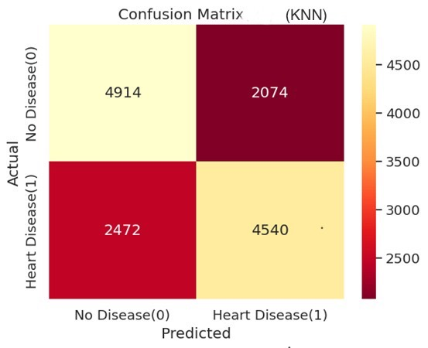
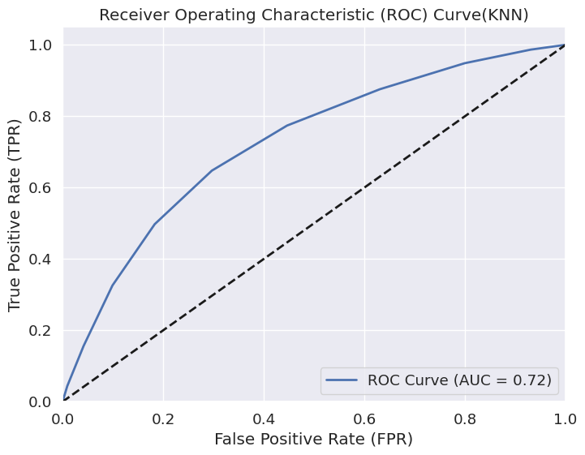
Experimental Results
k-Nearest Neighbors
Accuracy | Precision | Recall | F-1 Score | AUC
0.68 | 0.69 | 0.70 | 0.68 | 0.72
23
Figure 19: Confusion Matrix
Figure 20: ROC Curve

Slide 24
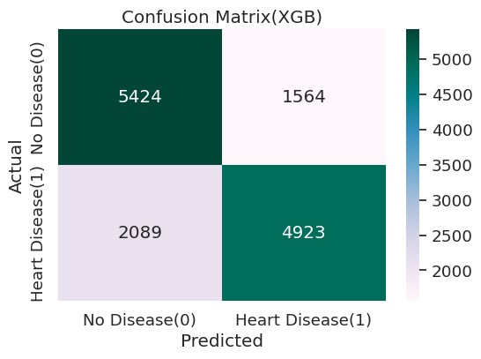
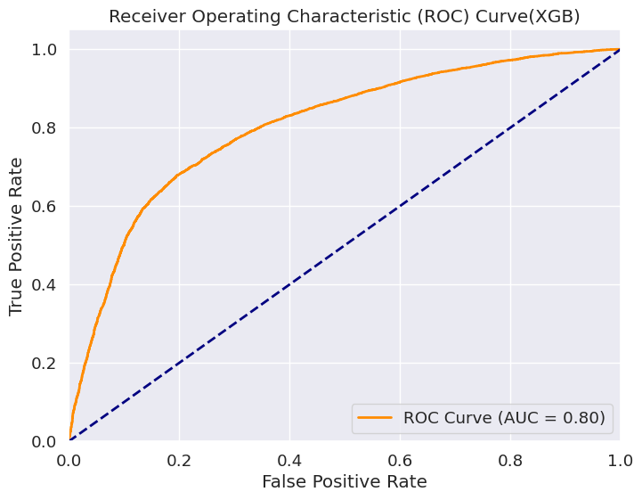
Experimental Results
XGBoost
Accuracy | Precision | Recall | F-1 Score | AUC
0.74 | 0.76 | 0.78 | 0.75 | 0.80
Figure 21: Confusion Matrix
Figure 22: ROC Curve
24

Slide 25
Experimental Results
Table 3: Performance measures of the ML models.
ML model | Accuracy (%) | 10-Fold CV accuracy (%) | Precision (%) | Recall (%) | F-1 score (%) | ROC-AUC (%)
RF | 80 | 73 | 77 | 79 | 75 | 80
XGB | 0.74 | 74 | 76 | 78 | 75 | 80
SVM | 0.73 | 73 | 75 | 76 | 74 | 69
DT | 0.73 | 73 | 77 | 80 | 75 | 80
LR | 0.72 | 71 | 75 | 77 | 74 | 72
KNN | 0.68 | 67 | 69 | 70 | 68 | 72
GB | 0.74 | 73 | 76 | 78 | 75 | 80
25

Slide 26
Experimental Results
Table 4: Performance Comparison with existing works
Ref. | Data Set | Year | Classifiers Used | Maximum Accuracy (%)
[18] | Kaggle | 2023 | KNN,GB | 76.20% with GB
[19] | Kaggle | 2022 | SVM,KNN, ANN,RF,DT,LR | 73.04% with ANN
[20] | Kaggle | 2021 | KNN. RF,SVM | 75.10% with all
[21] | Kaggle | 2019 | RF, KNN, LR, NB | 73.00% with RF
Proposed Work | Kaggle | 2024 | RF, SVM, DT, XGB, LR, KNN,GB | 80.00% with RF
26

Slide 27
Conclusion
If the disease was correctly diagnosed at an early stage, many lives may be saved.
This thesis explores the prediction of cardiac disease using machine learning models with a focus on sensitivity, specificity, and accuracy.
After fine-tuning the Seven ML models, we were able to achieve 80% accuracy in predicting CVDs.
27

Slide 28
Future Work
To improve the model accuracy.
To evaluate the models performances with optimal number of features using feature selection techniques.
To work on others different Models.
28

Slide 29
References
[1] Doppala, B.P.; Bhattacharyya, D.; Janarthanan, M.; Baik, N. A Reliable Machine Intelligence Model for Accurate Identification, 2022.
[2] Fachin A, De Carlo C, Maestro A, Zanon D, Barbi E, Maximova N. Rapid resolution of life-threatening hypertriglyceridemia after evinacumab administration in a pediatric HSCT recipient: a case report. Pharmaceuticals (Basel) 2023.
[3] Jin M, Meng F, Yang W, et al.. Efficacy and safety of evinacumab for the treatment of hypercholesterolemia: a meta-analysis. J Cardiovasc Pharmacol 2021; 78: 394- 402.
[4] Surma S, Romańczyk M, Filipiak KJ. Angiopoietin-like proteins inhibitors: new horizons in the treatment of atherogenic dyslipidemia and familial hypercholesterolemia. Cardiol J 2023; 30: 131-42.
[5] Banach M. Lipoprotein(a): the enemy that we still don’t know how to defeat. Eur Heart J Open 2023.
29

Slide 30
References
[6] Banach M, Penson PE. Drucebo effect – the challenge we should all definitely face! Arch Med Sci 2021; 17: 542-3
.
[7] Lee J, Egolum U, Parihar H, et al.. Effect of ezetimibe added to high-intensity statin therapy on low-density lipoprotein cholesterol levels: a meta-analysis. Cardiol Res 2021; 12: 98-108.
[8] Domanski MJ, Tian X, Wu CO, et al.. Time course of LDL cholesterol exposure and cardiovascular disease event risk. J Am Coll Cardiol 2020; 76: 1507-16.
[9] Ma W, Pan Q, Pan D, et al.. Efficacy and safety of lipid-lowering drugs of different intensity on clinical outcomes: a systematic review and network meta-analysis. Front Pharmacol 2021; 12: 713007.
[10] Bianconi V, Banach M, Pirro M; International Lipid Expert Panel (ILEP) . Why patients with familial hypercholesterolemia are at high cardiovascular risk? Beyond LDL-C levels. Trends Cardiovasc Med 2021; 31: 205-15.
30

Slide 31
References
[11] Vaduganathan M, Mensah G, Turco JV, et al.. The global burden of cardiovascular diseases and risk: a compass for future health. J Am Coll Cardiol 2022; 80: 2361-71.
[12] Yumuk V, Frühbeck G, Oppert JM, Woodward E, Toplak H An EASO position statement on multidisciplinary obesity management in adults. Obes Facts 2014.
[13] Wadden TA, Webb VL, Moran CH, Bailer BA Lifestyle modification for obesity. Circulation 2012.
[14] Balakrishna R, Bjørnerud T, Bemanian M, Aune D, Fadnes LT. Consumption of nuts and seeds and health outcomes including cardiovascular disease, diabetes and metabolic disease, cancer, and mortality: an umbrella review. Adv Nutr. 2022.
[15] Tsao CW, Aday AW, Almarzooq ZI, Alonso A, Beaton AZ, Bittencourt MS, et al. Heart disease and stroke statistics—2022 update: a report from the American Heart Association. Circulation. 2022.
[16] Surveillance Research Program. Joinpoint Regression Program version 4.9.0.1. Bethesda, Maryland: National Cancer Institute, Statistical Research and Applications Branch; 2021.
31

Slide 32
References
[17] Steliarova-Foucher E, Stiller C, Lacour B, Kaatsch P. International classification of childhood cancer, third edition. Cancer. 2005.
[18] Lauren M. Paladino, Alexander Hughes, Alexander Perera, Oguzhan Topsakal ; Evaluating the Performance of Automated Machine Learning (AutoML) Tools for Heart Disease Diagnosis and Prediction. Circulation 2023.
[19] Jan Carlo T. , Allemar Jhone P. Delima ; An Optimized Neural Network Using Genetic Algorithm for Cardiovascular Disease Prediction 2022.
[20] Vardhan Shorewala ; Early detection of coronary heart disease using ensemble techniques. Circulation 2021.
[21] Jaouja Maiga , Gilbert Gutabaga Hungilo , Pranowo ; Comparison of Machine Learning Models in Prediction of Cardiovascular Disease Using Health Record Data. 2019.
32

Slide 33
Thank You
33

