Slide 1
IOT Based Network Security Using Machine Learning Algorithm
Presented By:
Sumaiya Juthi
ID-20201115010
Suraiya Bithi
ID-20201116010
Section-C
Dept. Of Computer Science And Engineering.

Slide 2

Overview
Introduction
Network Security in IOT
Aim and objectives
Attacks in IOT
Attacks scenarios in IOT dataset
Related Works
Methodology
Data Samples
Data Analysis
Model Training
Model Evaluation
Result Analysis
Conclusion
References

Slide 3
Introduction
The Internet of Things(IoT) is a connected network of equipment that has the ability to communicate with each other and provide data to users via the Internet.
The explosive growth of IoT in recent years is due in part to its broad applicability, scalability, and support for smart applications.
The majority of IoT applications perform tasks inan automated fashion,with little or no interaction with humans.
we specifically focus on the strategic integration of ML, employing advanced algorithms such as XGBoost, CatBoost to enhance the security posture of IoT systems.

Slide 4
Network Security in IOT
The growing of IOT devices has increased. The numbers of cyber-attacks, network threats, security and privacy issues as side effects of this IOT networks.
As known complexity and matli disciplinary arrangements are features are the IOT systems. It is a big challenge to preserve the security requirement of the IOT system due to their vulnerabilitys and the wide-scale attack surface.
Limitation of computations of power resources are considered the main reasons behind the in capability of IOT devices to support complex security structures.

Slide 5
Aim and objectives
The specific objectives of the present research work are:
To comprehensively understand the potential types of attacks on IoT sensors within IoT sites.
To identify and evaluate existing machine learning approaches suitable for detecting attacks and anomalies in IoT environments.
To design and implement a robust machine learning-based framework for real-time detection of attacks and anomalies in IoT sensors.
To assess the performance and reliability of the proposed system through extensive experimentation and evaluation.
To analyze and compare the efficiency of different machine learning algorithm in the context of IoT sensor security.

Slide 6
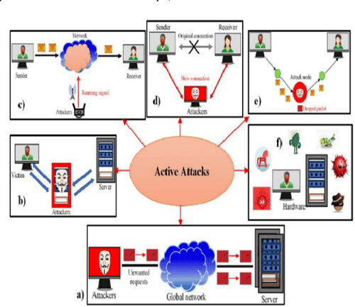
Attacks in IOT Various categories of cyber attacks:

Slide 7
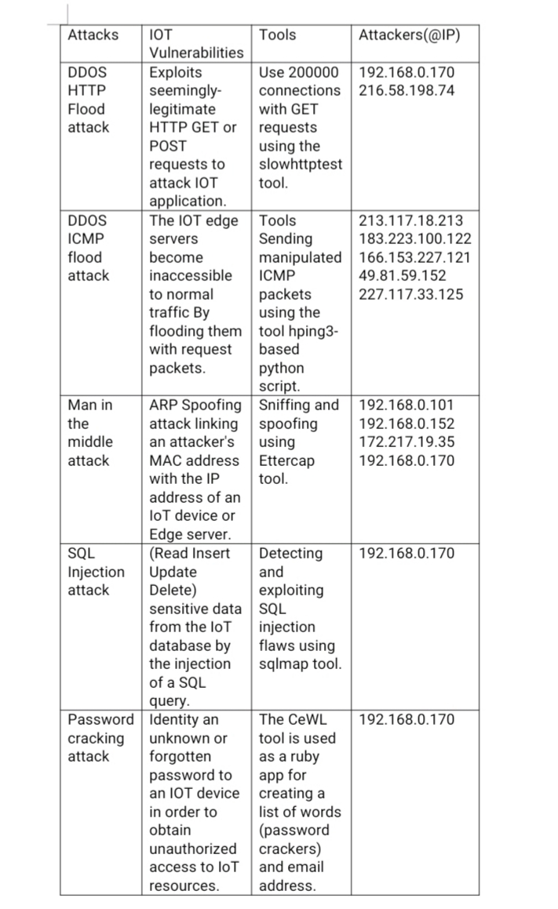
Types of attacks scenarios included in IOT dataset

Slide 8
Related Works
Machine Learning Techniques
In this section, we elucidate the diverse set of machine learning techniques employed in our thesis project, each serving a distinct purpose to address the complexities of our research objectives. The methodologies encompass Support Vector Machines(SVM), Random Forest, Decision Trees, XGBoost and CatBoost.

Slide 9
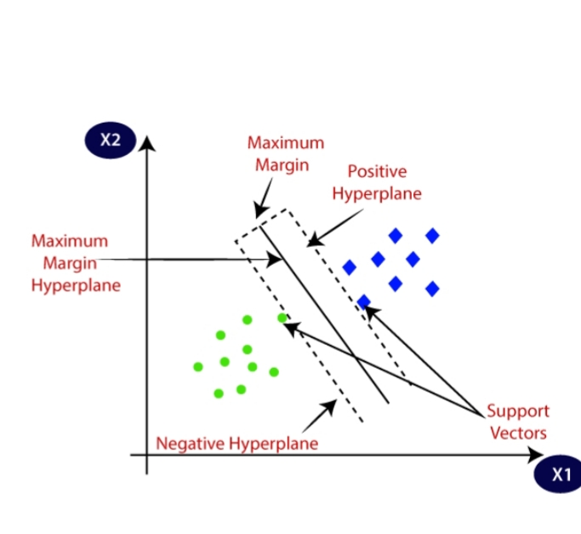
Support Vector Machine (SVM)
SVM works by finding the optimal hyperplane that best separates data points belonging to different classes in a high-dimensional space.
The key idea behind SVM is to maximize the margin, which is the distance between the hyperplane and the nearest data points from each class.

Slide 10
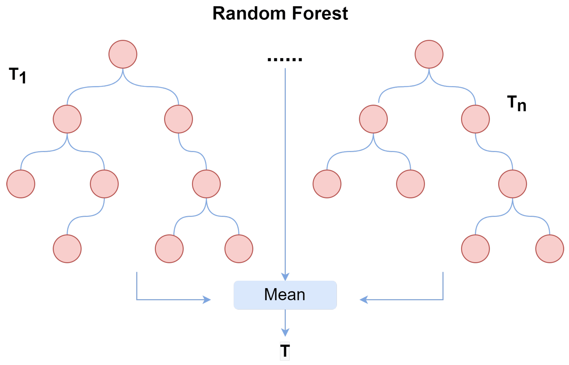
Random Forest
Random Forest is composed of a collection of decision trees, where each tree is trained independently on a random subset of the training data and a random subset of features.
This randomness helps to decorrelate the individual trees and reduces overfitting.

Slide 11
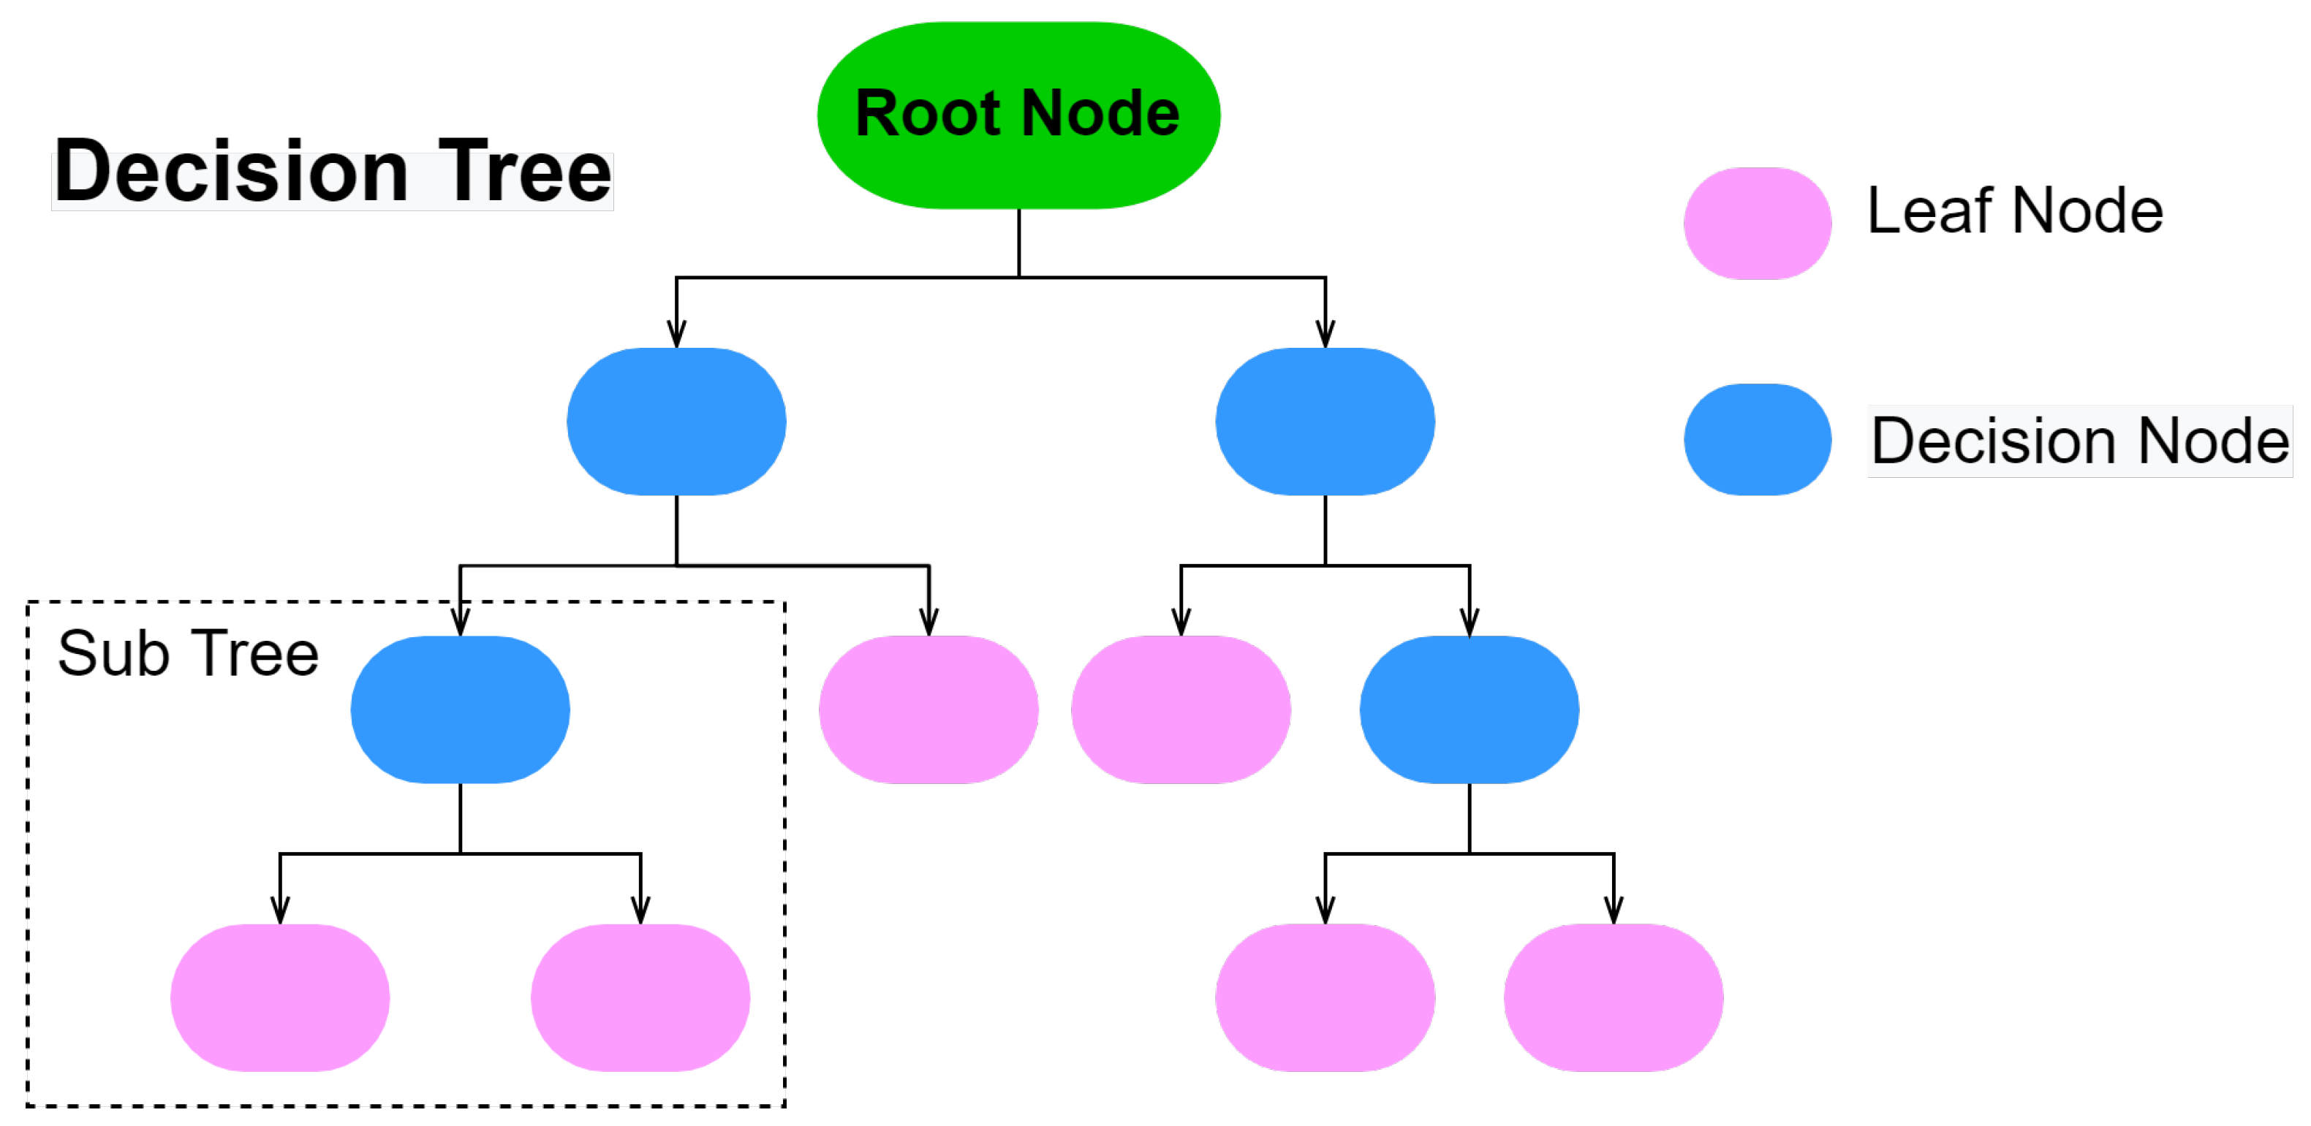
Decision Tree
A Decision Tree is a supervised learning algorithm used for both classification and regression tasks.
It's a flowchart-like structure where each internal node represents a "decision" based on a feature attribute, each branch represents the outcome of the decision, and each leaf node represents a class label or a numerical value.
Decision Trees recursively partition the feature space into subsets, based on the values of the input features, to minimize impurity or maximize information gain.

Slide 12
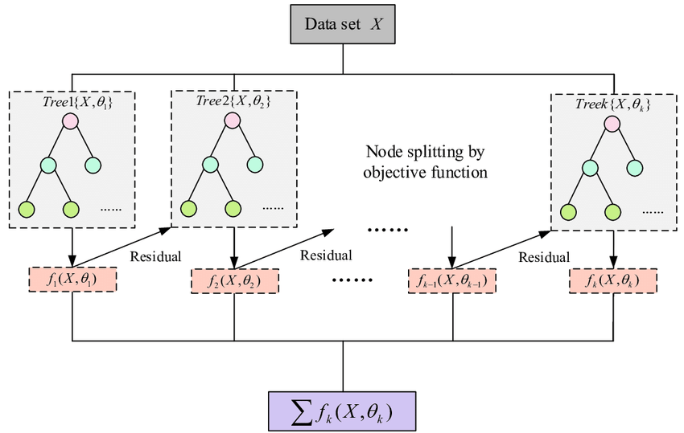
XGBoost
XGBoost is a robust machine-learning algorithm that can help you understand your data and make better decisions.
XGBoost is an implementation of gradient-boosting decision trees.
XGBoost is an optimized distributed gradient boosting library designed for efficient and scalable training of machine learning models. It is an ensemble learning method that combines the predictions of multiple weak models to produce a stronger prediction.

Slide 13
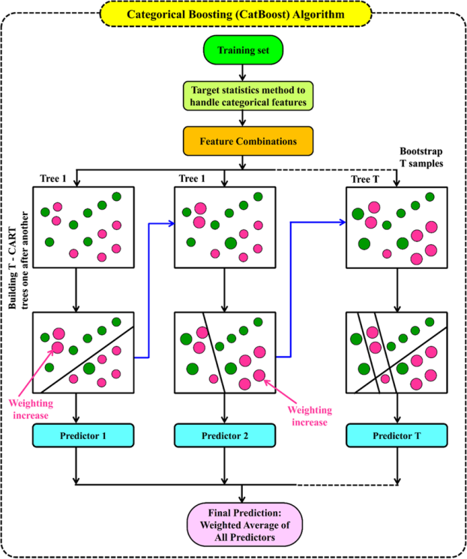
CatBoost
CatBoost is a supervised machine learning method that is used by the Train Using AutoML tool and uses decision trees for classification and regression.
Each subsequent tree improves the result of the previous tree, leading to better results.
CatBoost improves on the original gradient boost method for a faster implementation.

Slide 14
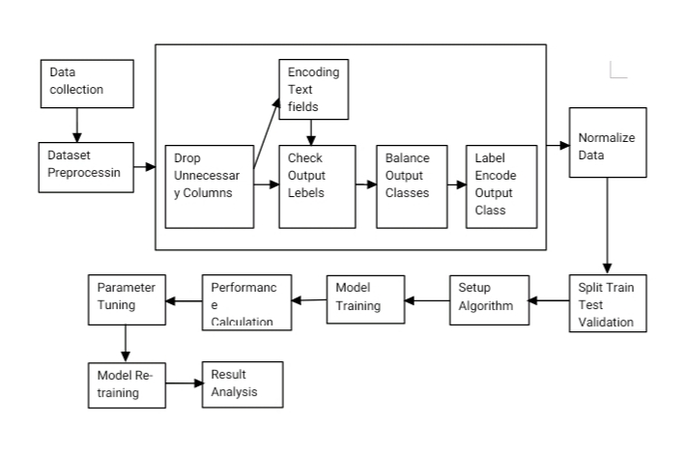
Methodology
Step by step process
System data flow diagram

Slide 15
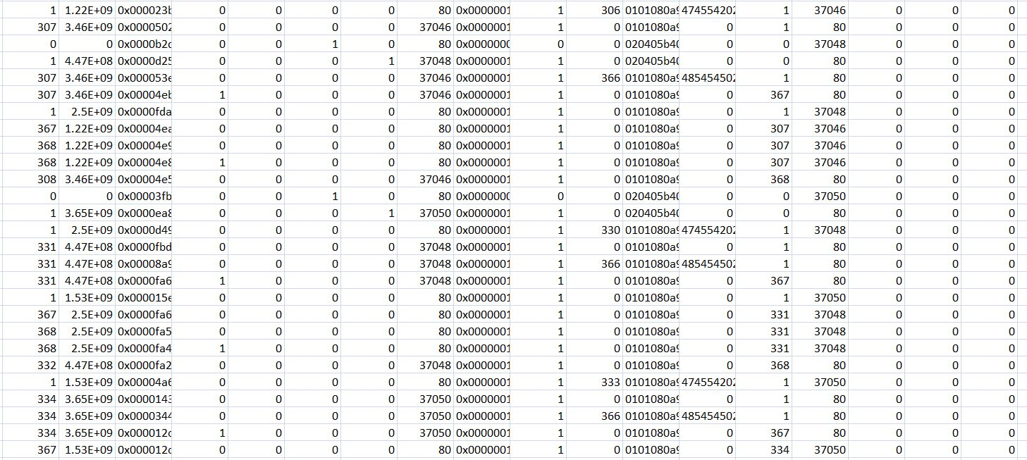
Data Samples

Slide 16
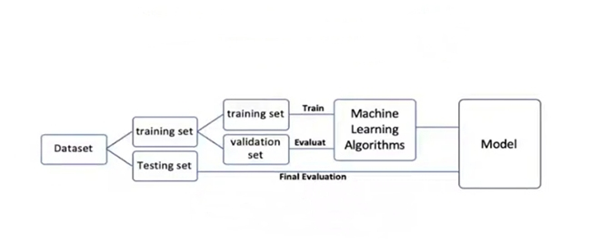
System Methods- Data analysis

Slide 17
Model Training
Train Test Splitting
Training Set:
The largest portion of the dataset, in the project 80%, is allocated for training the machine learning model. This subset is used to teach the model patterns and relationships within the data.
Validation Set:
About 20%, is designated as the validation set. This set is used during the training process to fine-tune model parameters and prevent overfitting.
Testing Set:
20%, is reservedfor testing the model's performance on unseen data. The testing set helps evaluate how well the model generalizes to new instance and assess its overall effectiveness.

Slide 18
Algorithm
XGBoost and CatBoost serves as the primary algorithm for model training.
Adopting a powerful ensemble learning approach, XGBoost, renowned for its robust gradient boosting framework and CatBoost, distinguished for its adept handling of categorical features, from a powerful tandem to address the intricacies of our specific task.
The strategic choice of these algorithms is underpinned by their proven track records in diverse applications, offering a blend of efficiency, accuracy and interpretability.

Slide 19
Model Evaluation
i. Accuracy
A model's accuracy is only a subset of the model's performance. Accuracy is one of the evaluating classification models. depicts single class accuracy measurements.
TP+TN
Accuracy=
TP+TN+FP+FN
ii. Precision
Precision means the positive predictive value. It is a measure of the number of true positives the model claims compared to the number of positives it claims. The precision value for a single class is given in the following equation
TP
Precision=
TP+FP

Slide 20
iii. Recall
Recall measures the ability of a classification model to capture and correctly identify all the relevant instances (true positives) within the dataset. It is calculated as the ratio of true positive predictions to the sum of true positives and false negatives.
TP
Recall=
TP+FN
iv. F1-Score
The F1-Score is the harmonic mean of precision and recall. It provides a balanced measure that consideres both false positives and false negatives. F1-Score is particularly useful when there is an uneven class distribution.
2×precision×recall
F1-Score=
precision+recall

Slide 21
v. Confusion matrix
A confusion matrix is a table that summarizes the performance of a classification algorithm. It presents the counts of true positive, true negative, false positive and false negative predictions. Each element in the matrix provides insights into the classification performance.

Slide 22
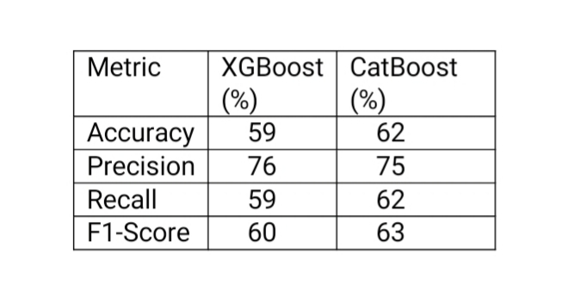
Result Analysis
Table: Result Comparison Report

Slide 23
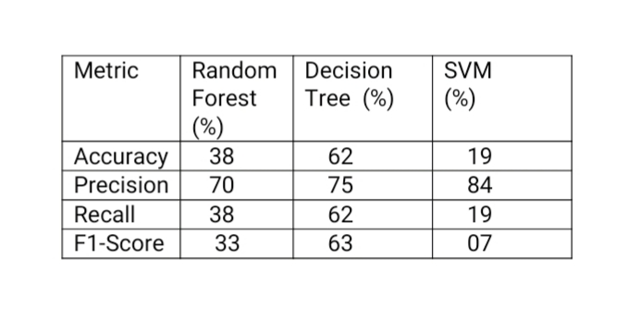
Accuracy comparison with related works
As a result, CatBoost and Decision Tree models showed the best performance compared with other models with 62% accuracy.

Slide 24
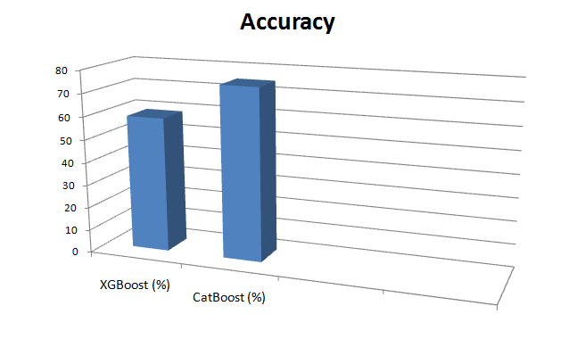
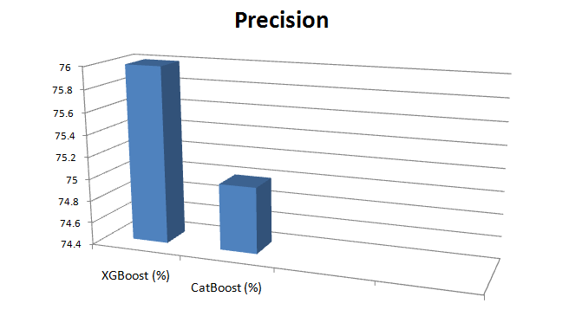
Results

Slide 25
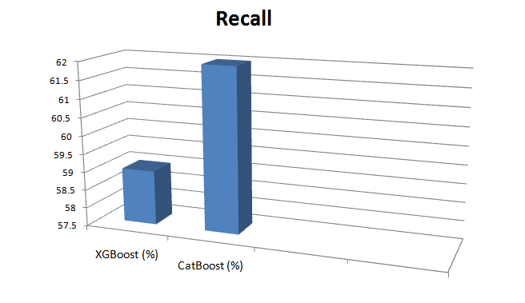
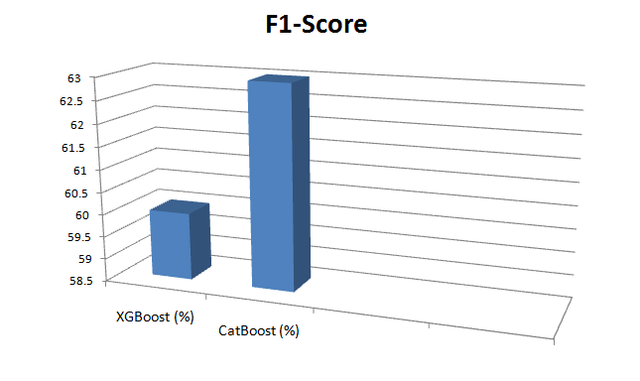
Results

Slide 26
Conclusion
Internet Of Things (IOT) has been recently one of the fastest-growing technologies around the world.
The increment of IOT devices cause a high complexity because of the increased data and requirement of their systems, also the growth of anomalies and security issues.
In this paper, different machine learning algorithms were used to detect the intrusion attacks in IOT systems.
The models were tested with different size of datasets and observed their performance by measuring cross entropy loss and accuracy for each model.
The performance if different machine learning techniques were compared for detecting IOT attacks accurately.
As a result, CatBoost and Decision Tree models have the best performance, with 62% accuracy, to detect attacks in IOT system compared with other algorithms used in this paper.

Slide 27
References
M.Zolanvari, M.A.Teixeira, L.Gupta,K.M.Khan, andR.Jain,‘‘Machinelearning-based network vulnerability analysis of industrial Internet ofThings,’’IEEE Internet Things J.,vol.6,no.4,pp.6822–6834,Aug.2019.
Edge-Iiot set Dataset. Accessed:Jan.15, 2022.[Online].Available:http://ieee-dataport.org/8939
N.Moustafa,M.Keshky,E.Debiez,andH.Janicke,‘‘FederatedTON_IoT Windows datasets for evaluating AI-based security applications,’’inProc.IEEE 19th Int.Conf.Trust,Secur.Privacy Comput.Commun.(TrustCom),
LosAlamitos,CA,USA,Dec.2020,pp.848–855.
THE INTERNET OF THINGS 2020:Here’sWhat Over 400 IoT Decision-Makers Say About the Future of Enterprise Connectivity and How IoT Companies Can Useitto GrowRevenue. Accessed:Jan.3,2022.[Online].Available:https://www.busin essinsider.com/internet-of-things-report?IR=T
THE INTERNET OF THINGS 2020:Here’s What Over400 IoT Decision-Makers Say Aboutthe Future of Enterprise Connectivity and How IoT Companies Can UseittoGrowRevenue.
Accessed:Jan.3,2022.[Online].Available:https://www.fortunebusinessinsights.com/industry-reports/internet-of-thin%gs-iot-market-100307

Slide 28
References
J.Sengupta,S.Ruj,and S.DasBit,‘‘A comprehensive survey on attacks, Security issues and block chain solutions for IoT and IIoT,’’J.Netw.Com-put.Appl.,vol.149,Jan.2020,Art.no.102481.
Kaspersky:Attackson IoT Devices DoubleinaYear. Accessed:Jan.3,2022.[Online].Available:https://iottechn
ews.com/news/2021/sep/07/kaspersky-attacks-on-iot-devices%-double-in-a-year/
Combating Ransomware. A Comprehensive Framework forAction:Key Recommendations fromthe Ransomware Task Force. Accessed:Jan.3,2022.[Online].Available:https://security And echnology.org/wp-content/uploads/2021/04/IST-Ransomwa%re-Task-Force-Report.pdf
N.Koroniotis,N.Moustafa,E.Sitnikova,and B.Turnbull,‘‘Towards the Development of realistic botnet datasetin the Internet of Things fornetwork forensican alytics:Bot-IoT data set,’’Future Gener.Comput.Syst.,vol.100, pp.779–796,2019.
Y.Meidan, M.Bohadana, Y.Mathov, Y.Mirsky, A.Shabtai,D.Breitenbacher, and Y.Elovici,‘‘N-baiot—Network-based detection ofIoT botnet attack susing deepauto encoders,’’IEEE Pervasive Comput.,
vol.17,no.3,pp.12–22,Oct.2018.

Slide 29
Thank You

