Slide 1




North Western University, Khulna
A Stacking Ensemble Based Model for the Sentiment Analysis on Bangla Movie Reviews
Presented By
Riaj Hossen ID-20201071010 | Sakib Ahmed ID-20201084010
S M Reazul Islam Rifat ID-20201139010 | Morium Akter Mithun ID: 202011152010

Slide 2

Overview
2

Slide 3
Introduction
A review that presents an author's assessment of a movie and provides either positive or negative feedback might aid viewers in following the story and making a viewing decision [1].
Bangla is the predominant language spoken by nearly 250 million people, 160 million of whom are from Bangladesh [3].
Identifying the feelings or emotions within a collection of textual data is known as sentiment analysis (SA) [6].
The main objective of sentiment analysis is to evaluate people's beliefs, attitudes, and emotions [8].
In delving into the sentiments expressed in Bengali movie comments on YouTube, this thesis aspires to enrich our understanding of the emotional dynamics within movie discussions while contributing valuable knowledge to the broader field of sentiment analysis(SA).

Slide 4
Related Works
Name | Year | Dataset Description | Model Used | Evaluation | Advantages | Disadvantages
Sharma et al. [15] | 2023 | 25,000 (Reviews) | Logistic Regression Support Vector Machine Naïve Bayes | Accuracy 70% 73% 71% | Providing recommendations for research, development, and industrial applications. | Neglects essential theoretical aspects like theoretical frameworks, dataset biases, context impact, model assessment, and ethics.
R. N. Bhavsar et al. [16] | 2023 | N/A | 1. Linear Regression 2. Logistic Regression 3. Decision Trees 4. Random Forests 5. Support Vector Machines (SVM) 6. Naive Bayes 7. K-Nearest Neighbors (KNN) 8. Clustering | N/A | New multi-label classification method developed for analyzing Assamese and Gujarati movie reviews using structured N-grams. | Improve theory, generalizability, dataset characterization, feature methods, justify algorithm choice in enhancements.
N.G.Ramadhan et al. [11] | 2022 | N/A | SVM Precision Recall | Accuracy 79% 75% 87% | Providing evidence of efficacy, suggesting future study opportunities. | Ignores feature exploration, sentiment subtleties, performance, interpretability, ethics, improvements, generalizability.

Slide 5
Related Works
Name | Year | Dataset Description | Model Used | Evaluation | Advantages | Disadvantages
Md. T. Zumma et al. [14] | 2022 | N/A | Logistic Regression Random Forest KNN | Accuracy 88% 78% 61% | Paper combines ML and NLP for sentiment analysis across diverse areas, providing methodological framework. | Bias in evaluation, dataset reliance, lacking comparison, overfitting neglect, no model interpretability discussion.
F. Zhang et al. [17] | 2021 | 91,794 (Article) | W2V+SVM W2V+SVM W2V+SVM W2V+SVM | Accuracy 85.21% 86.12% 85.89% 86.87% | Improving accuracy rates with dropout regularization and word2vec embedding in machine learning and deep learning. | Potential hindered by lack of exploration of model generalization, interpretability, future research paths, and new theoretical frameworks.
A. Tuhin et al. [12] | 2019 | 7,500 (sentences) | Naïve Bayes Topical-approach | Accuracy 70% 90% | High accuracy, thorough methodology, room for growth; significant professional advancement. | Study highlights challenges in Bangla sentiment analysis due to data scarcity and model fragility, underscoring need for diverse datasets and tailored ML models.
R.R. Chowdhury et al. [10] | 2019 | 4000 (Instances) | SVM (Tf-Idf) SVM (Count) Multinomial Naive Bayes Long Short Term Memory | Accuracy 88.90% 87.02% 88.38% 82.42% | Enhancement of sentiment analysis in Bangla movie reviews through analysis. | No consideration for dataset size, class imbalances.

Slide 6
6
Objective
Create a new dataset.
Preprocess the dataset.
Feature Extraction.
Compare ML, DL and BERT algorithms.
Improve Accuracy.
Stacking Model.
Beat the existing works.
Apply LIME and SHAP.

Slide 7
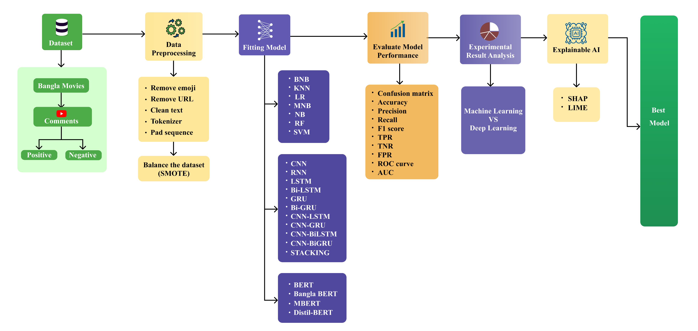
Methodology
Figure 1. Operational process of text classification from YouTube

Slide 8
8
YouTube Data Sources
Name | Year
Password | October 4, 2019
Nirsartho bhalobasha | August 8, 2013
Most welcome | August 20, 2012
Hridoy Bhanga Dheu | 2011
Molla Barir Bou | 2005
goriber tarzen | 2019
palta jobab | 2018
tokai | 2021
Ammajan | June 25, 1999
Monpura | February 13, 2009
Hajar Bochor Dhore | 2005
Uttarer Sur | April 14, 2012
Leader Ami Bangladesh | April 22, 2023
Golam | 2009
Mar Chakka | 2021
Tumi Acho Tumi Nei | 2022
Sujon Majhi | 2023
Hero Alom The Gangster | 2021
My name is simi | 2017
Nisshartho bhalobasha | 2018
prem korbo tomar sathe | 2019
Shedin brishty cilo | 2019
Gharer bou | Jun 26, 2019
Boro Bou | Nov 20, 2022
loafer | Feb 8, 2021
Chowdhury paribar | Sep 1, 2019
vidyasagar | Jan 3, 2017
Ei bheja rate | Jun 18,2019
Bir | Jun 29,2023
valobasha zindabad | Oct 14,2018
O shathi re | May 31,2016
Chotto shongshar | Mar 4,2017
Most Welcome 2 | 2017
Paglami | 2018

Slide 9
9
Dataset
Table 1. A Synopsis of the Data Set
Sentiment | Quantity of Reviews | Overall Reviews
Positive | 11,394 | 22,789
Negative | 11,395

Slide 10
Data Preprocessing
10
Non-Bangla Words, Punctuation, URLs and Emoticon Removal
Emoticon Removal
Example- "খুবই জঘন্য ও নিম্নমানের মুভি। 😒🧐”
"খুবই জঘন্য ও নিম্নমানের মুভি।“
Stemming
Example- “দৌড়ে” (runner), “রানার” (run), “রান” (run), “রান” (run).
Common form- “রান” (run)
Stop Words Removal
Example- "এই মুভিটা দেখলে হাসির ঝর্না ভেসে আসবে, অভিনয় সাধারণ নয়, অস্থির গান। অবশ্যই দেখতে যাবো!“
"এই ছবিটা হাসির ঝর্না ভেসে আসবে, অভিনয় সাধারণ নয়, সুপার গান। দেখতে যাবো!“
Lemmatization
Example- "শাবনূর মানেই সেই, মুভিটা অবশেষে খুঁজে পাইছি "
"শাবনূর মান সেই, মুভি অবশেষ খুঁজ পাওয়া "

Slide 11
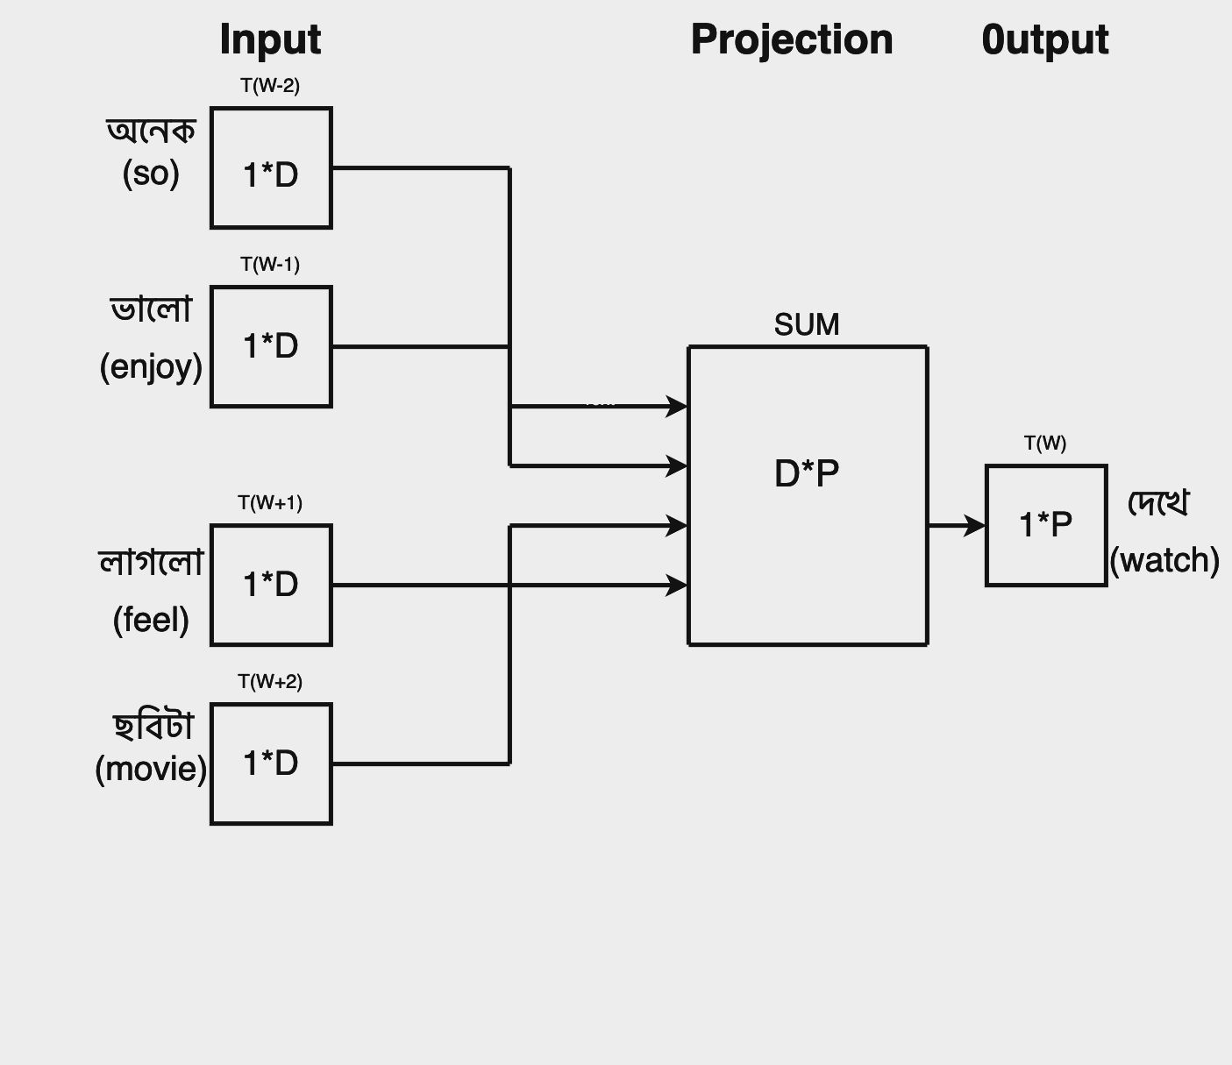
11
Feature Extraction
Feature Extraction
Bag-of-Words (BOW)
Word Embedding
The bag-of-words (BoW) model is a simple yet powerful technique used in natural language processing for text representation. It represents text data as a bag, or multiset, of words, disregarding grammar and word order but keeping track of word frequency. The BoW model operates on the principle of word frequency, assigning importance to words based on their occurrence rather than their position or context within the text.
Figure 2. Word Embedding

Slide 12
12
Experimental Results (ML)
Table 2. Obtained results of applied ML algorithms
Model | Sentiment | Precision | Recall | F1-Score | Accuracy (%) | Area Under curve (AUC) value | Mean Squared Error (MSE) value
BNB | Positive | 0.86 | 0.69 | 0.77 | 79.06 | 0.88 | 0.20
 | Negative | 0.74 | 0.89 | 0.81
SVM | Positive | 0.85 | 0.77 | 0.81 | 81.63 | 0.92 | 0.15
 | Negative | 0.79 | 0.87 | 0.83
KNN | Positive | 0.82 | 0.70 | 0.75 | 77.14 | 0.84 | 0.23
 | Negative | 0.74 | 0.84 | 0.79
LR | Positive | 0.86 | 0.69 | 0.77 | 83.55 | 0.90 | 0.17
 | Negative | 0.80 | 0.87 | 0.83
MNB | Positive | 0.82 | 0.80 | 0.81 | 81.08 | 0.89 | 0.18
 | Negative | 0.81 | 0.82 | 0.81
RF | Positive | 0.86 | 0.86 | 0.86 | 86.00 | 0.93 | 0.14
 | Negative | 0.86 | 0.86 | 0.86

Slide 13
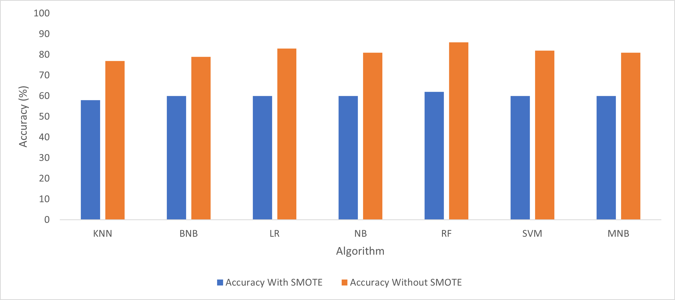
13
Experimental Results (ML)
Figure 3. Accuracy overview of the implemented ML algorithms

Slide 14
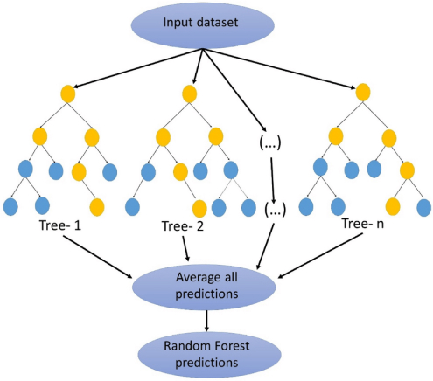
14
Experimental Results (ML)
BEST ML Model
Figure 4. Random Forest (RF)

Slide 15
Experimental Results (DL)
15
Table 2. Obtained results of applied DL algorithms
Model | Sentiment | Precision | Recall | F1-Score | Accuracy (%) | Area Under Curve (AUC) Value | Mean Squared Error (MSE) Value
CNN | Positive | 0.89 | 0.88 | 0.88 | 90.31 | 0.95 | 0.10
 | Negative | 0.88 | 0.89 | 0.88
RNN | Positive | 0.86 | 0.92 | 0.89 | 89.38 | 0.94 | 0.12
 | Negative | 0.91 | 0.85 | 0.88
LSTM | Positive | 0.88 | 0.89 | 0.88 | 88.02 | 0.92 | 0.11
 | Negative | 0.89 | 0.87 | 0.88
Bi- LSTM | Positive | 0.88 | 0.90 | 0.89 | 88.78 | 0.94 | 0.14
 | Negative | 0.90 | 0.87 | 0.88
GRU | Positive | 0.89 | 0.88 | 0.88 | 88.39 | 0.94 | 0.11
 | Negative | 0.88 | 0.89 | 0.88
Bi-GRU | Positive | 0.87 | 0.90 | 0.89 | 88.74 | 0.94 | 0.11
 | Negative | 0.90 | 0.87 | 0.88
CNN-LSTM | Positive | 0.66 | 0.58 | 0.61 | 60.35 | 0.71 | 0.32
 | Negative | 0.60 | 0.61 | 0.60
CNN-GRU | Positive | 0.88 | 0.88 | 0.88 | 89.78 | 0.91 | 0.14
 | Negative | 0.89 | 0.89 | 0.89
CNN-BiLSTM | Positive | 0.90 | 0.89 | 0.89 | 88.38 | 0.94 | 0.11
 | Negative | 0.89 | 0.90 | 0.89
CNN-BiGRU | Positive | 0.88 | 0.90 | 0.89 | 89.19 | 0.93 | 0.13
 | Negative | 0.90 | 0.87 | 0.89
Stacking | Positive | 0.93 | 0.94 | 0.94 | 94.36 | 0.96 | 0.09
 | Negative | 0.94 | 0.93 | 0.94

Slide 16
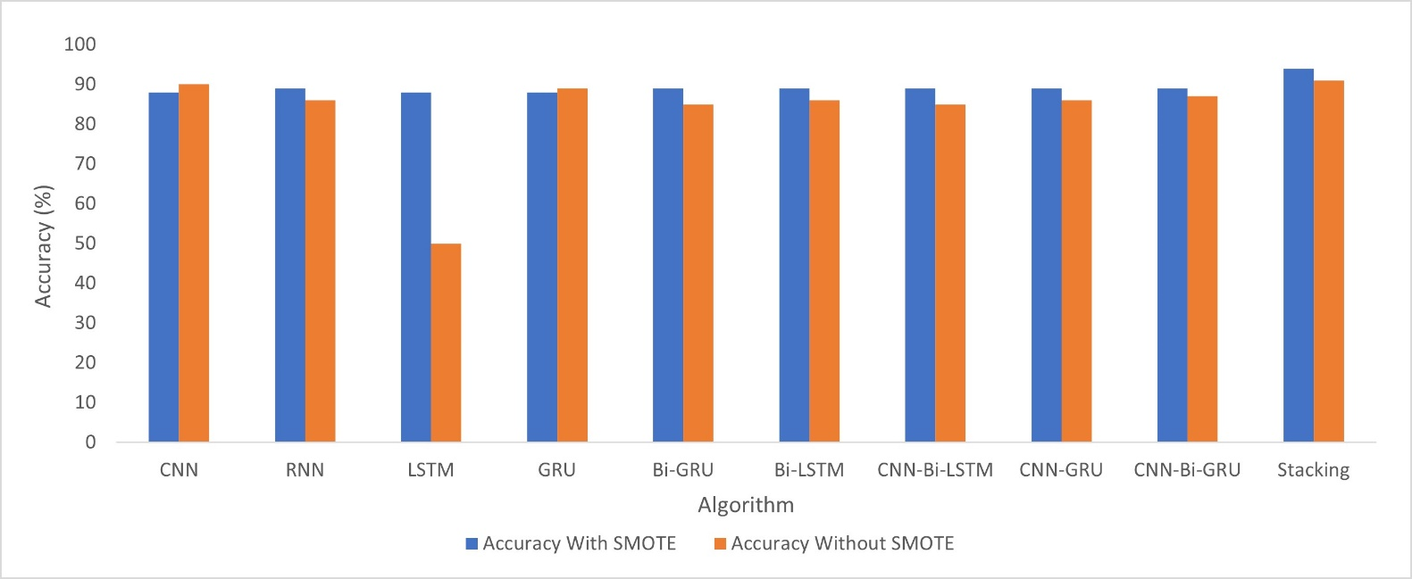
Experimental Results (DL)
16
Figure 5. Accuracy overview of the implemented DL algorithms

Slide 17
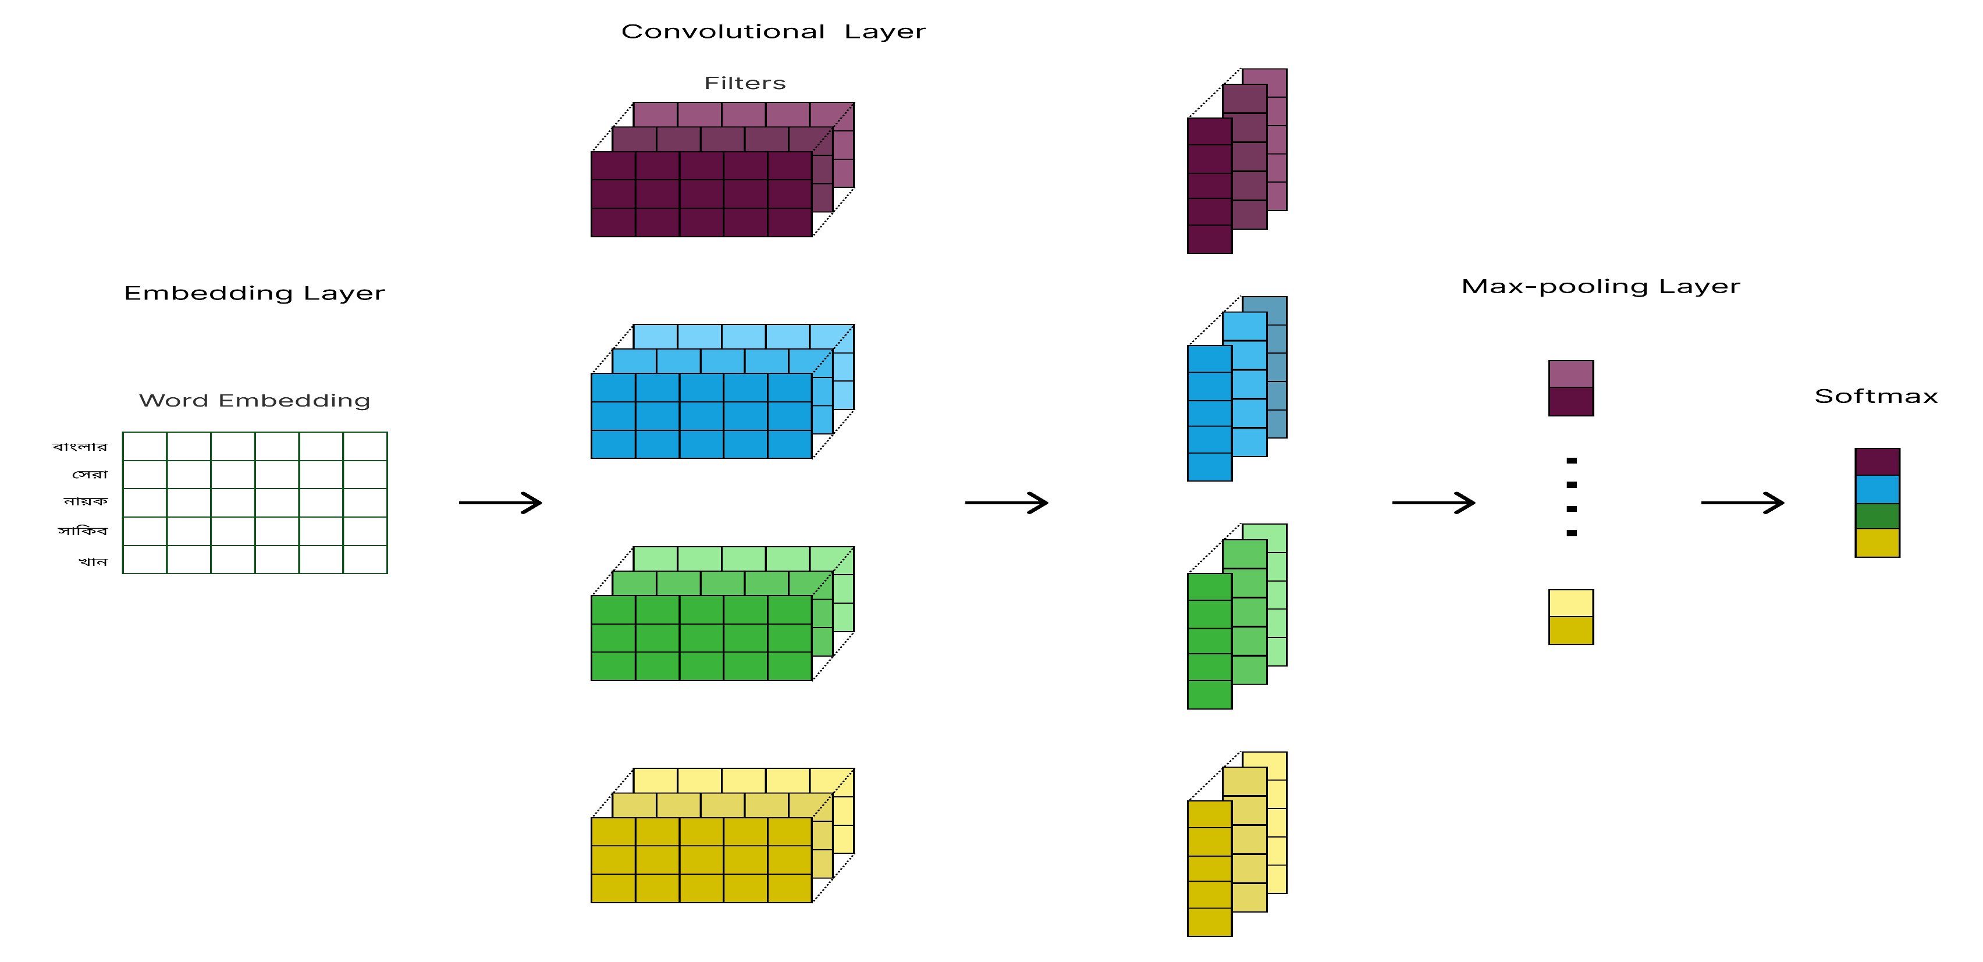
Experimental Results (DL)
17
BEST DL Model
Figure 6. Convolutional Neural Network (CNN)

Slide 18
Experimental Results (BERT)
18
Table 4. Obtained results of applied BERT algorithms
Model | Sentiment | Precision | Recall | F1-Score | Accuracy (%) | Area Under curve (AUC) value | Mean Squared Error (MSE) value
BERT | Positive | 0.82 | 0.90 | 0.86 | 90.60 | 0.91 | 0.17
 | Negative | 0.89 | 0.81 | 0.85
mBERT | Positive | 0.94 | 0.90 | 0.92 | 92.30 | 0.90 | 0.16
 | Negative | 0.91 | 0.94 | 0.92
Bangla-BERT | Positive | 0.94 | 0.88 | 0.91 | 91.25 | 0.91 | 0.10
 | Negative | 0.89 | 0.94 | 0.91
Distil-BERT | Positive | 0.90 | 0.90 | 0.90 | 89.66 | 0.75 | 0.25
 | Negative | 0.88 | 0.92 | 0.90

Slide 19
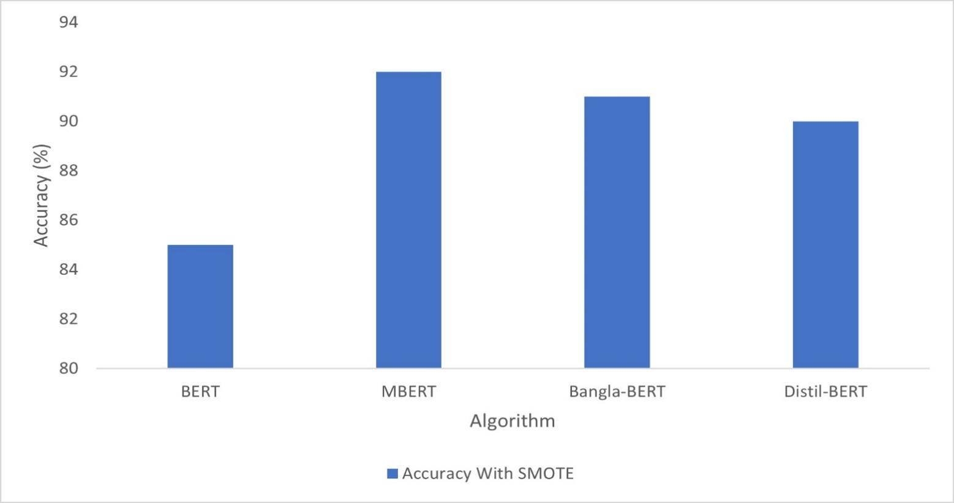
Experimental Results (BERT)
19
Figure 7. Accuracy overview of the implemented BERT algorithms

Slide 20
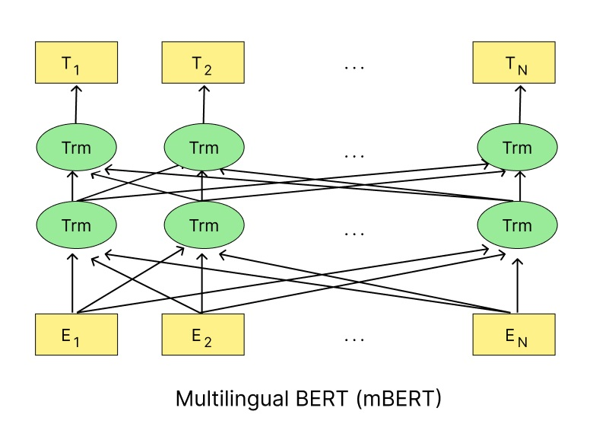
Experimental Results (BERT)
20
BEST BERT Model
Figure 8. multilingual Bidirectional Encoder Representations from Transformers (mBERT)

Slide 21
ML vs DL vs BERT
21
Performance Comparison
Table 5. Performance comparison among machine learning, deep learning, ensemble learning and BERT based transfer learning algorithms
Domain | Model | Precision | Recall | F1-Score | Accuracy (%) | Area Under curve (AUC) value | Mean Squared Error (MSE) value
ML | RF | 0.86 | 0.86 | 0.86 | 86.00 | 0.93 | 0.14
DL | CNN | 0.89 | 0.89 | 0.88 | 90.31 | 0.94 | 0.10
Ensemble | Stacking | 0.94 | 0.93 | 0.94 | 94.36 | 0.96 | 0.09
BERT-based TL | mBERT | 0.92 | 0.92 | 0.92 | 92.30 | 0.90 | 0.16

Slide 22
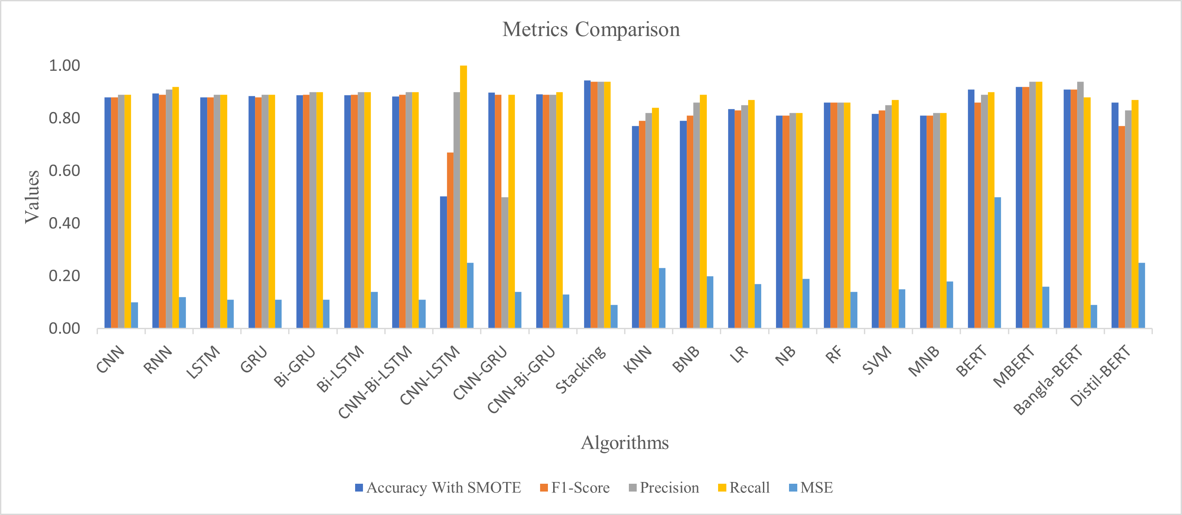
Accuracy overview
22
Figure 9. Accuracy overview of the implemented algorithms

Slide 23
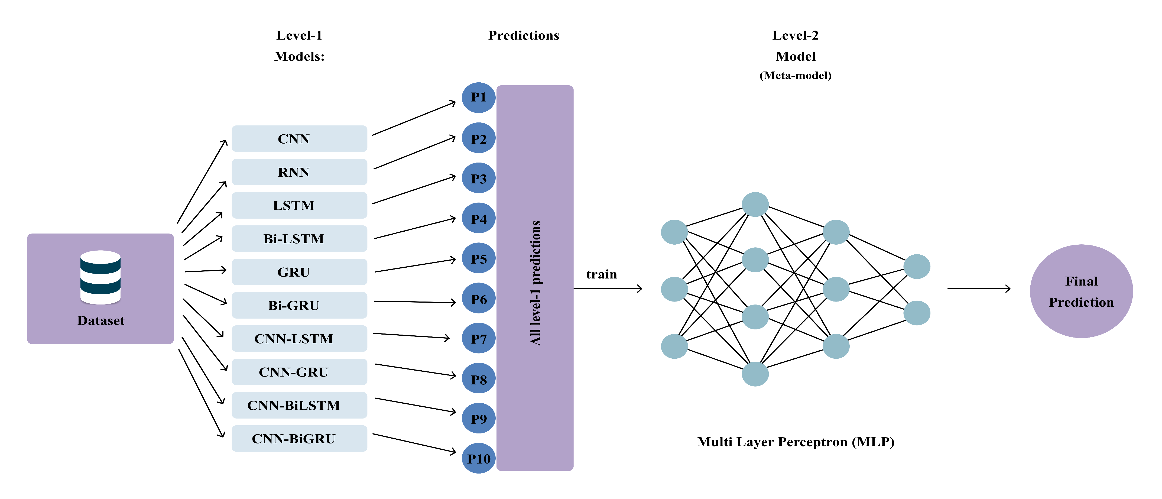
Stacking Ensemble Based Model
23
Architecture of stacking ensemble model
Figure 10. Architecture of stacking ensemble model

Slide 24
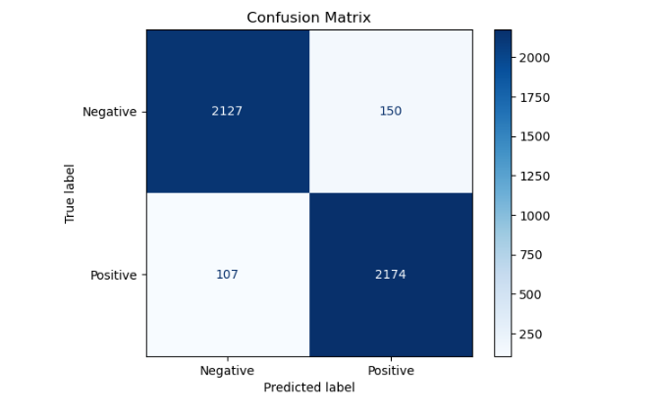
Stacking Ensemble Based Model
24
Confusion Matrix and ROC Curve of stacking ensemble model
Figure 11. Confusion matrix of the proposed stacking ensemble model

Slide 25
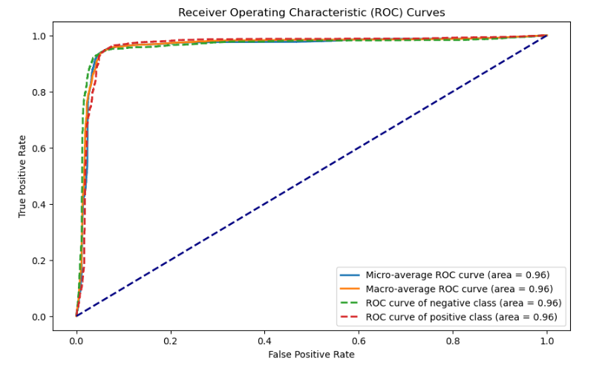
Stacking Ensemble Based Model
25
Receiver Operating Characteristic (ROC) Curve of Stacking ensemble model
Figure 12. ROC Curve of the proposed stacking ensemble model

Slide 26
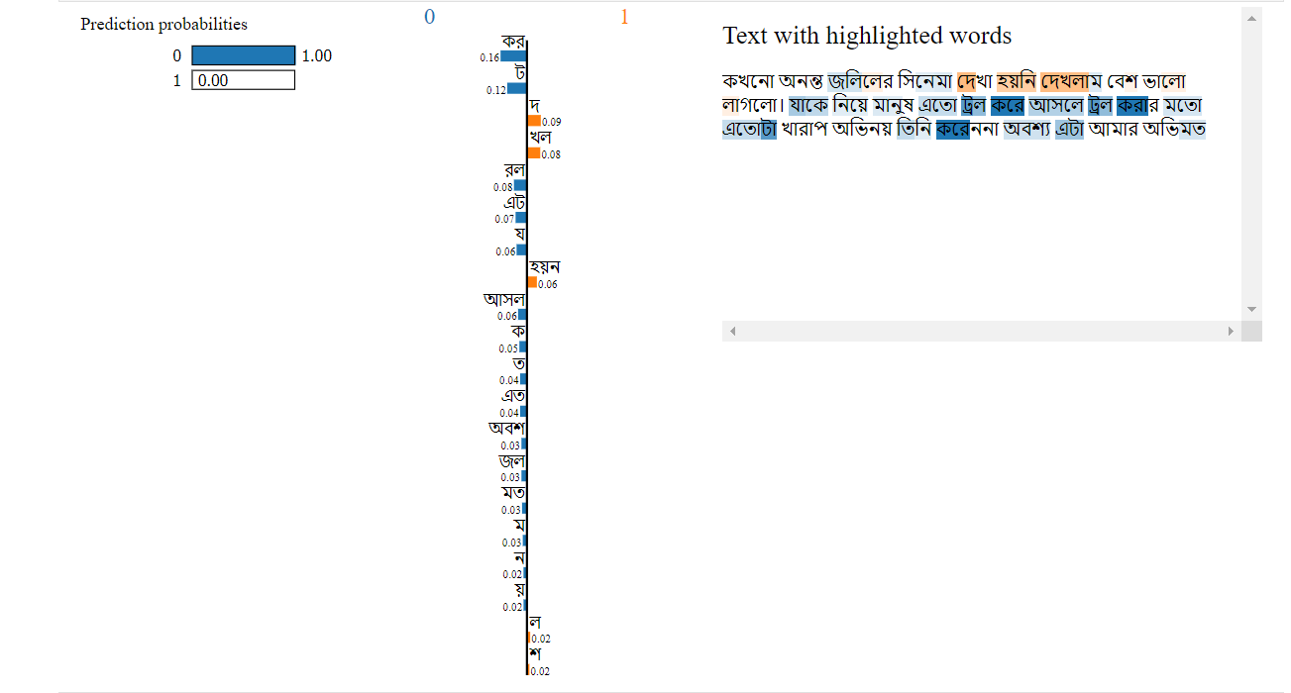
Stacking Ensemble Based Model
26
LIME EXPLAINABILITY
Fig. 13. LIME explanation of a Bangla movie review

Slide 27
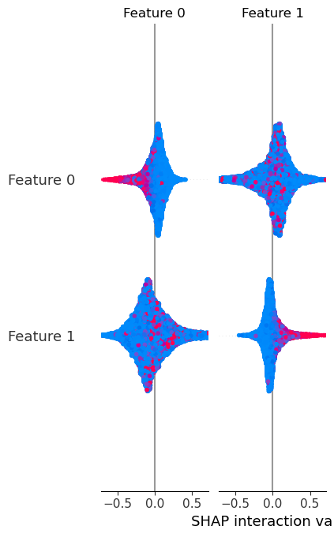
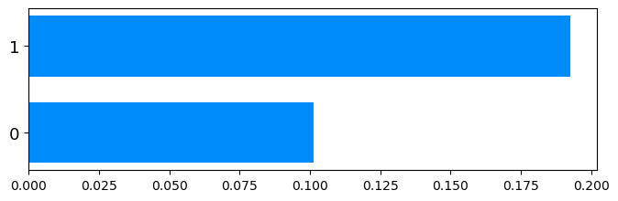
Stacking Ensemble Based Model
27
SHAP EXPLAINABILITY
(a) | (b)
Fig. 14. SHAP explanation of the Stacking model; (a) class wise Shapley value usage plot (b) beeswarm summary plot

Slide 28
Comparison with Existing Works
28
Name | Year | Dataset used | Best Model | Accuracy (%) | Statistical Test | Explainable AI
R. R. Chowdhury et al. [1] | 2019 | 4000 | SVM | 88.90 | No | No
P. Saha et al. [10] | 2021 | 4000 | LSTM | 84.25 | No | No
R. Rahman et al. [11] | 2021 | 3000 | MNB | 86.00 | No | No
H. Jahan et al. [9] | 2023 | 1000 | RF | 92.35 | No | No
Our Proposed | 2024 | 22,789 | Stacking | 94.36 | Yes (Friedman Test) | Yes (LIME & SHAP)

Slide 29
Conclusion and Future Works
29
No benchmark datasets for SA on Bangla Movie Reviews
Developed one of the largest Bangla Movie dataset of 22,789 comments.
10 deep learning models.
A Stacking ensemble model comprising of the 10 DL models as base classifiers and Multi-Layer Perceptron (MLP) as meta classifier.
Our Stacking Model achieves an outstanding accuracy of 94.36%.
Friedman Test is significant at p<0.05.
Apply LIME and SHAP, “কর” (best feature for Stacking)

Slide 30
30
References
[1] ACME, “The Significance of a Film Review”, retrieved on: December 22, 2018, from: www.revue-acme.com.
[2] Mshne, Gilad and Natalie Glance, (2006), “Predicting Movie Sales from Blogger Sentiment”, AAAI Spring Symposium: Computational Approaches to Analyzing Weblogs, PP 1-4.
[3] A. Akther, M. S. Islam, H. Sultana, A. R. Rahman, S. Saha, K. M. Alam, R. Debnath, “Compilation, Analysis and Application of a Comprehensive Bangla Corpus KUMono,” IEEE Access, vol. 10, pp. 79999-80014, 2022, doi: 10.1109/ACCESS.2022.3195236.
[4] G. M. Shahariar, M. T. R. Shawon, F. M. Shah, M. S. Alam, M. S. Mahbub, “Bengali Fake Reviews: A Benchmark Dataset and Detection System,” arXiv:2308.01987v1. https://doi.org/10.48550/arXiv.2308.01987.
[5] M. I. H. Junaid, F. Hossain, U. S. Upal, A. Tameem, A. Kashim, A. Fahmin, “Bangla Food Review Sentimental Analysis using Machine Learning,” 2022 IEEE 12th Annual Computing and Communication Workshop and Conference (CCWC), Las Vegas, NV, USA, pp. 0347-0353, 2022, doi: 10.1109/CCWC54503.2022.9720761.
[6] J. K. Adarsh, V. T. Sreedevi, D. Thangavelusamy, “Product Review System with BERT for Sentiment Analysis and Implementation of Administrative Privileges on Node-RED,” in IEEE Access, vol. 11, pp. 65968-65976, 2023, doi: 10.1109/ACCESS.2023.3275738.
[7] M. I. H. Junaid, F. Hossain, U. S. Upal, A. Tameem, A. Kashim, A. Fahmin, “Bangla Food Review Sentimental Analysis using Machine Learning,” 2022 IEEE 12th Annual Computing and Communication Workshop and Conference (CCWC), Las Vegas, NV, USA, pp. 0347-0353, 2022, doi: 10.1109/CCWC54503.2022.9720761.
[8] A. S. Talaat, “Sentiment analysis classification system using hybrid BERT models,” J Big Data, vol. 10, no. 1, Dec. 2023, doi: 0.1186/s40537-023-00781-w.

Slide 31
Thank You

