Slide 1

North Western University, Khulna
BANGLA WEB SERIES REVIEW ANALYSIS USING DEEP LEARNING AND BERT BASED APPROACHES
Presented By
Md. Asif Salman (20201079010)
Richi Jerald (20201083010)
Mushfiqul Islam (20201104010)

Slide 2
Overview
Introduction
Related Works
Methodology
Experimental Results and Analysis
Conclusions and Future Works

Slide 3
Introduction
Sentiment Analysis (SA): A person’s view on a particular topic [1].
Web Series review analysis: Part of SA
Bangla Web Series become more popular.
Over 250 million people use Bangla everyday [2].
Dearth of resources for Bangla SA based works (e.g. Web Series Review) [3].

Slide 4
Related Works
Name | Year | Dataset Used | Best Model | Accuracy
J. K. Adarsh et al [1] | 2023 | 1040 | BERT | 93.31%
N. Hossain et al. [2] | 2020 | 10,861 | CNN-LSTM | 82.50%
N. J. Prottasha et al. [3] | 2022 | 15,018 | BERT | 87.00%

Slide 5
Objective
Create a new dataset.
Preprocess dataset
Compare DL and BERT algorithms.
Improve accuracy.
Beat the existing works.

Slide 6
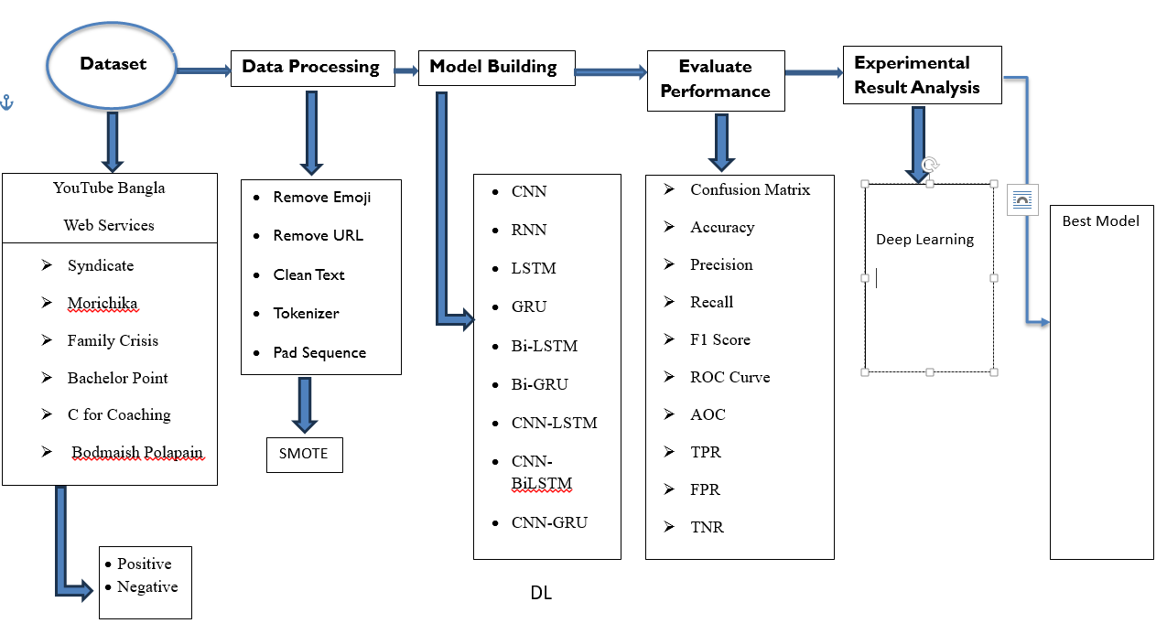
Methodology
System Architecture

Slide 7
Dataset
Sentiment | Number of reviews | Total Reviews
Positive | 8737 | 17219
Negative | 8482
The dataset has been divided into training and test sets at a ratio of 80% to 20%. We have collected 8737 positive comments and 8482 negative comments so class distribution of comments are almost similar.

Slide 8
Data Preprocessing
Removing non-Bangla words, punctuation, URLs, special characters, emoticon and so on.
Stemming
Example: “সিরিজটা দারুন উপভোগ করতেছিলাম” “সিরিজ দারুন উপভোগ করি”
Lemmatization
Example: “সিরিজটা সুন্দর লাগছে” “সিরিজ সুন্দর লাগে”
Stop words removal
Example: “বরং”(rather), “কিন্তু”(but), “নতুবা”(or), “যদি”(if), "এই“(this), "হয়“(is) etc.

Slide 9
Data Preprocessing
Feature Extraction
Dataset comprising 17,219 comments using Word2Vec, a prominent word embedding technique in natural language processing (NLP).
Word2Vec algorithm uses a neural network to learn word embeddings from a large corpus of text data.

Slide 10
Experimental Results (Deep Learning)
Models | Sentiment | Precision | Recall | F1-Score | Accuracy | AUC | MSE | Without Smote
CNN | Positive | 0.98 | 0.99 | 0.98 | 0.9849 | 0.997 | 0.016 | 0.9831
 | Negative | 0.99 | 0.98 | 0.98
RNN | Positive | 0.99 | 0.98 | 0.98 | 0.9843 | 0.996 | 0.015 | 0.9770
 | Negative | 0.98 | 0.99 | 0.98
LSTM | Positive | 0.65 | 0.49 | 0.65 | 0.4863 | 0.502 | 0.513 | 0.4852
 | Negative | 0.49 | 0.58 | 0.65
GRU | Positive | 0.99 | 0.98 | 0.98 | 0.9840 | 0.997 | 0.015 | 0.9828
 | Negative | 0.98 | 0.99 | 0.98
Bi-GRU | Positive | 0.99 | 0.98 | 0.98 | 0.9834 | 0.997 | 0.016 | 0.9822
 | Negative | 0.98 | 0.99 | 0.98
Bi-LSTM | Positive | 0.98 | 0.98 | 0.98 | 0.9819 | 0.995 | 0.018 | 0.9767
 | Negative | 0.98 | 0.98 | 0.98
CNN-Bi-LSTM | Positive | 0.98 | 0.98 | 0.98 | 0.9817 | 0.995 | 0.018 | 0.9817
 | Negative | 0.98 | 0.98 | 0.98
CNN-GRU | Positive | 0.99 | 0.98 | 0.99 | 0.9851 | 0.996 | 0.014 | 0.9811
 | Negative | 0.98 | 0.99 | 0.98
CNN-LSTM | Positive | 0.51 | 0.60 | 0.68 | 0.5135 | 0.489 | 0.486 | 0.5136
 | Negative | 0.68 | 0.51 | 0.68
CNN-Bi-GRU | Positive | 0.98 | 0.99 | 0.99 | 0.9849 | 0.997 | 0.015 | 0.9869
 | Negative | 0.99 | 0.98 | 0.98
Stacking | Positive | 0.99 | 0.99 | 0.99 | 0.9915 | 0.991 | 0.008 | 0.9887
 | Negative | 0.99 | 0.99 | 0.99

Slide 11
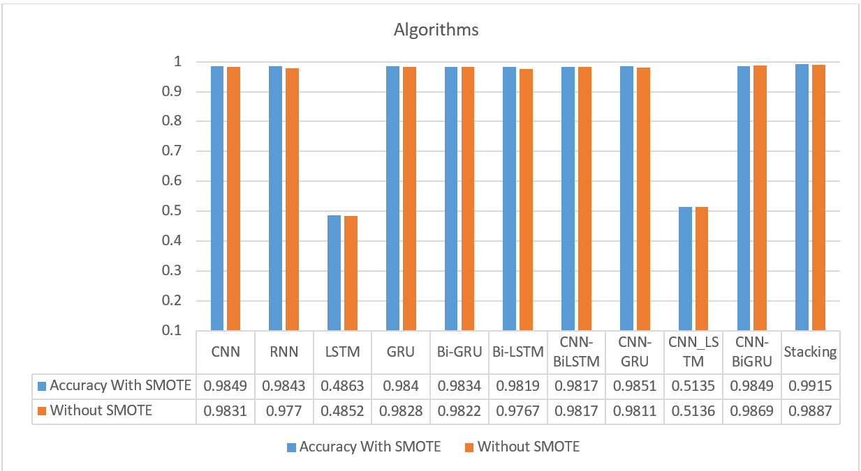
Experimental Results (Deep Learning)

Slide 12
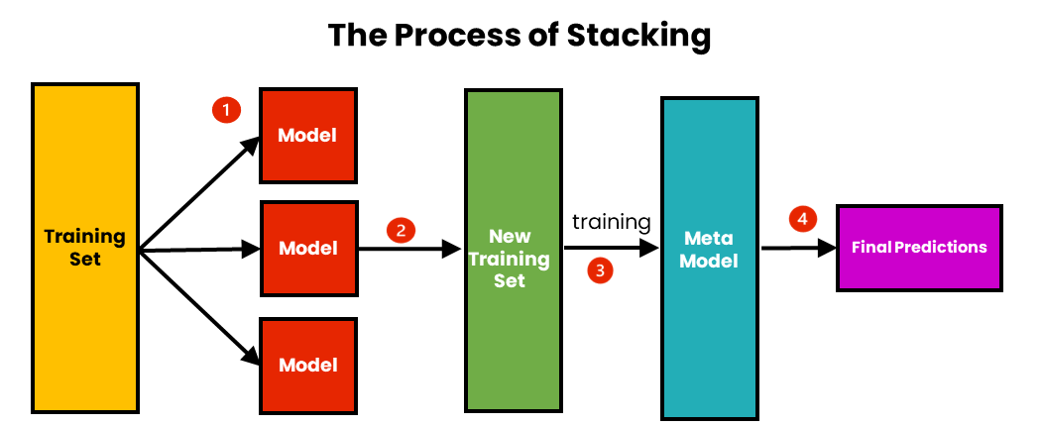
Experimental Results (Deep Learning)
Stacking obtained the highest scores for f1-score and accuracy is 0.9915

Slide 13
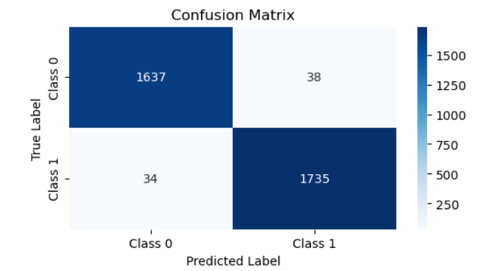
Confusion Matrix of Stacking

Slide 14
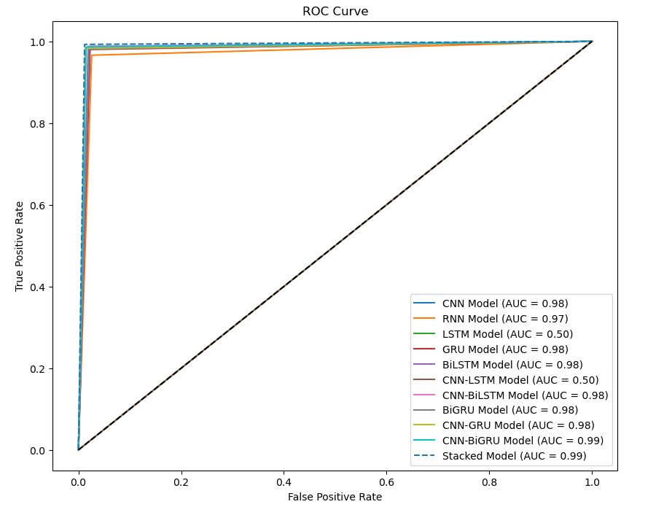
ROC Curve of Stacking Model

Slide 15
Experimental Results (BERT)
Model | Precision | Recall | F1-score | Accuracy
BERT | 0.976 | 0.976 | 0.976 | 0.976
Bangla-BERT | 0.992 | 0.992 | 0.992 | 0.992
MBert | 0.984 | 0.984 | 0.984 | 0.984
Distil-Bert | 0.968 | 0.966 | 0.966 | 0.966

Slide 16
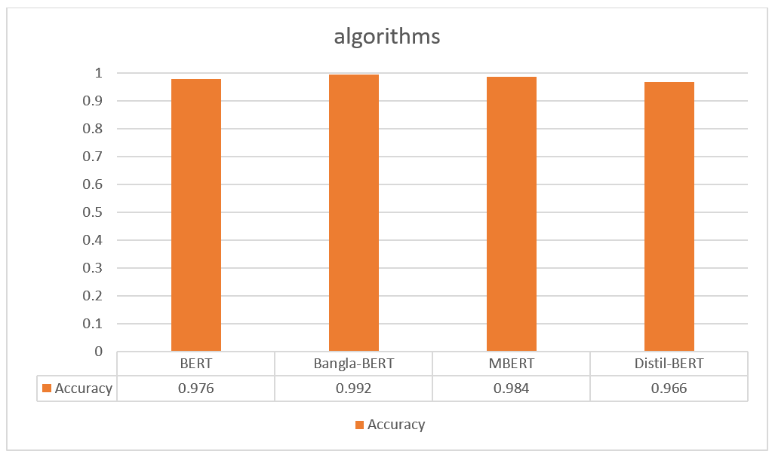
Experimental Results (BERT)
Bangla-BERT obtained the highest scores for f1-score, accuracy is 0.992 among all BERT models.

Slide 17
Comparison between DL and BERT
Domain | Algorithm | F1-Score | Accuracy | AUC | MSE
DL | Stacking | 0.99 | 0.9915 | 0.991 | 0.008
BERT | Bangla-BERT | 0.992 | 0.992 | - | -

Slide 18
Comparison between DL and BERT
Our Stacking model achieves an accuracy of 0.9915 and an f1 score of 0.99.
Banga-BERT achieves also same accuracy 0.992.
These outstanding results in the field of Bangla sentiment analysis are comparable to some existing works.

Slide 19
Conclusion
Constructed dataset: Curated 17,219 Bangla web series reviews from YouTube, manually annotated for sentiment analysis.
Importance of sentiment analysis: Provides subtle understanding of public opinion in Bangla web series comments.
SMOTE application: Significantly improved model performance by addressing class imbalance.
Model comparison:
Stacking and Bangla-BERT: Achieved highest accuracy of 99% each, outperforming other models.
Stacking DL method: Superior performance over basic deep learning approaches.
Bangla-BERT method: Excelled within BERT models for Bangla web series sentiment analysis.

Slide 20
Future Works
We plan to further balance and improve our dataset,
explore several hybrid and stacking feature extraction methodologies for the Sentiment Analysis on Bangla Web series Reviews,
Employ transformer-based learning in the future.

Slide 21
References
[1] J. K. Adarsh, V. T. Sreedevi, D. Thangavelusamy, “Product Review System With BERT for Sentiment Analysis and Implementation of Administrative Privileges on Node-RED,” in IEEE Access, vol. 11, pp. 65968-65976, 2023, doi: 10.1109/ACCESS.2023.3275738.
[2] M. I. H. Junaid, F. Hossain, U. S. Upal, A. Tameem, A. Kashim, A. Fahmin, “Bangla Food Review Sentimental Analysis using Machine Learning,” 2022 IEEE 12th Annual Computing and Communication Workshop and Conference (CCWC), Las Vegas, NV, USA, pp. 0347- 0353, 2022, doi: 10.1109/CCWC54503.2022.9720761.
[3] A. S. Talaat, “Sentiment analysis classification system using hybrid BERT models,” J Big Data, vol. 10, no. 1, Dec. 2023, doi: 10.1186/s40537-023-00781-w.
[4] G. M. Shahariar, M. T. R. Shawon, F. M. Shah, M. S. Alam, M. S. Mahbub, “Bengali Fake Reviews: A Benchmark Dataset and Detection System,” arXiv:2308.01987v1. https://doi.org/10.48550/arXiv.2308.01987.
[5] M. Hasan, L. Islam, I. Jahan, S. M. Meem, R. M. Rahman, “Natural Language Processing and Sentiment Analysis on Bangla Social Media Comments on Russia– Ukraine War Using Transformers,” Vietnam Journal of Computer Science, Vol. 10, No. 03, pp. 329-356, 2023, https://doi.org/10.1142/S2196888823500021.
[6] E. R. Rhythm, R. A. Shuvo, M. S. Hossain, M. F. Islam, A. A. Rasel, “Sentiment Analysis of Restaurant Reviews from Bangladeshi Food Delivery Apps,” 2023 International Conference on Emerging Smart Computing and Informatics (ESCI), Pune, India, pp. 1-5, 2023, doi: 10.1109/ESCI56872.2023.10100214.

Slide 22
Thank You

