Slide 1
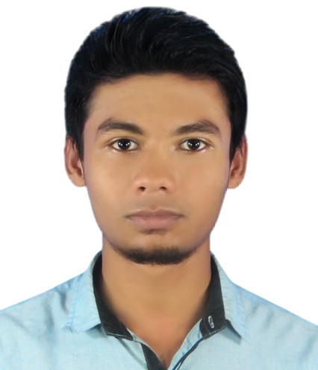
ABOUT
Trainee Java programmer under IsDB BISEW IT Scholarship Project. I am very much passionate about java programming language and capable of working with a variety of technology and software solutions, and managing databases.
Seeking an entry level Java develop position in a reputed organization where I can learn new skills, leverage my learnings, an contribute to the organization’s growth.
Mehedi Hasan
Software Developer
CONTACT :
SKILLS
Email : mdmehedi03@gmail.com
Phone : +8801621640037
Website : mehedihasan03
Linked in : mehedisoft
Java EE
Spring framework
Flutter
Java Swing
Spring boot
Android
PROJECTS :
Java SE
Spring Data JPA
Angular
Expense Management System
Technology: Javax Swing and MySQL.
Project Link: Expence-Management-System
JavaScript
Spring MVC
MySQL
Invoice management(Angular)
Technology: Angular, TypeScript, MySQL.
Project Link: Invoice-management(Angular)
Oracle Database
Hibernate
Servlet
Invoice management(Flutter)
Technology: Flutter, Dart, Java, MySQL.
Project Link: Invoice-management(Flutter)
EXPERIENCE
Trainee Software Developer (JEE)
IsDB BISEW IT Scholarship Project, Dhaka.
Strong in JavaScript, Java SE, Java EE, Javax Swing, Oracle Database, MySQL, Servlet, Spring Framework, Spring boot, Spring MVC, Bootstrap, Angular, Android, Flutter.
Invoice management(RESTful API)
Technology: Spring Boot, Hibernate, Spring Data JPA, MySQL.
Project Link: Invoice-management
REFERENCES :
EDUCATION
Moshaidul Islam
Consultant at
Show & Tell consulting Ltd
moshaidul@gmail.com
+8801711 071219
Relation: Consultant
Farid Ahmed
Faculty at IsDB-BISEW Scholarship Project.
TSP: New Horizon CLC
w3farid@gmail.com
+8801724 486878
Relation: Academic
Diploma in Enterprise Systems Analysis & Design - JEE (ESAD-JEE)
IsDB-BISEW IT Scholarship Project, Dhaka.
Master of Science
Noakhali Government College, Noakhali.
Subject: Entomology.
Bachelor of Science
Noakhali Government College, Noakhali.
Subject: Zoology.

