Slide 1
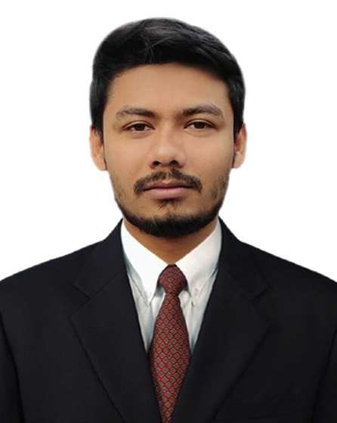
ABOUT
Junior Java Software Developer at Celloscope Ltd, adept in crafting high-quality, scalable solutions. Proven collaborator in cross-functional teams, spearheading successful projects like MRA-NVS(Microcredit Regulatory Authority-NID Verification System), Internet Banking, and ABS(Agent Banking Service). Eager to amplify technical prowess and drive innovation in new challenges.
Mehedi Hasan
Junior Software Developer
at
Celloscope Limited
SKILLS
Reactive Java
Clean Architecture
Spring Framework
Spring boot
Spring Security
Spring MVC
CONTACT :
Hibernate
Spring Data JPA
Phone :
+8801621640037
Email :
mdmehedi03@gmail.com
Website :
mehedihasan03.github.io/
Linked in : www.linkedin.com/in/mehedisoft/
Angular
Flutter
Android
JAVAX Swing
Java SE, Java EE
JavaScript
Servlets , JSP, JSTL
Git, GitHub, GitLab
Oracle Database 11g
MySQL, PostgreSQL
ADDRESS
C# (.Net)
Jasper (JRXML)
Present Address :
House 64, Road 03, PC Culture Housing, Shyamoli, Dhaka.
O-O System Analysis and Design (UML)
Proxmox VE
Permanent Address :
Mohib Menssion, Fatehpur, Ward No. 02, Noakhali Sadar, Noakhali.
EXPERIENCE
Junior Software Developer
Celloscope Limited.
Agrani & NRBCB Agent Banking, Agrani Internet Banking, and MRA-NID Verification System. Expertise spans front-end design, back-end development, and system scalability. Known for innovating user-friendly interfaces and enhancing banking functionalities
Nov 2022— Present
PERSONAL INFO
Father’s Name: Mohib Ullah
Mother’s Name: Anjuman Ara
Date of Birth: 13th July 1996
Marital Status: Unmarried
Religion: Islam
Nationality: Bangladeshi
Assistant Software Engineer
MILLENNIUM Information Solution Ltd.
Islamic Banking Core Systems QA Specialist ensuring Sharia-compliant functionality. Expert in meticulous testing, defect identification, and system validation. Maintains high-quality standards for seamless Islamic banking operations.
May 2022 — Nov 2022

Slide 2
LIVE PROJECTS :
Trainee Software Developer (JEE)
IsDB BISEW IT Scholarship Project, Dhaka.
Strong in JavaScript, Java SE, Java EE, Javax Swing, Oracle Database, MySQL, Servlet, Spring Framework, Spring boot, Spring MVC, Bootstrap, Angular, Android, Flutter.
Dec 2020 — Mar 2022
Agrani Agent Banking
Authority: Celloscope Ltd.
Hands-on: Java Rest API Service(Back-End)
NRBCB Agent Banking
Authority: Celloscope Ltd.
Hands-on: Java Rest API Service(Back-End), Report, Front-End.
EDUCATION
Agrani Internet Banking
Authority: Celloscope Ltd.
Hands-on: Java Rest API Service(Back-End), Report(Jasper).
Diploma in Enterprise Systems Analysis & Design - JEE (ESAD-JEE)
IsDB-BISEW IT Scholarship Project.
IDB Bhaban, Dhaka.
MRA-NID Verification System
Authority: Celloscope Ltd.
Hands-on: Java Rest API Service(Back-End), Report(Jasper), Front-End(Angular).
Master of Science
National University, Gazipur, Dhaka.
Subject: Entomology.
PROJECTS :
Bachelor of Science
National University, Gazipur, Dhaka.
Subject: Zoology.
Expense Management System
Technology: Javax Swing and MySQL.
Source: github.com/mehedihasan03/Expence-Management-System
TRAINING/COURSES
Invoice management(Angular)
Technology: Angular, TypeScript, MySQL.
Source: github.com/mehedihasan03/invoice
Computer Fundamental (CF)
IsDB-BISEW IT Scholarship Project, Dhaka.
Invoice management(Flutter)
Technology: Flutter, Dart, Java, MySQL.
Source: github.com/mehedihasan03/invoice_flutter_front_end.git
Basic Computer & Office Applications
Noakhali Technical Training Centre(NTTC), Noakhali.
Invoice management(RESTful API)
Technology: Spring Boot, Hibernate, Spring Data JPA, MySQL.
Source: github.com/mehedihasan03/Invoice_spring_boot_api.git
C# (.Net)
Digital Entrepreneurship and Innovation Ecosystem Development Project.
Bangladesh Hi-Tech Park Authority.
REFERENCES :
Moshaidul Islam
Consultant at
Show & Tell consulting Ltd
moshaidul@gmail.com
+8801711 071219
Relation: Consultant
Farid Ahmed
Faculty at IsDB-BISEW Scholarship Project.
TSP: New Horizon CLC
w3farid@gmail.com
+8801724 486878
Relation: Academic
I hereby declare that all the details furnished above are true and reflect my honest beliefs and qualifications for the software developer position.
I take responsibility for the accuracy of this information.
Signature
(Mehedi Hasan)
__________________

