Slide 1
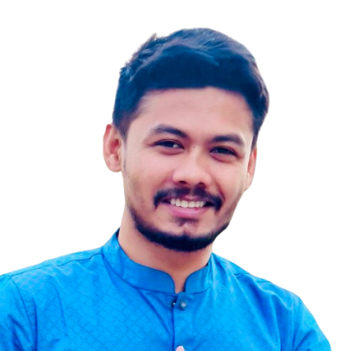
ABOUT
Junior Java Software Developer at Celloscope Ltd, adept in crafting high-quality, scalable solutions. Proven collaborator in cross-functional teams, spearheading successful projects like MRA-NVS(Microcredit Regulatory Authority-NID Verification System), Internet Banking, and ABS(Agent Banking Service). Eager to amplify technical prowess and drive innovation in new challenges.
SKILLS
Mehedi Hasan
Junior Software Developer
at
Celloscope Limited
Reactive JAVA
Clean Architecture
Spring Framework
Spring boot
MySQL, PostgreSQL
Spring MVC
Oracle Database 11g
Angular
CONTACT :
Flutter (Dart)
Android
Phone : +8801621640037
Email : mdmehedi03@gmail.com
Website : mehedihasan03
Linked in : Mehedi Hasan
Facebook: Mehedi Hasan
Instagram: Mehedi Hasan
JavaScript
JAVAX Swing
C# (.Net)
JAVA SE, JAVA EE
Servlets , JSP, JSTL
Git, GitHub, GitLab
Hibernate
Spring Data JPA
LIVE PROJECTS :
O-O System Analysis and Design (UML)
Jasper (JRXML)
Agrani Agent Banking
Authority: Celloscope Ltd.
Hands-on: Java Rest API Service(Back-End)
EXPERIENCE
Junior Software Developer
Celloscope Limited.
Experienced Full Stack Developer specializing in banking services: Agrani & NRBCB Agent Banking, Agrani Internet Banking, and MRA-NID Verification System. Expertise spans front-end design, back-end development, and system scalability. Known for innovating user-friendly interfaces and enhancing banking functionalities
Nov 2022— Present
NRBCB Agent Banking
Authority: Celloscope Ltd.
Hands-on: Java Rest API Service(Back-End), Report, Front-End.
Agrani Internet Banking
Authority: Celloscope Ltd.
Hands-on: Java Rest API Service(Back-End), Report(Jasper).
Assistant Software Engineer
MILLENNIUM Information Solution Ltd.
Islamic Banking Core Systems QA Specialist ensuring Sharia-compliant functionality. Expert in meticulous testing, defect identification, and system validation. Maintains high-quality standards for seamless Islamic banking operations.
May 2022 — Nov 2022
MRA-NID Verification System
Authority: Celloscope Ltd.
Hands-on: Java Rest API Service(Back-End), Report(Jasper), Front-End(Angular).

Slide 2
PROJECTS :
Trainee Software Developer (JEE)
IsDB BISEW IT Scholarship Project, Dhaka.
Strong in JavaScript, Java SE, Java EE, Javax Swing, Oracle Database, MySQL, Servlet, Spring Framework, Spring boot, Spring MVC, Bootstrap, Angular, Android, Flutter.
Dec 2020 — Mar 2022
Expense Management System
Technology: Javax Swing and MySQL.
Project Link: Expense-Management-System
Invoice management(Angular)
Technology: Angular, TypeScript, MySQL.
Project Link: Invoice-management(Angular)
EDUCATION
Diploma in Enterprise Systems Analysis & Design - JEE (ESAD-JEE)
IsDB-BISEW IT Scholarship Project.
IDB Bhaban, Dhaka.
Invoice management(Flutter)
Technology: Flutter, Dart, Java, MySQL.
Project Link: Invoice-management(Flutter)
Invoice management(RESTful API)
Technology: Spring Boot, Hibernate, Spring Data JPA, MySQL.
Project Link: Invoice-management
Master of Science
National University, Gazipur, Dhaka.
Subject: Entomology.
Bachelor of Science
National University, Gazipur, Dhaka.
Subject: Zoology.
REFERENCES :
Moshaidul Islam
Consultant at
Show & Tell consulting Ltd
moshaidul@gmail.com
+8801711 071219
Relation: Consultant
Farid Ahmed
Faculty at IsDB-BISEW Scholarship Project.
TSP: New Horizon CLC
w3farid@gmail.com
+8801724 486878
Relation: Academic
TRAINING/COURSES
Computer Fundamental (CF)
IsDB-BISEW IT Scholarship Project, Dhaka.
Basic Computer & Office Applications
Noakhali Technical Training Centre(NTTC), Noakhali.
C# (.Net)
Digital Entrepreneurship and Innovation Ecosystem Development Project.
Bangladesh Hi-Tech Park Authority.

