Slide 1
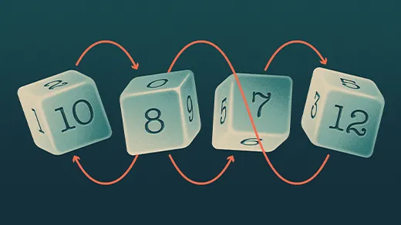
STA-227: Statistics
Basic Concepts of Probability
& Correlation Analysis

Slide 2

Correlation
What is Correlation ??
Define correlation as a statistical measure describing the relationship between two variables.
Example:
The relationship between hours of study and exam scores.

Slide 3
Correlation
Correlation
Types of Correlation
On the basis of Degree of correlation
On the basis of number of variables
On the basis of linearity
1. Simple Correlation
2. Partial Correlation
3. Multiple Correlation
1. Linear Correlation
2. Non-Linear Correlation
1. Positive Correlation
2. Negative Correlation

Slide 4
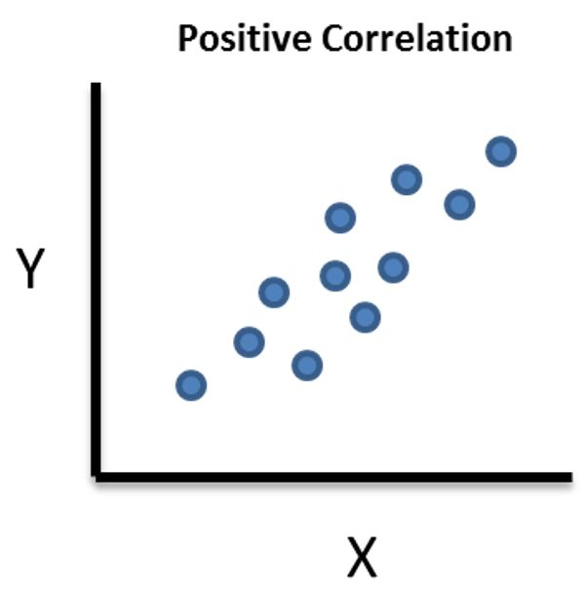
Correlation
What Is Positive Correlation?
When an increase in one variable corresponds to an increase in the other. The stronger this relationship, the closer the correlation coefficient is to +1.

Slide 5
Correlation
Examples of positive correlation in real life
With the growth of the company, the market value of company stocks increase.
If I walk more, I will burn more calories.
When demand increases, price of the product increases (at same supply level).
When you study more, you score high in the exams.

Slide 6
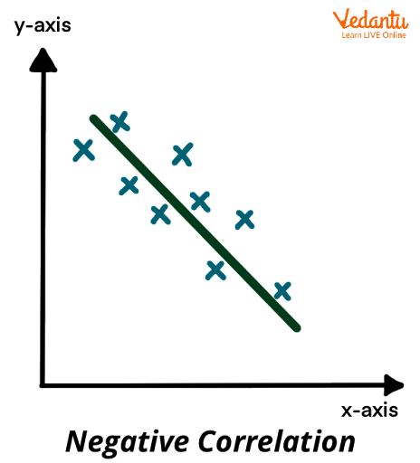
Correlation
What Is Negative Correlation?
Occurs when an increase in one variable corresponds to a decrease in the other. The stronger this relationship, the closer the correlation coefficient is to -1.

Slide 7
Correlation
Examples of negative correlation in real life
More vaccinations, less illness.
More expenditure, less money.
More time for fun, less grades.
More time at work, less time at home.

Slide 8
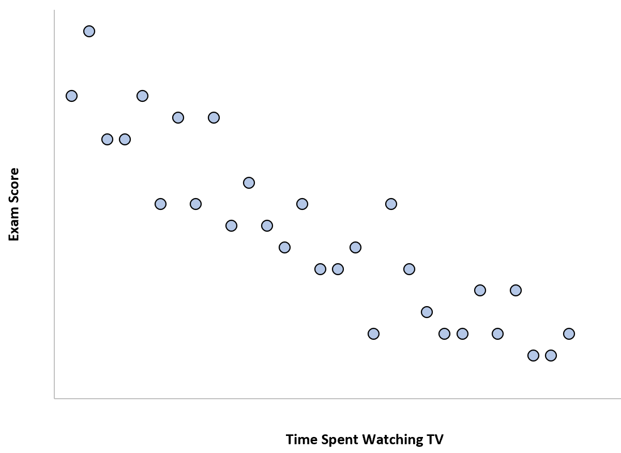
Correlation
What Is Simple Correlation?
Simple correlation is a measure used to determine the strength and the direction of the relationship between two variables, X and Y.

Slide 9
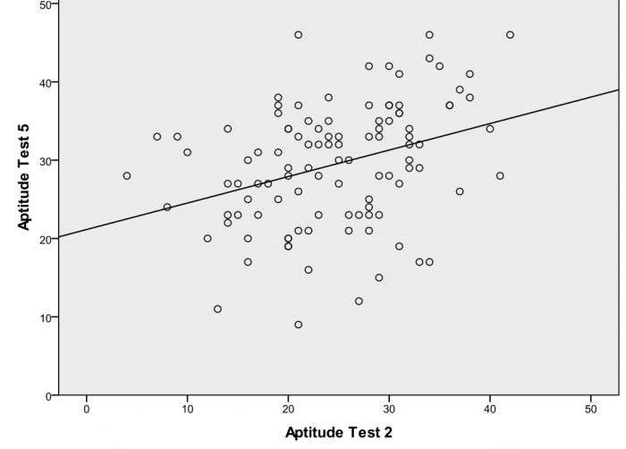
Correlation
What Is Partial Correlation?
Partial correlation, calculates the correlation between two variables, while excluding the effect of a third variable.

Slide 10
Correlation
What Is Partial Correlation?
Partial correlation, calculates the correlation between two variables, while excluding the effect of a third variable.

Slide 11
Correlation
What is probability??
Probability is the measure of the likelihood that an event will occur. It is expressed as a number between 0 and 1.

Slide 12
Basic Terminology of Probability
Sample Space (S):
The set of all possible outcomes of an experiment. It is often denoted by S.
Event:
A subset of the sample space. An event can consist of one or more outcomes. For example, in rolling a die, the event of getting an even number is {2, 4, 6}.
Probability of an Event (P(A)):
Number of Favorable Outcomes
P(A) =
Total Number of Possible Outcomes

Slide 13
Selection Sort
9
13
15
11
2
Iteration-1:
2
13
15
11
9
Iteration-2:
2
9
15
11
13
Iteration-3:
2
9
11
15
13
2
9
11
13
15
Iteration-4:

Slide 14
Bubble Sort
Step
01
Placing the 1st largest element at correct position
i = 0
6
0
3
5
i = 1
0
6
3
5
i = 2
0
3
6
5
0
3
5
6
sorted

Slide 15
Step
02
Placing the 2nd largest element at correct position
i = 0
0
3
5
6
i = 1
0
3
5
6
0
3
6
5
sorted

Slide 16
Step
03
Placing the 3rd largest element at correct position
i = 0
0
3
5
6
0
3
5
6
Sorted array

Slide 17
Source Code
void bubbleSort(int arr[], int size)
{
for (int i = 0; i < size - 1; i++)
{
for (int j = 0; j < size - i - 1; j++)
{
if (arr[j] > arr[j + 1]) {
// Swap arr[j] and arr[j + 1]
int temp = arr[j];
arr[j] = arr[j + 1];
arr[j + 1] = temp;
}
}
}
}

Slide 18
Insertion Sort
5
3
4
7
9
1
j
i
5
3
4
7
9
1
j
j
i
3
5
4
7
9
1
j
j
j
i
3
4
5
7
9
1
j
j
j
j
i
3
4
5
7
9
1
j
j
j
j
j
i
3
4
5
7
9
1
1
3
4
5
7
9

Slide 19
Source Code
void insertionSort(int arr[], int n) {
for (int i = 1; i < n; i++) {
int temp = arr[i];
int j = i - 1;
// Move elements of arr[0..i-1], that are greater than temp,
while (j >= 0 && arr[j] > temp) {
arr[j + 1] = arr[j];
j--;
}
arr[j + 1] = temp;
}
}

Slide 20
Marge sort
6
4
2
1
9
8
3
5
6
4
2
1
9
8
3
5
6
4
2
1
9
8
3
5
6
4
2
1
9
8
3
5
i
j
i
j
4
6
1
2
8
9
3
5
i
j
1
2
4
6
3
5
8
9
1
2
3
4
5
6
8
9

Slide 21
void merge(int A[], int mid, int low, int high)
{
int i, j, k, B[100];
i = low;
j = mid + 1;
k = low; while (i <= mid && j <= high)
{ if (A[i] < A[j])
{
B[k] = A[i];
i++;
k++; }
else {
B[k] = A[j];
j++;
k++;
}
}
while (j <= high)
{
B[k] = A[j];
k++;
j++;
}
for (int i = low; i <= high; i++)
{
A[i] = B[i];
}
}

Slide 22
void mergeSort(int A[], int low, int high)
{
int mid;
if(low<high)
{
mid = (low + high) /2;
mergeSort(A, low, mid);
mergeSort(A, mid+1, high);
merge(A, mid, low, high);
}
}

Slide 23
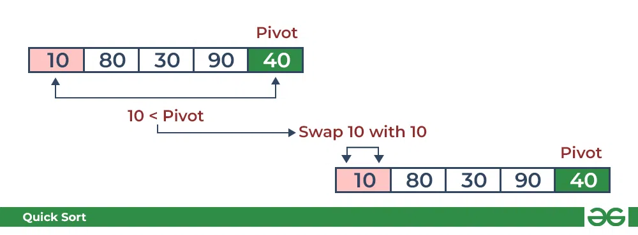
Quick sort

Slide 24
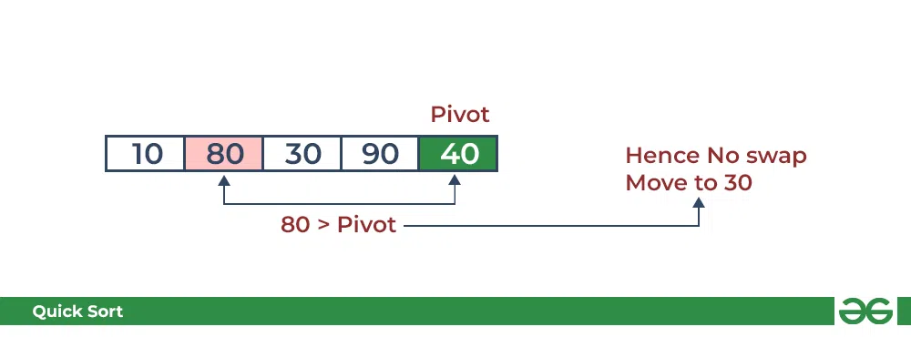

Slide 25
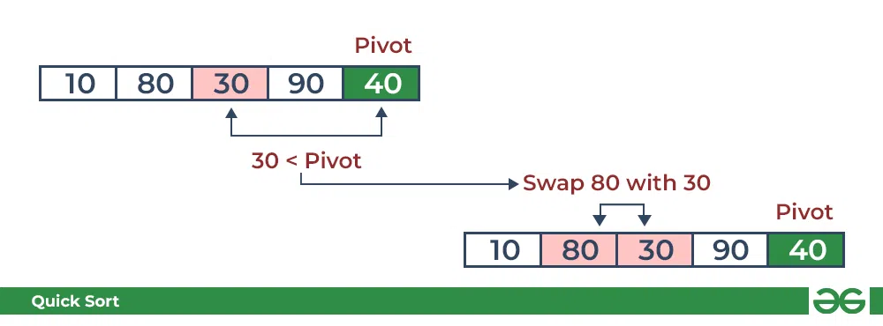

Slide 26
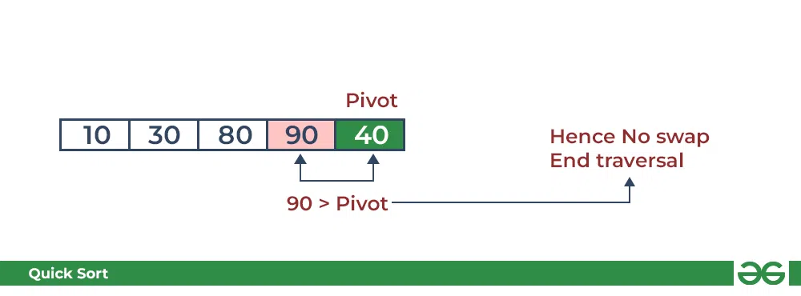

Slide 27
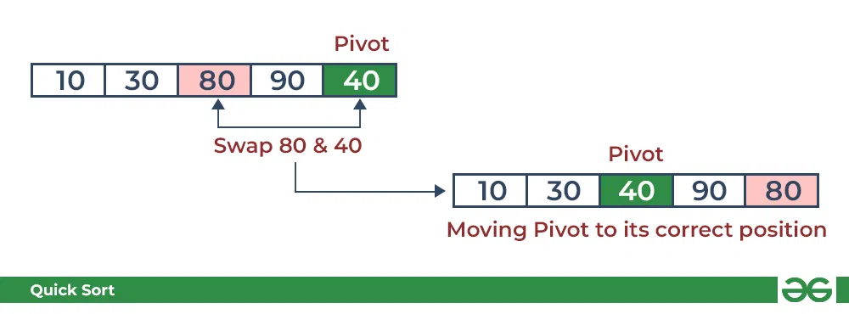

Slide 28
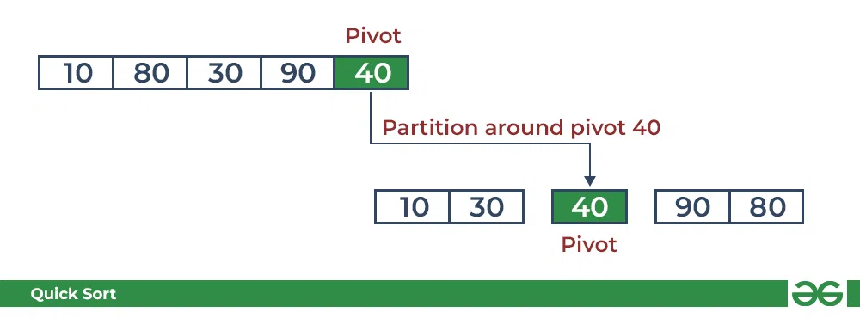

Slide 29
void quickSort(int arr[], int low, int high) {
if (low < high) {
// Find pivot element such that
// element smaller than pivot are on the left
// and elements greater than pivot are on the right
int pi = partition(arr, low, high);
// Recursively sort the elements before and after partition
quickSort(arr, low, pi - 1);
quickSort(arr, pi + 1, high);
}
}

Slide 30
int partition(int arr[], int low, int high) {
int pivot = arr[high];
int i = (low - 1);
for (int j = low; j <= high - 1; j++) {
// If the current element is smaller than or equal to the pivot
if (arr[j] <= pivot) {
i++;
swap(&arr[i], &arr[j]);
}
}
swap(&arr[i + 1], &arr[high]);
return (i + 1);
}

Slide 31
void swap(int* a, int* b) {
int t = *a;
*a = *b;
*b = t;
}

Slide 32


