Slide 1
ifconfig
Interface configuration
Prepared By – Mehedi Hasan

Slide 2
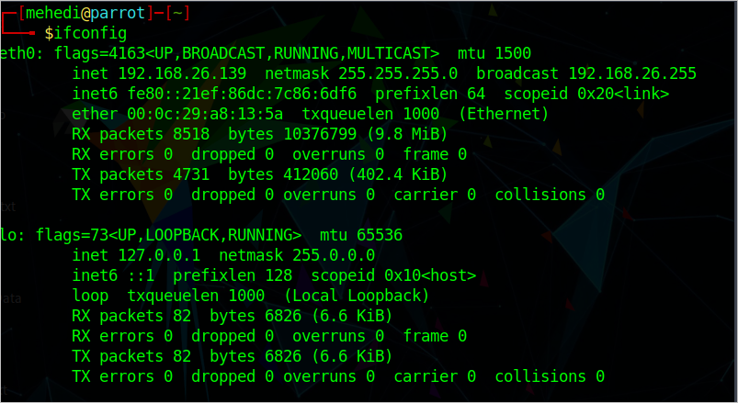
Cmd -> #ifconfig

Slide 3
Cmd -> #ifconfig
It is used to view and change the configuration of the network interfaces on your system.
eth0, lo and wlan0 are the names of the active network interfaces on the system.
eth0 is the first Ethernet interface. (Additional Ethernet interfaces would be named eth1, eth2, etc.) This type of interface is usually a NIC connected to the network by a category 5 cable.
lo is the loopback interface. This is a special network interface that the system uses to communicate with itself.
wlan0 is the name of the first wireless network interface on the system. Additional wireless interfaces would be named wlan1, wlan2, etc.

Slide 4
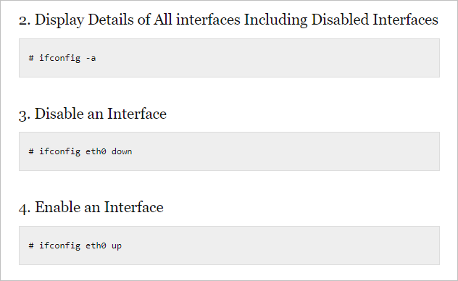
Cmd -> #ifconfig
Source: https://www.thegeekstuff.com/2009/03/ifconfig-7-examples-to-configure-network-interface/

Slide 5
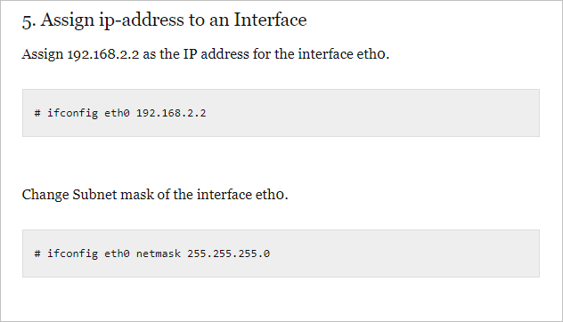
Cmd -> #ifconfig

Slide 6
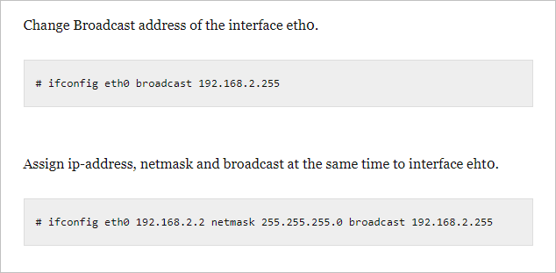
Cmd -> #ifconfig

Slide 7
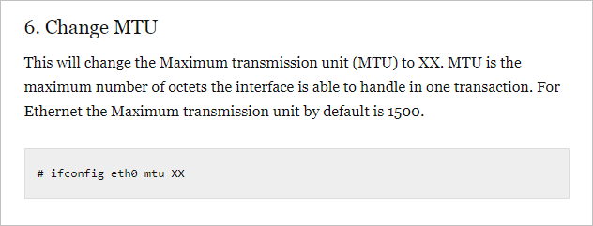
Cmd -> #ifconfig

Slide 8
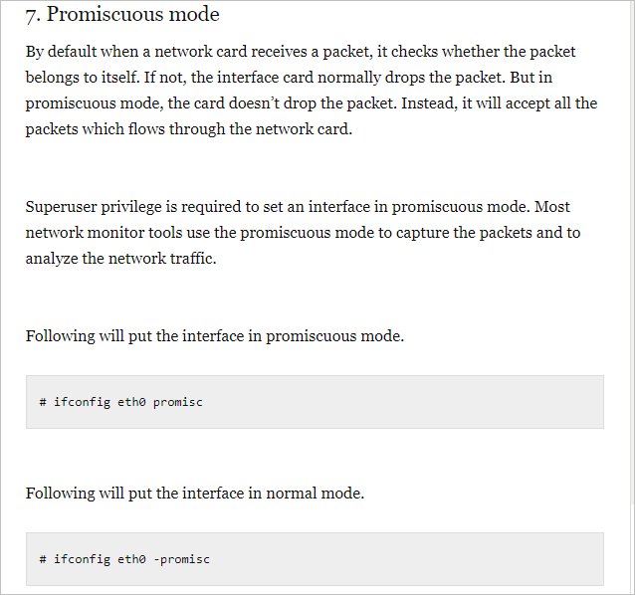
Cmd -> #ifconfig

