Slide 1
Recommend Academic Institute to open a Food/Restaurant Business
Applied Data Science Capstone
IBM Data Science Professional Certificate
Prepared by: Mehedi Masud

Slide 2
Problem Description
Background: One of my friends came to Canada as a new immigrant who had experience in food/restaurant business in his home country. He was wondering what to do in Canada. He asked me about the possibility to start a food corner/restaurant/coffee shop near an academic institute particularly in the Toronto city. My friend requested me to help him to suggest a suitable location or institute and type of restaurant/coffee shop he should start with. So he requested me to perform feasibility study by visiting all the academic institutes in Toronto. I told him I can recommend you proper place and suitable shops using my Data Science knowledge instead of visiting all the locations physically.
Objective and Target Audience: Opening a food/restaurant business is all about location, location, location. However, not every business is suitable for every location, and vice versa. It comes down to a combination of concept and ideal customer. So the objective of this project is to recommend someone who is interested to open a food/restaurant business nearby a college or university in the Toronto city. Mainly, the outcome of this project is to recommend popular type of restaurants among the students nearby by each academic areas. Based on the results one can decide the type of restaurant he should open and in which institute.

Slide 3
Description of Data
1- First we need to identify college and universities in the Toronto city. We collect all the college and university names from following link
https://en.wikipedia.org/wiki/Category:Universities_and_colleges_in_Toronto
2. We filtered out some non interested institutes. After filtering we identified 21 institutes that need to be explored. Following slide shows the names of the institutes.

Slide 4
List of Institutes
 | InstituteName
0 | Centennial College
1 | Business College
2 | Canadian Forces College
3 | Canadian Memorial Chiropractic College
4 | Ewart College
5 | George Brown College
6 | Glendon College
7 | The Glenn Gould School
8 | Humber College
9 | Islamic Institute of Toronto
10 | Keele Campus (York University)
11 | College and Seminary
12 | The Michener Institute
13 | OCAD University
14 | Oxford College
15 | Ryerson University
16 | Seneca College
17 | University of Toronto
18 | Tyndale University College and Seminary
19 | University of Guelph-Humber
20 | York University

Slide 5
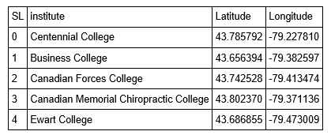
Description of Data
3. Then, we need geo-locational information (latitude and longitude) for each institute in the Toronto city. The samples are shown below that are obtained using "geolocator“ package.

Slide 6
Description of Data
4. We identified different venues nearby of each institute, and extract venues’ data searching by venue category with
categoryId='4d4b7105d754a06374d81259' //Food category ID.
In order to retrieve food categories venues information, we used "Foursquare“ API.
url='https://api.foursquare.com/v2/venues/search?categoryId={}&limit={}&radius={}&client_id={}&client_secret={}&ll={},{}&v={}'.format(categoryId,limit,radius,CLIENT_ID, CLIENT_SECRET, latitude, longitude, VERSION)
One result is shown below:
{u'name': u"Sid's Southside Cafe", u'categories': [{u'pluralName': u'College Cafeterias', u'primary': True, u'name': u'College Cafeteria', u'shortName': u'Cafeteria', u'id': u'4bf58dd8d48988d1a1941735', u'icon': {u'prefix': u'https://ss3.4sqi.net/img/categories_v2/education/cafeteria_', u'suffix': u'.png'}}], u'hasPerk': False, u'location': {u'distance': 160, u'labeledLatLngs': [{u'lat': 43.66201648509592, u'lng': -79.39850649514088, u'label': u'display'}], u'city': u'Toronto', u'cc': u'CA', u'country': u'Canada', u'state': u'ON', u'formattedAddress': [u'100 St. George St (University of Toronto)', u'Toronto ON', u'Canada'], u'crossStreet': u'University of Toronto', u'address': u'100 St. George St', u'lat': 43.66201648509592, u'lng': -79.39850649514088}, u'id': u'4ba247e6f964a5206ee937e3', u'referralId': u'v-1540363652'}

Slide 7
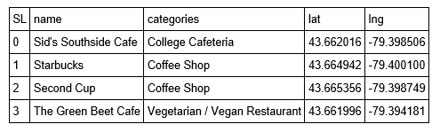
Description of Data
5. From the results we extract venue names, venue category and locations for each institute. The partial result near University of Toronto is shown below:
6. After getting all relevant data we explore venues for each institute and perform some statistical analysis and machine learning (Clustering) to recommend proper venue category and place.

Slide 8
Methodology to Explore Institutes
First part is to identify, gather and process required data to explore institutes. The steps were discussed before, here we summarize:
Identify names of academic institutes in the Toronto City. We only consider colleges and universities
Identify location information (latitude and longitude) for each institute. We used “geolocator“ package for this purpose
Indentify different venues nearby of each institute, and extract venues data searching by venue category with “Food Category ID”, our choice of interest. In order to retrieve food categories venues information, we used "Foursquare“ API.
Extract venue names, venue category and locations for each institute from the API results

Slide 9
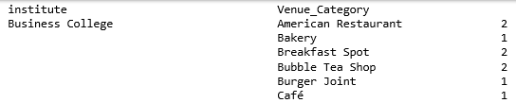
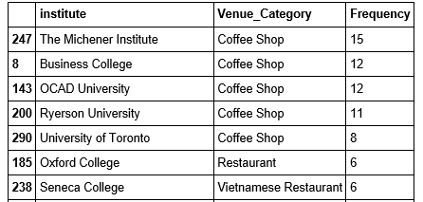
Methodology to Explore Institutes
Second part is to do exploratory data analysis. For this purpose we performed following analysis:
Number of different venues of food categories for each institute. A sample is shown below
Identify Top 20 venues of food categories among all institutes. See sample below.

Slide 10
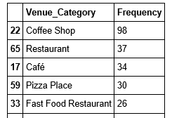
Methodology to Explore Institutes
Find top 10 venues of food categories in institutes in Toronto Area. See sample below.
Visualize the statistics. See slide next.

Slide 11
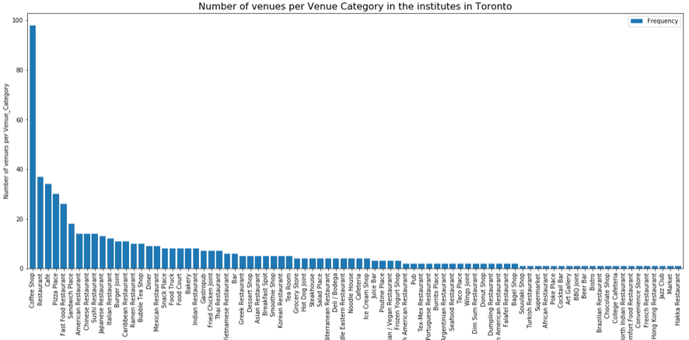
Methodology to Explore Institutes

Slide 12
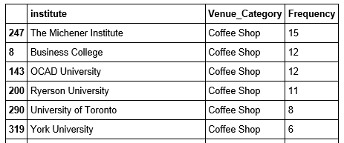
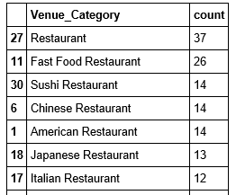
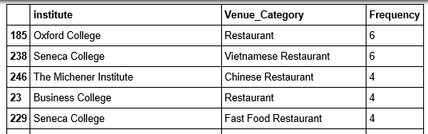
Methodology to Explore Institutes
Find number of Coffee shops in each institute
Find number of different restaurants in each institute and count different restaurants in all institutes.

Slide 13
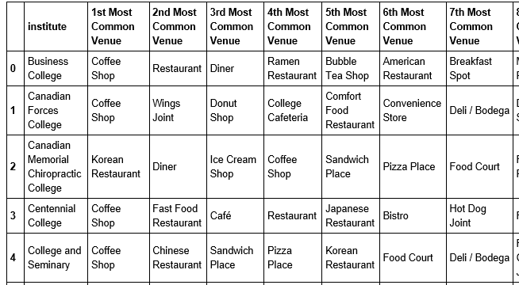
Methodology to Explore Institutes
Analyze venues in each institute (the top 10 venues for each Institute). Samples shown below.

Slide 14
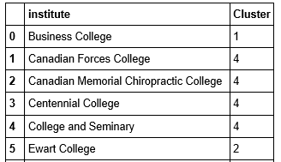
Methodology to Explore Institutes
Cluster Institutes based on venues. We used K-Means clustering algorithm and considered 5 clusters and find the best clusters. Sample shown below.

Slide 15
Results Exploratory analysis results
Coffee Shop is more popular in academic institute
Restaurant is second most popular
"The Michener Institute" is good choice to open Coffee Shop
For restaurant category "general" and "First food restaurant" is more popular
"Seneca College" and "Humber College" is good to open a restaurant

Slide 16
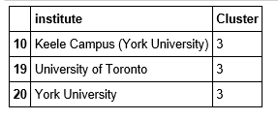
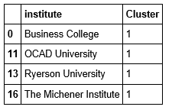
Results Clustering analysis results
Best cluster is C3 which consist of following institutes.
Second best cluster is C1 which consist of following institutes.

Slide 17
Discussions
The objective of this project is to recommend someone who is interested to open a food corner/restaurant/coffee shop nearby a college or university in the Toronto city. To do the job we performed several exploratory analysis and applied K-Mean clustering algorithm. Following points are observed.
Students like more Coffee shop and Cafe in an academic institute. The “Michener Institute” has most “Coffee shop”
Among restaurants “First-food” restaurant is very popular.
Among types if restaurant “Chinese” and “American” Restaurants are very popular
“ Vietnamese Restaurant “ is popular in Seneca College
Among cluster, cluster with institutes “Keele Campus”, “Toronto University” and “York University” is the best cluster.

Slide 18
Recommendation
Opening a “Coffee shop” is a good choice in an academic institute.
The “Michener Institute” is recommended to open a “Coffee shop”
Second recommendation is to open a “general” restaurant or “Fast Food” restaurant.
"Seneca College" and "Humber College" are good places to open a general or first food restaurant
If someone wants to open a “ Vietnamese Restaurant “ recommendation is “Seneca College”
In general one is recommended to consider the cluster with institutes “Keele Campus”, “Toronto University” and “York University” is the best cluster.

Slide 19
Conclusion
In this project we identified academic institutes in the Toronto city and explore venues considering venues with food category. The objective project is to recommend someone who is interested to open a food corner/restaurant/coffee shop nearby a college or university in the Toronto city. Mainly, the outcome of this project is to recommend popular type of restaurants among the students nearby by each academic areas. Based on the results one can decide the type of restaurant he should open and in which institute.

Slide 20
Thank you

