Slide 1


Design and Implementation of a 0 to 99 Counter Circuit: A Comprehensive Exploration

Slide 2
Course Instructor: Nuzat Nuary Alam Group(5) Member : Pritha Biswas Prama( 22-46161-1) Aishee Debnath( 22-46416-1) MD.Mehedi Hasan Polas( 22-46566-1) Riya Das( 22-46592-1)

Slide 3
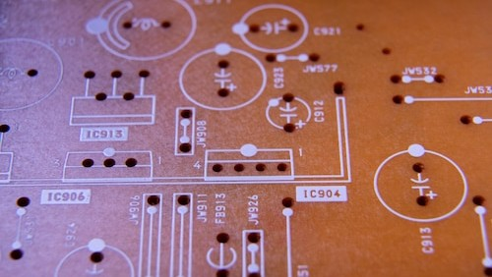
Introduction
In this presentation, we will explore the design and implementation of a 0 to 99 counter circuit. We will delve into the intricacies of digital logic, circuitry, and practical applications. Join us for a comprehensive examination of this fundamental
electronic component.

Slide 4


Overview of Counters
Counters are sequential logic circuits used for counting and timing applications. They are essential in digital electronics and are widely used in embedded systems and microcontrollers.
Understanding the design and operation of counters is crucial for electronic engineers and hobbyists
alike.

Slide 5
Component 1. Bread Board 2. 555 3. 4026 2 pcs 4. 7segment 2pcs 5. 1k ohm 5pcs 7. Connectors 8. Push button switch has context menu 9. 10k preset potentiometer

Slide 6

Binary Coded Decimal
(BCD) Counting
BCD is a binary representation of decimal numbers in which each digit is represented by a four-bit binary code. We will explore the principles of BCD counting and its signiﬁcance in the design of a 0 to 99 counter
circuit.

Slide 7


Circuit Simulation and Testing
Simulation tools such as SPICE and Verilog are invaluable for validating the functionality of the counter circuit. We will explore the process of simulating and testing the circuit to verify its accuracy and reliability.

Slide 8
Visual Element 7 segment display has been used for showing counting. Countdown will start from 0 ang continue till 99 which will be displayed in the 7 segment display.

Slide 9
User Interaction A button is used for manually resetting the counter to 0 to start counting.

Slide 10


Design Considerations
The design of a 0 to 99 counter circuit involves careful consideration of clock frequency, synchronous/asynchronous operation, and counting modes. We will examine these factors in detail and their impact on the performance of the circuit.

Slide 11


Applications of 0 to 99
Counters
0 to 99 counters ﬁnd diverse applications in digital clocks, timers, frequency dividers, and industrial automation. Understanding the versatility of these counters is essential for their practical utilization
in electronic systems.

Slide 12
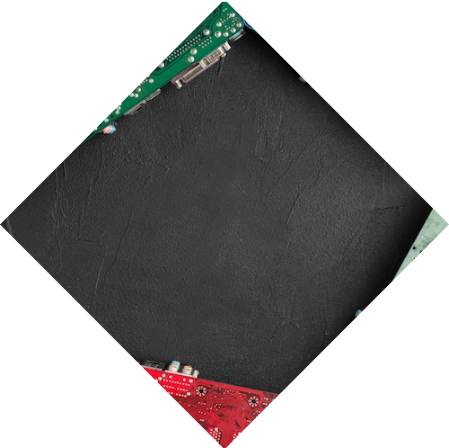

Implementation Challenges
Implementing a 0 to 99 counter circuit requires addressing challenges such as glitch reduction, cascading multiple counters, and signal propagation delays. We will discuss strategies to overcome these challenges and ensure reliable circuit operation.

Slide 13


Future Developments
The ﬁeld of digital electronics is constantly evolving, leading to advancements in integrated circuit technology and low- power design. We will explore potential future developments and innovations in the realm of 0 to 99 counter circuits.

Slide 14
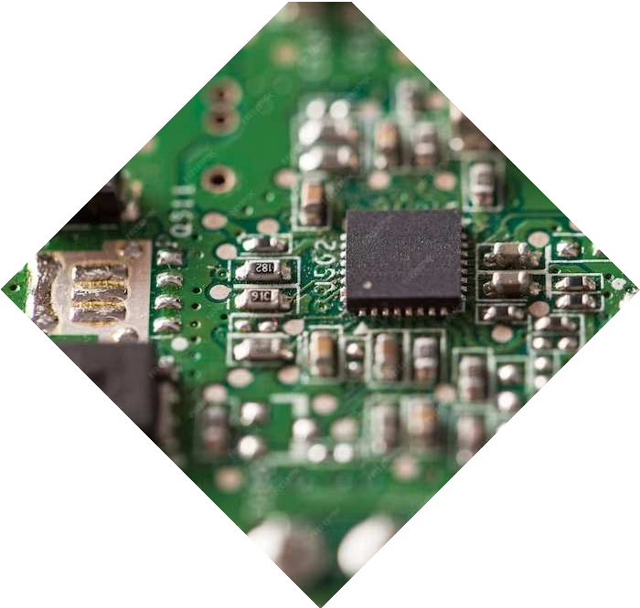

Design Optimization
Optimizing the design of a 0 to 99 counter circuit involves considerations such as power consumption reduction, miniaturization, and enhanced functionality. We will delve into strategies for achieving an eﬃcient and compact circuit design.

Slide 15
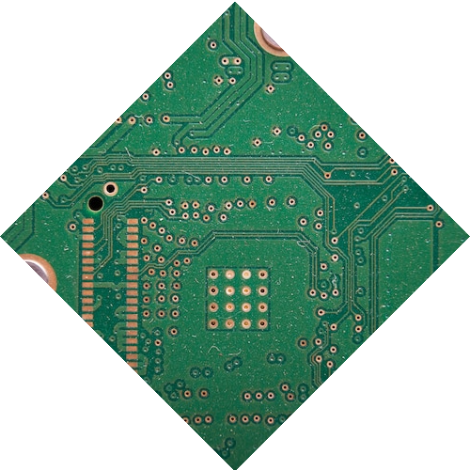

Real-world Implementation
The practical implementation of a 0 to 99 counter circuit involves printed circuit board (PCB) layout, component selection, and manufacturability. We will explore the transition from design to real- world deployment of the circuit.

Slide 16
Conclusion
In conclusion, the design and implementation of a 0 to 99 counter circuit is a fundamental aspect of digital electronics. Through this exploration, we have gained insights into the intricacies of counter circuits and their diverse applications.
We invite you to apply this knowledge in your electronic endeavors.

Slide 17
Thanks!
Do you have any question?

