Slide 1


Lift and Staircase Detection using Smartphone Sensor

Slide 2
Group members
Mehedi Rahman - 1620647042
Ahmed Zisan – 1611243042
MD. Sadman – Al – Islam- 1610503042
Sumaia Rahman – 1430058042

Slide 3
Problem statement
Smartphone sensor is popular for human activity detection.
Users always carry the sensors like accelerometer, gyroscope in their daily life.
We want to detect if a person is using staircase or a lift using these two sensor.
We want to create an app which will show the activity.

Slide 4
Originality
Most of the work we have seen have used accelerometer to detect human activity like sitting, walking, running etc.
There are some work where researchers have used wearable device to collect the data.
We want to use accelerometer and gyroscope data collected from smartphone to distinguish between lift and staircase activity.
It can be further developed to implement new features in wearable healthcare technology, measuring height distance from ground etc.

Slide 5
Process
We have created an app which can read sensor data from an android device and store it.
The application works with two sensors . Accelerometer and Gyroscope.
The data read are stored in csv format.
We can easily read these data from the csv file and visualize it using pandas and matplotlib.
We used Support Vector Machine(SVM) to classify the dataset.

Slide 6
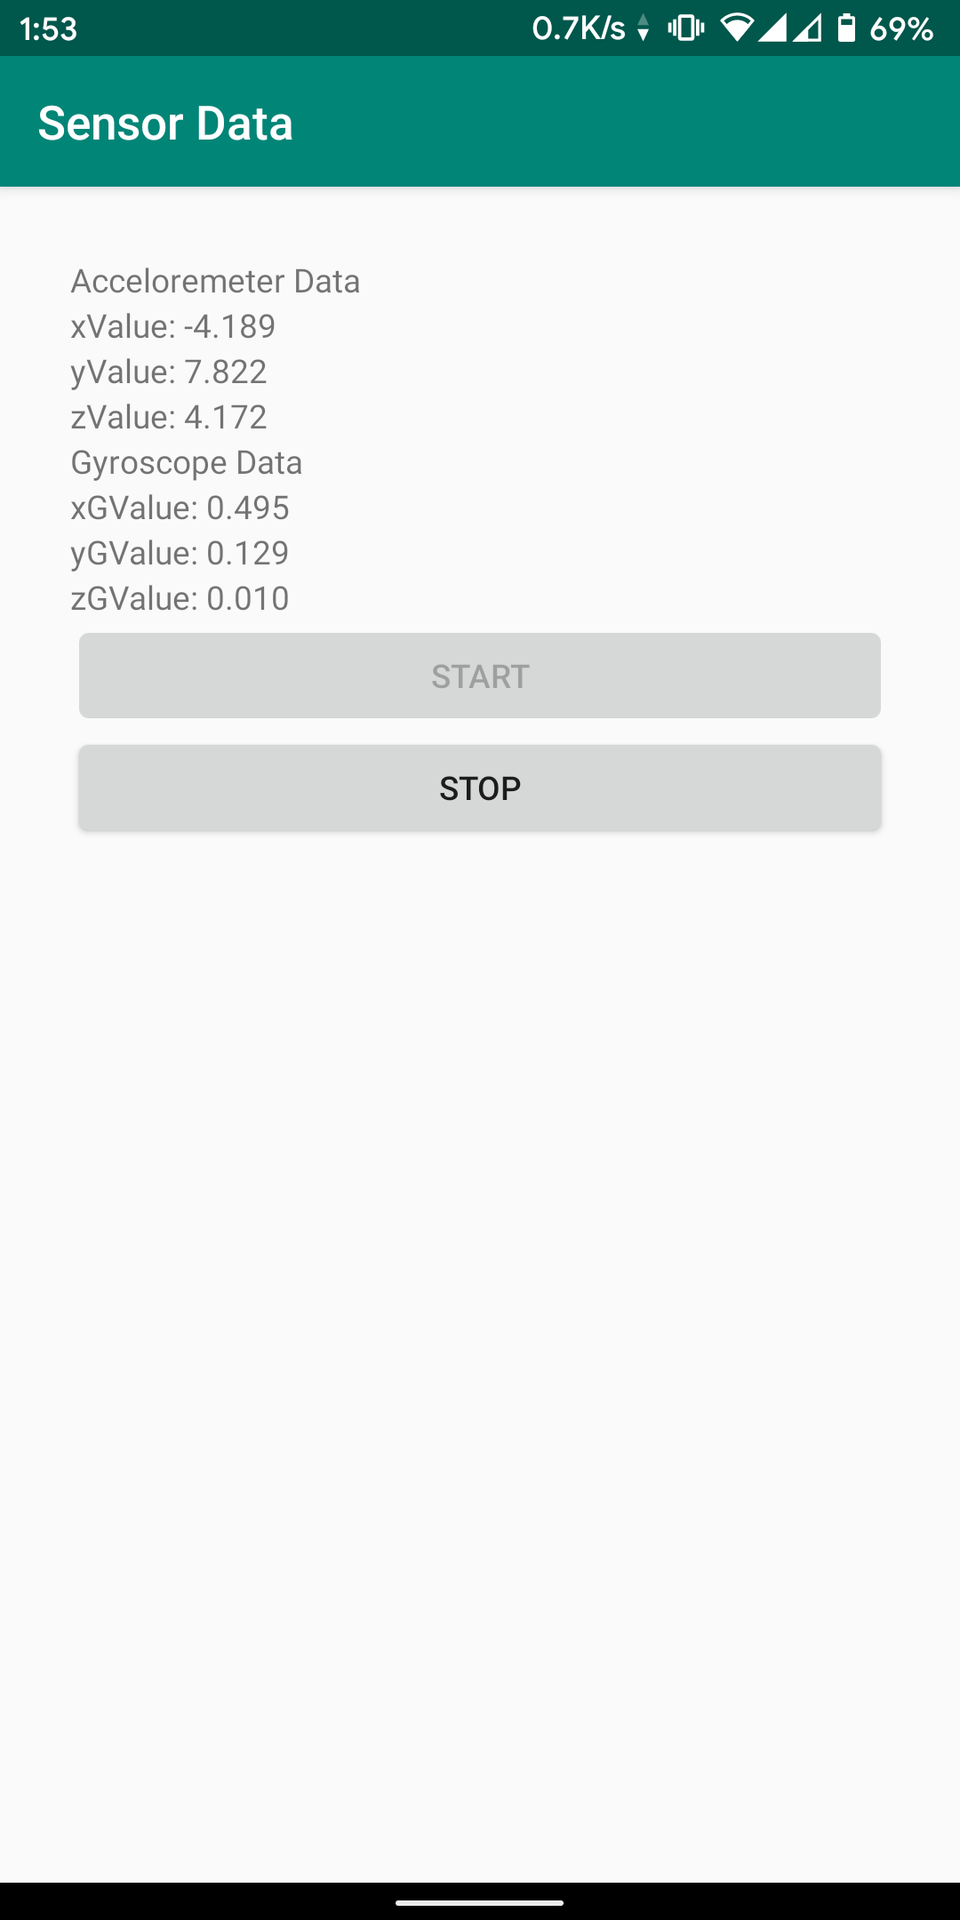
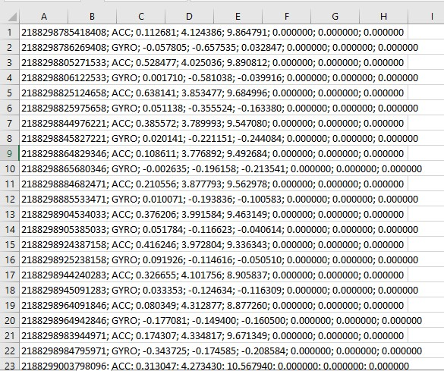
Sensor Data App

Slide 7
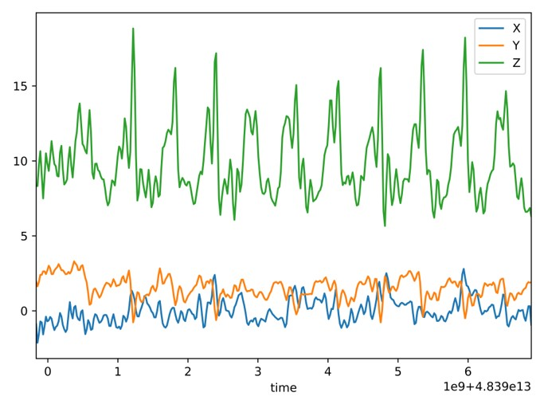
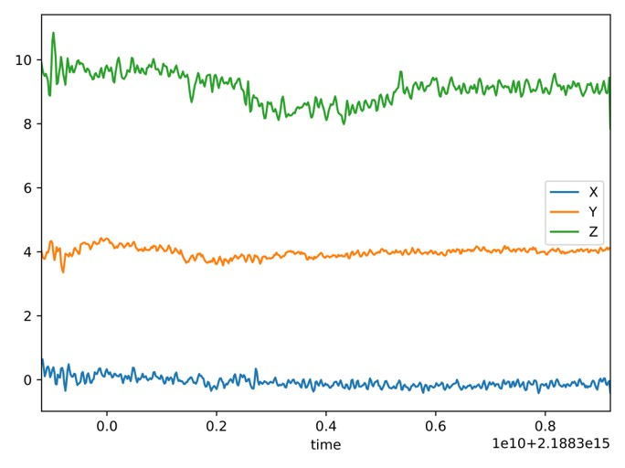
Visualized data
Stair Up Accelerometer Data
Lift Up Accelerometer Data

Slide 8
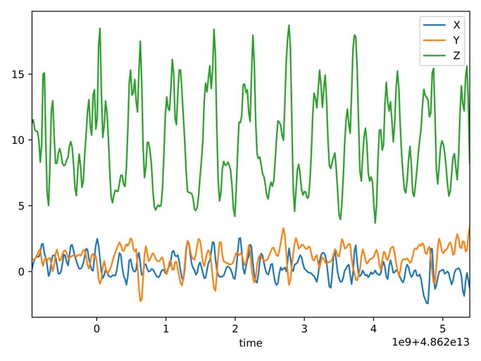
Visualized data
Stair Up Accelerometer Data
Stair down Accelerometer Data

Slide 9
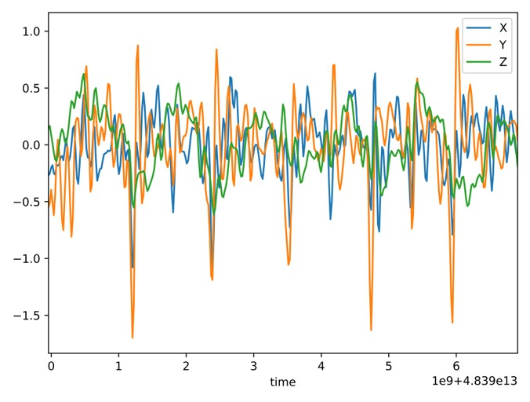
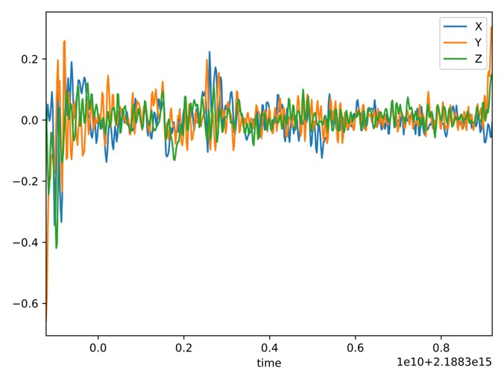
Visualized data
Stair Up Gyroscope Data
Lift Up Gyroscope Data

Slide 10
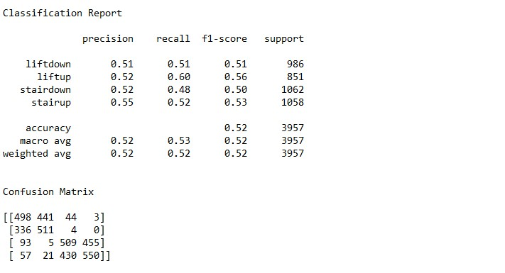
SVM Classification
Classification Report with Linear kernel

Slide 11
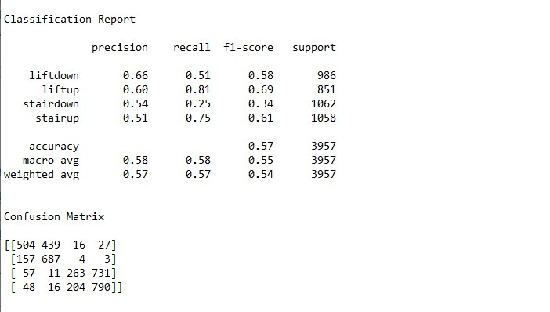
SVM Classification
Classification Report with Polynomial kernel

Slide 12
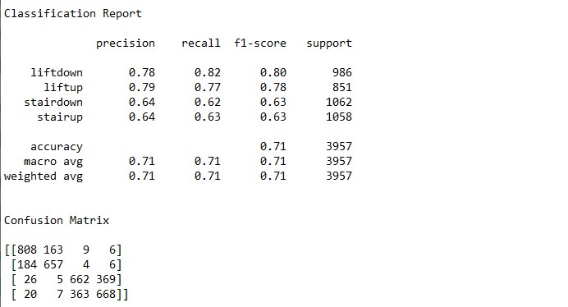
SVM Classification
Classification Report with Gaussian kernel (C= 1.0,Gamma=1.0)

Slide 13
Progress
We have already created the app to read sensor data and visualized the data. From the visualized data we can clearly see the differences between lift and staircase activity.
We have collected stair data of two different person as movement varies from person to person.
We tried to classify the dataset using SVM.
Our next plan is to add more data to dataset and try to increase precision.

Slide 14
Thank you

