Slide 1

Repeat Exam Registration & Application Generator
Md Mehedi Hasan – 16201073
Arafat Bin Kashem – 16201066
Md All Mamun - 16201071

Slide 2
Motivation
While applying for a repeat exam, we requires submitting a application to the registrar.
As there are no format official format available for the application, students often go through hassles while preparing the application.
We will develop a program which will let the student generates a repeat exam form within a minutes.

Slide 3
Features:
Login Page
Registration & Application Generator Page
Admin Panel / Faculty Page

Slide 4
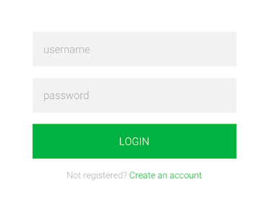
Login Page
Student can create account or Login from this page.
Login is required for saving their information to database.
They can reuse the generated application by login in
the account.

Slide 5
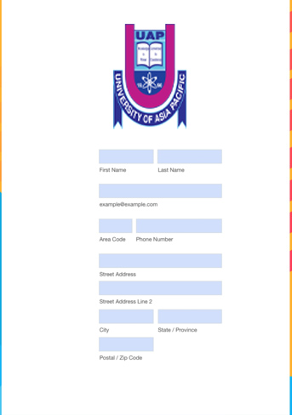
Application Generator Page
Student will need to provide the following data for creating the application:
Name
Registration Number
Subject Code
Subject Name
Then they can click on download or print the application directly.
A copy of the application will be saved on the database

Slide 6
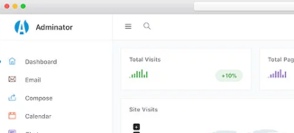
Admin/Faculty Page
Admin or faculty will also require login.
The admin or faculty can see the database.
They can accept or reject an application.

Slide 7
Working Plan
Weeks | Work Plan
Week 4 | Prototype Design
Week 5 | Front End Design
Week 6 | ERD diagram and Database Design
Week 7 | Database create and Database connection
Week 8 | User sing up, sing in and profile
Week 9 | Project Update - 1
Week 10 | Project Update - 2
Week 11 | Project Update - 3
Week 12 | Demo submission
Week 13 | Final project submission
Week 14 | Report submission and Presentation

Slide 8
Conclusion
The Repeat Exam Application Generator will help the student to save their valuable times.
It will keep them free from the overwhelming confusion about the procedure of writing a repeat examination application and registered themselves for repeat examination.

