Slide 1
Basics of Hardware and Software
&
The Programming Process
CSC 101 – Introduction to Computer Science
Lecture 01
Department of
Computer Science and Engineering,
Independent University, Bangladesh
Notes:
Abstract idea in your head ----> binary executable code on a physical machine

Slide 2
Review
First thing-Do you have access to course material in www.piazza.com
Have you managed to download and install codeblock!
Course content, goals and policies
What is Computer Science?
  Computer science has a unique position among the sciences - doesn’t aim to understand the natural (or social)
  Goal of CS is to solve (efficiently) real-world problems using computing devices
  Computer Scientists …
    Identify problems that can be solved using a computer
    Develop (and code) algorithms to solve problems
    Develop software to run programs faster
    Build faster computers
    Design new computing devices
    …
There is much more to computer science than programming but programming is at the heart of many things we do

Slide 3
Review
Computer science has application in many different areas
  Biology and medicine : DNA sequencing
  Meteorology : weather prediction
  Space exploration : computers on space crafts
  Entertainment : movies, games
  Physics : simulation
  …
Design of correct and efficient algorithms plays a big role in computer science

Slide 4
Today
Hardware/Software basics
Programming Process
  From problem formulation to binary execution
C++ program structure
  Write Hello World in class

Slide 5
Hardware and Software
A computer system consists of two types of components
  Hardware
    Physical component
  Software
    Any program
Other types of “wares”
  Firmware
  Malware
Term quite broad
Notes:
Defining software is a little tricky

Slide 6
HW or SW?
Flash Drive
MSN Messenger
Pentium
Web cam
Internet
A picture stored on your hard disk
HW
SW
HW
HW
HW + SW (?)
?

Slide 7
Main Hardware Component Categories
  Central Processing Unit (CPU)
  Main Memory
  Secondary Memory / Storage
  Input Devices
  Output Devices
Why need both primary
and secondary memory?
The
Cloud
What about
supercomputers, servers,
clusters, mobile phones?
Notes:
Conventional machine : desktop/laptop
Why secondary memory? - volatile and size

Slide 8
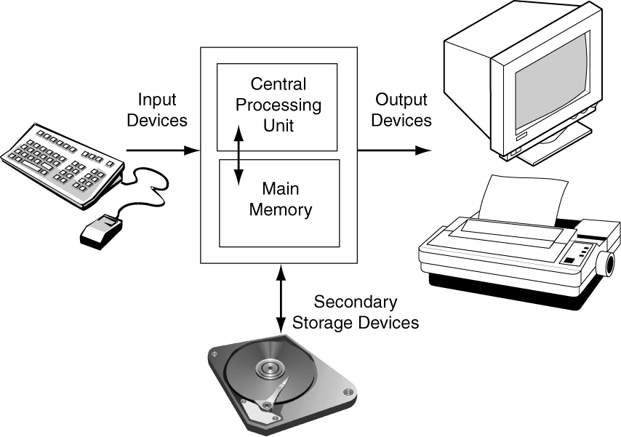
Main Hardware Component Categories
Ones upon a time a computer system…
This figure needs updating!

Slide 9
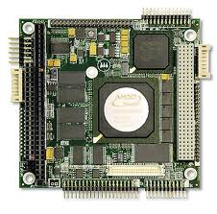
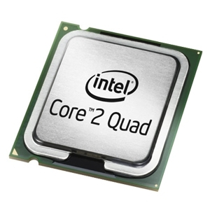
Central Processing Unit (CPU)
Comprised of two types of components
  Control Unit
    Retrieves and decodes program instructions
    Coordinates activities of all other parts of computer
  Arithmetic and Logic Unit (ALU)
    Hardware optimized for high-speed numeric calculation
    Hardware designed for true/false, yes/no decisions
Notes:
CU: managerial role
ALU: everything is just an add
Not uniformly applicable to all types of systems

Slide 10
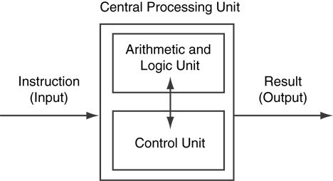
CPU Organization

Slide 11
Software
Categories of software:
  Operating system: programs that manage the computer hardware and the programs that run on them
  Examples: Windows, UNIX, Linux
  Application software: programs that provide services to the user
  Examples : word processing, games, programs to solve specific problems
Notes:
OS: Do some of the dirty work, create an environment that makes it easy for other programs to run, also manage some of these programs. Got to have some OS running on it.

Slide 12


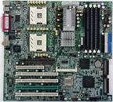
Programming Process
Identify a problem and follow a systematic method to solve it using a computer
Problem statement
English
Need an efficient way to translate our thoughts so that the computer understands what we want it to do

Slide 13
Programming Process
Identify a problem and follow a systematic method to solve it using a computer
Problem statement
Programming
Languages
or
High-level
Languages
C, C++, Java,
Python, Lisp
…
English
Algorithm
Need an efficient way to translate our thoughts so that the computer can understand what we want it to do

Slide 14
design
code
Algorithm
High-level
languages
Problem statement
compile
run
Notes:
Design and coding …

Slide 15
design
code
Algorithm
High-level
languages
Problem statement
debug
compile
debug
run and test
Which step is most challenging?
Which one is most time consuming?
Notes:
Paper writing analogy
Compiler

Slide 16
Programming Process
Involves a number of different steps
  Formulating Problem Statement
  Designing
  Coding
  Compiling
  Running and Testing
  Debugging
3, 4, 5 – required for every program
Ideally want to avoid 6, but unfortunately you will find you are doing this a lot
2 is (technically) optional – but extremely important even for smallish programs that you write for this class
For this class, 1 will be done for you

Slide 17

Developing Algorithms
An algorithm is a set of instructions to accomplish a task or solve a problem
Algorithms have been around for a long time
Many examples of algorithms in our daily life …
Al Khawarizmi *
circa 780 AD
*http://en.wikipedia.org/wiki/Mu%E1%B8%A5ammad_ibn_M%C5%ABs%C4%81_al-Khw%C4%81rizm%C4%AB

Slide 18
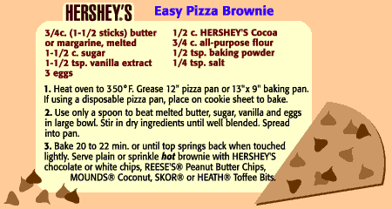

Slide 19
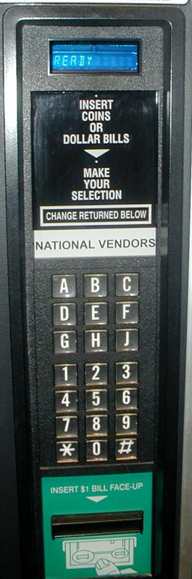

Slide 20
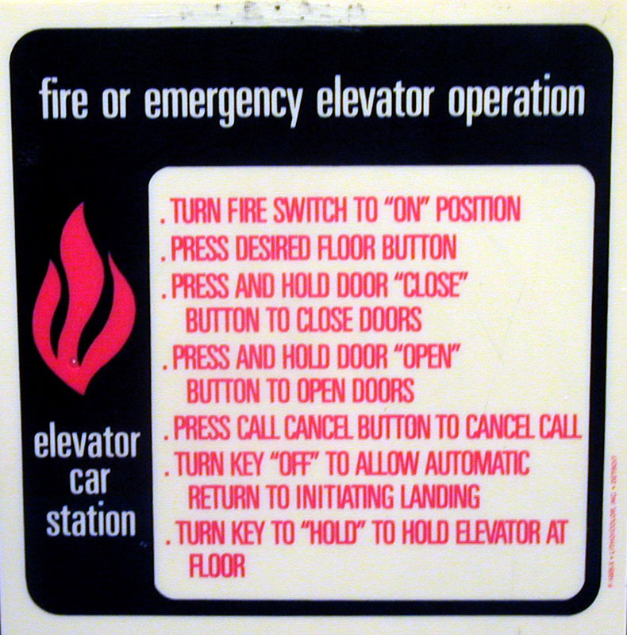

Slide 21
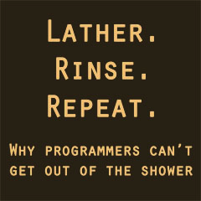
Who are these algorithms intended for?

Slide 22
Algorithms in CS
Developing an algorithm : coming up with the set of instructions
Executing an algorithm : following the instructions
In CS, we develop algorithms that get executed on computer systems
Execution sequence is same as instruction sequence in your algorithm
  The program won’t do anything without you telling it
  The program will do exactly what you tell it to do
Algorithms need to be precise and contain enough details
  No place for “few”, “many”, “some”

Slide 23
Algorithms in CS
Algorithms will typically have three major parts
  Input
  Processing
  Output
Each part is broken down into several sub steps
Getting input and generating output is often fairly easy
  sometimes implicit
Processing the input is where all the cool stuff happens

Slide 24
Algorithm in CS
Algorithms will …
  often work with “values”
    state of being in an emergency
    oven temperature
  need to make “decisions”
  need to “repeat” a sub task many times
    shampoo example

Slide 25
Developing an Algorithm : Example
Develop an algorithm for
  going to Las Vegas from this classroom
Assume,
  Algorithm will be executed by a classmate
  Classmate has a bus ticket to Vegas for this afternoon
  Other
    Classmate knows what a plane is
    Classmate knows what an airport is
    …

Slide 26
Algorithm to get to Vegas
Leave classroom
Walk to parking garage
Find car
Drive to airport
Park car at parking lot
Drive to airport
Leave car and head towards terminal
Look at monitor for your flight information
Go through security
Find gate
Wait until boarding time
Board plane
There is no magic
Board plane to
Vegas
De-board
when plane lands
Unbuckle seat belt
Get luggage from overhead bin
Slowly walk out
Head towards baggage claim

Slide 27
Algorithm to get to Vegas
Get up from seat
Grab backpack
Walk to door
Leave classroom
Walk to parking garage
Find car
Drive towards airport
Park car at parking lot
Drive to airport
Start car
Fasten seatbelt
Put Trans on reverse
Press on gas
Leave car and head towards terminal
Get boarding pass
Look at monitor for gate information
Go through security
Find gate
Wait until boarding time
Board plane
Board plane to
Vegas
Put Liquids in a clear plastic bag
Take off shoes
Walk through metal detector
De-board
when plane lands
Unbuckle seat belt
Get luggage from overhead bin
Slowly walk out
Head towards baggage claim
There is no magic

Slide 28
Techniques for Developing Algorithms
Previous algorithm is a (very) simple example of abstraction
  Breakdown the problem in conceptually high-level pieces
  Reason about the high level concepts, assuming we know how to do the smaller tasks
Somewhat analogous to creating an outline for a paper
Abstraction is a very powerful tool in programming and in CS in general

Slide 29
Techniques for Developing Algorithms
Ask “how would I solve the problem?”
Need to write a program to find the shortest route from San Marcos to ABIA (e.g., GPS)
  Which route would I take?
  How would I come to that decision?
  What information does the computer need?

Slide 30
Techniques for Algorithm Development
Simplify and solve the simple cases first
Example :
  An algorithm for detecting palindromes
  madam, racecar
What’s the simplest case?
Problems can often be characterized by the size of the input data
  multiply two matrices

Slide 31
Techniques for Developing Algorithms
Practice!
Try solving problems on your own – outside the ones assigned for this class
Games help
  Sudoku (not the math part)
  Mastermind
Puzzles help
  Five friends go to dinner, A can’t sit next B, C needs an empty chair next to her …
Do NOT Look at the solution-THINK

Slide 32
Coding
We have an algorithm now we are ready to code
  Choose a programming language
  Choose a text editor - NOT Word!

Slide 33
IDE
Integrated Development Environment-IDE
IDE’s allow us to do all but one of the steps we talked about in one single environment
  Write code
  Compile
  Run
  Debug

Slide 34
IDE
In the lab this week you will get an introduction to the IDE we will be using for the course
  CODE :: BLOCK IDE for C++
There are many advantages to using an IDE
There are some bad things about IDE’s as well
  Not discussed in this class!

Slide 35
Programming Advice
Understand the problem
  Refine the problem statement if necessary
Sketch out the algorithm on paper
  Recall the basic algorithm structure
    input -> processing -> output
Don’t do everything on paper
  Need to express the algorithm using the syntax of the language so that the compiler can translate it for the machine
Don’t be frustrated if your program doesn’t work at first (or the 100th try!)

Slide 36
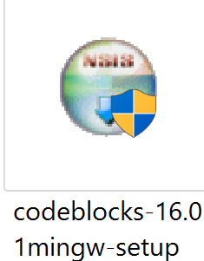
Let’s Do it
We will use Code::Block, an open source IDE
Download: codeblocks (Latest Version)
from
https://sourceforge.net/projects/codeblocks/files/Binaries/16.01/Windows/codeblocks-16.01mingw-setup.exe/download
Click on this icon in the download folder of your computer to install code::block

Slide 37
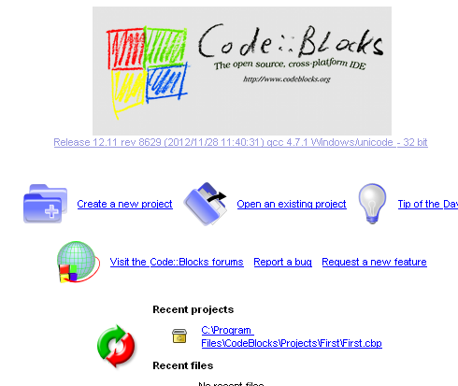

The Very First Computer Program in Code::Block
1. double click on the code::blockes icon on your desktop.
You will see this:
Click “ Create a new project”,

Slide 38
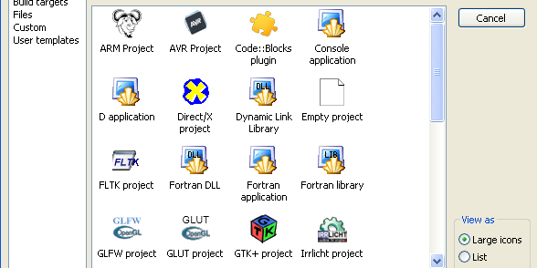
The Very First Computer Program in Code::Block
You will see this
Click “Console application ”

Slide 39
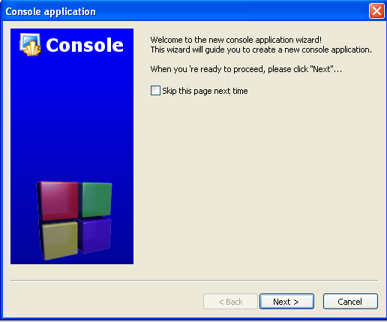
The Very First Computer Program in Code::Block
You will see this
Click “Next ”

Slide 40
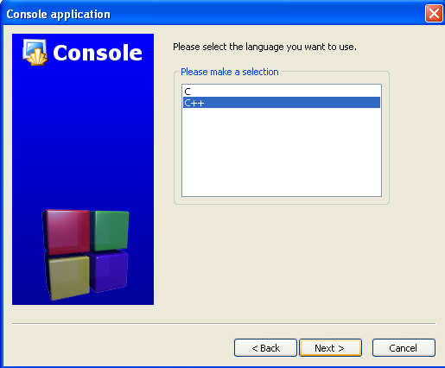
The Very First Computer Program in Code::Block
You will see this
Select “C++” and Click “Next ”

Slide 41
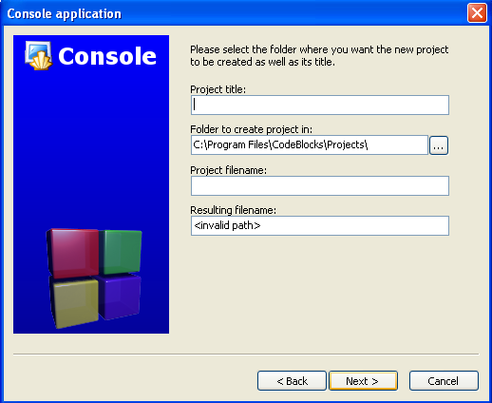
The Very First Computer Program in Code::Block
You will see this:
Write the name of the Project
Select location where you want to save your project
Click “Next”
First

Slide 42
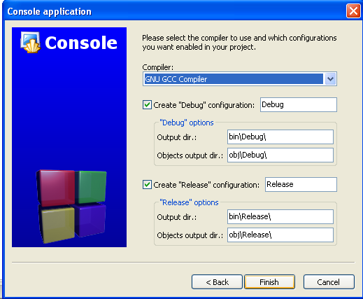
The Very First Computer Program in Code::Block
You will see this
Click “Finish”

Slide 43
The Very First Computer Program in Code::Block
You will see this
Click “Finish”

Slide 44
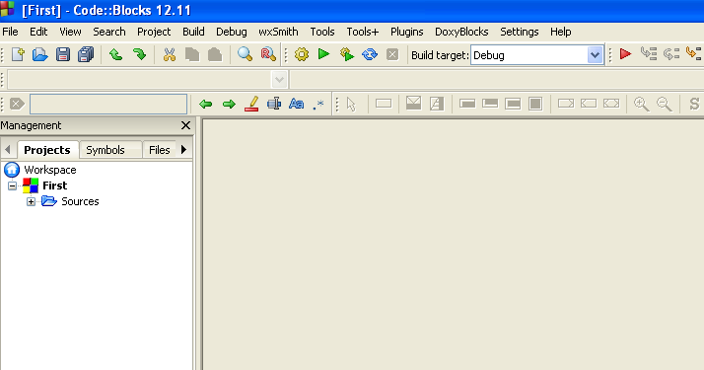
The Very First Computer Program in Code::Block
You will see this
Click on the +

Slide 45
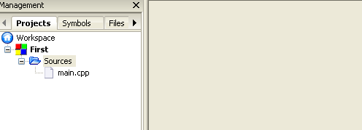
The Very First Computer Program in Code::Block
You will see this
Double Click on the main.cpp

Slide 46
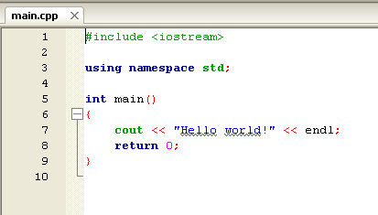
The Very First Computer Program in Code::Block
You will see this
This is your first program, you can edit this and print your name

Slide 47
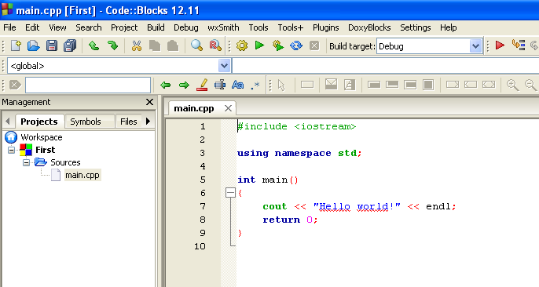
The Very First Computer Program in Code::Block
Click this to compile and run your code

Slide 48
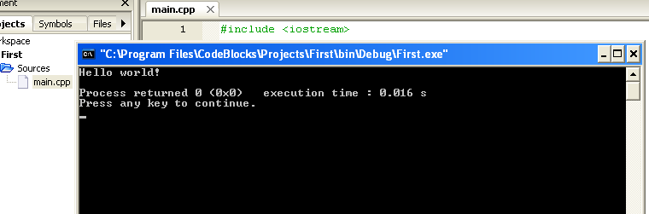
The Very First Computer Program in Code::Block
You will see the OUTPUT of the program you just wrote

Slide 49
Extra Slides
(not covered in class)

Slide 50
Compiling
Translate to a language that is more suitable for the machine to understand
  Ingeniously named “machine language”
The ‘compiler’ does this for us
  The compiler is just another program running on your computer
  Compilers are usually associated with a particular language
Does our program compile?
  What do we do if it doesn’t?
    Compilation error
    Go back to source code
    Unpleasant process known as ‘debugging’
Notes:
Part of the reason why HLL is so restrictive

Slide 51
What Happens Next?
Code is translated to machine language and produces object code
We can look at the ‘human-readable’ version of the machine code
  Assembly language
  Program looks more like a sequence of arithmetic operations
  Some of the stuff is quite obscure
Thankfully we don’t have to worry about that for this course

Slide 52
Running
Now we are ready to run our program
Is it running correctly?
  How do we know?
  Try out a lot of different test cases
  Known as the testing phase
What if our program is not working correctly?
  We have at least one run-time error
  Go back to source code
  Unpleasant process known as ‘debugging’

