Slide 1
Operators
CSC 101 – Introduction to Computer Science
Lecture 03
Department of
Computer Science and Engineering,
Independent University, Bangladesh

Slide 2
Review
statements
  assignment statement
  output statement
  input statement
variables
literals
keywords
  using, namespace, int, float, double, char, bool, include
comments

Slide 3


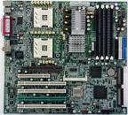
design
Languages
C
C++
Java
Python
Algorithm
code
High-level
languages
A language is not a software!
Problem statement
Compilers
GCC
G++
Visual C++
javac
Compiler is a software that will translate high-level code to binary
Usually named after the language
debug
compile
debug
run and test
IDE
Eclipse
Visual Studio
Dev C++
Platform by OS
Windows
Mac
Linux
Platforms by architecture
x86 (Intel, AMD)
Power (IBM)
IDE is a software that will package an editor, a compiler, and a debugger

Slide 4
Expressions
C++ allows us to create complex mathematical expressions by combining variables and literals with operators
An expression is a statement that has a value
An expression never appears on the left-hand side of an assignment statement
  x + y + 17 = 0;

Slide 5
Parts of an Expression
An expression can be a combination of the following elements
  Literal: 17, 2.54, ‘C’, “hello”
  Variable: x, numberOfFriends
  Operators: +, -, <, >
Examples
    a = 17;
    b = 17 + a;
    c = 5 + 2 * numberOfFriends - 4 / 10;

Slide 6
Expression I/O
cout will output the value of an expression
    cout << 17 * 3 - 9 << endl;
displays 42
we can also do chained output of expressions
  cout << "John " << "3:" << 17 - 1;
displays John 3:16

Slide 7
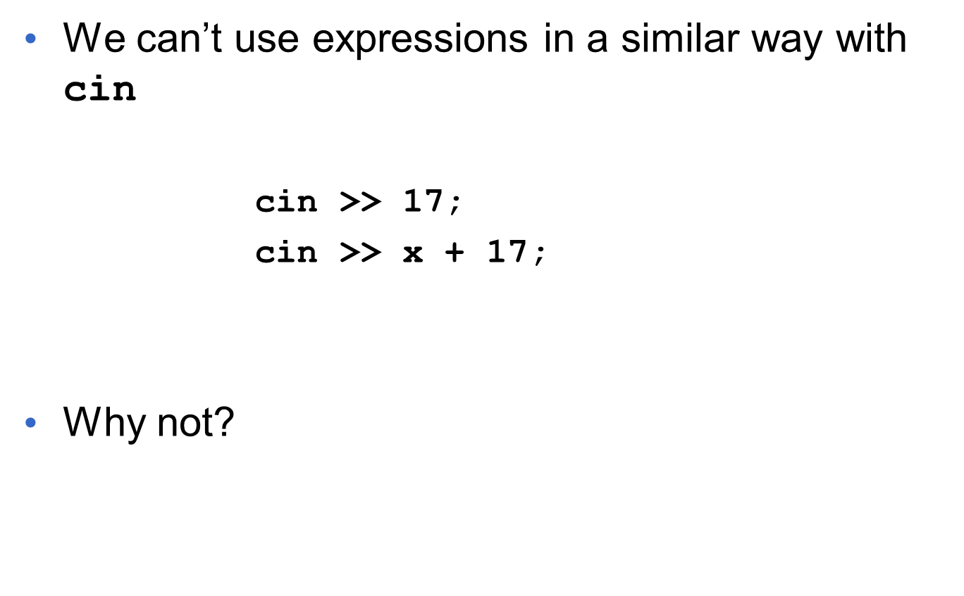
Expression I/O

Slide 8
Advantages of Using Expressions
Expressions can
  shorten the length of a program
  reduce the need for some variables
  sometimes make it easier to follow the logic

Slide 9
Operators
We have the basic math operators
  + - * /
We have the comparison operators
  < > >= <= ==
We have some operators that are less frequently used
      % modulus or remainder
      - unary negation
Don’t confuse this with percentage

Slide 10
Operator Precedence
If an expression contains more than one operator then which operation is performed first is determined by operator precedence
Precedence hierarchy of arithmetic operators is pre-defined in the C++ language
Similar to precedence rules you used for high-school arithmetic
PEMDAS

Slide 11
Operator Precedence in C++
    - (unary negation)
    * / %
    + -
For operators with same precedence perform
operations from left to right

Slide 12
About the Division Operator
Results of an algebraic or arithmetic operation depends on the data type of the operands
This becomes problematic for division operations in particular
    int / int -> int
    double / double -> double
So,
7/5 == 1
If you want a decimal number then you need to convert one of the operands to floating-point
7.0/5 == 1.4
demo

Slide 13
A Few More Operators
Shorthand Operators
  Combine addition and assignment : +=
  Combine multiplication and assignment : *=
  Combine other arithmetic operators and assignment :
  -=, /=, %= …
  x = x + 17;
  is equivalent to
  x += 17;
Included in the language for convenience

Slide 14
The Post-Increment Operator
Addition of 1 to a variable is done so frequently in programs that we have a special operator for that purpose
x = x + 1;
  is equivalent to
  x++;
Partly how C++ gets its name
Other similar operators: x--, ++x and --x

Slide 15
Strings in C++
The string data type is special
  Composite data type
    contains a string of characters (char data types)
  C++ has a library for handling strings
The string “Hello World!” is actually stored as
H | e | l | l | o |  | W | o | r | l | d | !

Slide 16
Using Strings
We can declare string variables just like variables of the other data types
    string firstName, lastName;
We can assign string literal values to string variables
  firstName = "Quentin";
  lastName = "Tarantino";

Slide 17
String Input and Output
We can display string variables and literals using cout
cout << firstName << " " << lastName;
We can read text input from the keyboard into a string variable using cin >>
    string firstName;
    cout << "Enter your first name: ";
    cin >> firstName;

Slide 18
String Comparison
Can use relational operators to compare strings
For us, the most useful one is the equality operator ==
firstName == secondName
Returns true if the two strings are identical, false otherwise

Slide 19
String Comparison
There are other relational operators, such as > and < that compare the length of two strings
firstName < secondName
Returns true if firstName has fewer characters than secondName, false otherwse

Slide 20
String Operators
OPERATOR | MEANING
>> | extracts characters from stream up to whitespace, insert into string
<< | inserts string into stream
= | assigns string on right to string object on left
+= | appends string on right to end of contents on left
+ | concatenates two strings
[] | references character in string using array notation
>, >=, <, <=, ==, != | relational operators for string comparison. Return true or false
We will learn how to use some of these later in the semester
For now just know they are out there

Slide 21
Named Constants
Sometimes we may want to give a name to a literal and refer to the name rather than the literal itself
const double PI = 3.1415926536;
Using named constants is good practice
Program will still compile and run even if you do not use named constants
Program will not compile if you use them incorrectly
STYLE
Rule of thumb: If you are using the same literal (other than 1) more than once, declare it as a constant
Notes:
Variable will always have a name

Slide 22
Identifier Rules
An identifier is a programmer-defined name for some part of a program: variables, functions, etc.
A variable (or function) name should represent the purpose of the variable (or function)
For example:
numberOfFriends
Rather than
n1 or f
Stylistic issue, but an important issue
Increases readability, reduces coding time, avoids errors
STYLE

Slide 23
Identifier Rules
The first character of an identifier must be an alphabetic character or an underscore ( _ ),
After the first character you may use alphabetic characters, numbers, or underscore characters.
Of course upper- and lowercase matters
Cannot use a keyword as an identifier

Slide 24
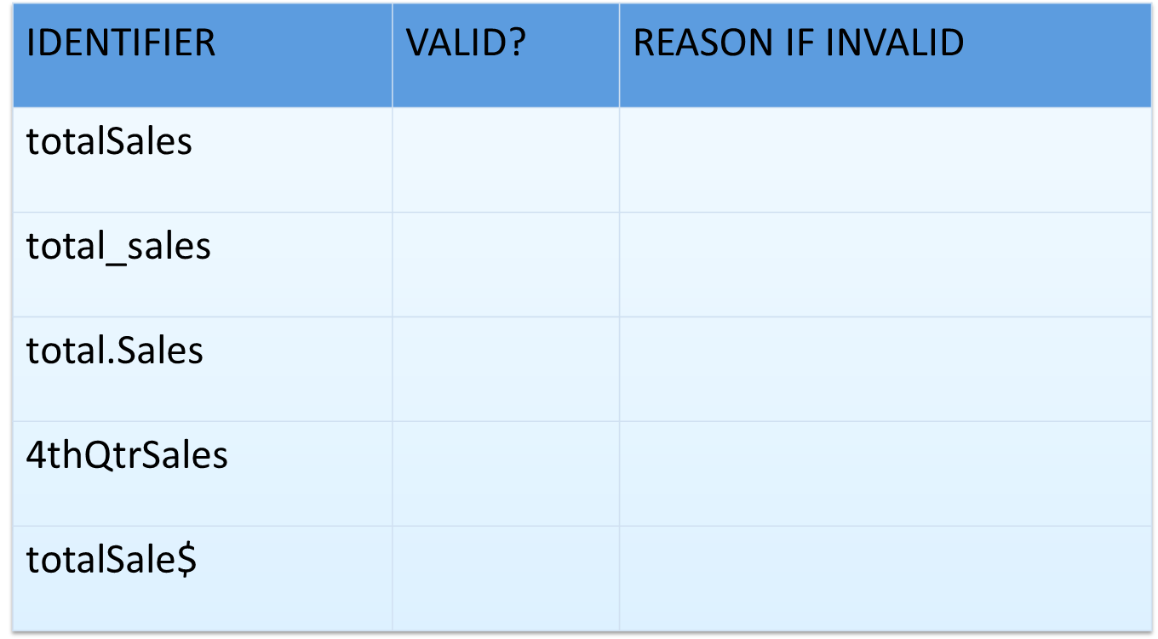
Valid and Invalid Identifiers

Slide 25
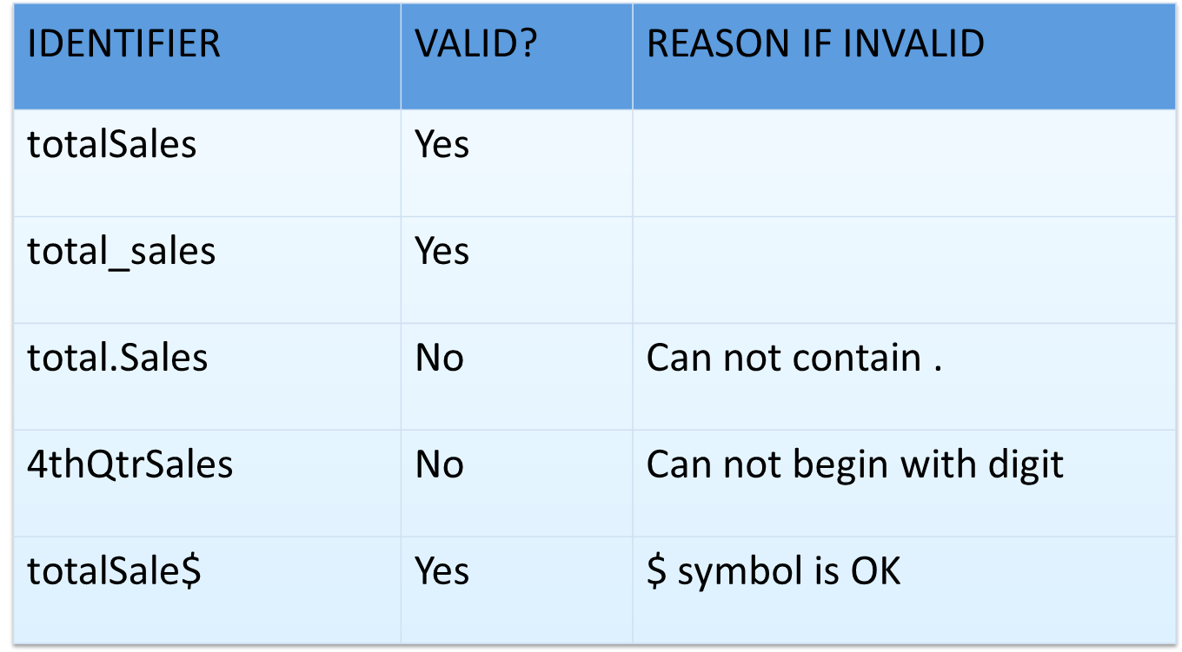
Valid and Invalid Identifiers

Slide 26
// sample C++ program
#include <iostream>
using namespace std;
int main() {
int friendCount;
string name;
name = "Quentin”;
friendCount = 17;
cout << name << "has " << friendCount;
cout << "friends." << endl ;
return 0;
}

