Slide 1
Nested Loops
CSC 101 – Introduction to Computer Science
Lecture 08
Department of
Computer Science and Engineering,
Independent University, Bangladesh

Slide 2
Today
  - Nested loop statements
  - Breaking out of a loop
  - Sorting

Slide 3
Nested Loops
A nested loop is a loop inside the body of another loop
Inner (inside), outer (outside) loops
      for (row = 1; row <= 3; row++) //outer
      for (col = 1; col <= 3; col++) //inner
      cout << row * col << endl;
Useful for processing 2D arrays
      while( !done ) { //outer
      ...
      ...
      for (int i = 0; i < N; i++) //inner
      cout << i << endl;
      ...
      }
Will need this for Assignment 2

Slide 4
Nested Loops
Inner loop goes through all repetitions for each repetition of outer loop
Inner loop repetitions complete sooner than outer loop
Total number of repetitions for inner loop is product of number of repetitions of the two loops.

Slide 5
Breaking Out of a Loop
The break statement can be used to cause immediate termination of a loop
Place break in loop body inside an if statement
while (count < MAXCOUNT) {
// do stuff
if (reachedThreshold)
break;
// do some other stuff
}
Use with caution
  makes code harder to understand and debug
When used in an inner loop, terminates that loop only and goes back to outer loop
demo

Slide 6
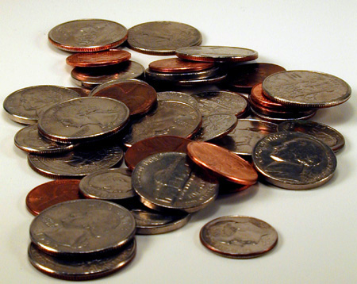
Providing Change
(Back in the day) when we bought stuff with cash, the cashier at the store had to
  calculate the amount of change owed to the customer and
  determine the coins and bills that make up that change
Today, most cash registers will do 1, but few will do 2.
We will write a program to do task 2

Slide 7
Providing Change
Lets do a few examples
What coins and bills would we hand back if …
  we owe the customer $ 0.41
    Four dimes and a penny
    A quarter, a dime, a nickel and a penny
    Eight nickels and a penny
  we owe the customer $ 23.36
    A twenty, three ones, three dimes, a nickel and a penny
What assumption are we making here?

Slide 8
Providing Change
Think about the problem …
Assume
  All change provided in coins
  Infinite coins in each denomination
    Implies we always have a solution
Input to the program
  Amount of change owed
Output
  Minimum number of coins

Slide 9
Providing Change
In reality, the solution is going to be constrained by the number of coins we have in each denomination
The algorithm we just implemented is an example of a “greedy algorithm”
  Choose the best one at each step
This algorithm is applicable to many other situations
  Network routing algorithms
  Traveling Salesman Problem

Slide 10
Sorting
One of the most common applications in CS is sorting
  arranging data by their values: {1, 5, 3, 2} → {1, 2, 3, 5}
There are many algorithms (methods) for sorting
  Selection Sort
  Bubble Sort
  Insertion Sort
  Quick Sort
  Merge Sort
  Heap Sort
Based on iteratively swapping two elements in the array so that eventually the array is ordered.
  The algorithms differ in how they choose the two elements.
In here, we use Bubble-Sort as an Example. Interested students may also find the details of Insertion Sort from textbook (p82-83).
You may use whatever algorithm in assignment /exam
"Classic" sorting algorithms
Faster, more complex sorting algorithms

Slide 11
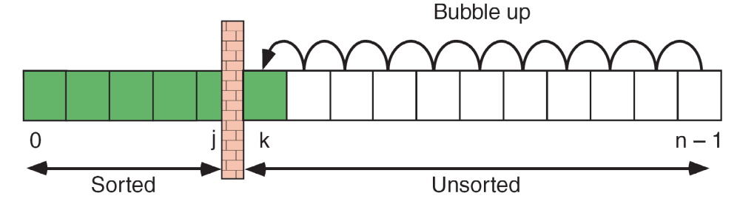
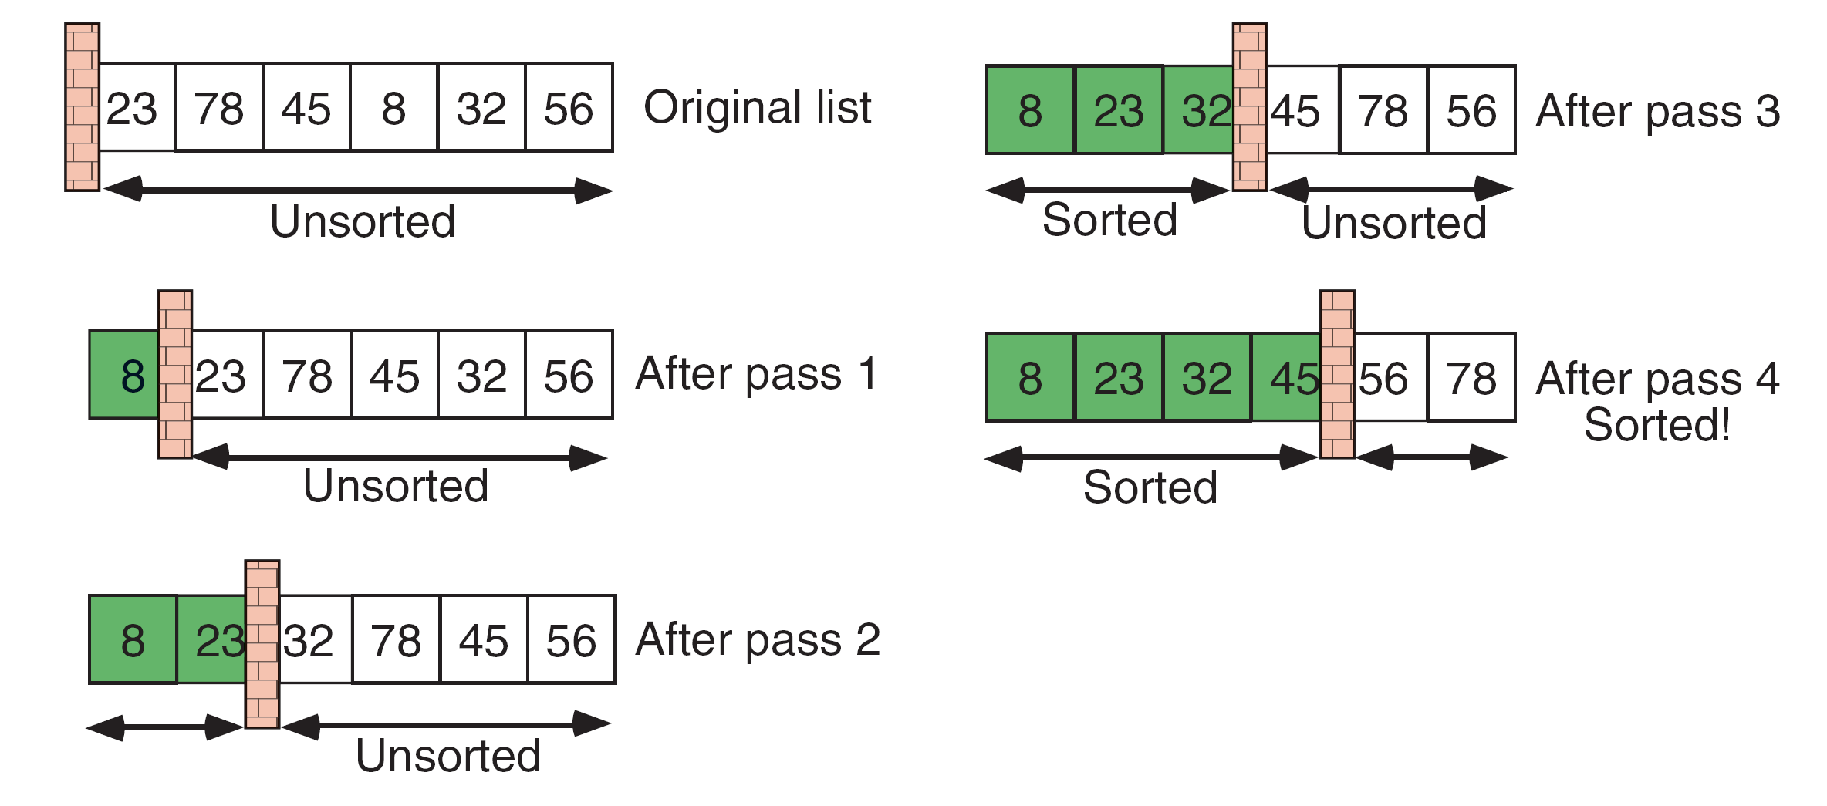
Bubble Sort
The array is divided into two parts: sorted and unsorted.
Initially the whole array is unsorted.
In each pass, start from the end, we swap neighboring elements if they are out of sequence (so called "bubbling up").
Inner Loop (Bubbling)
Outer Loop (Pass)
23 | 78 | 45 | 8 | 32 | 56
Bubbling
23 | 78 | 45 | 8 | 32 | 56
Original
23 | 78 | 45 | 8 | 32 | 56
23 | 78 | 8 | 45 | 32 | 56
After Pass 1
23 | 8 | 78 | 45 | 32 | 56
8 | 23 | 78 | 45 | 32 | 56
Sorted

Slide 12
Bubble Sort
After bubbling up, the smallest element must be at [0]
If we repeat the whole bubbling again, the second smallest element is in [1]
In other words, if we repeat for N-1 times, the whole array will be sorted!
bubble-sort dance: http://youtu.be/lyZQPjUT5B4

Slide 13
#include <iostream>
using namespace std;
const int n=10;
void main() {
int a[n], j, k, tmp;
cout <<"Input" << n <<" numbers: ";
for (j=0; j<n; j++)
cin >> a[j];
// j = pass no. = length of sorted region
for(j=0; j<n-1; j++) // outer loop
for(k=n-1; k>j; k--) // bubbling
if (a[k]<a[k-1]) {
tmp = a[k]; // swap neighbors
a[k] = a[k-1];
a[k-1] = tmp;
}
cout << "Sorted: ";
for(j=0; j<n; j++) cout << a[j];
}
Bubble Sort
Demo!
j=0
F
j++
j<n-1
Bubbling
T
F
k=n-1
k--
k>j
T
a[k]<
a[k-1]
F
T
swap a[k] and a[k-1]
CS2363 A

Slide 14
So difficult to remember the indexes?
In here, we loops as long as k>j, since we know that numbers before j are sorted. But actually it's not a great deal if we check up to 0 !
(even though it's unneeded and waste time…)
2
for(j=0; j<n-1; j++) // outer loop
for(k=n-1; k>j; k--) // bubbling
if (a[k]<a[k-1]) {
tmp = a[k]; // swap neighbors
a[k] = a[k-1];
a[k-1] = tmp;
}
In here, bubbling is done by:
Starting from the end (n-1), and
Bubbling the small numbers up (k--)
But actually, it's also equivalent if we:
-Start from the front (0), and
-Sinking the large numbers down (k++)
1

Slide 15
So difficult to remember the indexes?
for(j=0; j<n-1; j++) // outer loop
for(k=n-1; k>j; k--) // bubbling
if (a[k]<a[k-1]) {
tmp = a[k]; // swap neighbors
a[k] = a[k-1];
a[k-1] = tmp;
}
Change 1: Loop from the front
Change 2: Loop the whole array
Now, both loops go from
0..n-1, easier to remember!
(although it's slower…)
for(j=0; j<n-1; j++)
for(k=0; k<n-1; k++)
if (a[k]>a[k+1]) {
tmp = a[k];
a[k] = a[k+1];
a[k+1] = tmp;
}
Since we start from0
So we compare [k] with [k+1]
(instead of [k-1])

