Slide 1
Parameter Passing Modes
CSC 101 – Introduction to Computer Science
Lecture 14
Department of
Computer Science and Engineering,
Independent University, Bangladesh
Some slides adopted from Gaddis

Slide 2
Today
Parameter passing to functions
Pass by Value
Pass by Reference

Slide 3
Review
Passing values into functions
  arguments vs. parameters
  three rules for parameter passing
Usage of the return statement
  return a value to the caller
  stop function execution
Scoping Rules
  local variables in functions
  function parameters
  global variables

Slide 4
Parameter Passing
In C++, parameters can be passed to a function in two ways
  pass by value
    use this when we don’t want the parameter value to be changed after execution
  pass by reference
    use this when we do want the parameter value to be changed after execution
This is the mode we have seen so far in class

Slide 5
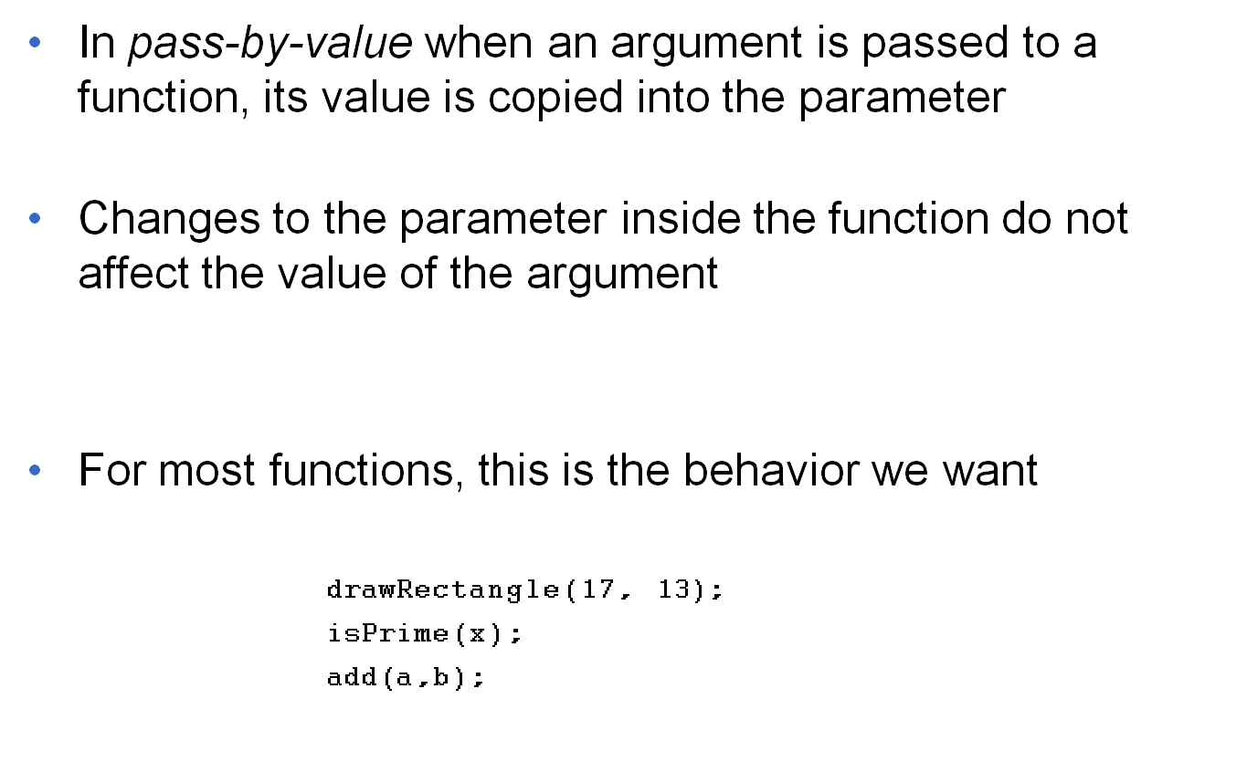
Passing Data by Value
One-way communication

Slide 6
Passing Data by Value
bool doSomething(int num);
int main() {
int val = 5;
doSomething(val);
}
val
num
5
5
argument in
calling function
parameter in callee
main()
doSomething()

Slide 7
Passing Data by Reference
There are some situations when we want the parameter values to be modified inside the function
We use this mode when we are interested in getting back more than one result/value from the caller
If we need only one value back we can use the return statement
      char readChoice();
      mychar = readChoice();
Can’t use return if we need more than one value back
      int getHumanMove();
      int row = getHumanMove(); // returns row only, not col
Pass-by-reference gives us the power to return more than one value
typical examples are array initializations and updates

Slide 8
Passing Data by Reference
Pass-by-reference is implemented using reference parameters
Reference parameters are special parameters that allow a function to work with the original argument from the function call, not a copy of the argument
Allows for two-way communication

Slide 9
Passing Data by Reference
bool doSomething(int& num);
int main() {
int val = 5;
doSomething(val);
}
val
num
5
5
argument in
calling function
parameter in callee
main()
doSomething()
Argument and parameter refer to the same memory location

Slide 10
Pass-by-reference Syntax
A function parameter is designated as a reference parameter using the ampersand (&) symbol
    void getDimensions(int& x, int& y);
Each reference parameter must contain &
Space between data type and & is unimportant
    int& x is equivalent to int & x
Must use & in both prototype and header

Slide 11
Pass-by-reference Notes
Argument passed as reference parameter must be a variable, cannot be an expression or constant
      int myfunc(int &x);
      myfunc(17); // doesn’t work
Use pass-by-reference only when needed
  don’t use when argument should not be changed by function or when function needs to return only one value
  use of too many reference parameters makes debugging difficult
why?
demo

