Slide 1

choose the right A-level subjects
personalised recommendations
Smart Educational Recommendations
students and professionals
real-world insights

Slide 2
Aims & Objectives
Problem: Students struggle to choose the right A-level subjects, often without reliable guidance
Target Users: Secondary school students
Objectives/Success criteria:
Identify gaps in existing guidance tools.
Analyse links between subjects, university courses, and careers.
Design clear, user-friendly UI/UX with personalised recommendations.
Build and test a working prototype.
Refine based on feedback and evaluate usability and accuracy.

Slide 3
State of the Art
Related platforms:
UCAS, Prospects, The Student Room, reddit forums
Gap:
These provide static information and lack interactive, personalised recommendations and peer-driven insights
Adding value:
Combining subject recommendations, real stories, and career/uni mapping

Slide 4
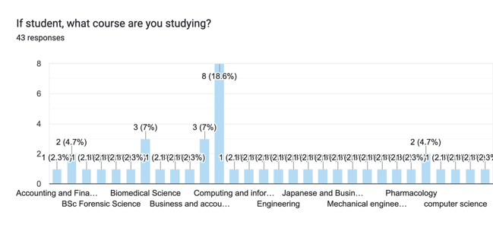
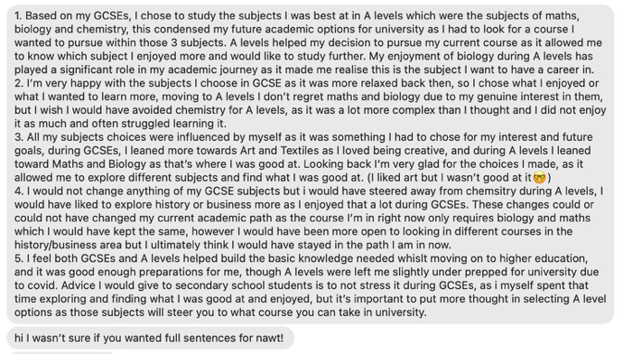
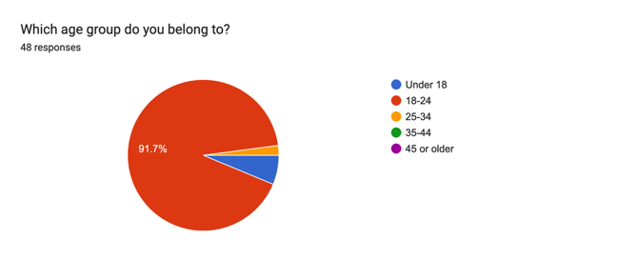
Methodology & Analysis
Agile over Waterfall- Scrum feedback, DSDM (fefoevdep)
Research - gathered requirements from students

Slide 5
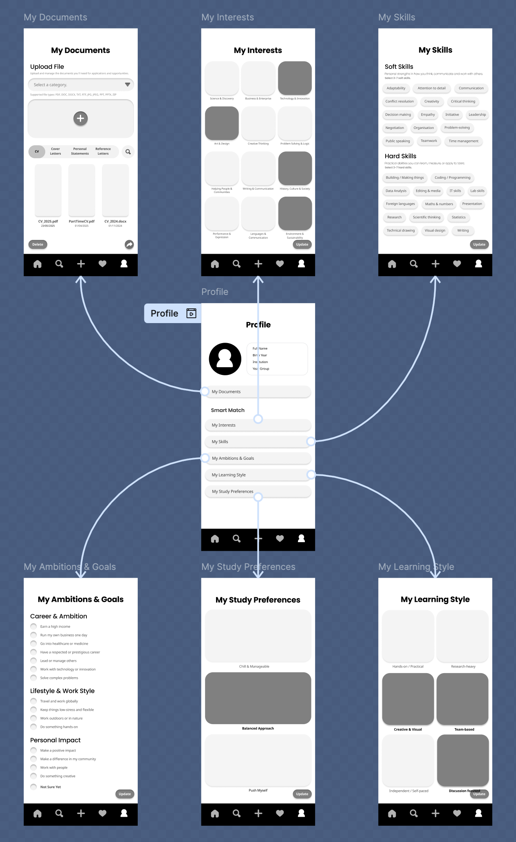
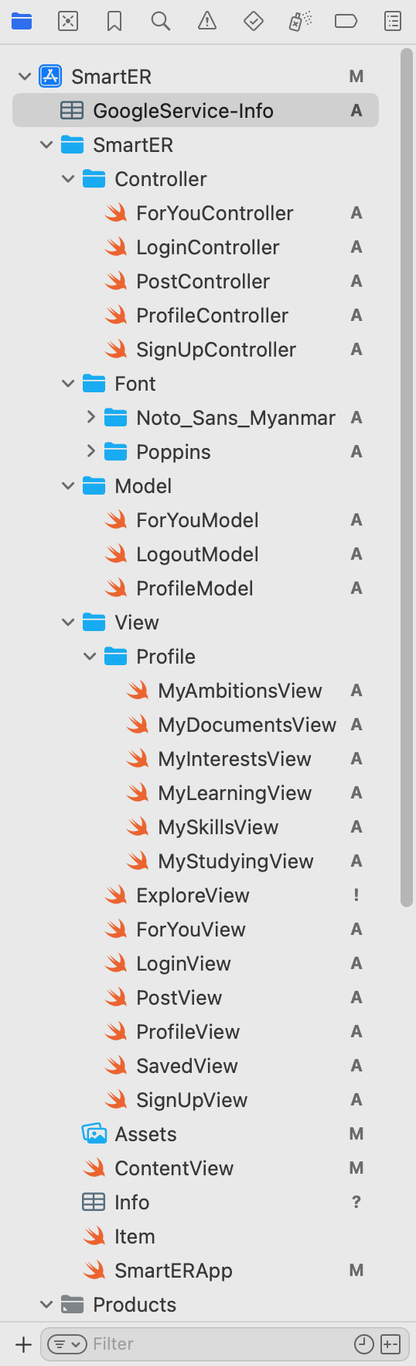
Design & Implementation
Low, mid, high-fidelity wireframes
SwiftUI and Xcode to build the app
Challenges- recommendation logic with limited data was challenging- I overcame it by building a rule-based mapping (e.g., linking interests to subjects).”

Slide 6
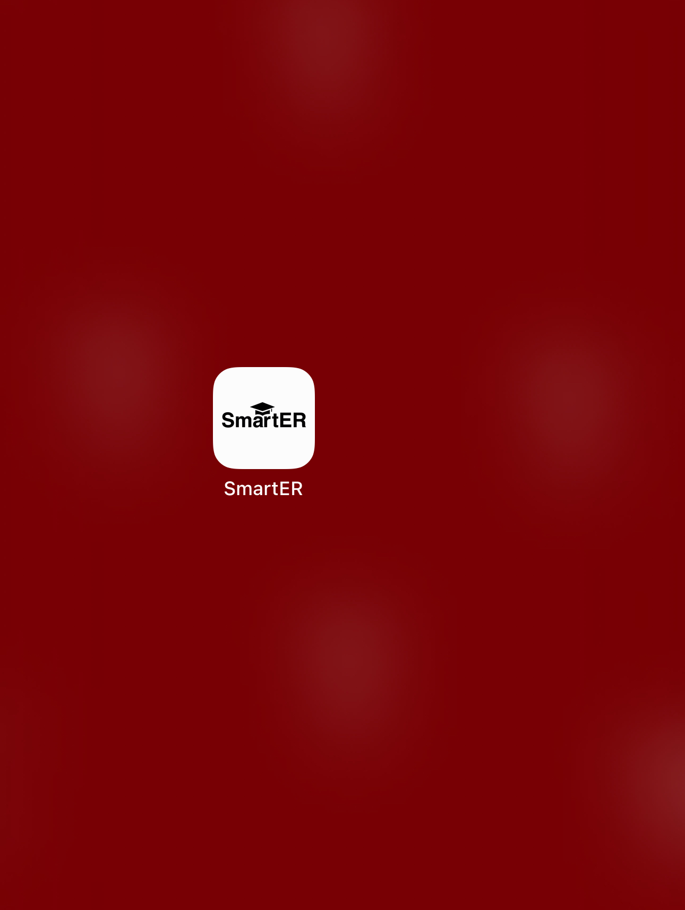
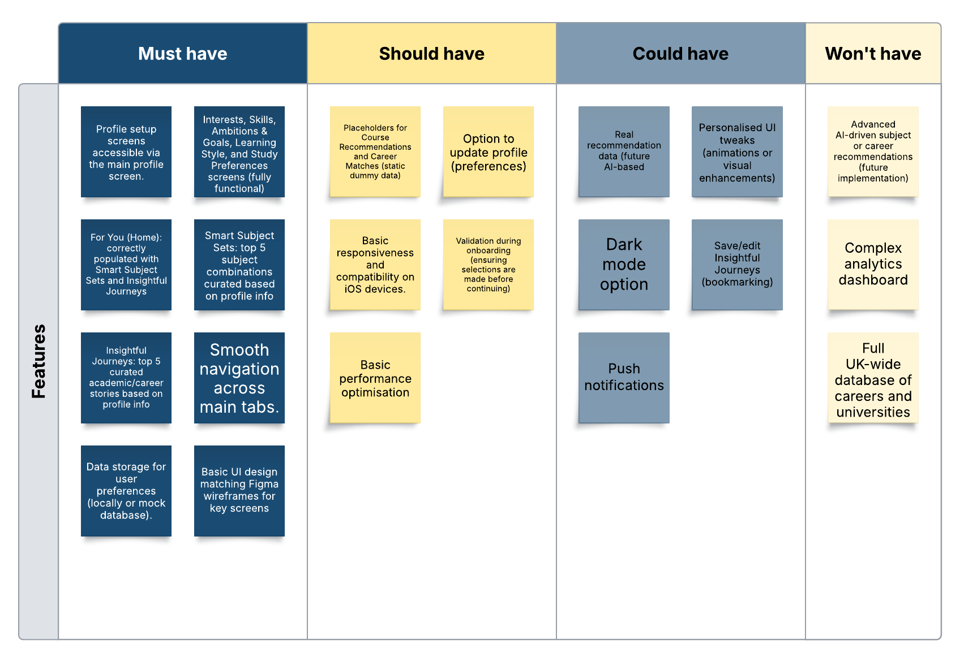
Demonstration

Slide 7
Testing and Validation
Usability Testing:
Students tested the app for ease of navigation, clarity of UI elements, and overall experience.
System Testing:
Verified that key features (profile data storage, Smart Subject Sets) worked as intended across the flow
Feedback:
Positive response for UI simplicity and structure, but users wanted more subject examples and stories

Slide 8
Reflection
What to improve:
More data integration and a stronger algorithm for recommendations
Skills learned:
SwiftUI, user-driven design, and how to iterate quickly based on testing
Potential:
Scale with more data and partnerships with education platforms

Slide 9
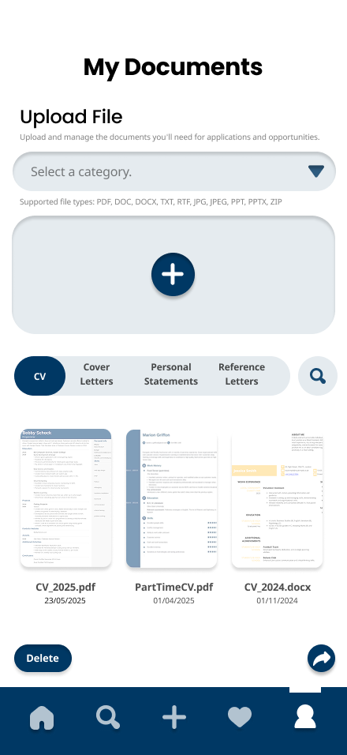
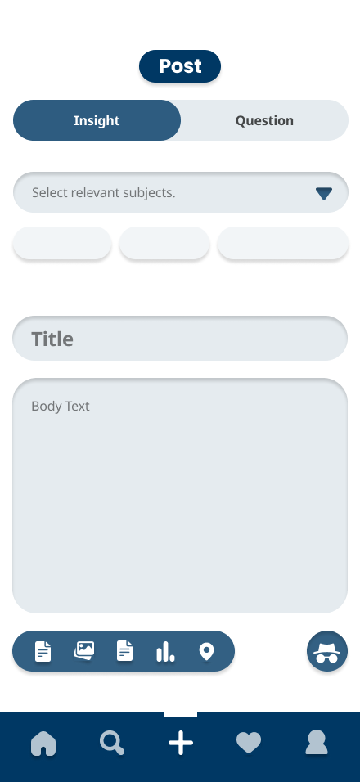
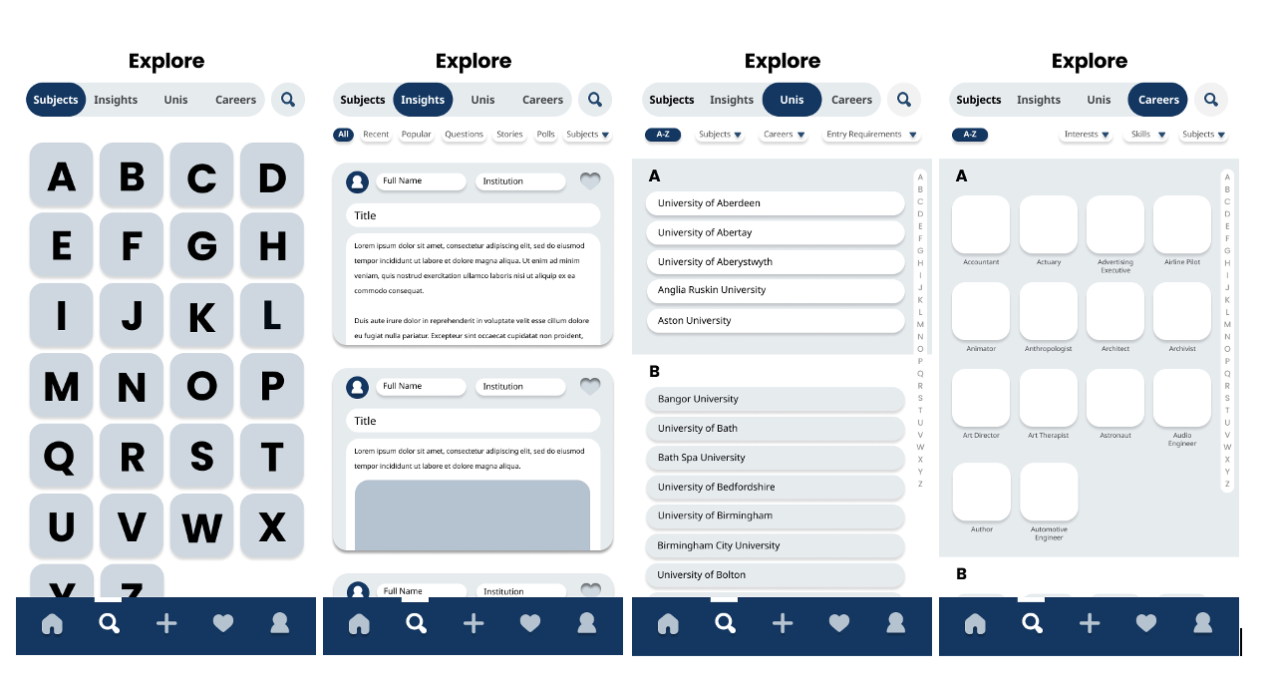
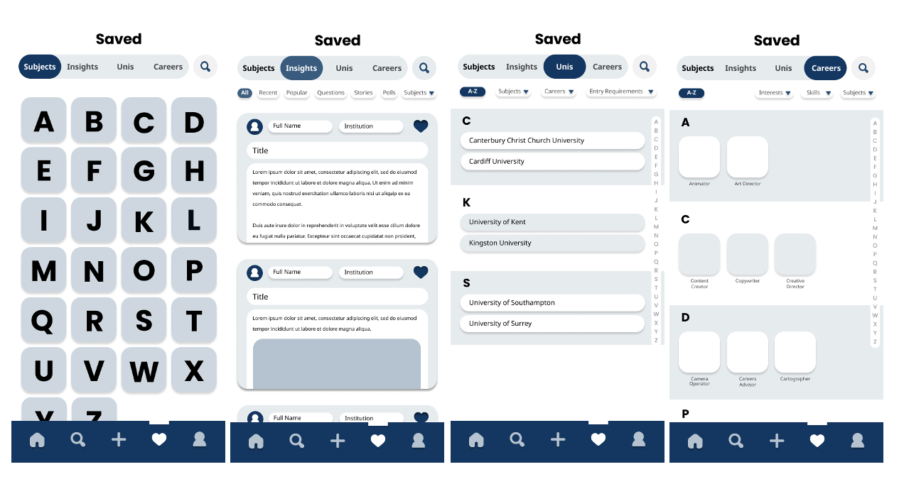
What next?

