Slide 1



Spotify
A Data-Driven Evolution for Spotify

Slide 2

Our team
Anvesh Ratna Alluri
Ashish Rogannagari
Lasya Nadagiri
Meher Venkat karri
Prajeeth Nakka

Slide 3
Agenda
Introduction:
- Who are they, what do they do?
Competitors:
- Key rivals and their impact.
project Importance:
- Why this analysis matters.
Objectives:
- Goals for personalization, engagement, and growth.
Challenges:
- Competition, costs, and privacy risks.
Solutions:
- Data-driven strategies and dashboard insights.
Before & After:
- Spotify’s transformation using data.
Lessons & Improvements: Key takeaways and future opportunities.

Slide 4



Introduction
is the world’s leading music streaming platform,
celebrated for its personalized listening experiences, extensive music catalog, and cutting-edge features.
Launched in 2008, it has grown to serve 500 million users across 180+ countries as of 2024, offering both freemium and premium subscription models.
Spotify leverages advanced AI and machine learning algorithms to create unique user experiences, including curated playlists and real-time recommendations, making it a dominant force in the global music streaming industry.

Slide 5
what they do ?
Music Streaming: Offers a vast library of songs across genres and languages for online listening.
Podcast Streaming: Hosts and streams diverse podcasts, including exclusive content.
Personalized Recommendations: Provides curated playlists and music suggestions based on user preferences.
Freemium and Premium Models: Offers free, ad-supported streaming and a paid, ad-free premium subscription.
Content Creation & Distribution: Supports artists and podcasters with tools for uploading, distributing, and analyzing content globally.
Global Reach: Operates in over 180 countries, making music and audio accessible worldwide.

Slide 6




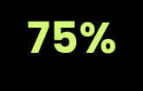
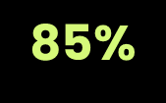
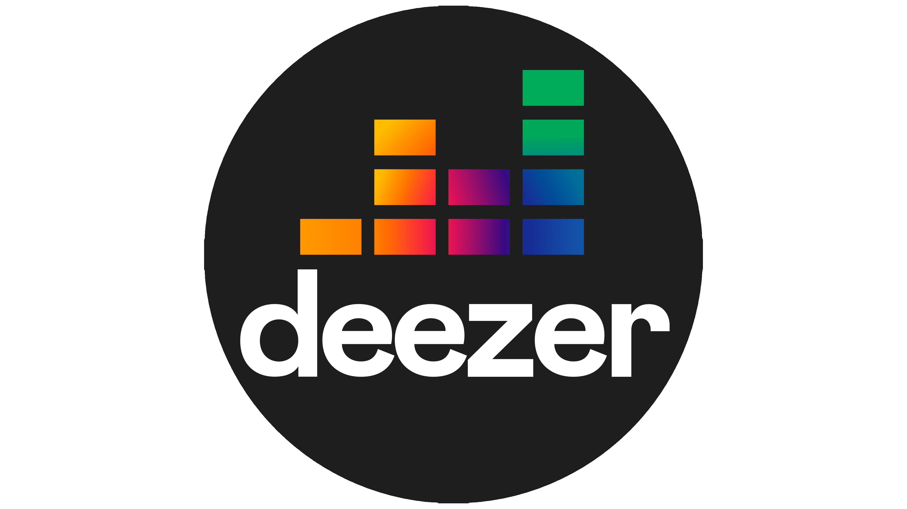


who are major competitors ?

Slide 7
Importance of the Project
Market Leadership: Strengthen Spotify's position as the leading music streaming platform.
User Engagement : Enhance personalized user experiences to increase satisfaction and retention.
Global Reach: Leverage insights to grow in competitive and emerging markets.
Innovation: Drive continuous improvements in AI, content, and cross-device usability.
Competitive Advantage: Address challenges from key competitors through strategic enhancements.

Slide 8
Project Objectives
Enhance Personalization:
- Leverage AI and machine learning to improve user recommendations.
Optimize Cross-Device Usability :
- Ensure seamless user experience across all devices.
Increase User Engagement :
- Introduce innovative features and exclusive content to boost interaction.
Strengthen Market Position :
- Expand global reach and address competitive challenges.
Drive Data-Driven Strategies:
- Use analytics to support decisions in content development and platform design.

Slide 9
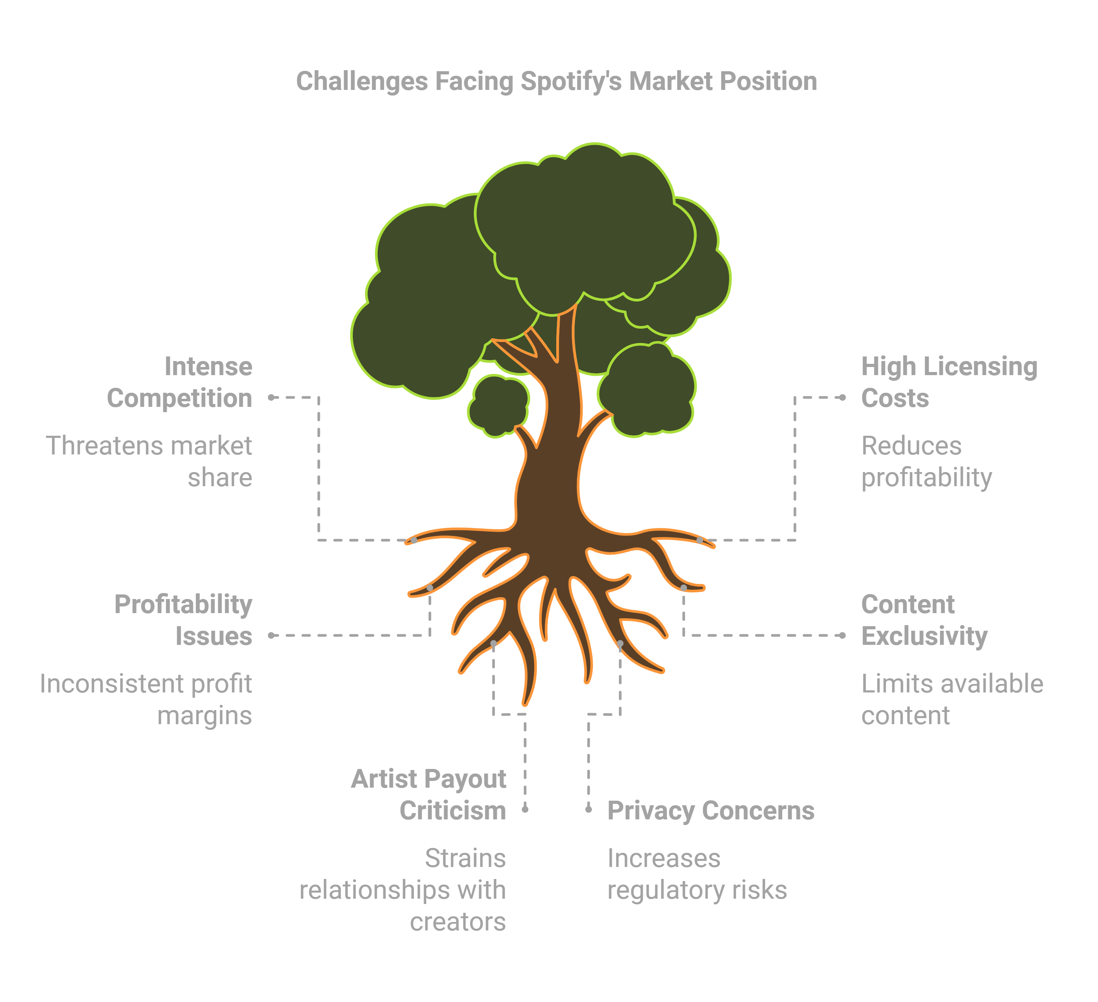
Problems and Challenges Faced by Spotify:
Competition: Rivals like Apple Music and Amazon Music dominate market share.
High Costs: Licensing fees limit profitability.
Exclusive Deals: Competitors secure artist exclusives.
Artist Issues: Low payouts create tensions.
Privacy Risks: User data collection faces regulatory challenges.
Slow Growth: Mature markets limit expansion.

Slide 10
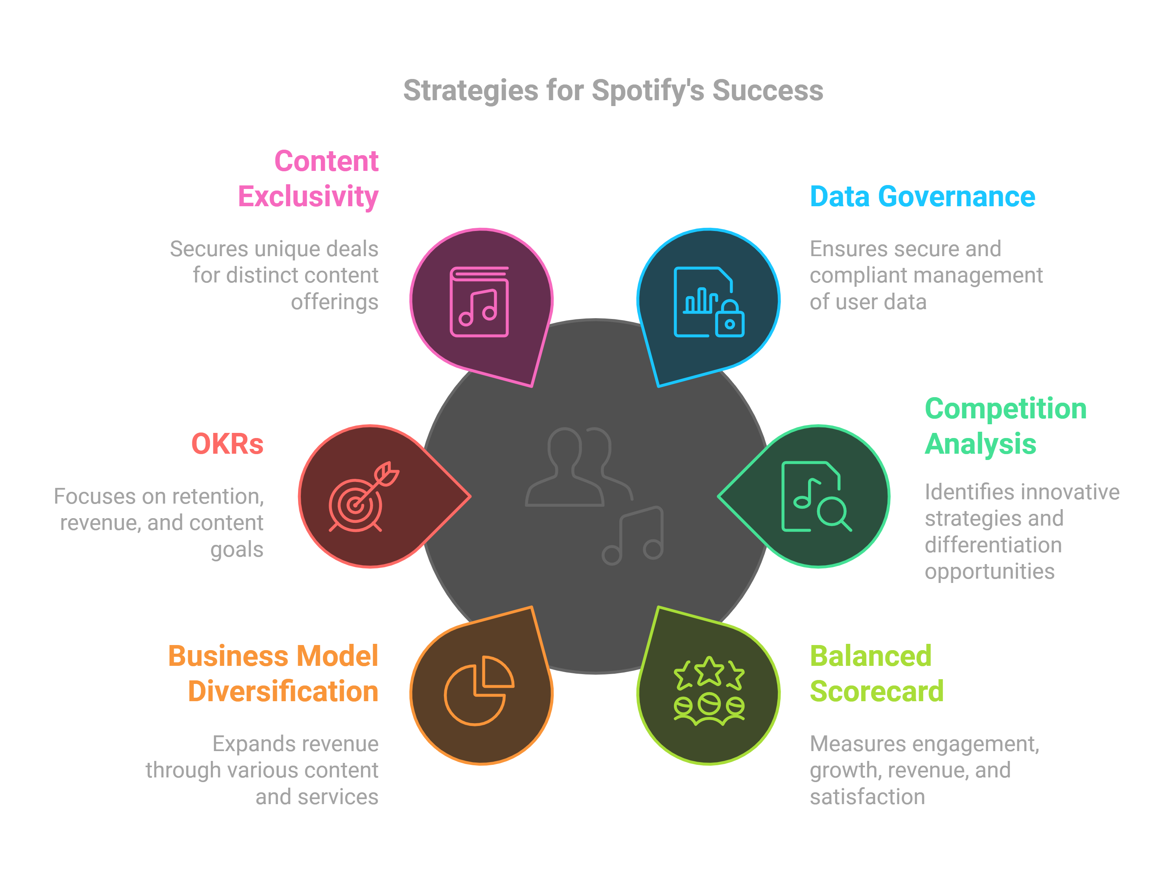
Our Problems Solving Journey

Slide 11
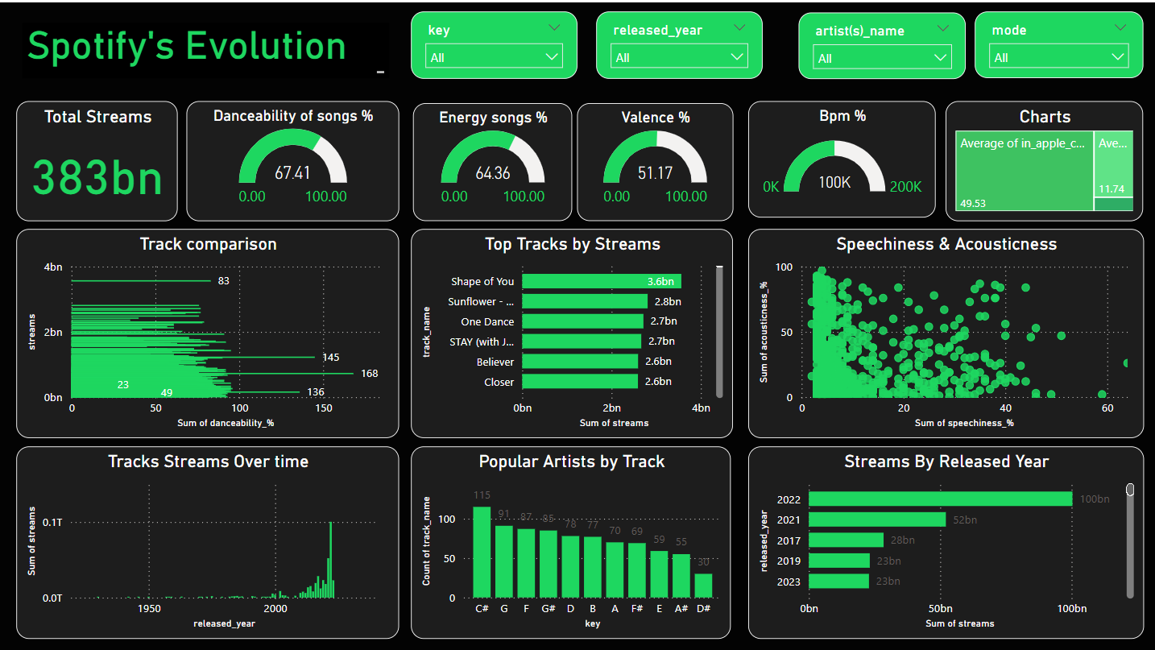
Spotify’s Evolution: Insights and Strategic Impacts

Slide 12


How This Dashboard Solves Spotify’s Challenges
Improving Personalization | Metrics like danceability, energy, and valence help refine Spotify's recommendation algorithms.
Competing with Rivals | Identifies popular tracks and artists to create exclusive playlists and secure artist deals.
Content Exclusivity | Highlights high-performing tracks and popular artists for exclusive deals and Spotify Originals.
Expanding Revenue | Tracks speechiness for podcasts, helps focus investments in new content like podcasts/audiobooks.
Market Trends | Streams over time and by release year help identify emerging trends and user behavior patterns.
User Satisfaction | Speechiness, acousticness, and top tracks offer insights to create balanced, engaging content.

Slide 13



Before and After: Spotify’s Data-Driven Transformation
Personalization | Same playlists for everyone. | Custom playlists like Discover Weekly.
Content Strategy | No exclusive content, basic music library. | Exclusive deals with artists and podcasts.
Monetization | Ads were not personalized, low revenue. | Targeted ads and new income from podcasts.
Market Expansion | No focus on local markets or regional music. | Regional playlists and local artist support.
User Engagement | Many users left due to lack of excitement. | Better recommendations and higher user loyalty.
Reference : https://100xventurehub.com/case-study-spotifys-transformation-with-data-driven-decisions/

Slide 14
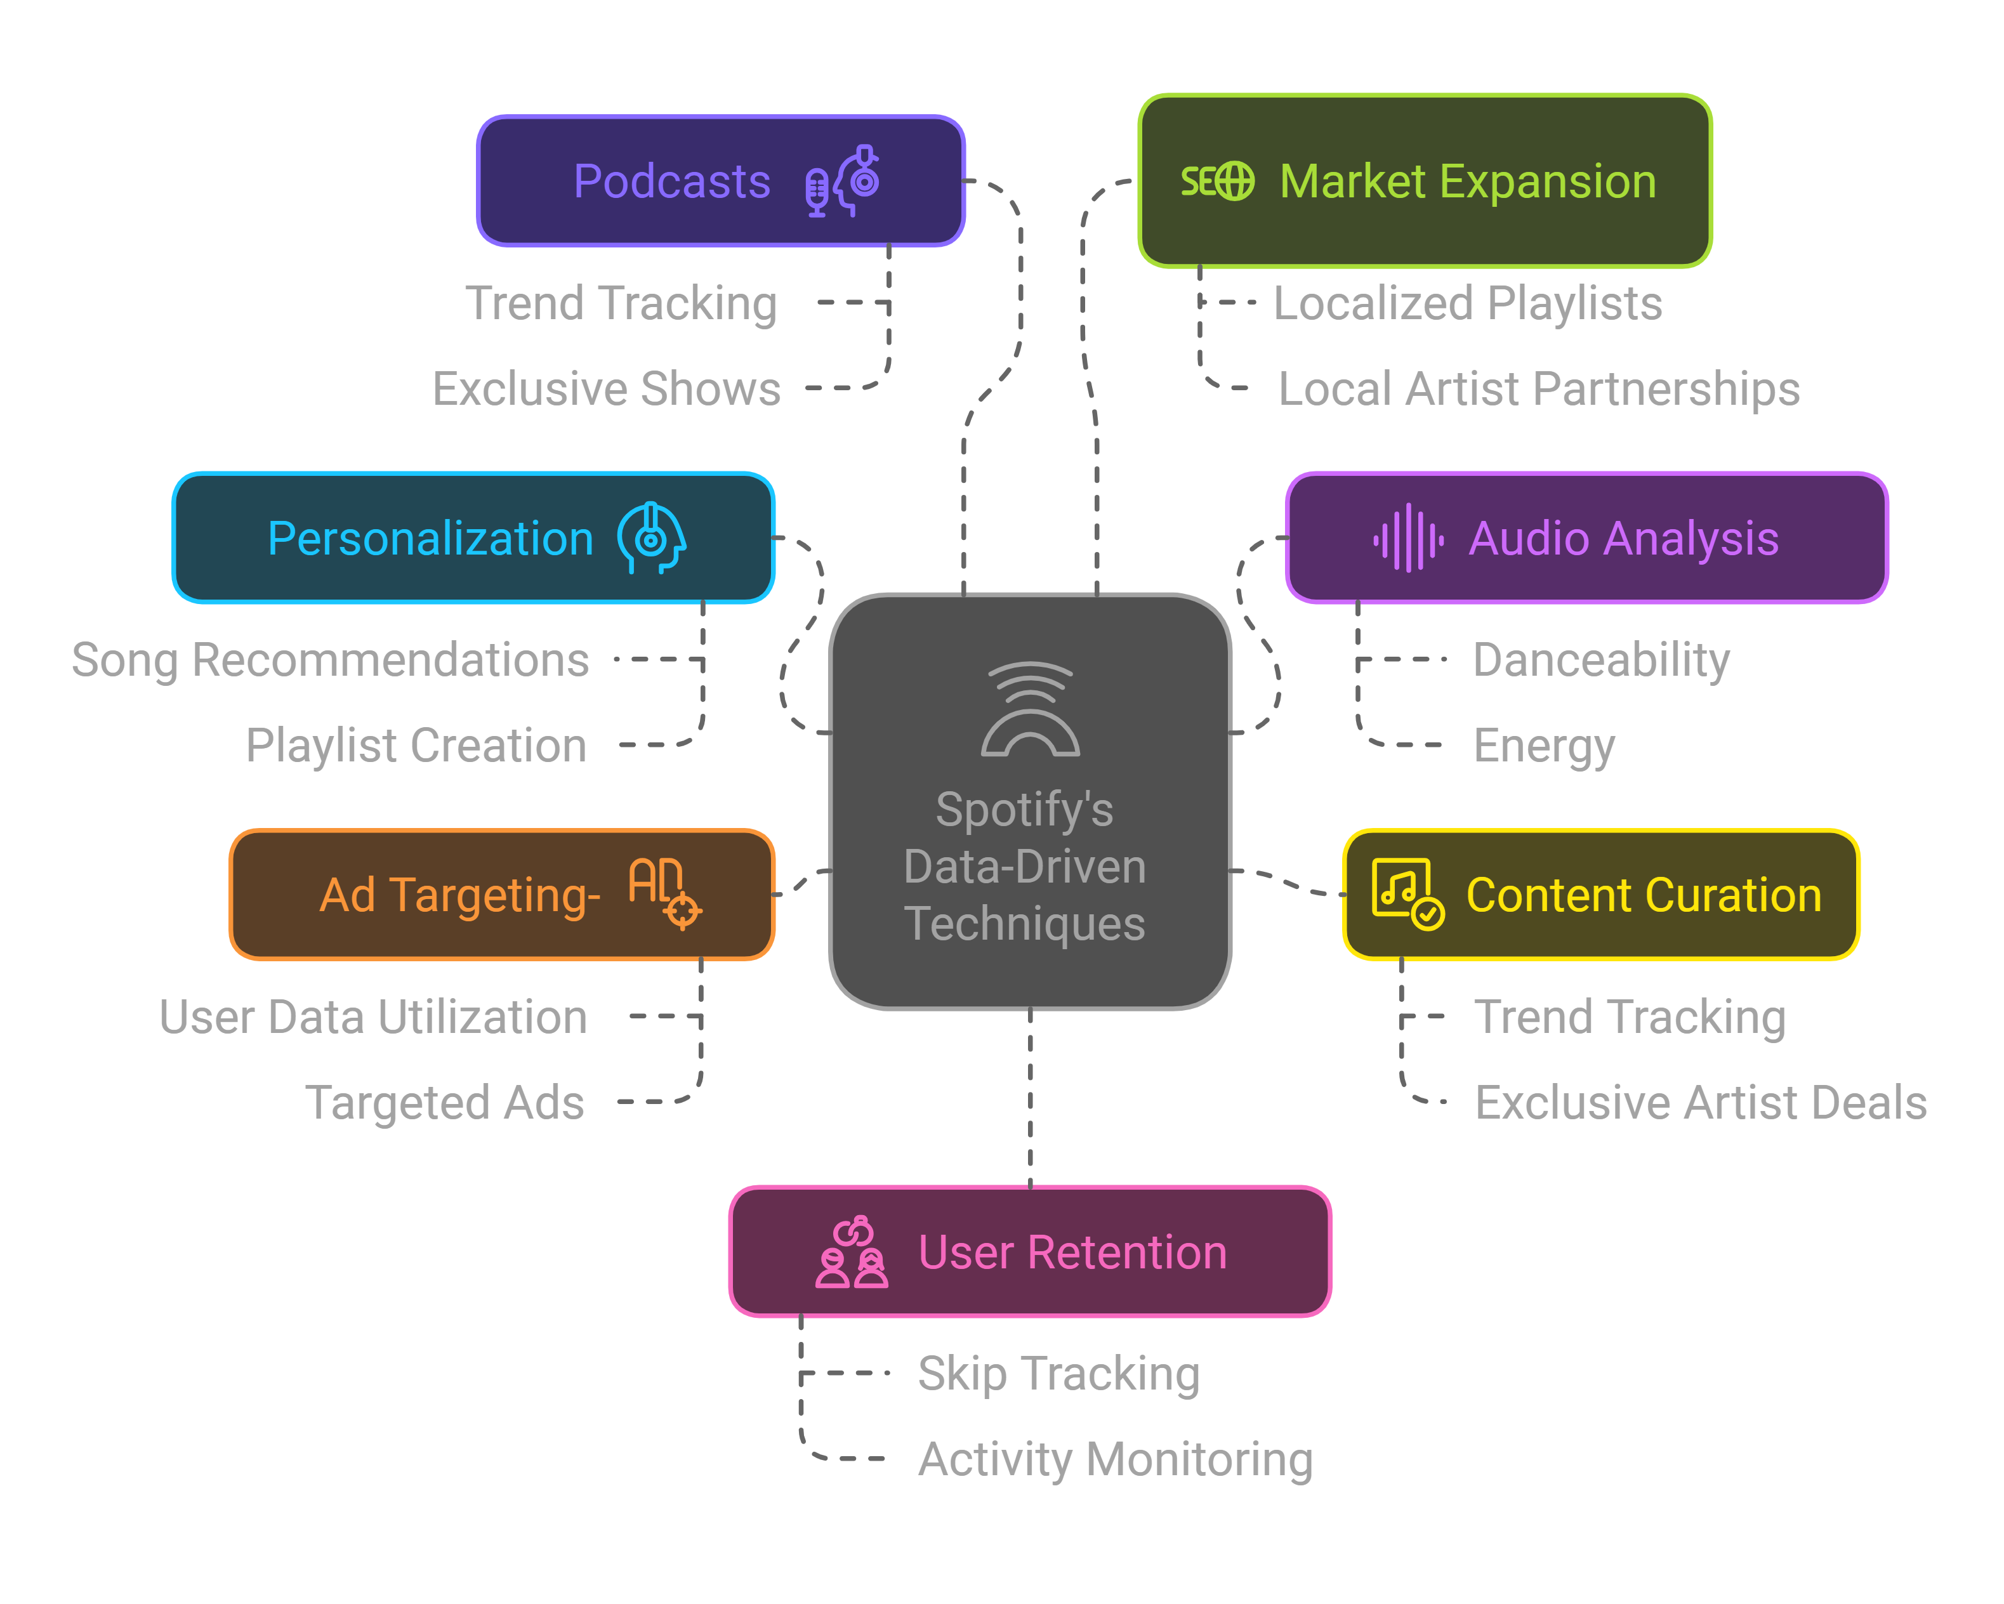



Data-Driven Strategies That Built Spotify’s Success
2012 | Personalization | Started using data for basic recommendations.
2013 | Ad Targeting | Launched personalized ads based on user habits.
2014 | Audio Analysis | Acquired The Echo Nest for song feature analysis.
2015 | Discover Weekly & Playlists | Introduced personalized playlists using ML.
Mid -2010’s | Market Expansion | Used data for localized playlists and artist partnerships.
2018 | Podcasts | Expanded exclusive content with podcast investments.
2020+ | User Engagement | Improved session tracking to retain users.
Reference https://www.pragmaticinstitute.com/resources/articles/data/case-study-how-spotify-prioritizes-data-projects-for-a-personalized-music-experience/

Slide 15



What Do We Learn from Spotify’s Journey?
Integrating diverse data sources (user behavior, audio features, regional trends).
Balancing personalization with data privacy regulations.
Managing high licensing costs while driving profitability.Ensurin regional relevance for global expansion.
Personalization is key to engagement (Discover Weekly proved this).
Exclusive content differentiates the platform in a competitive market.
Regional strategies unlock new growth opportunities.
Expand into new content types like audiobooks.
Enhance artist support with better payout transparency.
Strengthen data governance to stay compliant with evolving regulations.

Slide 16
References:
The Guardian: Discover Weekly Explained
Machine Learning (ML) for personalized playlists like Discover Weekly.
Bernard Marr: Spotify and AI
AI for audio analysis and user insights.
Google Cloud: Spotify Case Study
Data infrastructure and compliance strategies.
Spotify Engineering Blog: Discover Weekly Data
Collaborative filtering for personalized playlist creation.
Harvard Business Review: Global Expansion
Regional data insights for localized playlists and market growth.
TechCrunch: Spotify and Podcasts
Investment in podcasts and speechiness analysis.
Pragmatic Institute: Data Analytics at Spotify
Monetization strategies for free-tier users through personalized ads.
Medium (Towards Data Science): Spotify and Audio Features
AI analysis of audio features like danceability and energy.

Slide 17


