Slide 1
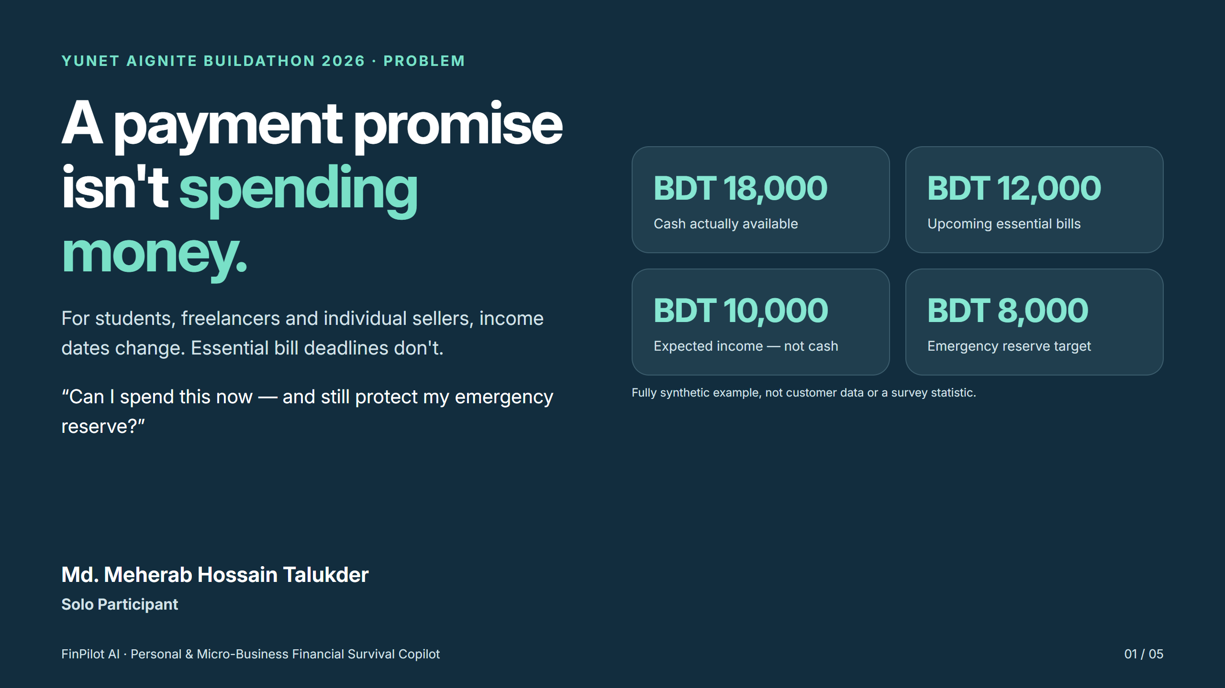
Md. Meherab Hossain Talukder
Solo Participant

Slide 2


Slide 3
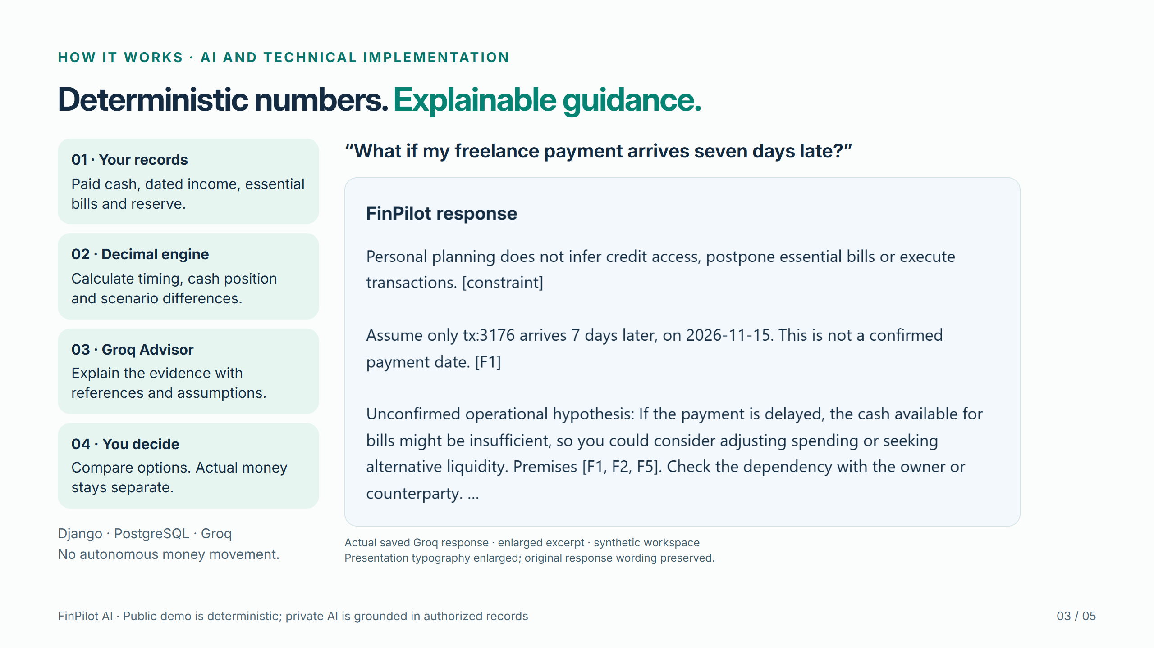

Slide 4
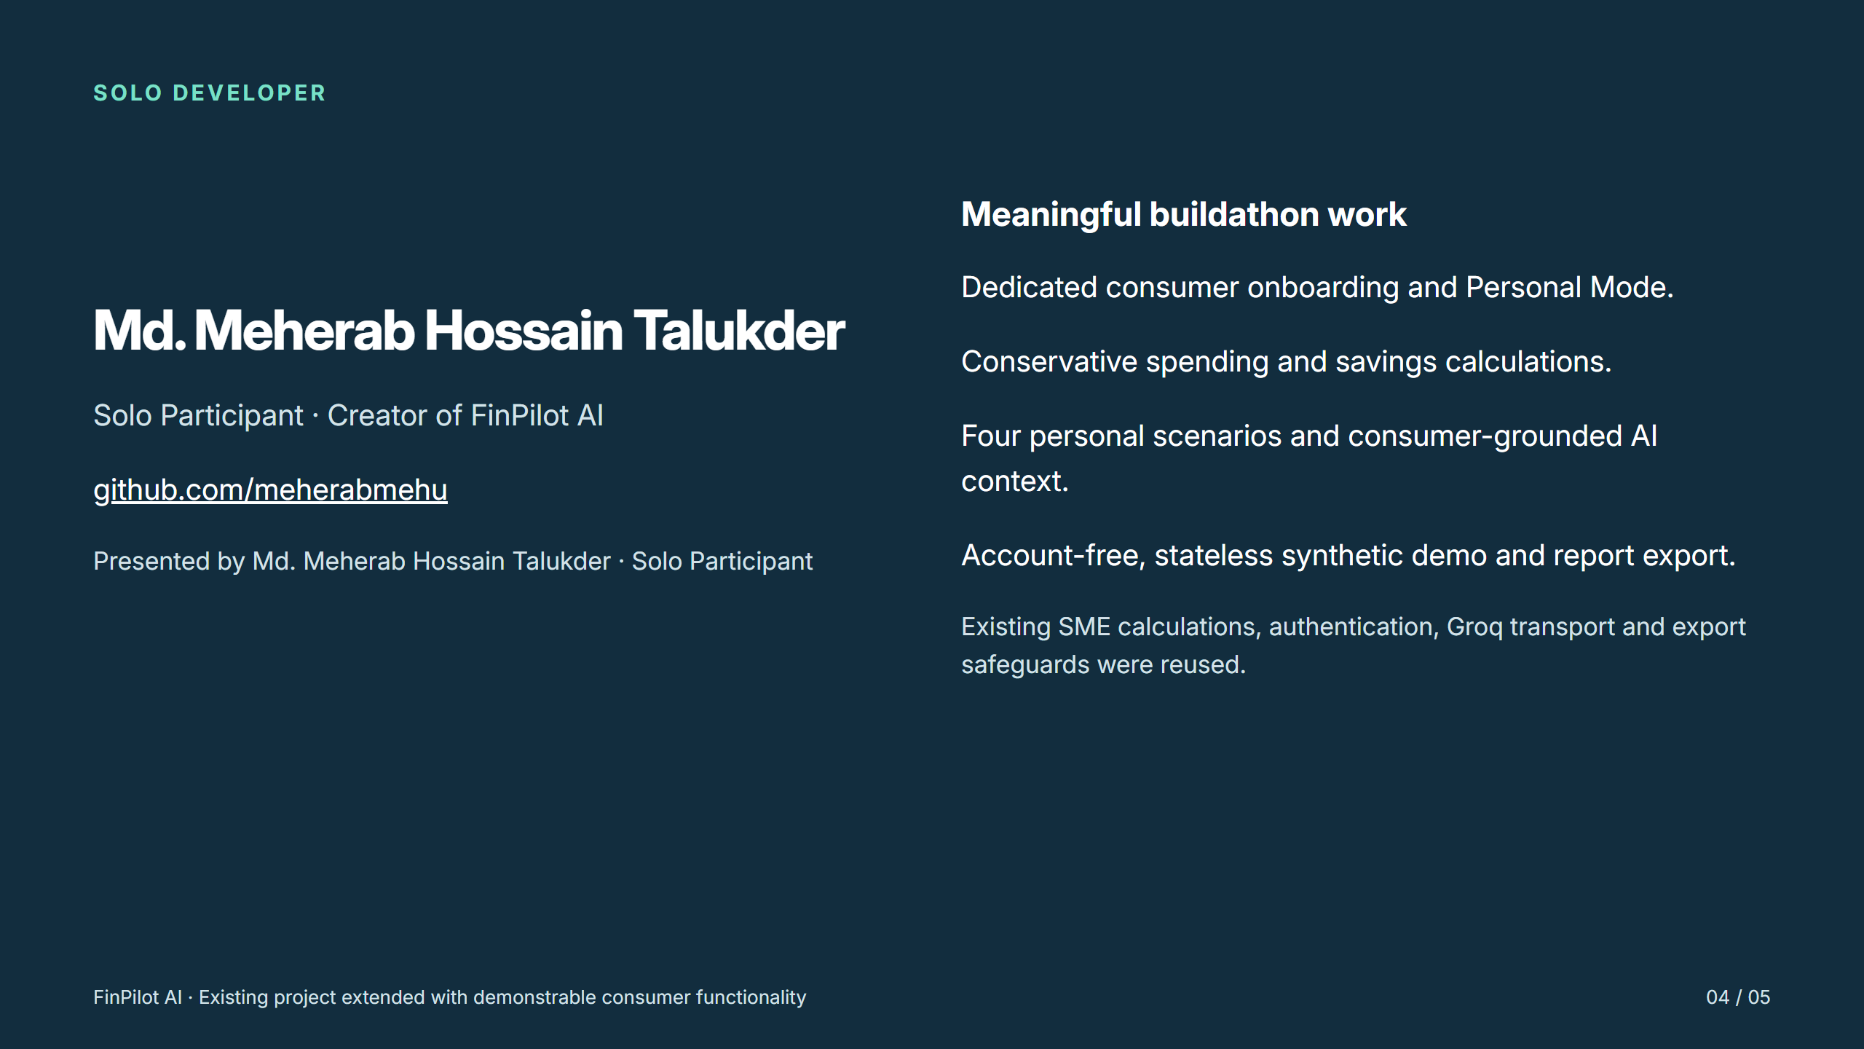

Slide 5


