Slide 1

Digital Strategy
MGT 857 Fall 2023
Session 10
(Digital Transformation: The New York Times Paywall)
Vineet Kumar
Yale School of Management

Slide 2
Digital Strategy Framework
(Paths to Digital Value)
Digital
Disruptor
Technology
Digital Organization
What capabilities do you need?
How do you transform a company?
Blockchain
Digital
Native
Digital
Complement
AI
Augmented Reality
…
Digital Platform

Slide 3
Agenda for NYT Case
What problem was Paywall addressing?
Is the Paywall “working”?
How should Paywall be Designed?
Should digital and print be complements or substitutes?
If you flip a switch and everything was Digital, would the Times do ok?
What should the Times’ transformation strategy be?
Fall 2018
MGT 857 Digital Strategy

Slide 4
NYT Exhibits

Slide 5
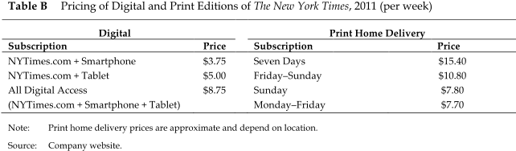

Slide 6
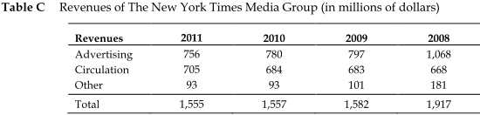

Slide 7
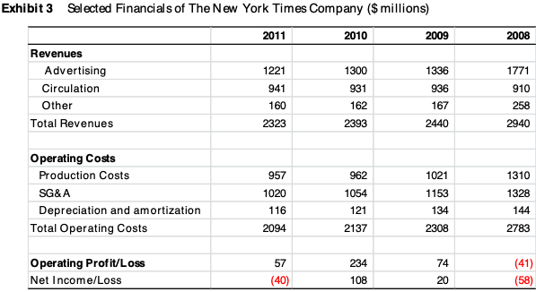

Slide 8
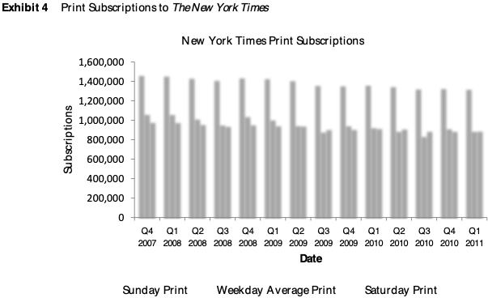

Slide 9
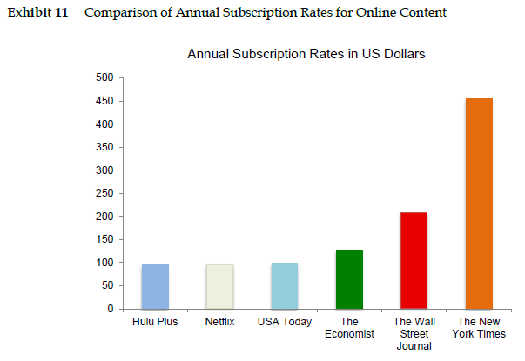

Slide 10
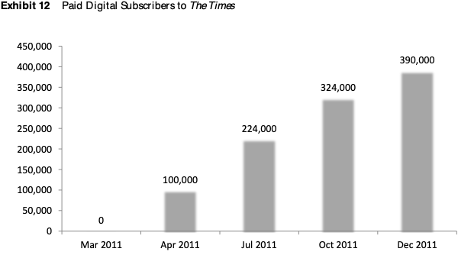

Slide 11
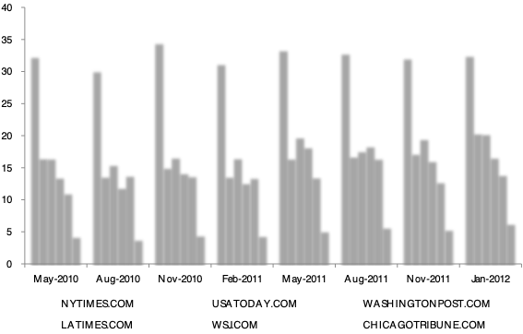
Exhibit 13
Newspaper Traffic (Unique Visitors)

Slide 12
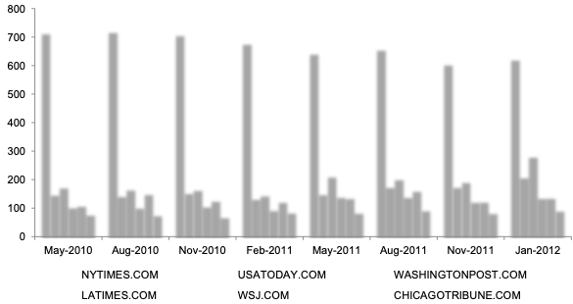
Exhibit 13
Newspaper Traffic (Page Views)

Slide 13
Context for NYT Paywall
Digital Media mostly relied on advertising-supported model
Problem: Digital Ad CPMs very low compared to print
The High Price of Low-Cost CPMs
https://hbr.org/2016/08/the-high-price-of-low-cost-cpms
Need a new model of monetization
Fall 2018
MGT 857 Digital Strategy

Slide 14
Questions
What problem was Paywall addressing?
Is the Paywall “working”?
How should Paywall be Designed?
Should digital and print be complements or substitutes?
If you flip a switch and everything was Digital, would the Times do ok?
What should the Times’ transformation strategy be?
Fall 2018
MGT 857 Digital Strategy

Slide 15
NYT Discussion

Slide 16
Newspapers: What is the Problem?

Slide 17
The New York Times What is the Problem?
Newspapers sales decline as new media cannibalizes the old.
Consumers are more familiar with “free” news and lots of alternatives online.
Lots of viewers at NYTimes.com:
But advertising revenue insufficient !
Can you go “all digital” and make money?

Slide 18
Is the Paywall working?
No
Might impact access and share of voice
New digital users may not be loyal
Paywall Revenue of 80M compared to NYT Revenue of 1500+ M (2010)
Page Views diminished – Ad Revenue lower
What assumptions are we making?
Yes
Visitors to website not lower
Revenue is incremental
390K users
Better than previous paywalls
Can get better individual data on customers with paywall
390 K subscribers x $4 / week x 52 weeks
=
$80 M / year
Fall 2018
MGT 857 Digital Strategy

Slide 19
Design of Paywall
Leaky Paywall
All social media traffic free access
Google searches free
Can bypass by clearing browser cache
Was a carefully thought out strategy
Not implementation mistake
Impacts brand and “share of voice”
Why does NYT care so much about ”medium” readers?
Ad Revenue
Annoyance Costs
Costs
Subscription Price
Subscribers
Low
Medium
High
Number of Articles Read
Fall 2018
MGT 857 Digital Strategy

Slide 20
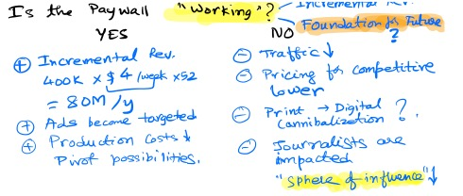
Is the Paywall working?
(Incremental Revenue)
Digital Strategy (MGT 857)

Slide 21
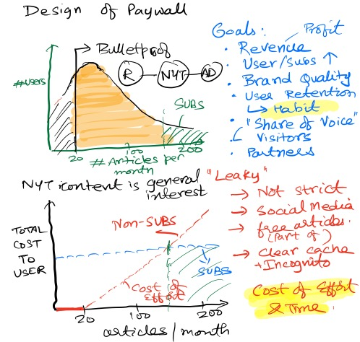
Design of Paywall

Slide 22
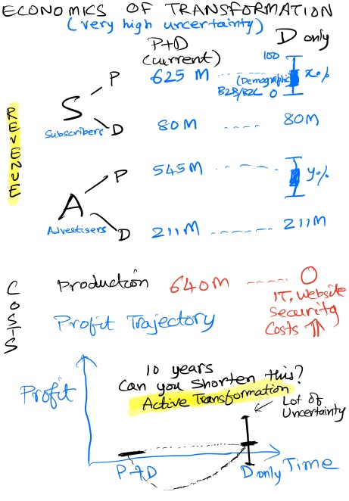
Economics of Transformation

Slide 23
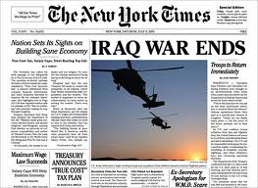
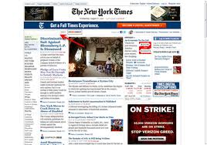
The New York Times Paywall What is the problem?
2004:
2011:
$ 700+ per year
$ 0.00 per year
Why? The promise of digital advertising…

Slide 24
Print to Digital Transformation
Transitions are quite tricky
Especially with your core product.
Scenario A doesn’t look great, but can potentially deal with it.
What if you end up in Scenario C ???
Are you prepared to lose money during the transition?
For how long?
Profitability
Current
Print
A
Digital only Future
Digital
B
Time
C
Fall 2018
MGT 857 Digital Strategy

Slide 25
“Active” Digital Transformation
Newspapers sales decline as new media cannibalizes the old.
Consumers are more familiar with “free” news and lots of alternatives online.
Lots of viewers at NYTimes.com:
But advertising revenue insufficient !
How do you create and capture digital value?
Need to understand the value creation process in the digital world.
Determine whether you need multiple media to co-exist.
Complements or Substitutes?
Key decision to make
From this overall strategy, determine how best to transition.

Slide 26
The New York Times Paywall
How do you actively manage transition?
Can we speed up digital transition?
We’ve just raised price of digital.
Which of the 4 strategies should we rule out?
 | P | D
Value creation
Value capture (Price)

Slide 27
The New York Times Paywall
How do you actively manage transition?
Can we speed up digital transition?
We’ve just raised price of digital.
Which of the 4 strategies should we rule out?
 | P | D
Value creation | X
Value capture (Price) |  | X

Slide 28
NYT - What Happened? Q1, 2012
News Media Group (Q1 2012 vs. Q4 2011)
Ad revenues -6.1%
Circulation revenues +9.7%
Total revenues +1.3%
Source: NYT Company and Audit Bureau of Circulations

Slide 29
Further Updates
Advertising is declining (both print AND digital)
Introduced “Native Advertising” in 2013.
Type of ad in which marketers create story like ads that run alongside news articles.
At the end of 2013, they had 760,000 digital subscribers with annual subscription revenues of $150 million.
International Expansion: Rebranded as “The International New York Times” with goal of overseas growth.
Bottomline: “Going All In” on Paywall
Plan to introduce more product and price tiers in 2014

Slide 30
NYT Updates
In 2014, tried an inexpensive subscription offering curated news on a mobile platform:
NYT Now App for $8 a month
Got 200,000 subscribers.
In May 2015, converted NYT Now to Free Ad Supported App
Subscribers were converted to NYT digital subscriptions
Customer Acquisition and Brand Building

Slide 31
NYT Updates
In August 2015, NYT crossed the mark of 1 million Digital only Subscribers
In addition to 1.1 Subscribers for Print + Digital
Digital only will overtake bundle in the near future
Print Ad revenue still falling
Overall, company is much more profitable now, with healthy growth
Paywall has ensured that the business not just survives, but thrives!

Slide 32
NYT Updates
In August 2015, NYT crossed the mark of 1 million Digital only Subscribers
In addition to 1.1 Subscribers for Print + Digital
Digital only will overtake bundle in the near future
Print Ad revenue still falling
Overall, company is much more profitable now, with healthy growth
Paywall has ensured that the business not just survives, but thrives!
In 2017-2018, Digital subscription have crossed 3 million

Slide 33
Why is Digital Transformation Difficult?
Destination is uncertain
The journey can be treacherous
It affects your employees differently
Slow decline may be ok for many people
Relative comparison: Others are going through it too.
Requires imagination and risk-taking
But the payoffs can be big!

Slide 34
Digital Transformation Lessons
Identify how customer value is migrating to digital
Passive Transformation
Examine what will happen if you follow the technology path
Your customers will take you to digital platforms
Plan a path to follow your customers to digital
But, be “agnostic” about technology
Active Transformation
Investigate how value can be best created in digital platforms
Figure out how to actively migrate your customers
Design incentives to:
Make sure customers know you’re creating the future
Employees understand how you will lead technology in your industry over next 5 – 10 years
Which approach do you want to choose?

Slide 35
How should Ford / Mercedes react to Autonomous Driving?
MGT 857 Digital Strategy

