Slide 1



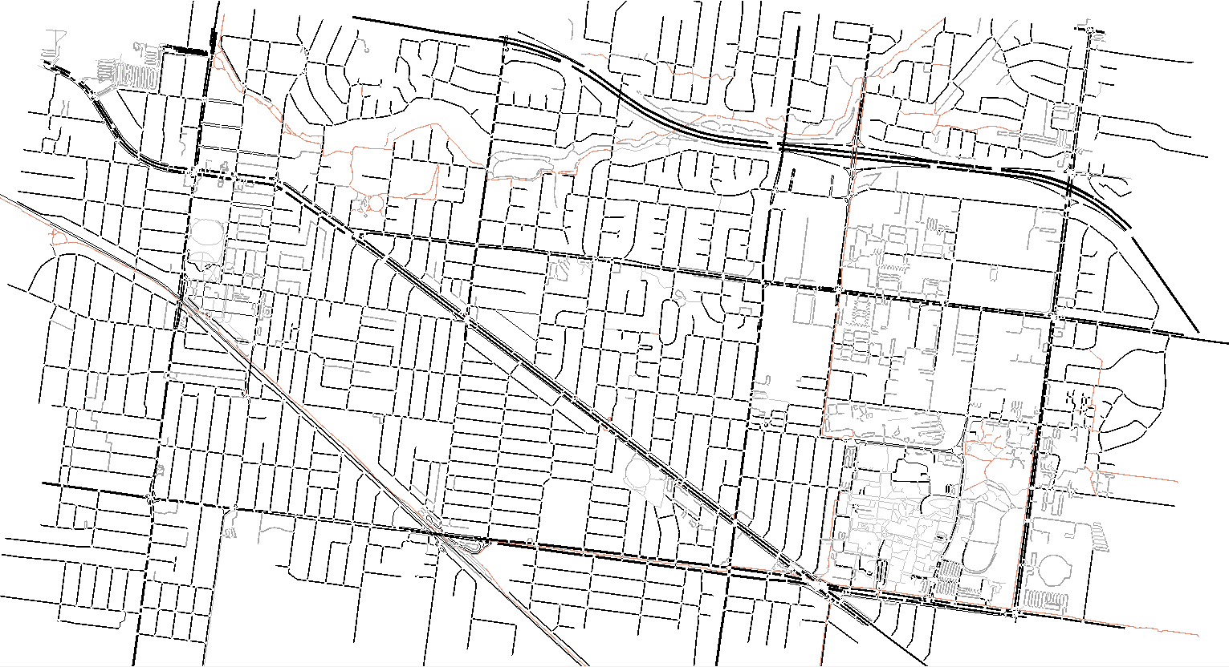
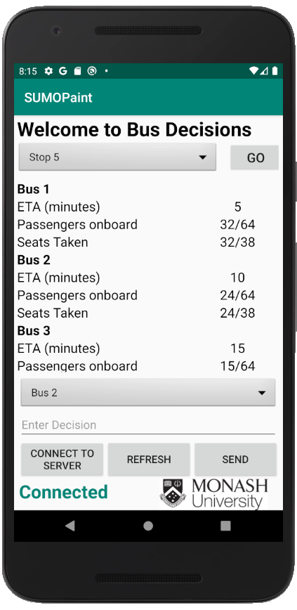
Human Decision Making on Boarding Public Transport
Meher Singh
Supervisor: Dr Wynita Griggs
Project Aim
Design and develop a human-in-the-loop simulation platform, based on SUMO, for gathering data on human decision making when boarding public transport.
Server/Simulation
The simulation developed in this project is developed on the open source, continuous traffic simulation software SUMO. It is run from a python script that acts as the server, receiving information from the simulation and sending it to the application.
Server Connectivity
The application developed in this project uses a TCP socket connection to connect to the server running the bus simulation that is also developed in this project.
The app allows the user to select a bus stop in the route and view the buses arriving to that stop
The app displays key details for each bus arriving to the stop selected by the user. These details can allow the user to make a decision on which bus to take
The app allows the user to select a bus, and provide a reasoning behind their decision
Buttons to interact with the app
Status bar to show whether the app is connected to the server

