Slide 1
EC-2 : ELASTIC COMPUTE CLOUD
Amazon EC2 is a web service that provides secure, resizable compute capacity in the cloud. It allows you to provision virtual servers called EC2 instances.
You can create and manage these instances through the AWS Management Console, the AWS Command Line Interface (CLI), or through automation tools and infrastructure orchestration services.
In order to create an EC2 instance, you need to define:
Hardware specifications, like CPU, memory, network, and storage.
Logical configurations, like networking location, firewall rules, authentication, and the operating system of your choice.

Slide 2
What Are Instance Families?
General purpose
Compute optimized
Memory optimized
Accelerated computing
Storage optimized
General purpose | Provides a balance of compute, memory, and networking resources, and can be used for a variety of workloads. | Scale-out workloads such as web servers, containerized microservices, caching fleets, distributed data stores, and development environments.
Compute optimized | Ideal for compute-bound applications that benefit from high-performance processors. | High-performance web servers, scientific modeling, batch processing, distributed analytics, high-performance computing (HPC), machine/deep learning, ad serving, highly scalable multiplayer gaming.

Slide 3
Memory optimized | Designed to deliver fast performance for workloads that process large data sets in memory. | Memory-intensive applications such as high-performance databases, distributed web-scale in-memory caches, mid-size in-memory databases, real-time big-data analytics, and other enterprise applications.
Accelerated computing | Use hardware accelerators or co-processors to perform functions such as floating-point number calculations, graphics processing, or data pattern matching more efficiently than is possible with conventional CPUs. | 3D visualizations, graphics-intensive remote workstations, 3D rendering, application streaming, video encoding, and other server-side graphics workloads.
Storage optimized | Designed for workloads that require high, sequential read and write access to large data sets on local storage. They are optimized to deliver tens of thousands of low-latency random I/O operations per second (IOPS) to applications that replicate their data across different instances. | NoSQL databases, such as Cassandra, MongoDB, and Redis, in-memory databases, scale-out transactional databases, data warehousing, Elasticsearch, and analytics.

Slide 4
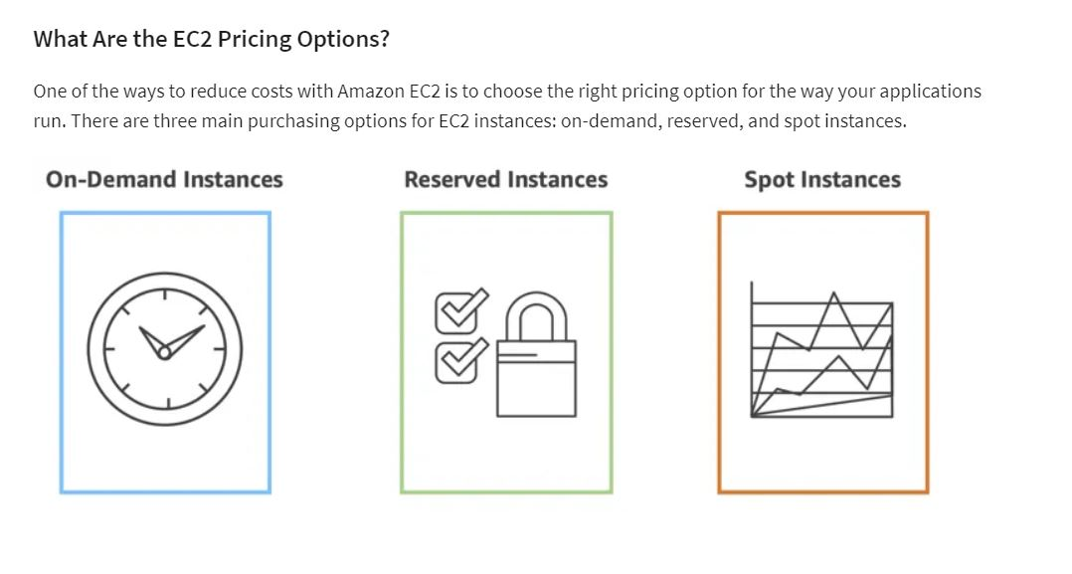

Slide 5
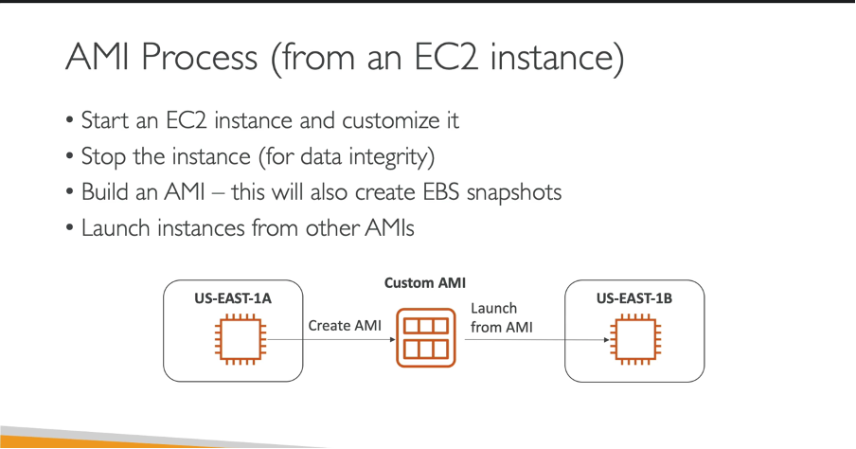


An Amazon Machine Image (AMI) is a supported and maintained image provided by AWS that provides the information required to launch an instance. You must specify an AMI when you launch an instance. You can launch multiple instances from a single AMI when you require multiple instances with the same configuration. You can use different AMIs to launch instances when you require instances with different configurations.

Slide 6
TASK //
DIFFERENCE BETWEEN SNAPSHOT AND AMI
TYPES OF SERVICES OFFERED BY AWS(HINT -03)
DIFFERNCE BETWEEN HDD AND SSD
END ,,,,,,

