Slide 1
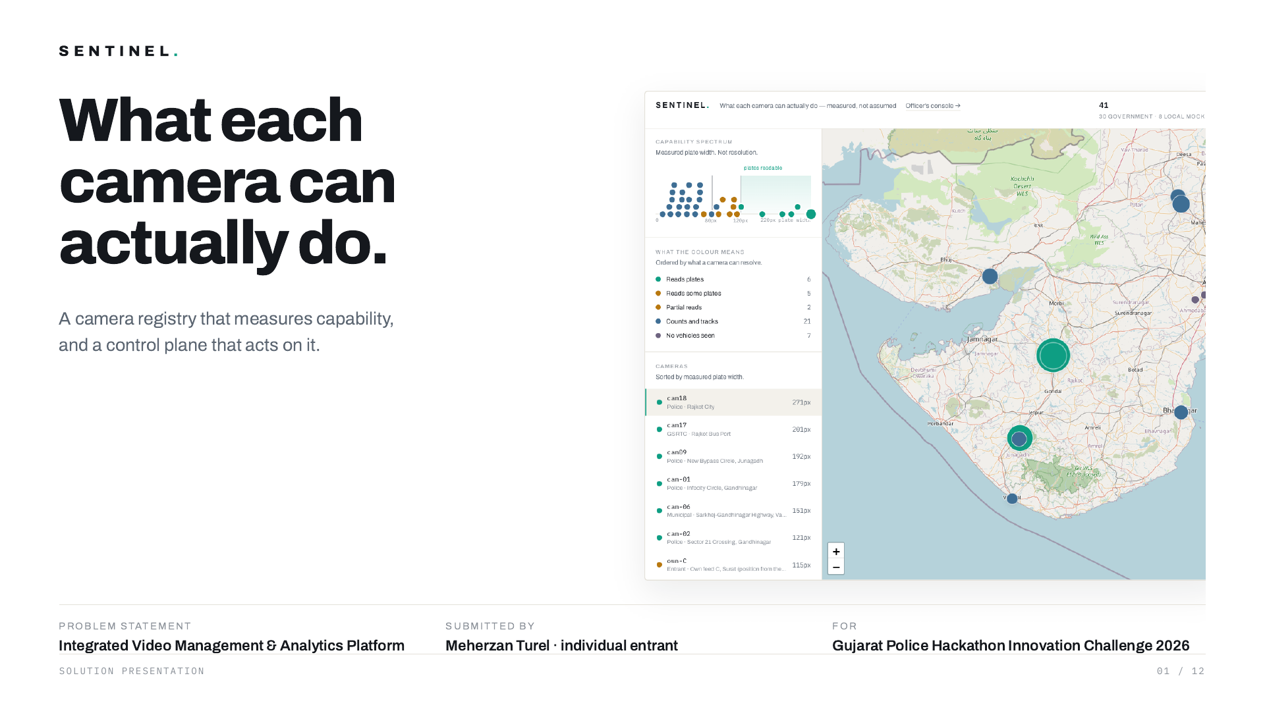
Notes:
Sentinel . What each camera can actually do. A camera registry that measures capability, and a control plane that acts on it. Problem statement Integrated Video Management & Analytics Platform Submitted by Meherzan Turel · individual entrant For Gujarat Police Hackathon Innovation Challenge 2026 Solution presentation

Slide 2
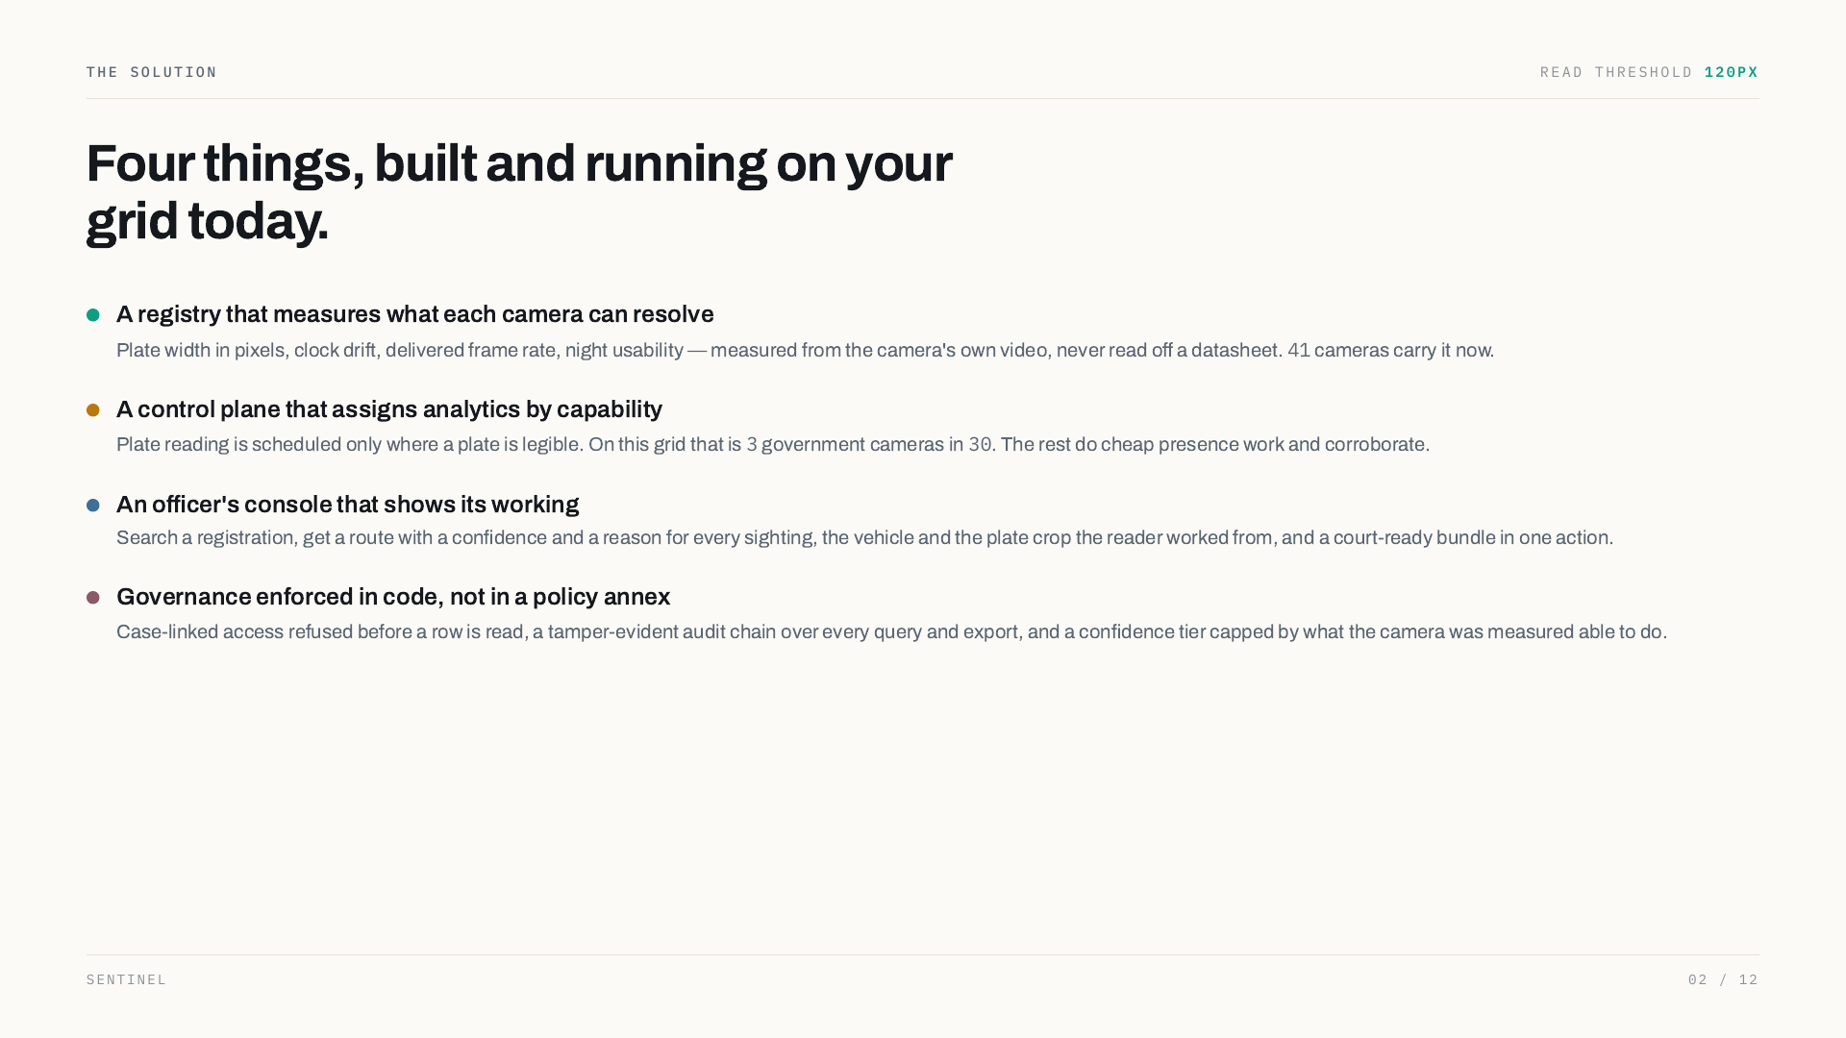
Notes:
The solution read threshold Four things, built and running on your grid today. A registry that measures what each camera can resolve Plate width in pixels, clock drift, delivered frame rate, night usability — measured from the camera's own video, never read off a datasheet. cameras carry it now. A control plane that assigns analytics by capability Plate reading is scheduled only where a plate is legible. On this grid that is government cameras in . The rest do cheap presence work and corroborate. An officer's console that shows its working Search a registration, get a route with a confidence and a reason for every sighting, the vehicle and the plate crop the reader worked from, and a court-ready bundle in one action. Governance enforced in code, not in a policy annex Case-linked access refused before a row is read, a tamper-evident audit chain over every query and export, and a confidence tier capped by what the camera was measured able to do. Sentinel

Slide 3
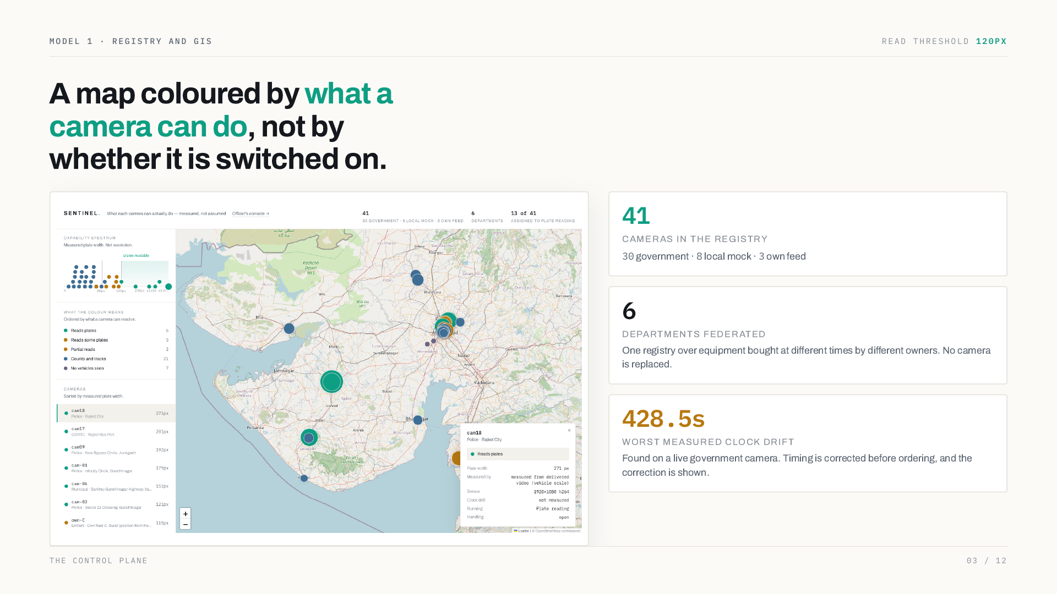
Notes:
Model 1 · registry and GIS read threshold A map coloured by what a camera can do , not by whether it is switched on. cameras in the registry government · local mock · own feed departments federated One registry over equipment bought at different times by different owners. No camera is replaced. worst measured clock drift Found on a live government camera. Timing is corrected before ordering, and the correction is shown. The control plane

Slide 4
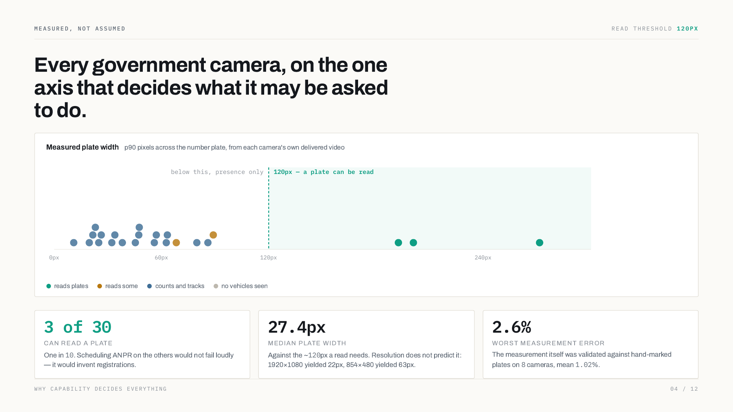
Notes:
Measured, not assumed read threshold Every government camera, on the one axis that decides what it may be asked to do. Measured plate width p90 pixels across the number plate, from each camera's own delivered video reads plates reads some counts and tracks no vehicles seen of can read a plate One in . Scheduling ANPR on the others would not fail loudly — it would invent registrations. median plate width Against the ~ px a read needs. Resolution does not predict it: 1920×1080 yielded 22px, 854×480 yielded 63px. worst measurement error The measurement itself was validated against hand-marked plates on cameras, mean %. Why capability decides everything

Slide 5
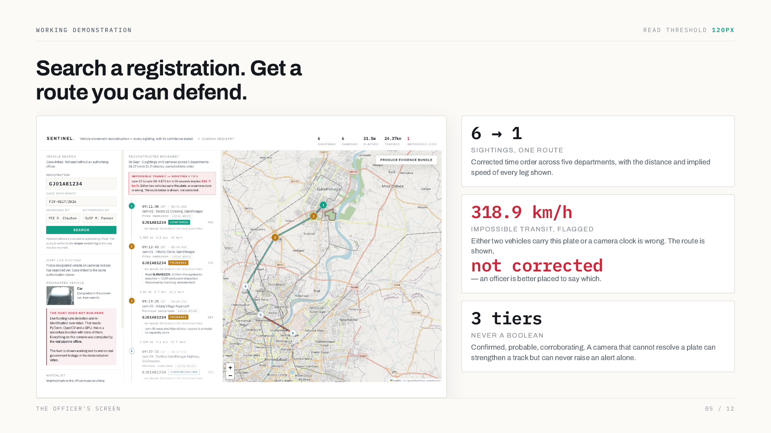
Notes:
Working demonstration read threshold Search a registration. Get a route you can defend. 6 → 1 sightings, one route Corrected time order across five departments, with the distance and implied speed of every leg shown. 318.9 km/h impossible transit, flagged Either two vehicles carry this plate or a camera clock is wrong. The route is shown, not corrected — an officer is better placed to say which. 3 tiers never a boolean Confirmed, probable, corroborating. A camera that cannot resolve a plate can strengthen a track but can never raise an alert alone. The officer's screen

Slide 6
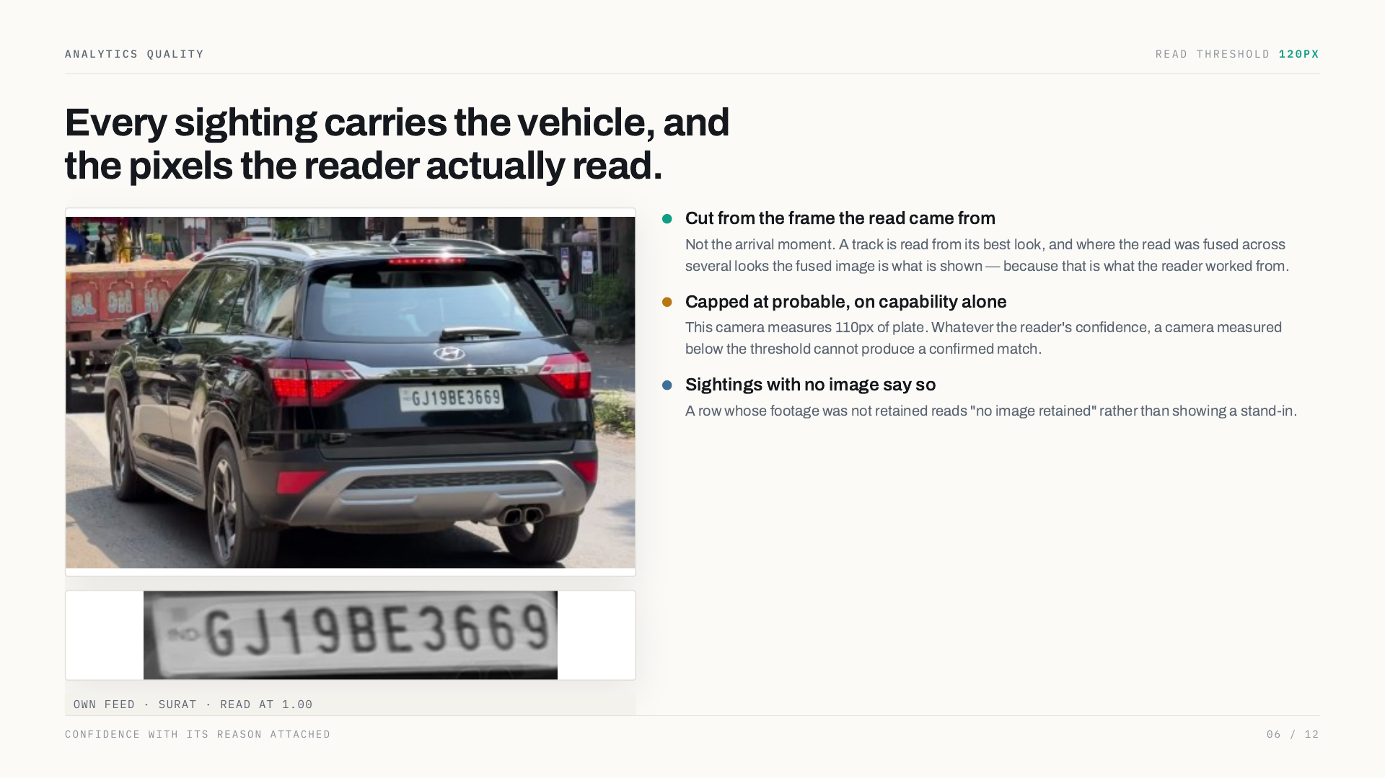
Notes:
Analytics quality read threshold Every sighting carries the vehicle, and the pixels the reader actually read. own feed · Surat · read at 1.00 Cut from the frame the read came from Not the arrival moment. A track is read from its best look, and where the read was fused across several looks the fused image is what is shown — because that is what the reader worked from. Capped at probable, on capability alone This camera measures 110px of plate. Whatever the reader's confidence, a camera measured below the threshold cannot produce a confirmed match. Sightings with no image say so A row whose footage was not retained reads "no image retained" rather than showing a stand-in. Confidence with its reason attached

Slide 7
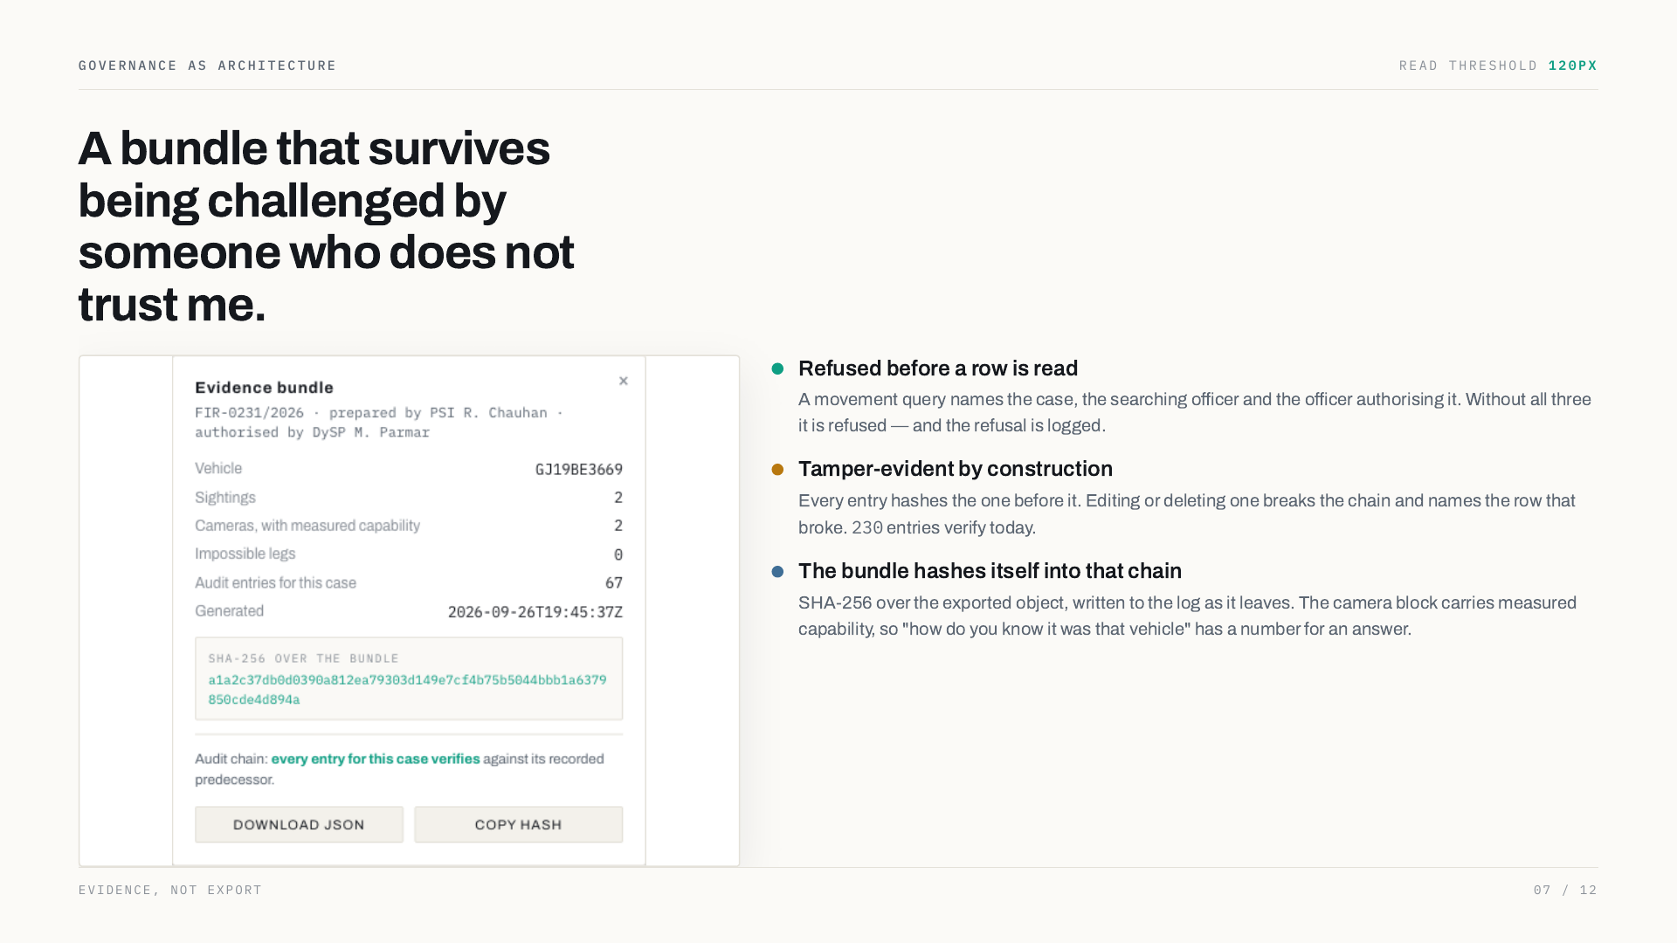
Notes:
Governance as architecture read threshold A bundle that survives being challenged by someone who does not trust me. Refused before a row is read A movement query names the case, the searching officer and the officer authorising it. Without all three it is refused — and the refusal is logged. Tamper-evident by construction Every entry hashes the one before it. Editing or deleting one breaks the chain and names the row that broke. entries verify today. The bundle hashes itself into that chain SHA-256 over the exported object, written to the log as it leaves. The camera block carries measured capability, so "how do you know it was that vehicle" has a number for an answer. Evidence, not export

Slide 8
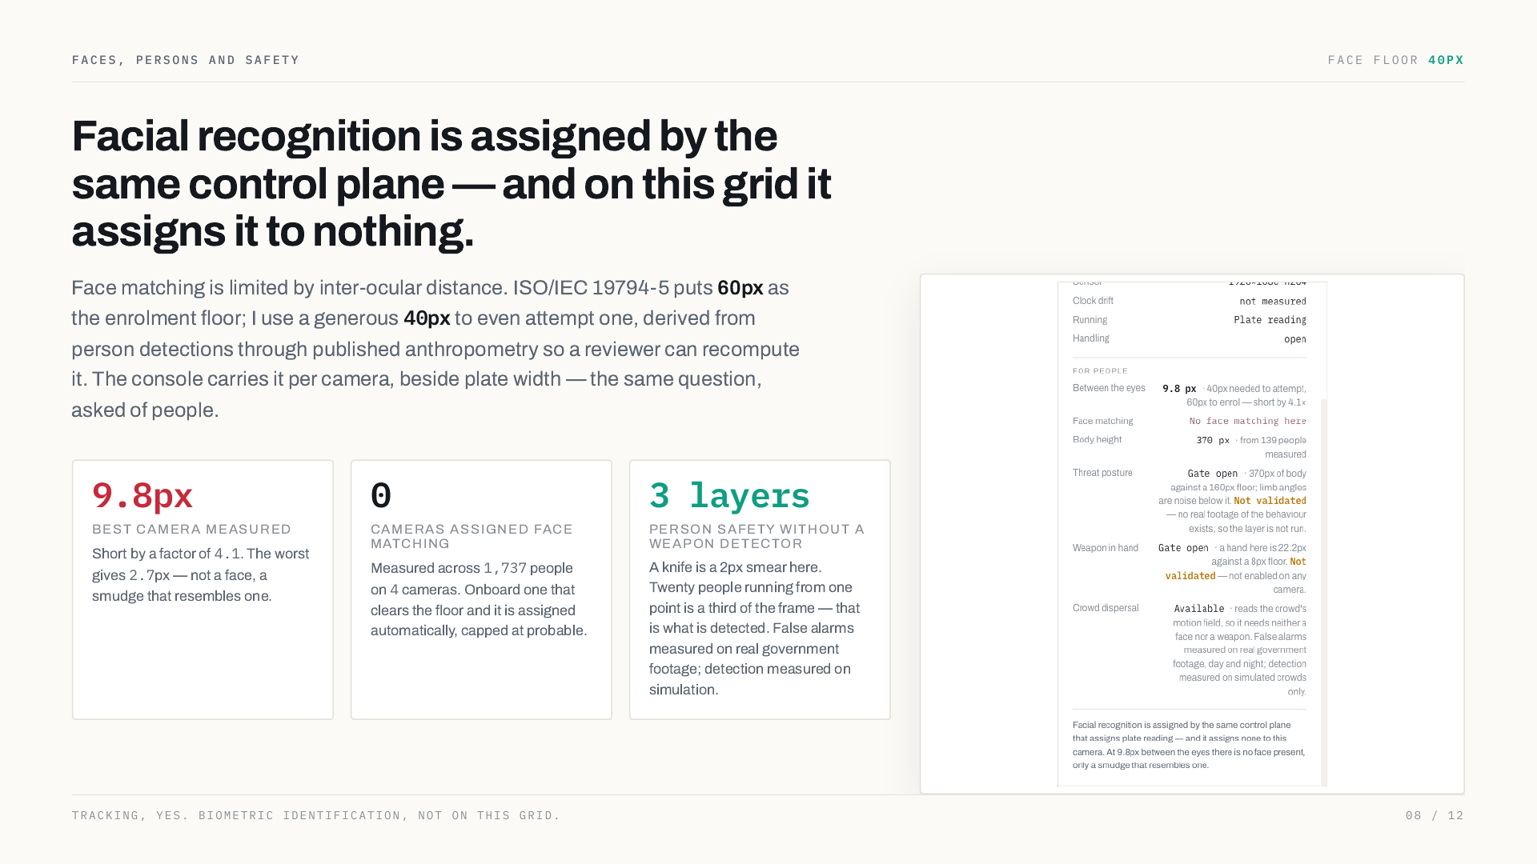
Notes:
Faces, persons and safety face floor Facial recognition is assigned by the same control plane — and on this grid it assigns it to nothing. Face matching is limited by inter-ocular distance. ISO/IEC 19794-5 puts 60px as the enrolment floor; I use a generous px to even attempt one, derived from person detections through published anthropometry so a reviewer can recompute it. The console carries it per camera, beside plate width — the same question, asked of people. best camera measured Short by a factor of . The worst gives px — not a face, a smudge that resembles one. cameras assigned face matching Measured across people on cameras. Onboard one that clears the floor and it is assigned automatically, capped at probable. 3 layers person safety without a weapon detector A knife is a 2px smear here. Twenty people running from one point is a third of the frame — that is what is detected. False alarms measured on real government footage; detection measured on simulation. Tracking, yes. Biometric identification, not on this grid.

Slide 9
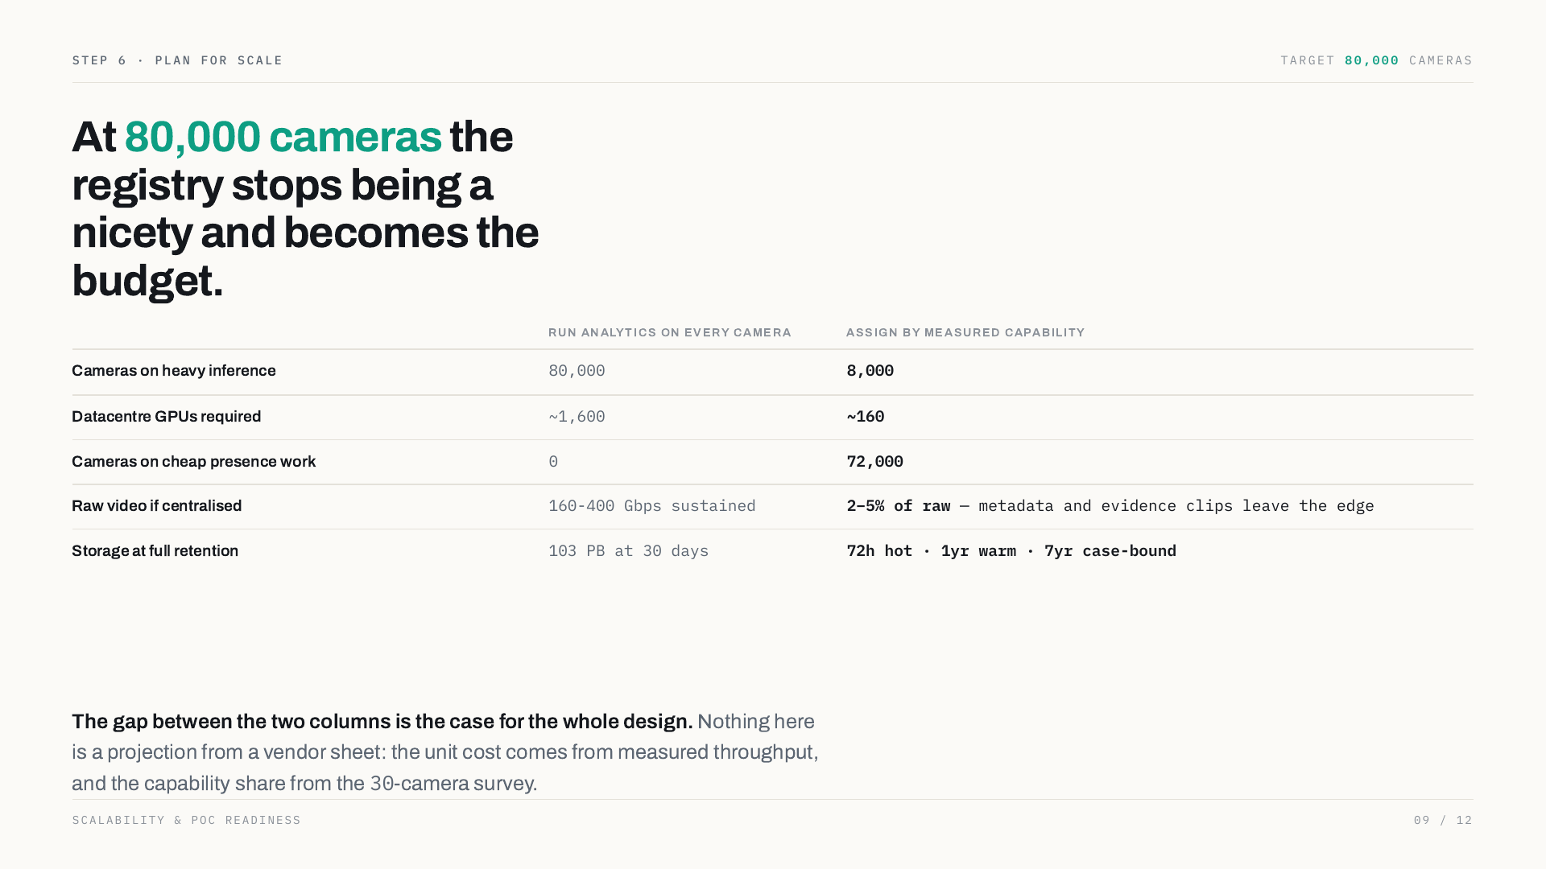
Notes:
Step 6 · plan for scale target cameras At 80,000 cameras the registry stops being a nicety and becomes the budget. Run analytics on every camera Assign by measured capability Cameras on heavy inference Datacentre GPUs required ~ ~ Cameras on cheap presence work 0 Raw video if centralised Gbps sustained 2–5% of raw — metadata and evidence clips leave the edge Storage at full retention PB at 30 days 72h hot · 1yr warm · 7yr case-bound The gap between the two columns is the case for the whole design. Nothing here is a projection from a vendor sheet: the unit cost comes from measured throughput, and the capability share from the -camera survey. Scalability & PoC readiness

Slide 10
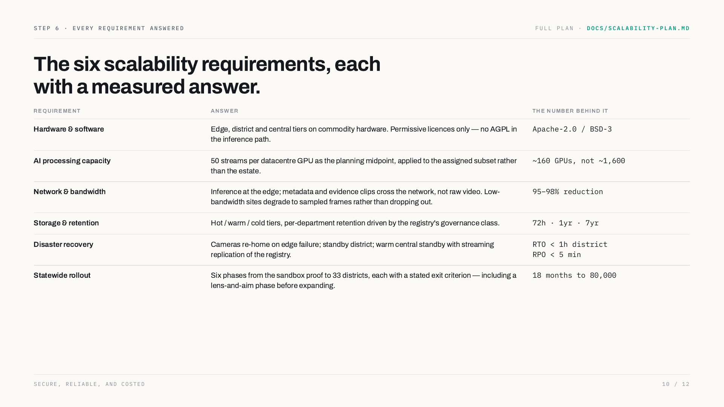
Notes:
Step 6 · every requirement answered full plan · docs/scalability-plan.md The six scalability requirements, each with a measured answer. Requirement Answer The number behind it Hardware & software Edge, district and central tiers on commodity hardware. Permissive licences only — no AGPL in the inference path. Apache-2.0 / BSD-3 AI processing capacity 50 streams per datacentre GPU as the planning midpoint, applied to the assigned subset rather than the estate. ~ GPUs, not ~ Network & bandwidth Inference at the edge; metadata and evidence clips cross the network, not raw video. Low-bandwidth sites degrade to sampled frames rather than dropping out. 95–98% reduction Storage & retention Hot / warm / cold tiers, per-department retention driven by the registry's governance class. 72h · 1yr · 7yr Disaster recovery Cameras re-home on edge failure; standby district; warm central standby with streaming replication of the registry. RTO &lt; 1h district RPO &lt; 5 min Statewide rollout Six phases from the sandbox proof to 33 districts, each with a stated exit criterion — including a lens-and-aim phase before expanding. 18 months to Secure, reliable, and costed

Slide 11
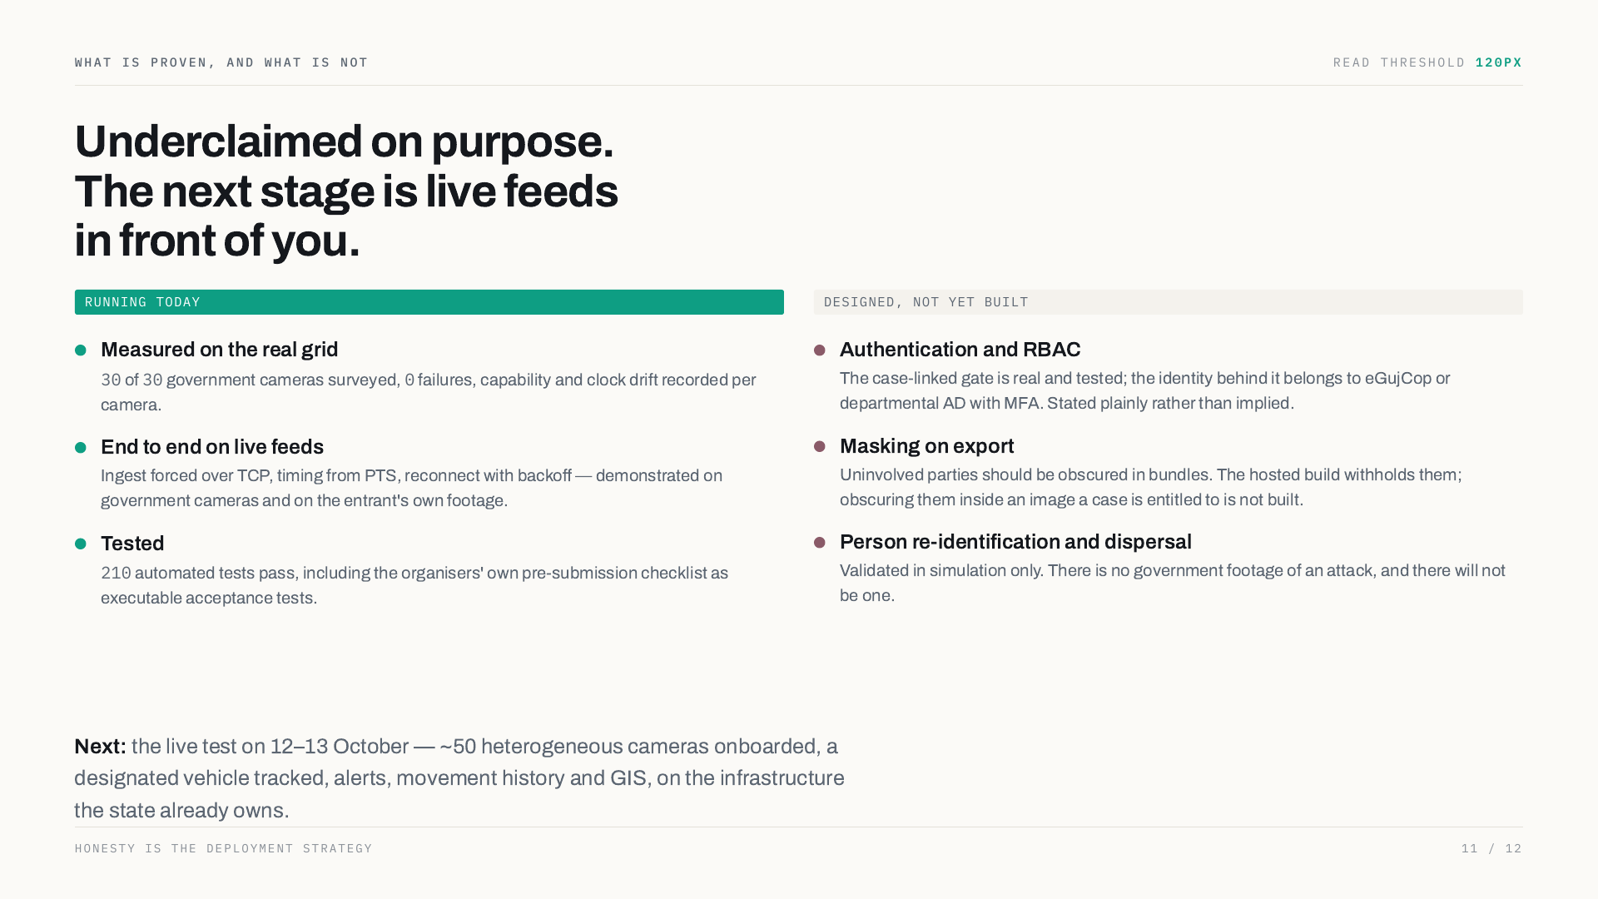
Notes:
What is proven, and what is not read threshold Underclaimed on purpose. The next stage is live feeds in front of you. Running today Measured on the real grid of government cameras surveyed, failures, capability and clock drift recorded per camera. End to end on live feeds Ingest forced over TCP, timing from PTS, reconnect with backoff — demonstrated on government cameras and on the entrant's own footage. Tested automated tests pass, including the organisers' own pre-submission checklist as executable acceptance tests. Designed, not yet built Authentication and RBAC The case-linked gate is real and tested; the identity behind it belongs to eGujCop or departmental AD with MFA. Stated plainly rather than implied. Masking on export Uninvolved parties should be obscured in bundles. The hosted build withholds them; obscuring them inside an image a case is entitled to is not built. Person re-identification and dispersal Validated in simulation only. There is no government footage of an attack, and there will not be one. Next: the live test on 12–13 October — ~50 heterogeneous cameras onboarded, a designated vehicle tracked, alerts, movement history and GIS, on the infrastructure the state already owns. Honesty is the deployment strategy

Slide 12
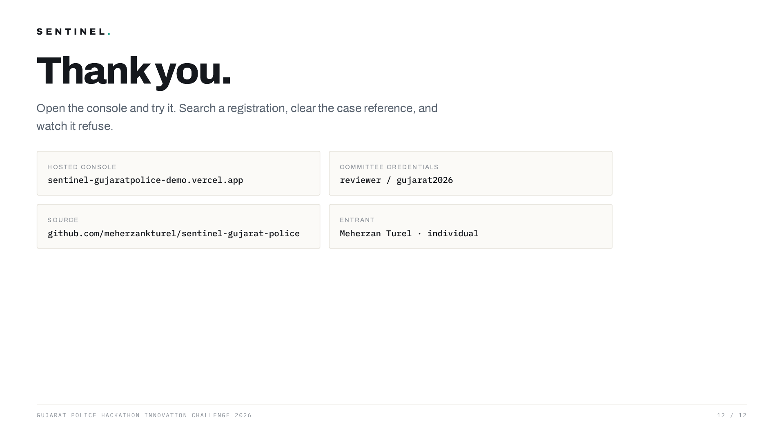
Notes:
Sentinel . Thank you. Open the console and try it. Search a registration, clear the case reference, and watch it refuse. Hosted console sentinel-gujaratpolice-demo.vercel.app Committee credentials reviewer / gujarat2026 Source github.com/meherzankturel/sentinel-gujarat-police Entrant Meherzan Turel · individual Gujarat Police Hackathon Innovation Challenge 2026

