Slide 1

Datashift Hungary KFT
Méhes Ádám, Pálfi Sándor

Slide 2
Project goals:
Connect three offices(Budapest, Debrecen, Pécs)
Centralized server infrastructure (Active Directory + remote access VPN)
Secure communication between offices (site-to-site VPN)
Second- and third layer redundancy
VLAN-based network segmentation

Slide 3
Project timeline
1.Company and project planning
Planning of Datashift Hungary and goals
Setting up offices and services
2.Evaluation of networking requirements
Determining number of employees and devices
Planning of topology and VLANs
3. Construction of prototype topology
Placement of routers, switches and servers
IPv4/IPv6 addressing, DHCP, DNS and OSPF routing setup

Slide 4
4. Setting up security and servers
Firewall, ACL and VPN setup
Configuration of Web and Active Directory servers
5. Testing and debugging
Testing of inter-office connectivity
Testing of internet access and network services
6. Documentation and project presentation
Documentation into Word document
PowerPoint presentation and finalization

Slide 5
Company introduction
Datashift Hungary
  Hungarian-owned IT company
  Headquartered in Budapest
  Branch offices in Pécs and Debrecen
Offered services:
  Planning, construction and maintenance of networking infrastructure
  Cybersecurity
  Cloud services
  IT consulting and support
  Data analysis
Goal: Modern, data-driven IT solutions for small and medium businesses in Hungary

Slide 6
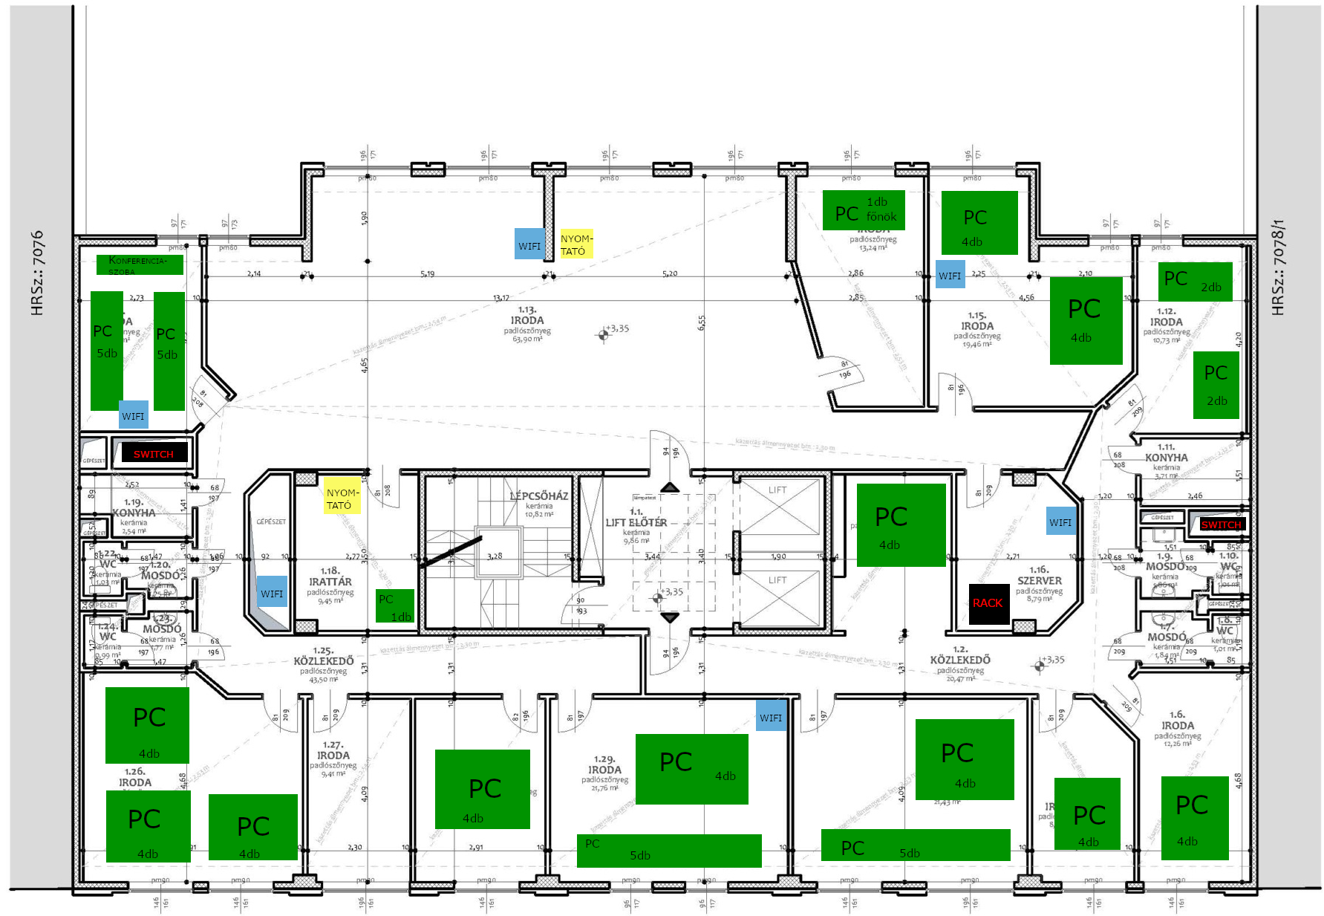
Offices
Budapest (headquarters)

Slide 7
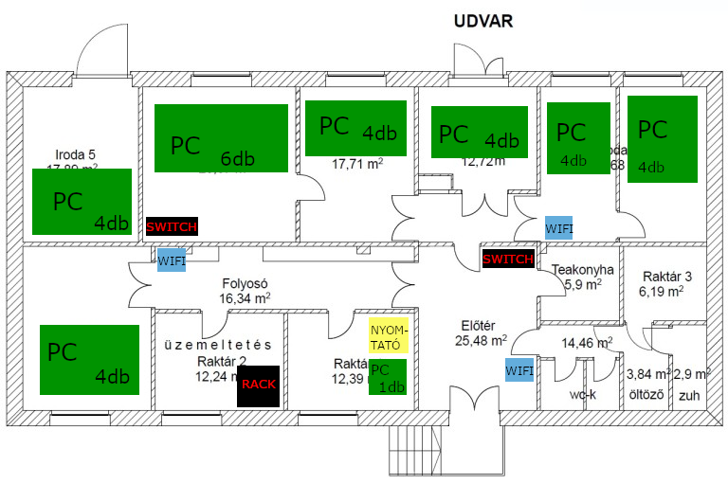
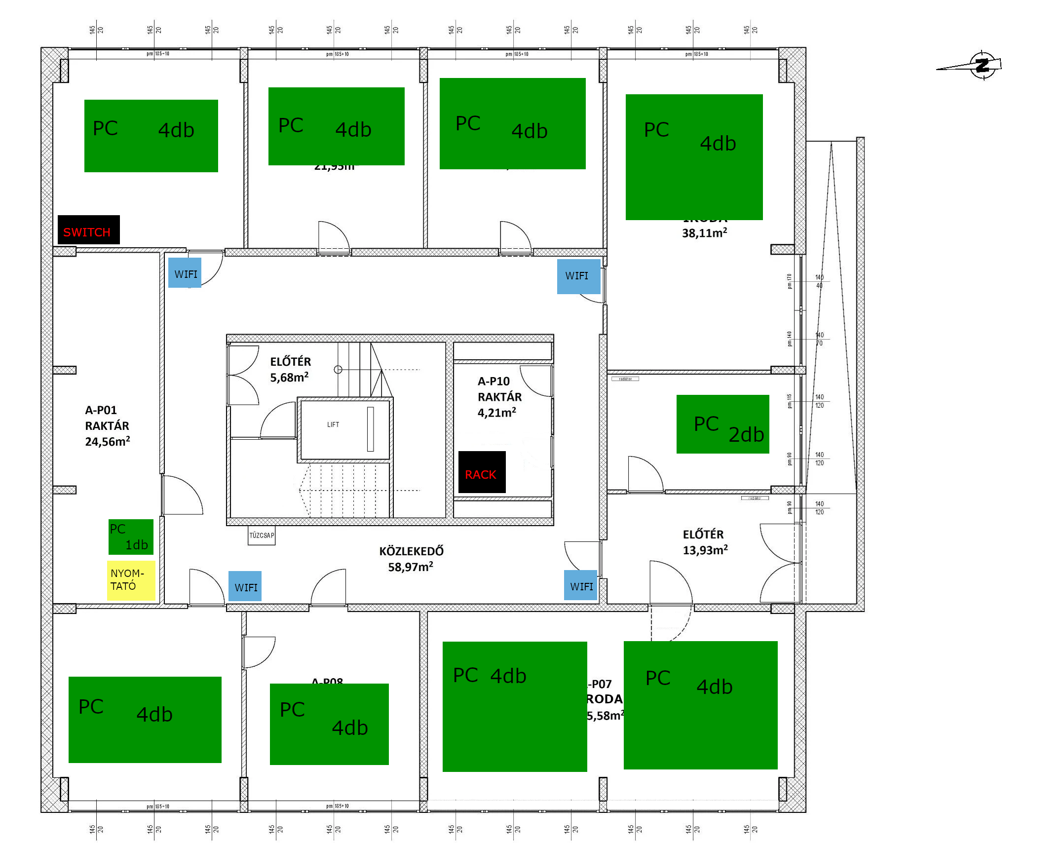
Offices
Debrecen
Pécs

Slide 8
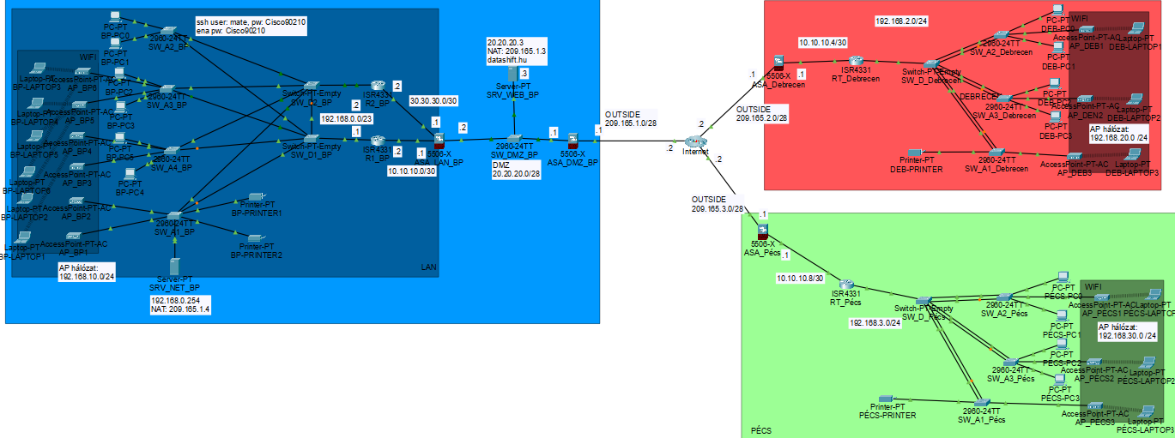
Logical topology overview

Slide 9
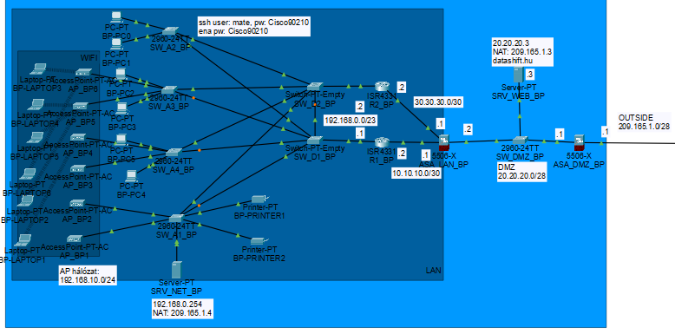
Budapest building
Main services and company management
Server infrastructure
Supporting services for branch offices
Video conference

Slide 10
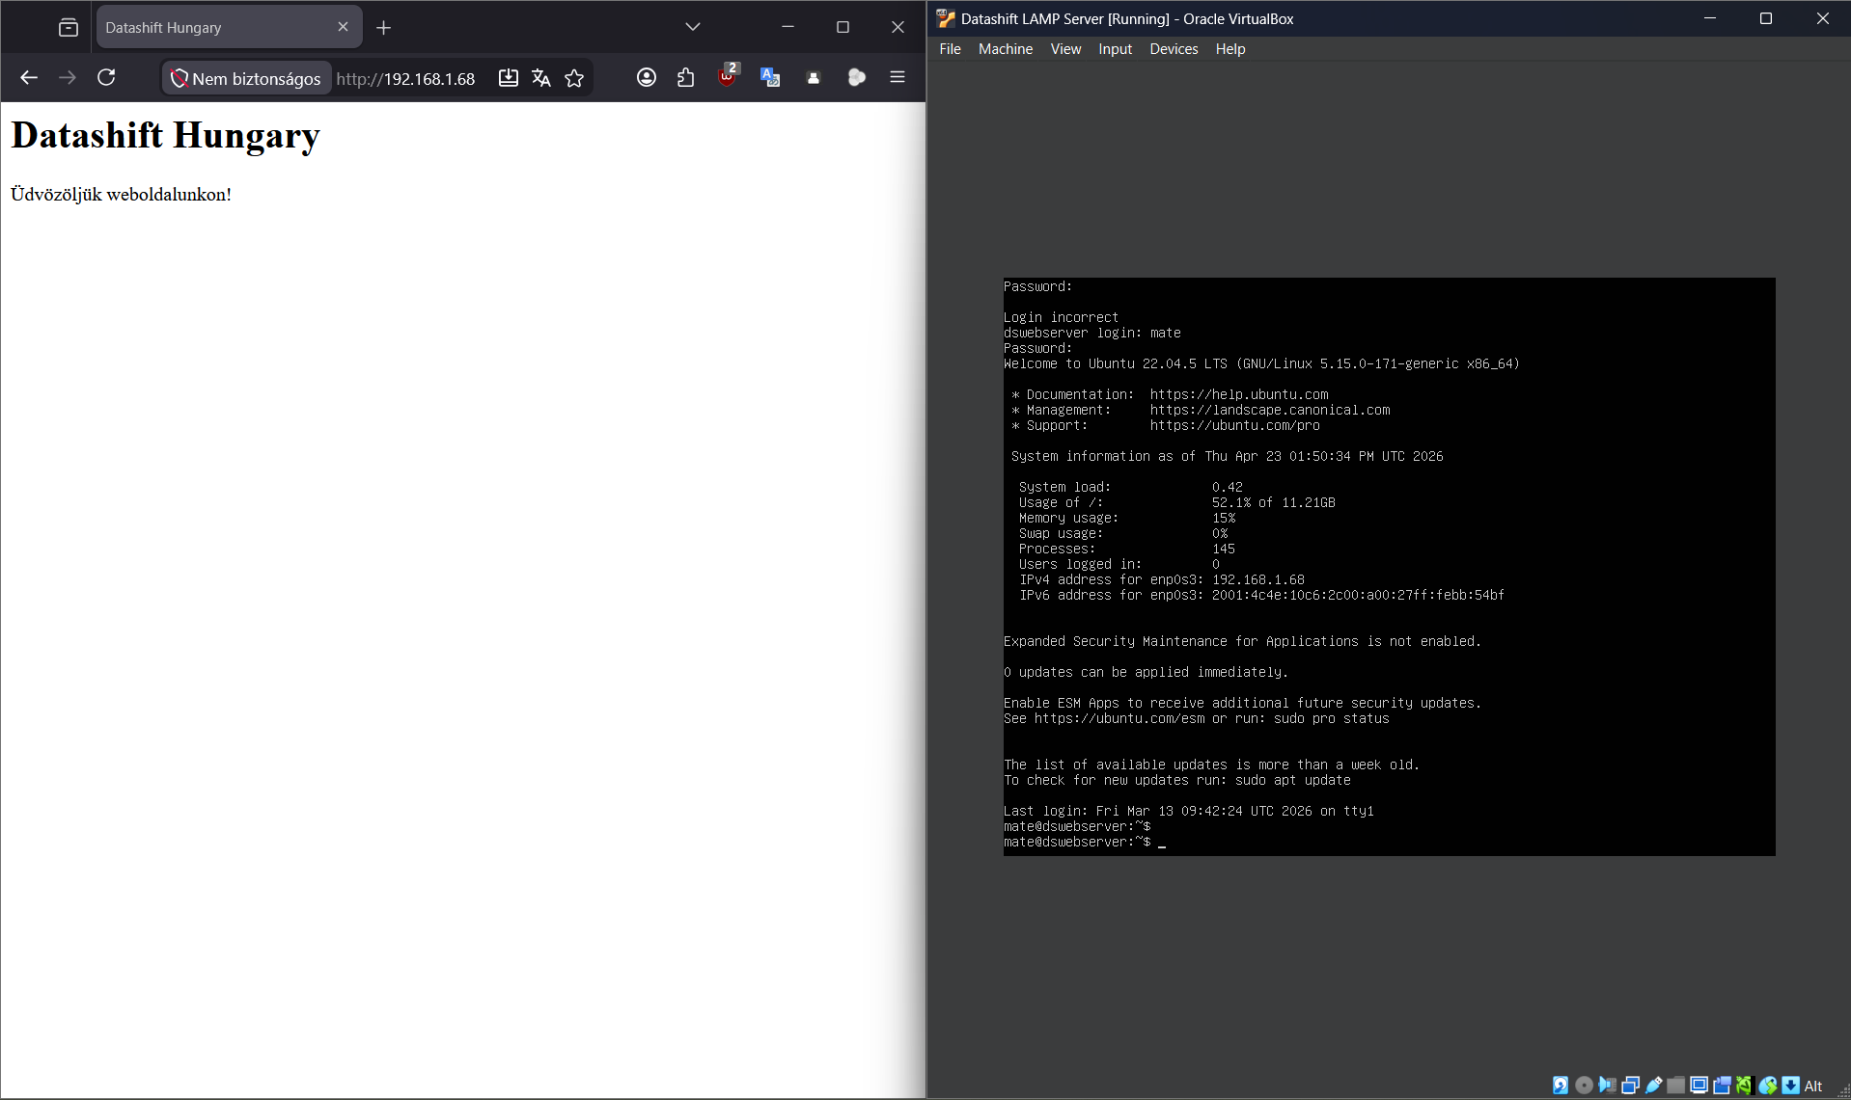
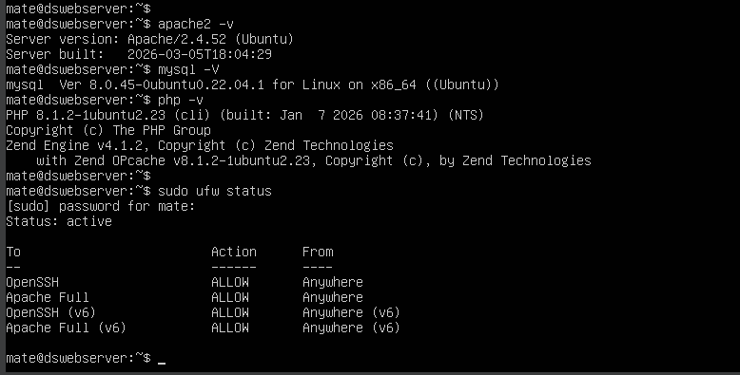
Linux server
LAMP server
Hosting of datashift.hu
Contact form and support for clients

Slide 11
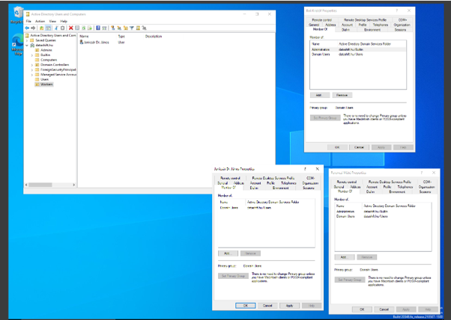
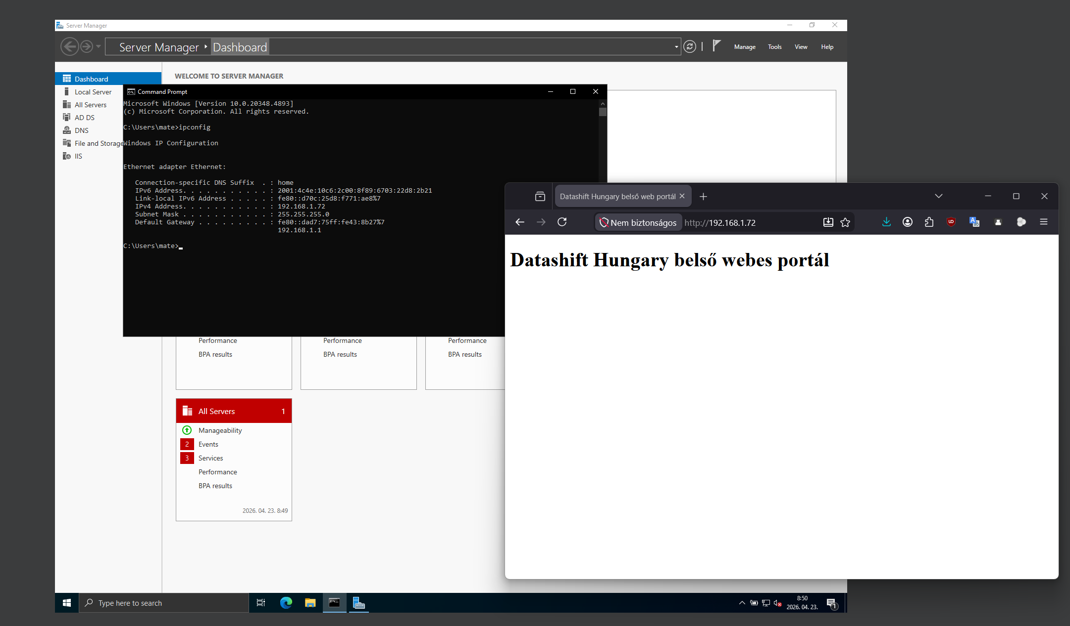
Windows server
Active Directory server
Hosting of internal web portal and tools
Remote access VPN for employees

Slide 12
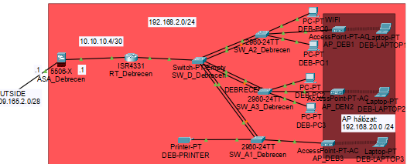
Debrecen building
Company branch office in Debrecen
The office provides services in Debrecen and adjacent regions.

Slide 13
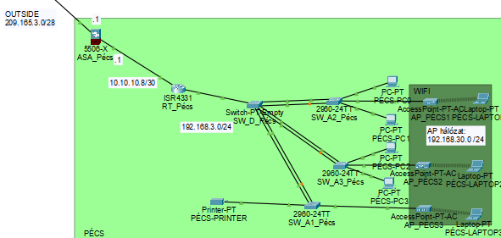
Pécs building
Company branch office in Pécs
The office provides services in Pécs and adjacent regions.

Slide 14
Thank you for your attention!

