Slide 1
MINI PROJECT PRESENTATION
AI Powered Garments Contractor & Worker Management System
A simple digital system for garment operations, workforce records, and AI-assisted planning
Mehjabeen Ansari · Roll No. 6 · BSc CS
GARMENT ERP · SMART OPERATIONS PLATFORM
01

Slide 2


THE PROJECT NEED
From scattered factory records to one connected system
Traditional challenge
Project solution
Separate paper records for buyers, fabric, orders, and workers
Manual updates can create delays and calculation mistakes
Important production information is harder to review quickly
One digital workspace for daily garment operations
Clear records for material, work progress, and piece-rate payment
AI guidance supports planning and waste reduction
GARMENT ERP · PROBLEM → DIGITAL SOLUTION
02

Slide 3







ACTUAL SYSTEM ARCHITECTURE
MERN stack for a connected garment ERP
React, Node.js, Express, and MongoDB work together to manage factory information in one web application.
Frontend
Backend API
Database
React.js + Tailwind CSS
Node.js + Express.js
MongoDB
Creates the responsive dashboard and user interface.
Processes business logic, orders, and worker records.
Stores buyers, inventory, orders, workers, and reports.
TypeScript is used across the project to make data and code more reliable.
DEVELOPMENT TOOLS
VS Code
Jira Kanban Board
GitHub
GARMENT ERP · MERN + TYPESCRIPT + TAILWIND CSS
03

Slide 4
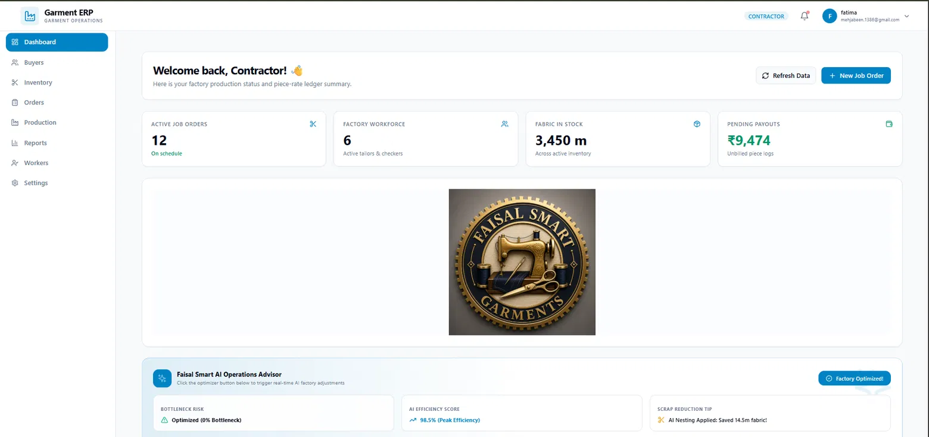
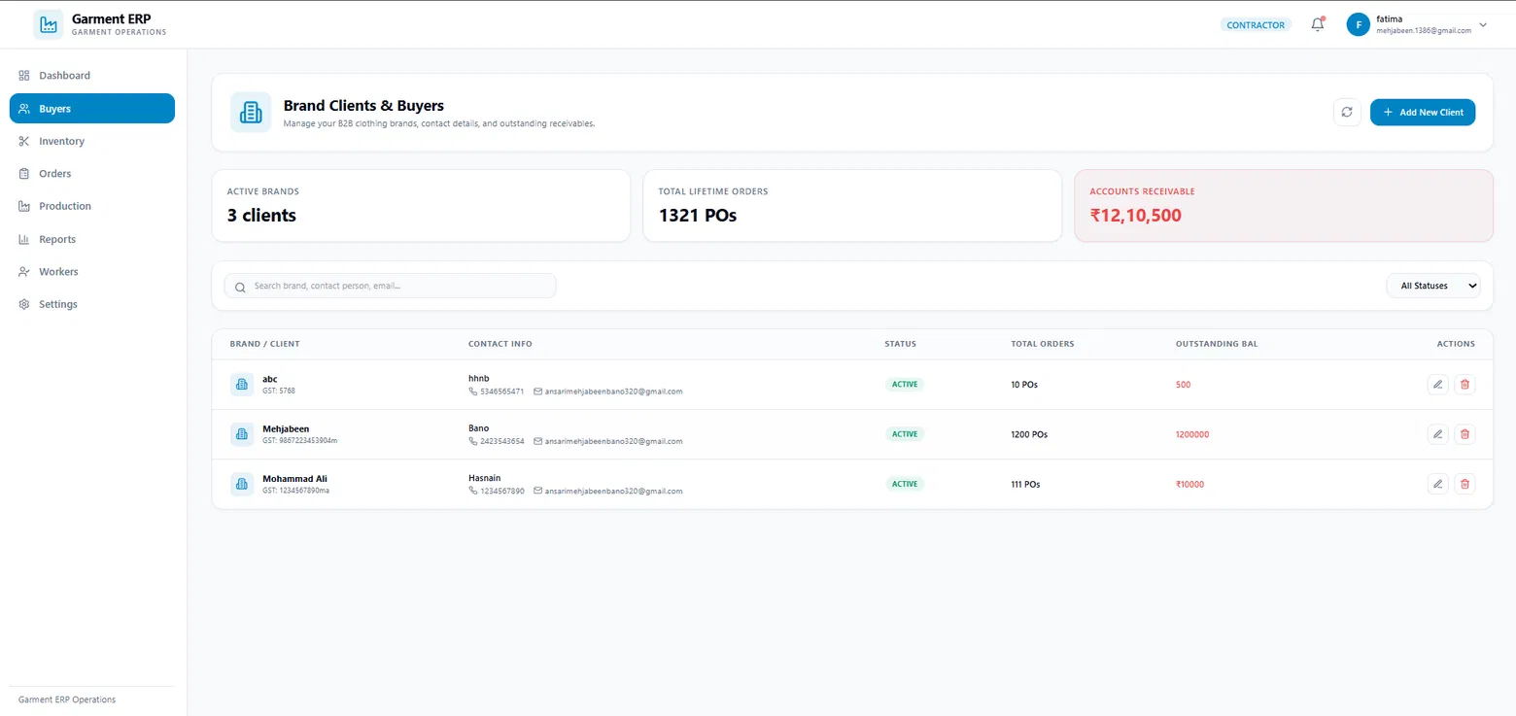
OPERATIONS OVERVIEW
Dashboard gives a quick factory view
The contractor sees the work situation first, then moves to organised buyer records.
Dashboard with an AI Operations Advisor for easy day-to-day decision support
01 · DASHBOARD
One screen for operations, stock, workforce, and AI guidance.
02 · BUYERS
Keeps clients, contacts, orders, and balances together.
Buyer directory keeps customer records structured and searchable
GARMENT ERP · DASHBOARD + BUYERS
04

Slide 5
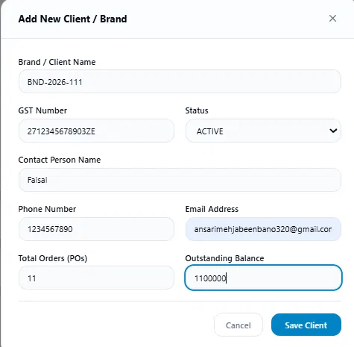
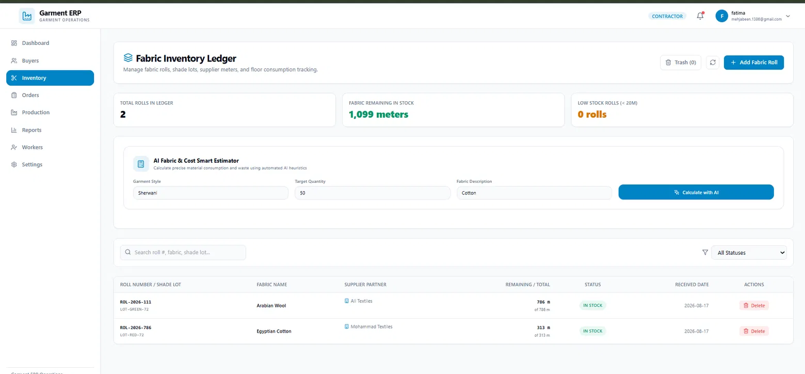

STRUCTURED FACTORY RECORDS
Client entry and fabric inventory stay connected
Clean forms and ledgers reduce the chance of missing details during daily factory work.
Structured client and brand entry form
Fabric ledger for rolls, suppliers, material quantity, and stock status
Client information and raw-material information are captured in clear, reusable records instead of scattered paper notes.
GARMENT ERP · CLIENTS + FABRIC INVENTORY
05

Slide 6



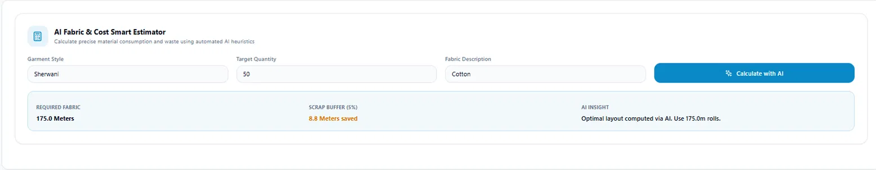
AI FEATURE HIGHLIGHT
AI plans fabric before production starts
The estimator turns simple production inputs into a practical material-planning suggestion.
Input · garment style, quantity, and fabric type
Calculate · expected fabric requirement
Advise · a layout idea to reduce waste
AI Fabric & Cost Smart Estimator shown as a simple planning tool inside the inventory workspace
AI gives a useful estimate and suggestion; the contractor checks the final plan before production.
GARMENT ERP · AI FABRIC & COST ESTIMATOR
06

Slide 7
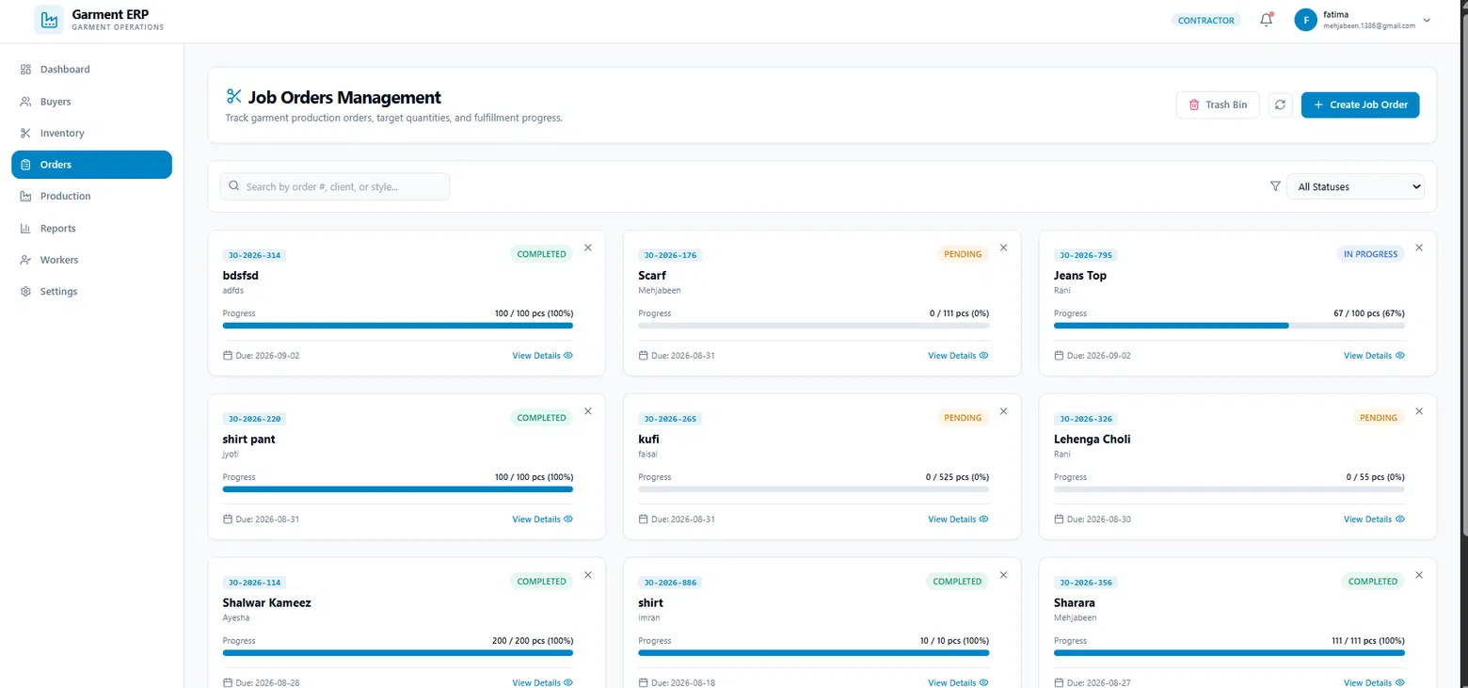


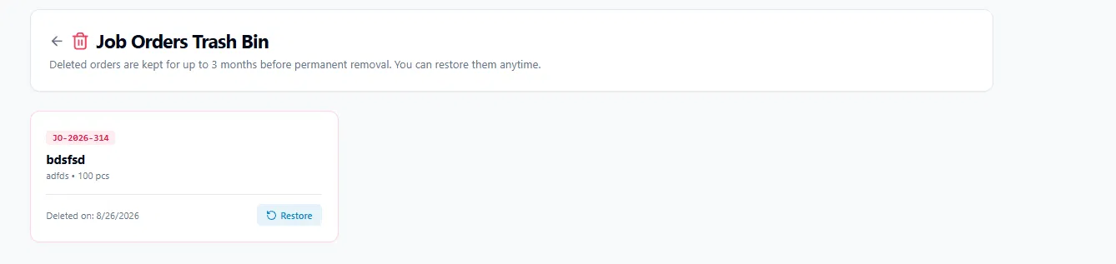
ORDER CONTROL
Job tracking protects order data
Track progress clearly
Managers can compare completed pieces with the target and focus on orders that are still pending.
Job orders show targets, progress, status, and due dates in a single view
Recover safely
Soft delete moves an accidental deletion to the Trash Bin before permanent removal.
Trash Bin keeps deleted orders available for recovery
GARMENT ERP · JOB ORDERS + DATA RECOVERY
07

Slide 8



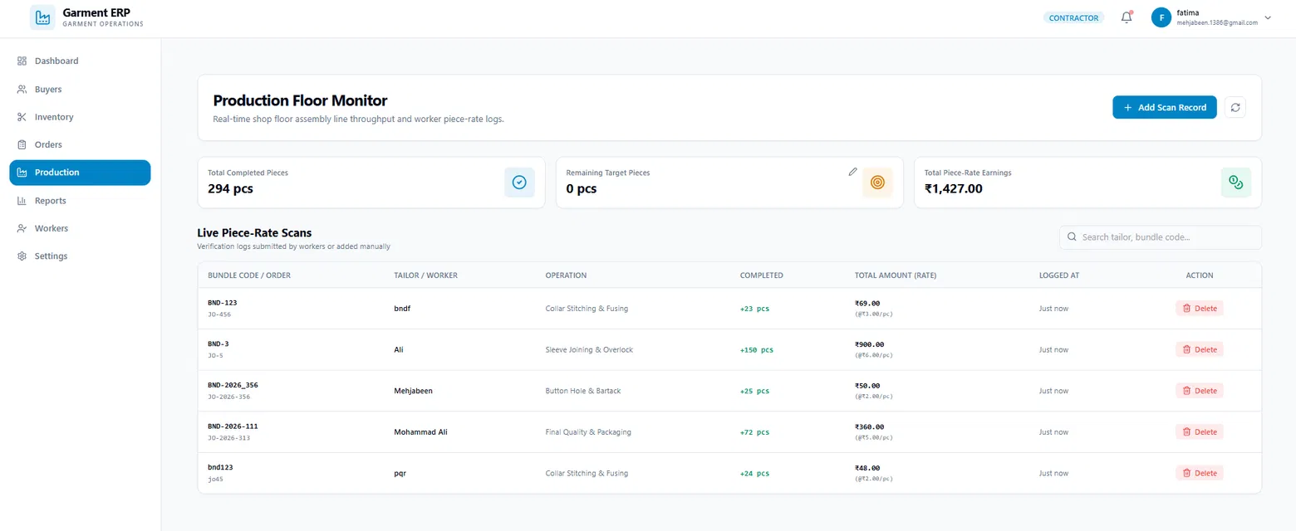
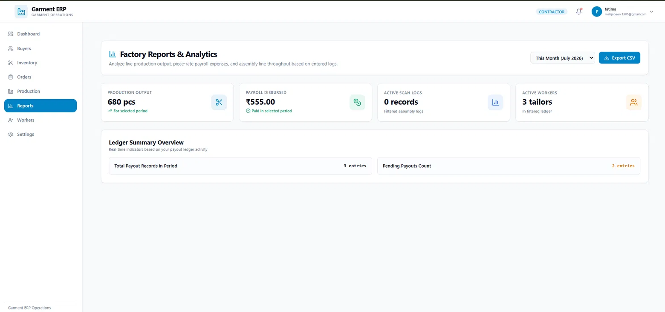
FACTORY VISIBILITY
Production and reports make work visible
Record completed work on the production floor
Review output and workforce information
Act using clear reports for the next decision
Production Floor Monitor records and reviews piece-rate work
Reports & Analytics summarise factory activity for review
GARMENT ERP · PRODUCTION + REPORTING
08

Slide 9


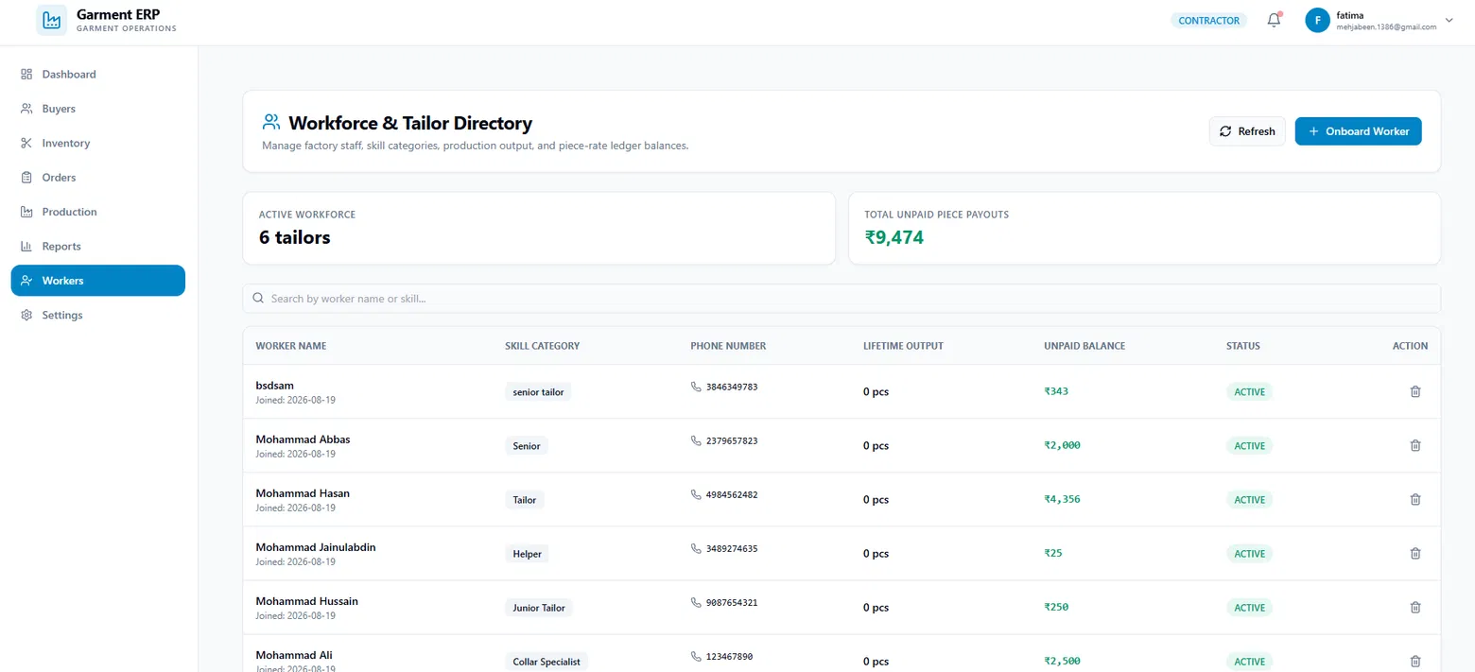
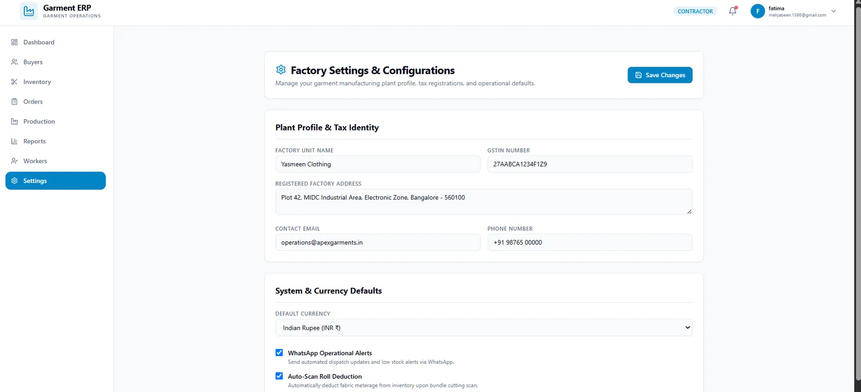
ADMINISTRATION FOUNDATION
Workforce and factory settings stay centralised
People records and factory rules are organised so daily operations remain consistent.
WORKFORCE DIRECTORY · skills, output, payment balance, and status
FACTORY SETTINGS · profile, tax, currency, and operational preferences
Worker directory supports clear piece-rate record management
Factory configuration keeps essential operating details in one place
GARMENT ERP · WORKFORCE + FACTORY SETTINGS
09

Slide 10




AI IN SIMPLE WORDS
AI features, explained simply
The AI features shown in the dashboard and estimator are decision-support tools for the contractor.
1. Fabric estimation
2. Waste guidance
3. Operations advice
The system uses garment style, quantity, and fabric details to estimate how much material may be needed.
It suggests a better cutting or layout plan so unused fabric can be reduced during production planning.
It reviews work indicators and presents simple efficiency or bottleneck guidance for the manager to consider.
AI helps the contractor understand options faster; the final operational decision remains with the contractor.
GARMENT ERP · AI DECISION SUPPORT
10

Slide 11






CONNECTED BUSINESS FLOW
From order to payment: a clear flow
Every module contributes to a traceable garment-factory workflow.
Buyer
Fabric
Job Order
Production
Payment
Create a clear client record
Plan and check material
Set target and due date
Record completed pieces
Review ledger and reports
AI assists planning at the fabric and operations stages, helping the contractor prepare the next order more confidently.
GARMENT ERP · END-TO-END WORKFLOW
11

Slide 12

Thank You!
12

