Slide 1

Demo presentation
DATA SCIENCE PROJECT
Mentor: Belma Ibrahimović
Intern: Mehmed Kadrić

Slide 2


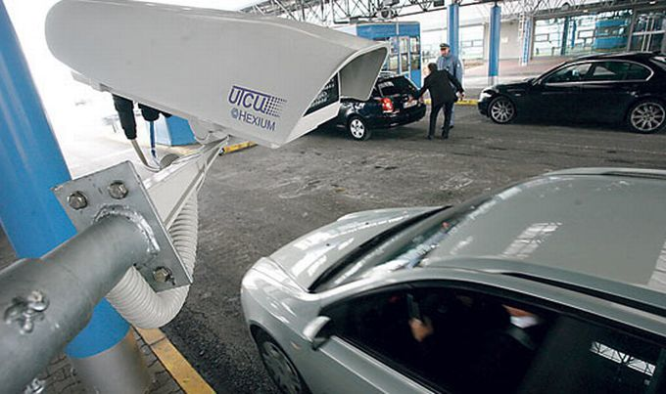
MOTIVATION
DATA SCIENCE
MACHINE LEARNING

Slide 3
TABLE OF CONTENTS
TASK 1: Python for Data Science
TASK 2: Classification in Data Science
TASK 3: Anomaly Detection
Conclusion

Slide 4

Python for data science
Important for DS
Easy to use language
Most common libraries used in data science:
Numpy
Pandas
Scikit-learn
Matplotlib
„Started from the bottom, now I‘m here“

Slide 5
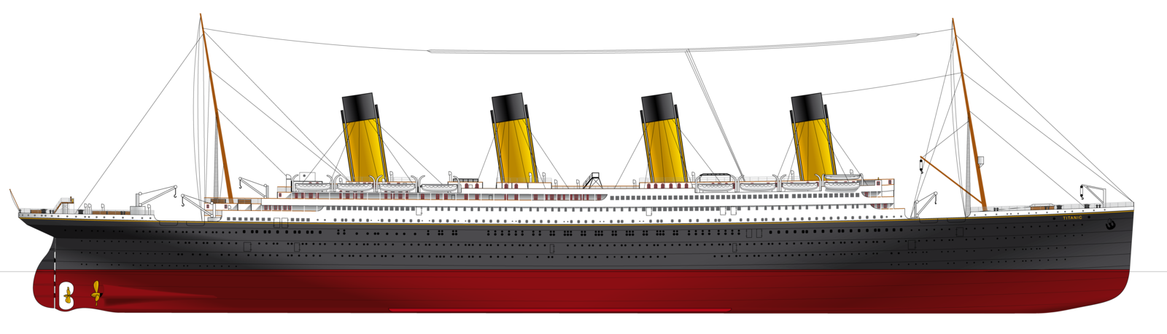
CLASSIFICATION IN DATA SCIENCE
Use-case scenario:
Titanic sank after colliding with an iceberg, killing 1502 out of 2224 passengers and crew (32% survival rate)
Latest discovery have shown that there were additional 10 passengers
Goal:
Create the system which would predict probability of their survival
Dataset was given

Slide 6
TITANIC
Supervised learning
Preprocessing:
1303 examples, 4 features
 | Name | PClass | Age | Sex | Survived
1 | Allen, Miss Elisabeth Walton | 1st | 29 | female | 1
Missing values in Age column and PClass column
Only one outlier in PClass column
Dimensionality reduction
 | Title | PClass | LifeStage | Survived
1 | Miss | 1st | 2 | 1

Slide 7
TITANIC
There are many classification algorithms such as: Logistic Regression, Naive Bayes classifier, SVM, KNN, Decision Trees, etc.
Support Vector Machine Classifier gave the best results
Actual output | Model output | Probability 0 | Probability 1
0 | 0 | 0.98511669 | 0.01488331
0 | 0 | 0.98511669 | 0.01488331
1 | 0 | 0.78656724 | 0.21343276
0 | 0 | 0.96557864 | 0.03442136
0 | 0 | 0.99201528 | 0.00798472
0 | 0 | 0.99201528 | 0.00798472
1 | 1 | 0.19527331 | 0.80472669
1 | 0 | 0.78665345 | 0.21334655
1 | 1 | 0.15862112 | 0.84137888
1 | 1 | 0.21237841 | 0.78762159
Accuracy
Precision
Recall
F1-score

Slide 8
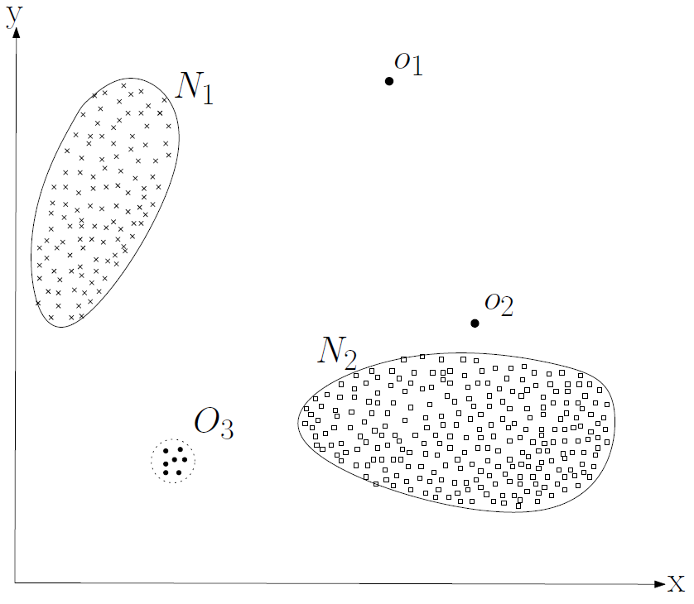
Anomaly detection
Anomalies are patterns in data that do not conform to a well defined notion of normal behavior
Anomaly detection techniques:
Classification based
Nearest Neighbor based
Clustering based
Statistical
Information theoretic
Spectral

Slide 9
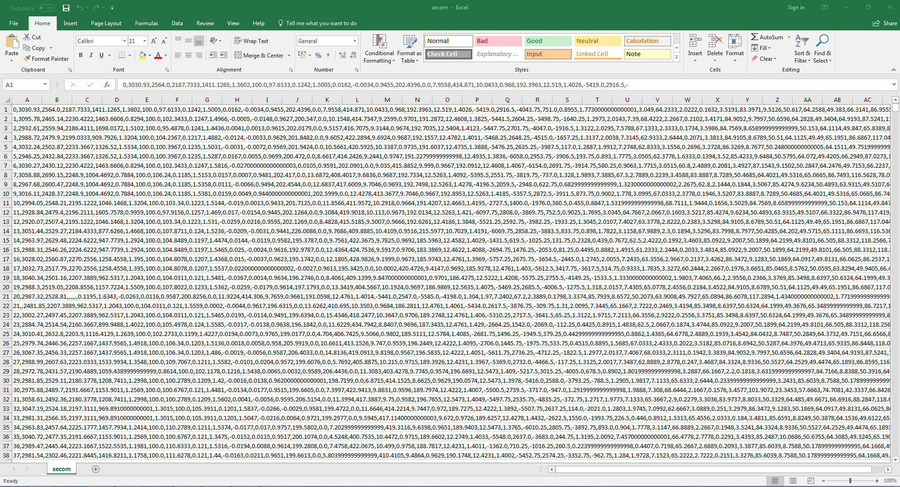
Anomaly detection
Develop system which can be used for smart production monitoring and fault detection in manufacturing processes
Given dataset: 1567 instances, 591 features
Unbalanced dataset: 104 fails
Only numeric values
Missing values
Outliers

Slide 10
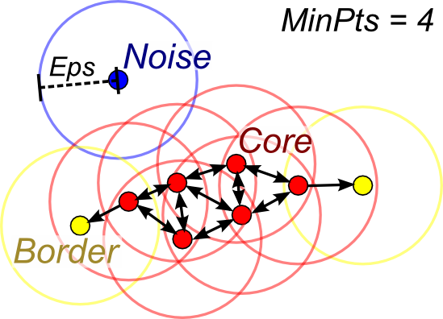
Anomaly detection
DBSCAN (Density-based spatial clustering of applications with noise) algorithm
Core point
Border point
Noise point
Advantages:
Does not require number of clusters
Can find arbitrarily shaped clusters
Requires two parameters
Disadvantages:
border points that are reachable from more than one cluster can be part of either cluster, depending on the order the data are processed
Can‘t cluster data sets well with large differences in densities

Slide 11
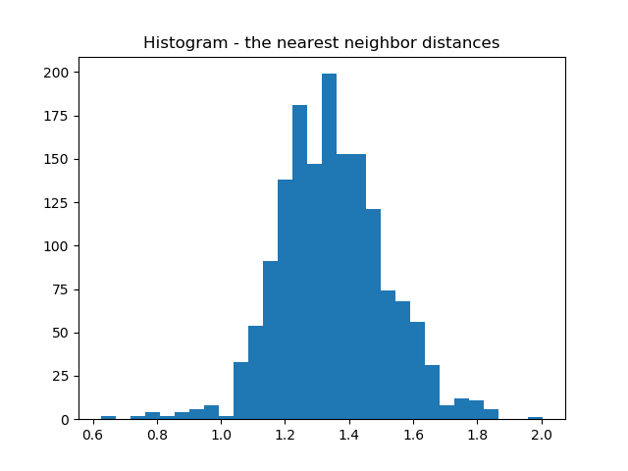
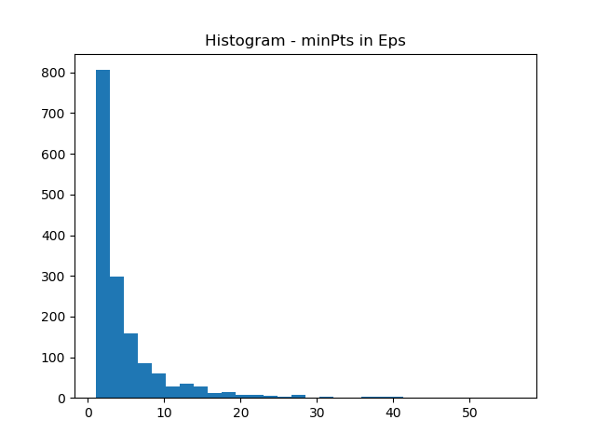
Anomaly detection
Parameter tuning:
In DBSCAN learning algorithm, thare are two parameters: eps and minPts
Eps = 1.45
minPts = 6

Slide 12
Anomaly detection
Unbalanced dataset – accuracy is not a good measure
 | Precision | Recall | F1-score | Support
-1 | 0.07 | 0.51 | 0.13 | 104
0 | 0.94 | 0.54 | 0.69 | 1463
Avg/total | 0.88 | 0.54 | 0.65 | 1567

Slide 13
Anomaly detection
Possible applications:
Fraud detection
Fault detection
System health monitoring

Slide 14
THANK YOU!

