Slide 1

Data science internship – month 1
Mentor: Belma Ibrahimović
Intern: Mehmed Kadrić

Slide 2

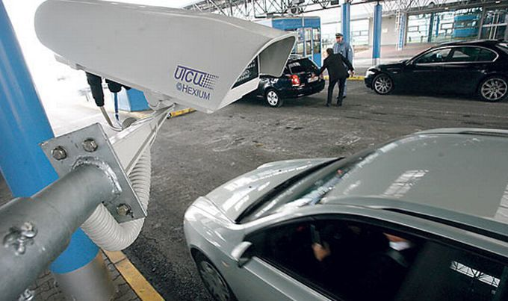
MOTIVATION
Effects of machine learning algorithms are all around us
Curiosity
Digit recognition

Slide 3
TABLE OF CONTENTS
TASK 1: Python for Data Science
TASK 2: Classification in Data Science
TASK 3: Anomaly Detection
Conclusion

Slide 4

Python for data science
Important for DS
Easy to use language
Most common libraries used in data science:
Numpy
Pandas
Scikit-learn
Matplotlib
„Started from the bottom, now I‘m here“

Slide 5
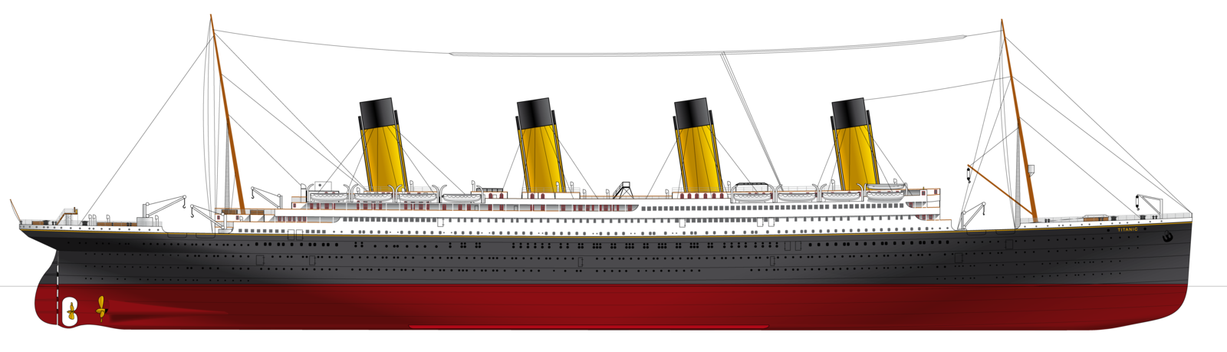
CLASSIFICATION IN DATA SCIENCE
Use-case scenario:
Titanic sank after colliding with an iceberg, killing 1502 out of 2224 passengers and crew (32% survival rate)
Latest discovery have shown that there were additional 10 passengers
Goal:
Create the system which would predict probability of their survival
Dataset was given
Supervised learning

Slide 6
TITANIC
Preprocessing
1303 examples, 4 features
Missing values in Age column and PClass column
Only one outlier in PClass column
Dimensionality reduction
 | Name | PClass | Age | Sex | Survived
1 | Allen, Miss Elisabeth Walton | 1st | 29 | female | 1
 | Title | PClass | LifeStage | Survived
1 | Miss | 1st | 2 | 1

Slide 7
TITANIC
There are many classification algorithms such as: Logistic Regression, Naive Bayes classifier, SVM, KNN, Decision Trees, etc.
Support Vector Machine Classifier gave the best results
Name | Probability of survival | Actually survived
Sage, Miss Constance | 0.0148 | 0
Sage, Miss Dorothy | 0.0148 | 0
Wilkinson, Mrs Elizabeth Anne | 0.2134 | 1
Thomas, Master Assad Alexander | 0.0344 | 0
Zakarian, Mr Artun | 0.0079 | 0
Zakarian, Mr Maprieder | 0.0079 | 0
Anderson, Mr Harry | 0.8047 | 1
Andrews, Miss Kornelia Theodosia | 0.2133 | 1
Brown, Mrs John Murray (Caroline Lane Lamson) | 0.8413 | 1
Carter, Mr William Ernest | 0.7876 | 1
Accuracy
Precision
Recall
F1-score

Slide 8
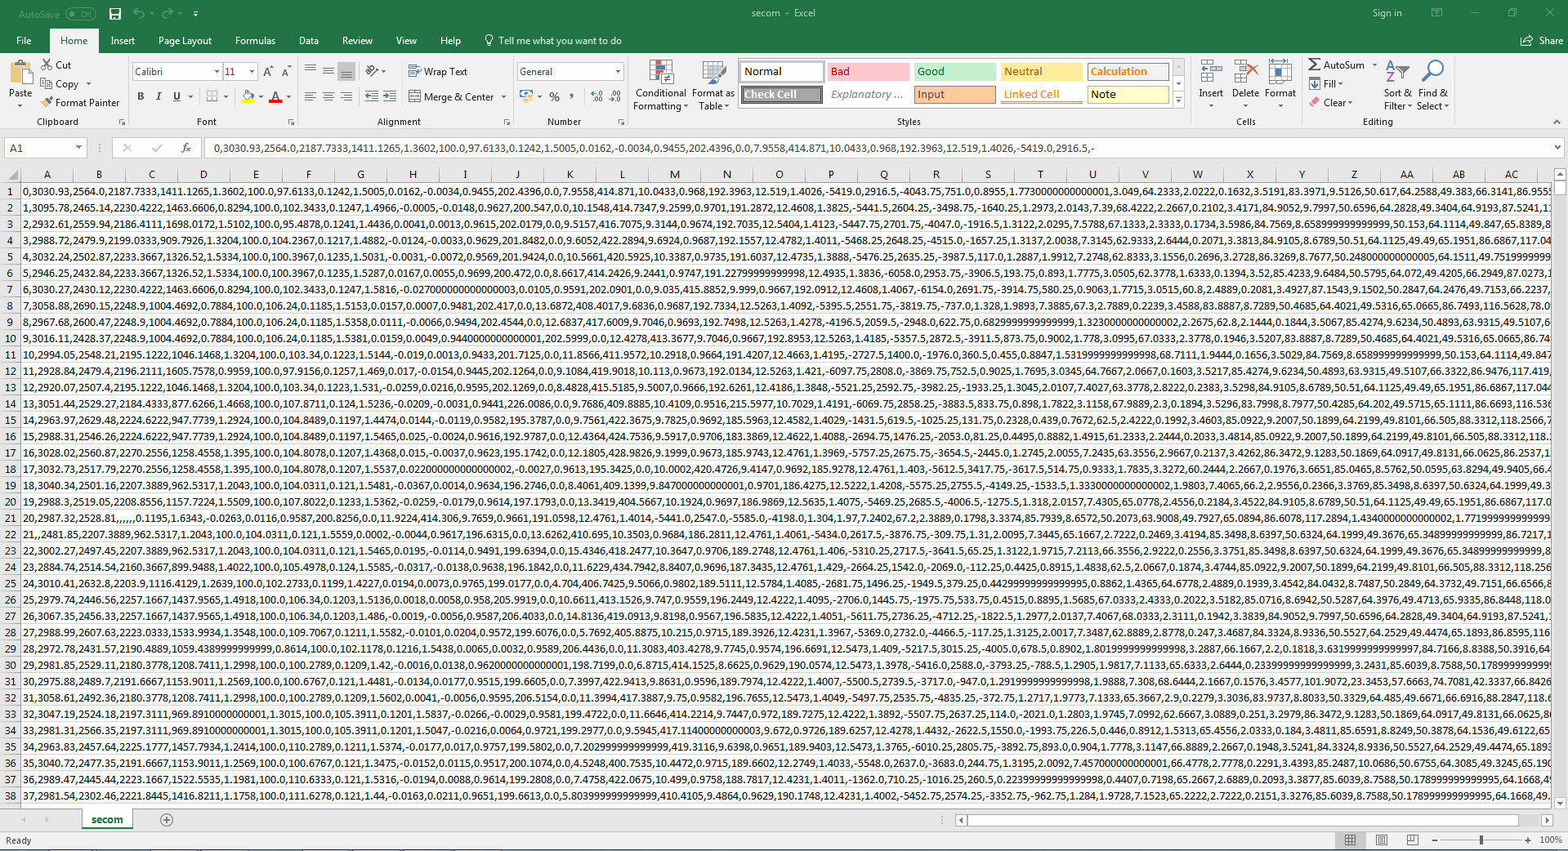
Anomaly detection
Develop system which can be used for smart production monitoring and fault detection in manufacturing processes
Given dataset: 1567 instances, 591 features
Unbalanced dataset: 104 fails
Only numeric values
Missing values
Outliers

Slide 9

Anomaly detection
Anomalies are patterns in data that do not conform to a well defined notion of normal behavior
Anomaly detection techniques:
Classification based
Nearest Neighbor based
Clustering based
Statistical
Information theoretic
Spectral

Slide 10
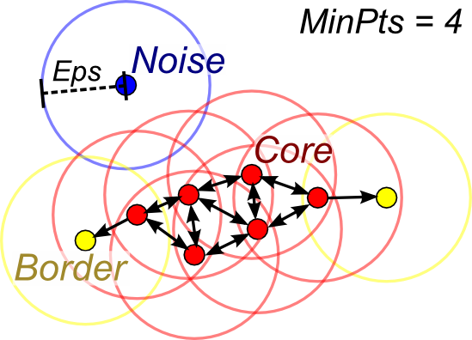
Anomaly detection
DBSCAN (Density-based spatial clustering of applications with noise) algorithm
Core point
Border point
Noise point
https://www.naftaliharris.com/blog/visualizing-dbscan-clustering/

Slide 11
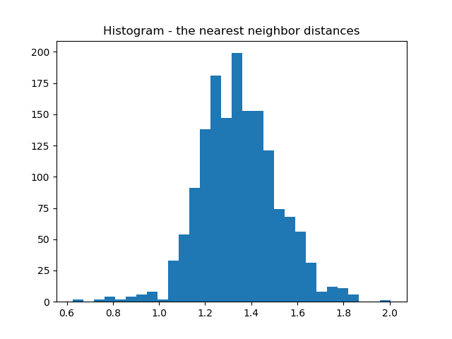
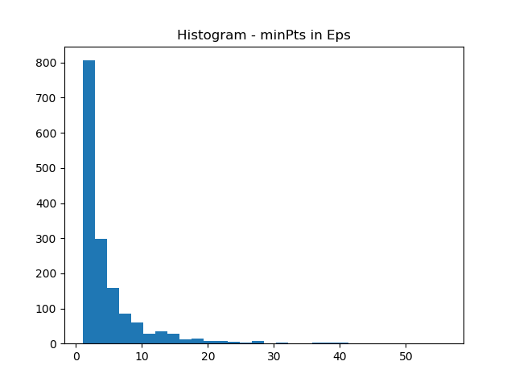
Anomaly detection
Parameter tuning:
In DBSCAN learning algorithm, thare are two parameters: eps and minPts
Eps = 1.45
minPts = 6

Slide 12
Anomaly detection
Unbalanced dataset – accuracy is not a good measure
It‘s important to detect the fault in a timely manner
 | Precision | Recall | F1-score | Support
Outlier | 0.07 | 0.51 | 0.13 | 104
Not outlier | 0.94 | 0.54 | 0.69 | 1463
Avg/total | 0.88 | 0.54 | 0.65 | 1567

Slide 13
CONCLUSION
Learn while working
Math is fun
Advantage of creative mindset
There is no general approach for solving machine learning problems

Slide 14
THANK YOU!

