Slide 1

DATA SCIENCE INTERNSHIP MONTH 2
MENTOR: BELMA IBRAHIMOVIĆ
INTERN: MEHMED KADRIĆ

Slide 2
TABLE OF CONTENTS
Anomaly detection system
Object detection for self-driving car
Research
Example
What next?

Slide 3
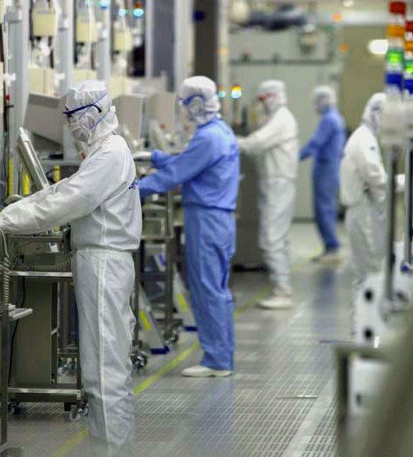
REAL WORLD PRODUCTION PROCESS
The process of manufacturing semiconductors consists of more than a hundred steps
Each step require few measurements
Preventive action
Nuclear Power Plant anomaly detection system

Slide 4
ANOMALY DETECTION SYSTEM
Poor performance of previous system
One-class SVM algorithm
 | Precision | Recall | F1-score | Support
Outlier | 0.07 | 0.51 | 0.13 | 104
Not outlier | 0.94 | 0.54 | 0.69 | 1463
Avg/total | 0.88 | 0.54 | 0.65 | 1567
DBSCAN

Slide 5
ANOMALY DETECTION SYSTEM
Poor performance of previous system
One-class SVM algorithm
 | Precision | Recall | F1-score | Support
Outlier | 0.07 | 0.51 | 0.13 | 104
Not outlier | 0.94 | 0.54 | 0.69 | 1463
Avg/total | 0.88 | 0.54 | 0.65 | 1567
DBSCAN
 | Precision | Recall | F1-score | Support
Outlier | 0.58 | 1.00 | 0.74 | 104
Not outlier | 1.00 | 0.95 | 0.97 | 1463
Avg/total | 1.00 | 0.95 | 0.96 | 1567
OneClassSVM

Slide 6
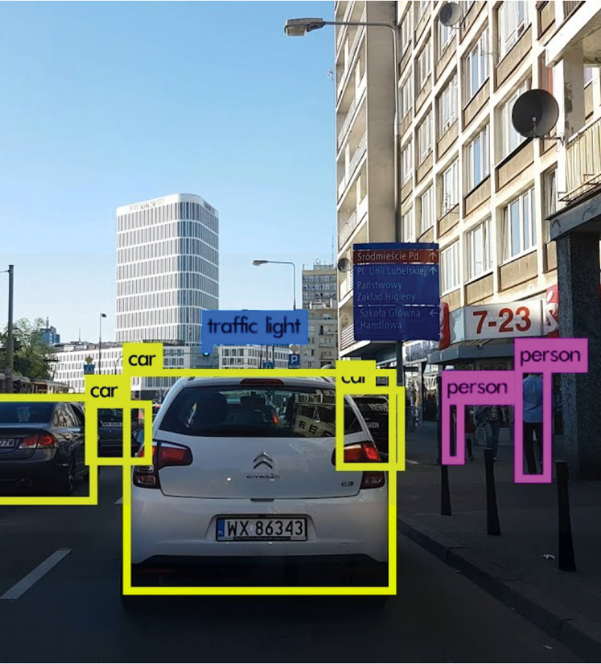
OBJECT DETECTION FOR SELF-DRIVING CAR
YOLO object detection for self-driving car using Tensorflow
Objects are: car, truck, pedestrian and street lights
YOLO – deep learning state of the art approach
Projects consists two major tasks:
Research
Develop POC

Slide 7
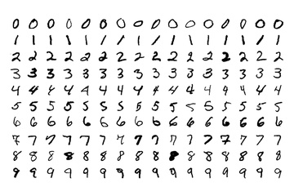
COMPUTER VISION AND DEEP LEARNING
We try to teach computers how to see
DL added a huge boost to the already rapidly developing field of CV
Artificial Neural Networks
Convolutional Neural Networks

Slide 8
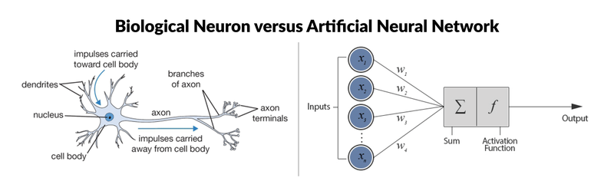
ARTIFICIAL NEURAL NETWORKS
Inputs, weights, activation function, output
Backpropagation

Slide 9
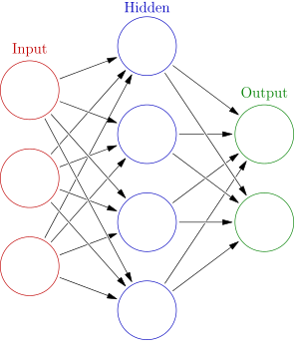
ARTIFICIAL NEURAL NETWORKS - TRAINING
Step 1: Randomly initialise the wights to small numbers
Step 2: Input the first obesrvation of your dataset
Step 3: Forward-Propagation
Step 4: Measure generated error
Step 5: Back-Propagation
Step 6: Repeat Steps 1 to 5 and update weights
Step 7: Epochs

Slide 10
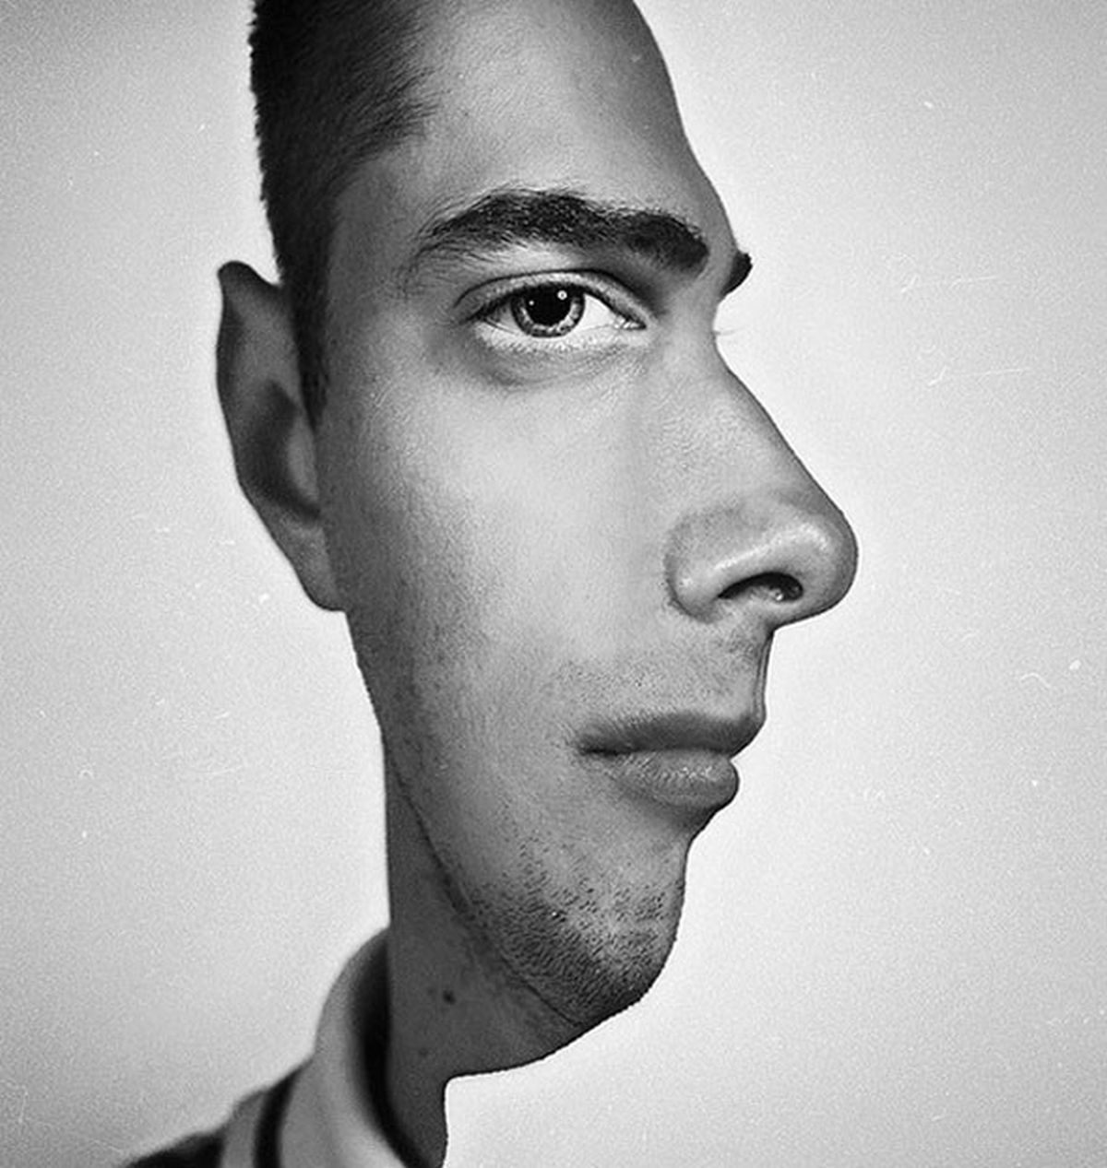
CONVOLUTIONAL NEURAL NETWORK
Depending on the features that you process you categorize things in certain ways
CNN automatically extracts features
CNN
Image
Output
Label (Image class)

Slide 11
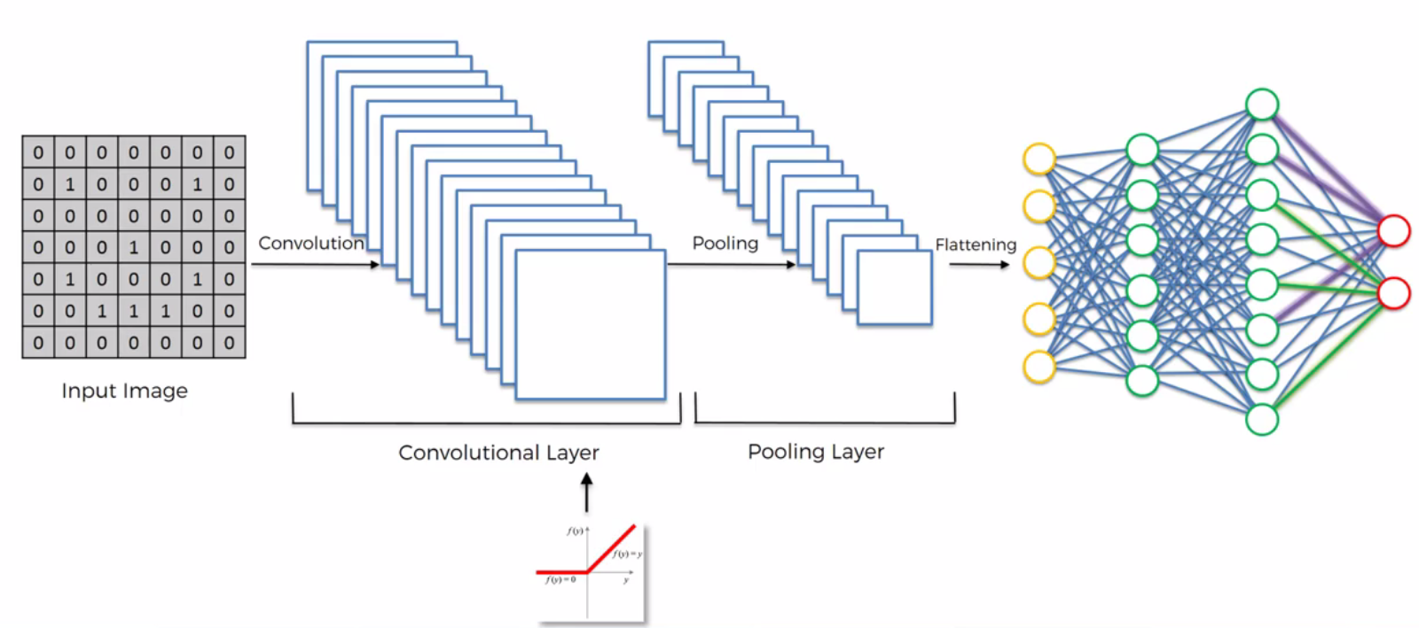
ARCHITECTURE OF CNN
Input image
Convolution
Convolutional layer
Pooling Layer
Flattening
Fully connection

Slide 12
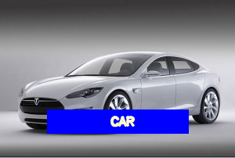
Example – Car recognition with CNN
Probably the most well-known problem in computer vision
Convolutional NN for car recognition
Small dataset

Slide 13
What next?
More research on YOLO approach
Build an AI system for object detection

Slide 14
THANK YOU!

