Slide 1

DEMO PRESENTATION
DATAS SCIENCE PROJECT
Mentor: Belma Ibrahimović
Intern: Mehmed Kadrić

Slide 2



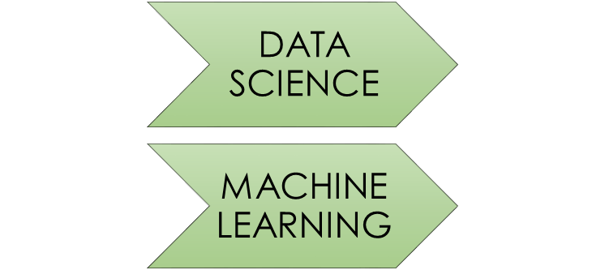
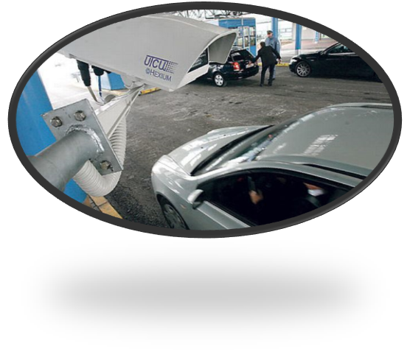

Slide 3
TABLE OF CONTENTS
TASK 1: Python for Data Science
TASK 2: Classification in Data Science
TASK 3: Anomaly Detection
Conclusion

Slide 4

PYTHON FOR DATA SCIENCE
Important for DS
Easy to use language
Most common libraries used in data science:
  Numpy
  Pandas
  Scikit-learn
  Matplotlib
„Started from the bottom, now I‘m here“

Slide 5
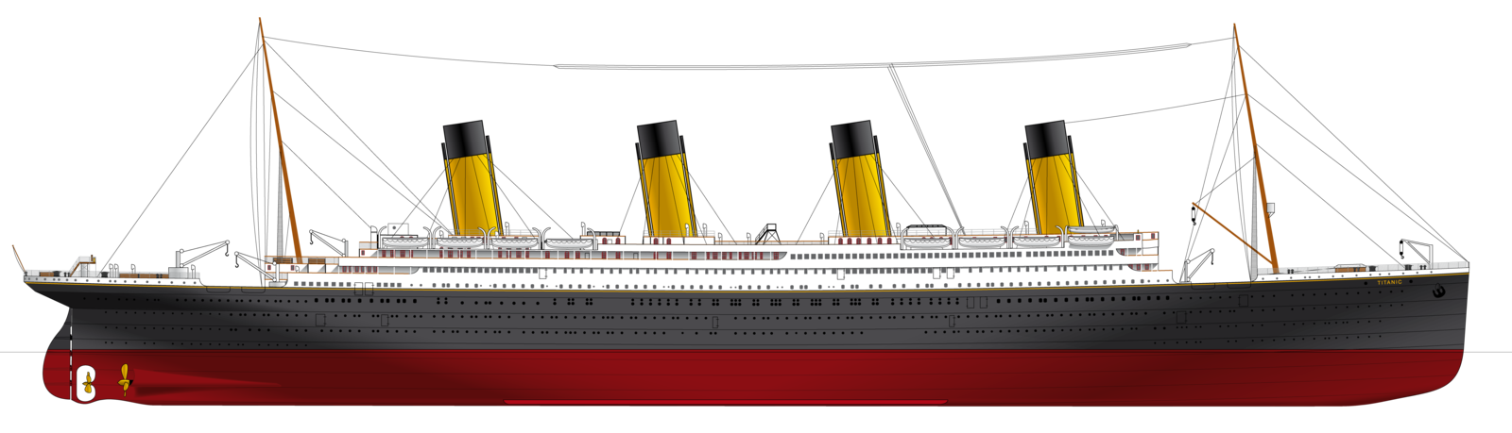
CLASSIFICATION IN DATA SCIENCE
Use-case scenario:
  Titanic sank after colliding with an iceberg, killing 1502 out of 2224 passengers and crew (32% survival rate)
  Latest discovery have shown that there were additional 10 passengers
Goal:
  Create the system which would predict probability of their survival
Dataset was given

Slide 6

Supervised learning
Preprocessing:
  1303 examples, 4 features
 | Name | PClass | Age | Sex | Survived
1 | Allen, Miss Elisabeth Walton | 1st | 29 | female | 1
Missing values in Age column and PClass column
Only one outlier in PClass column
Dimensionality reduction
 | Title | PClass | LifeStage | Survived
1 | Miss | 1st | 2 | 1

Slide 7

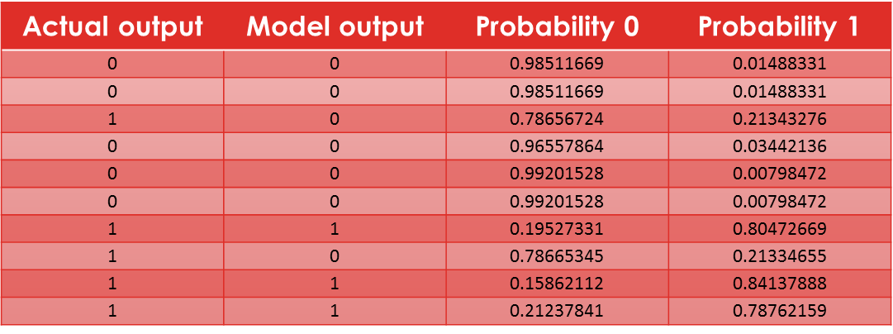
There are many classification algorithms such as: Logistic Regression, Naive Bayes classifier, SVM, KNN, Decision Trees, etc.
Support Vector Machine Classifier gave the best results
Accuracy
Precision
Recall
F1-score

Slide 8

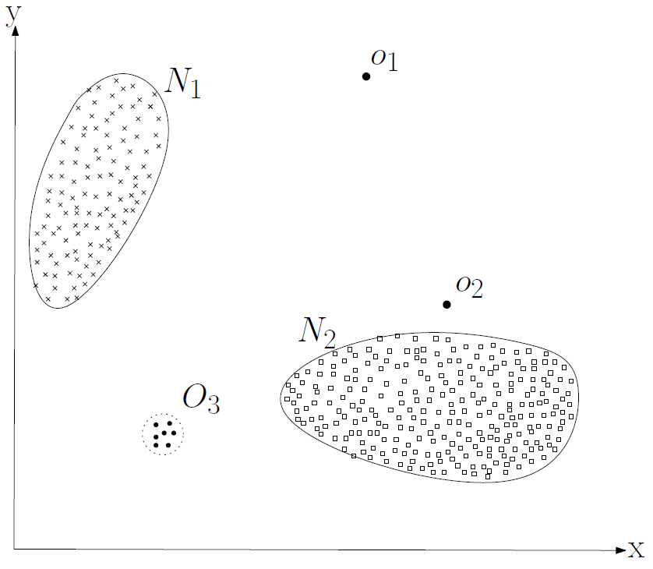
Anomalies are patterns in data that do not conform to a well defined notion of normal behavior
Anomaly detection techniques:
  Classification based
  Nearest Neighbor based
  Clustering based
  Statistical
  Information theoretic
  Spectral

Slide 9

Develop system which can be used for smart production monitoring and fault detection in manufacturing processes
Given dataset: 1567 instances, 591 features
Unbalanced dataset: 104 fails
Only numeric values
Missing values
Outliers

Slide 10
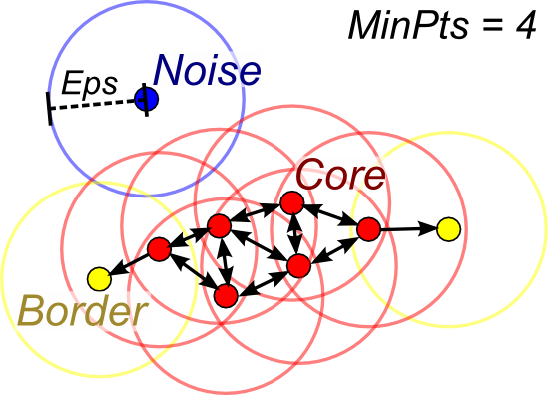
DBSCAN (Density-based spatial clustering of applications with noise) algorithm
  Core point
  Border point
  Noise point
Advantages:
  Does not require number of clusters
  Can find arbitrarily shaped clusters
  Requires two parameters
Disadvantages:
  border points that are reachable from more than one cluster can be part of either cluster, depending on the order the data are processed
  Can‘t cluster data sets well with large differences in densities

Slide 11
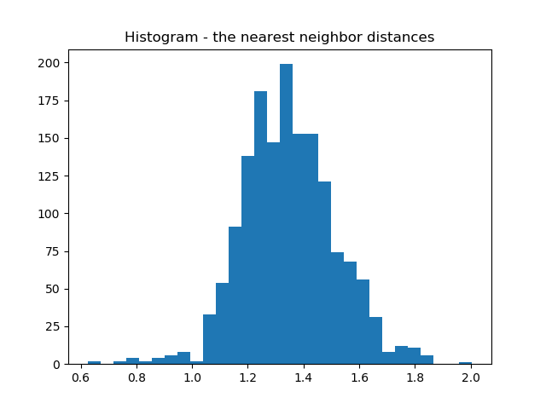
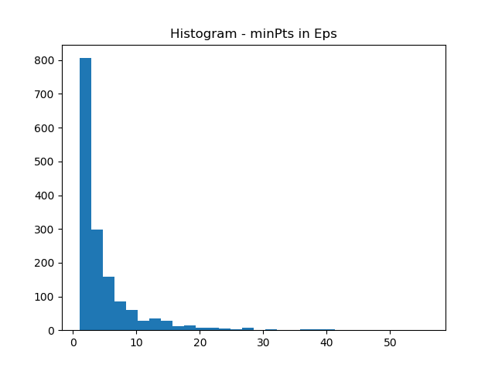
Parameter tuning:
  In DBSCAN learning algorithm, thare are two parameters: eps and minPts
Eps = 1.45
minPts = 6

Slide 12
Unbalanced dataset – accuracy is not a good measure
 | Precision | Recall | F1-score | Support
-1 | 0.07 | 0.51 | 0.13 | 104
0 | 0.94 | 0.54 | 0.69 | 1463
Avg/total | 0.88 | 0.54 | 0.65 | 1567

Slide 13
Possible applications:
  Fraud detection
  Fault detection
  System health monitoring

Slide 14


