Slide 1
CS210 Term Project Presentation
Mehmet Barış Baştuğ
mehmet.bastug
30617

Slide 2
Data
I have taken my Youtube watch history data from takeout.google.com
I have tried to work with also my Google search history but my jupyter notebook gave me this error so i just worked with my youtube data
Error:
IOPub data rate exceeded. The notebook server will temporarily stop sending output to the client in order to avoid crashing it. To change this limit, set the config variable `--NotebookApp.iopub_data_rate_limit`. Current values: NotebookApp.iopub_data_rate_limit=1000000.0 (bytes/sec) NotebookApp.rate_limit_window=3.0 (secs)

Slide 3
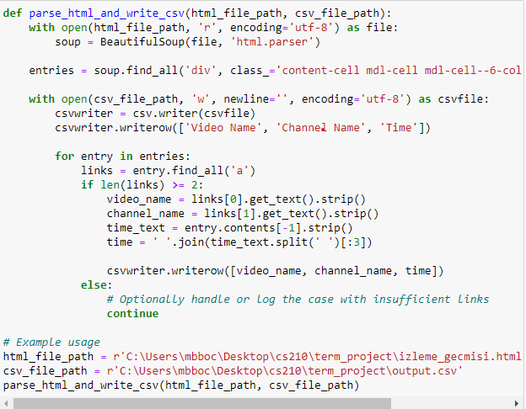
The data i get from youtube was in a html file. I have resetted my search data at the beggining of september so i could not get any data before it.
I parsed the html file with using beautiful soup. The data was categorized into 3 parts which are Video Name, Channel Name, and the time i watched the video.
I have parsed my html file and put it into a csv file in order to work easier.

Slide 4
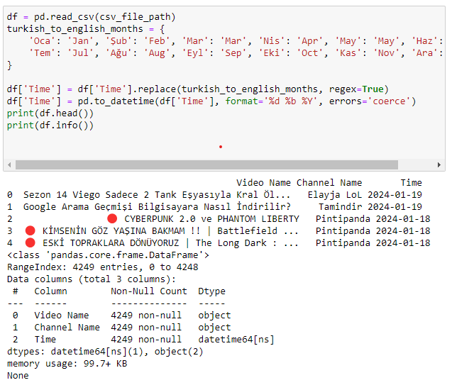
Because i am using Google and youtube in Turkish, the data showed my the time i watched the video in turkish months so i changed them into English and maked them datetime64 type in order to have easier calculations with them later.
Then i printed head and info and i checked that parsing was succesfull.

Slide 5
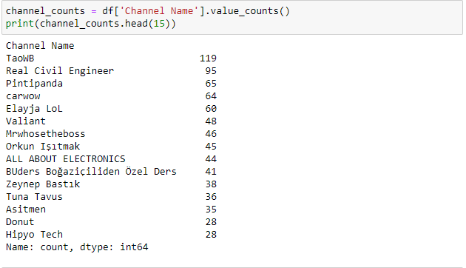
Here i also checked the channels and how many times they appeared on my watch history.
It seems like i am watching too many League of Legends content.

Slide 6
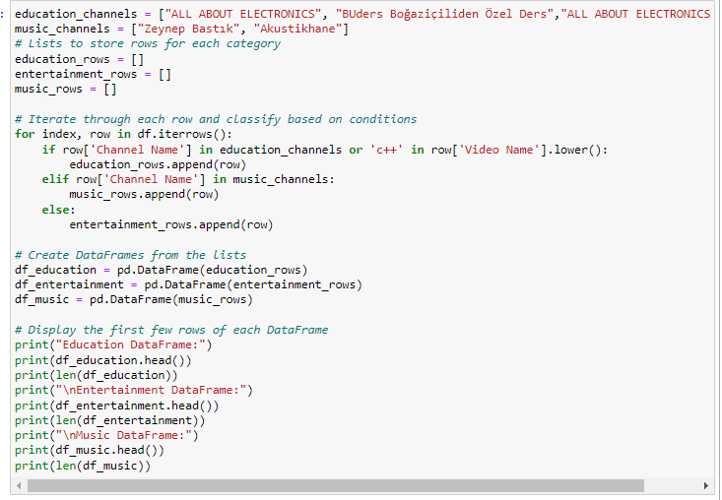
Here, i wanted to sort my data into 3 types: education, music and entertainment. The videos i have wathced from the channel (education_channels) are for educational purpose(for exams), and i only watch Zeynep Bastık and Akustikhane covers from youtube because they are not on Spotify. I also added c++ keyword into education category for video name search because except these channels i only watch c++ content for educational purposes on youtube.

Slide 7
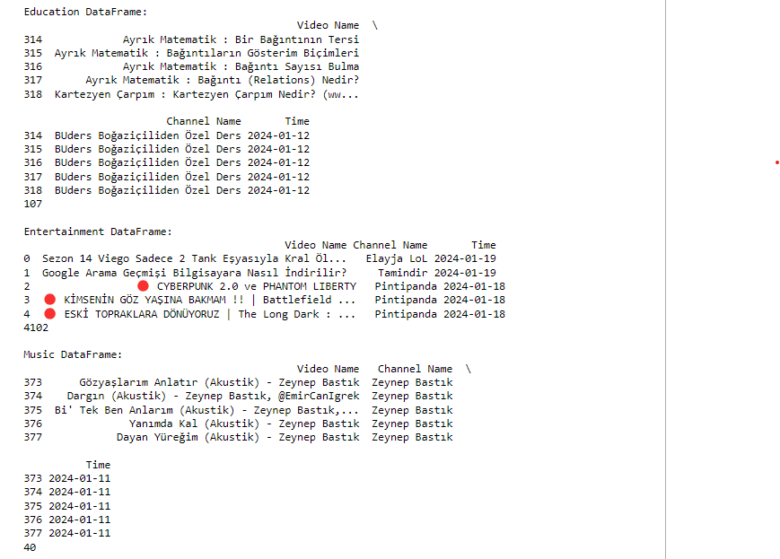
Here are the head and info for each category education, music and entertainment.

Slide 8
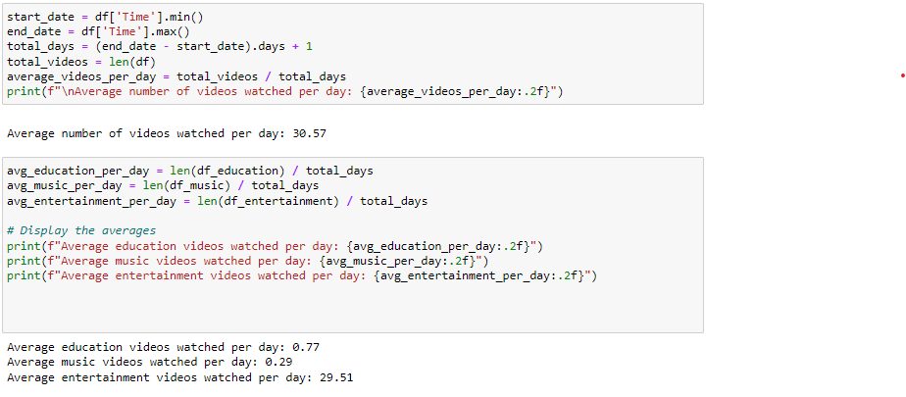
Then i calculate the average video watched per day and calculated it for each category too.
It seems like i am watching too many entertainment videos.

Slide 9
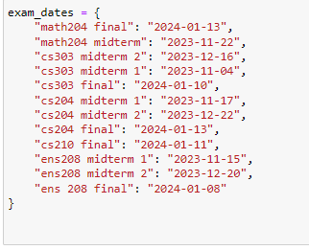
Here i gave my exam dates in order to analyze how my youtube behaivour changes at that time.

Slide 10
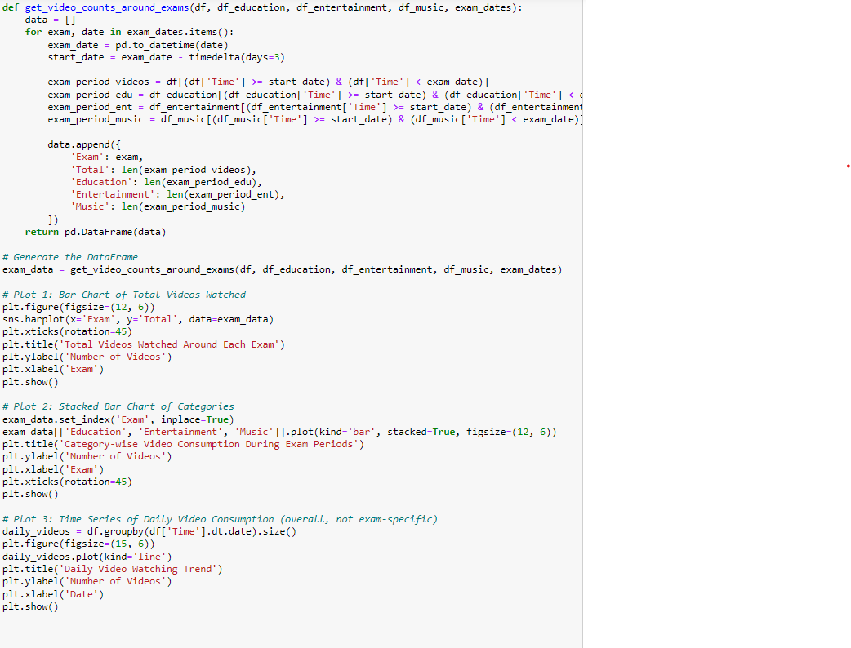
Here i have tried to visiulize my data in order to analyze my data better.I used timedelta(days = 3) because i am starting to sudty 2 days before exam day which comes to 3 days total.

Slide 11
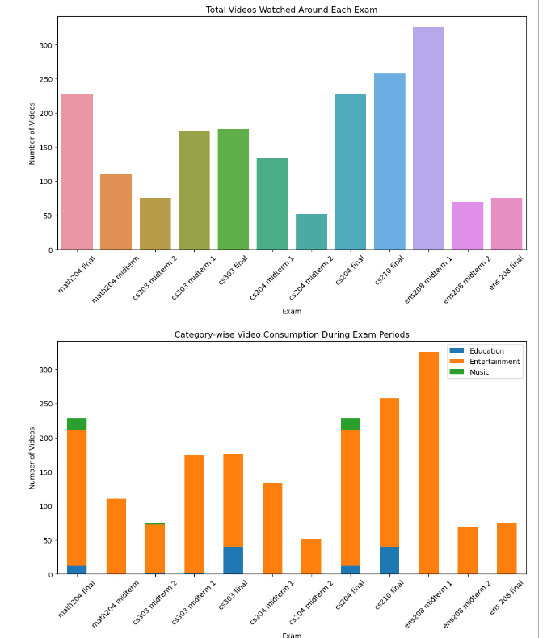
These 2 charts can really explain which exams i studied the most and which i did not care to much. For ens 208 midterm 1 i did not care too much because i can see that i have watched to many videos and they are all entertainment. On the other hand on math 204 final amount of videos wathced is relatively high but it has education and music videos inside it.

Slide 12
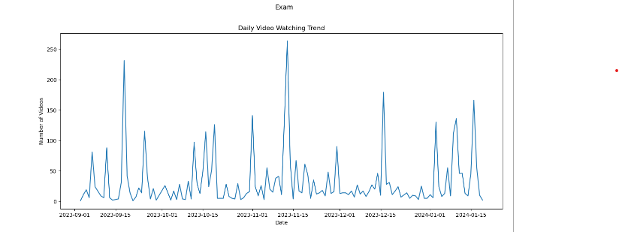
This table shows how many video i watched per day but i did not used it for analyzing my data.

Slide 13
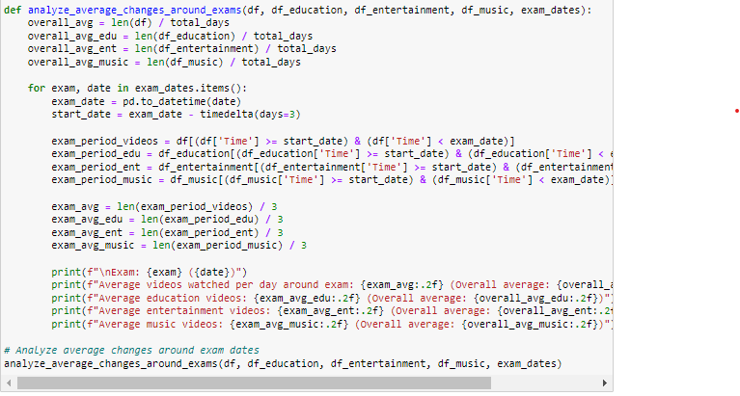
Here i analyze how video watching habits change around exam dates. I take the average number of videos watched per day in each category during a 3 day period of the exam.

Slide 14
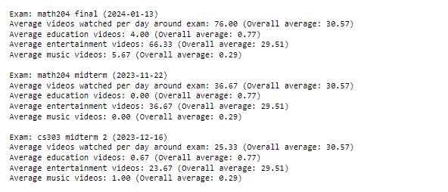
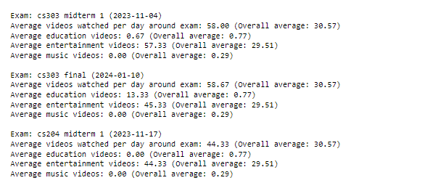
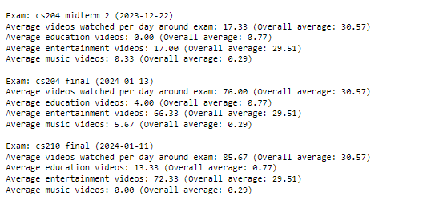
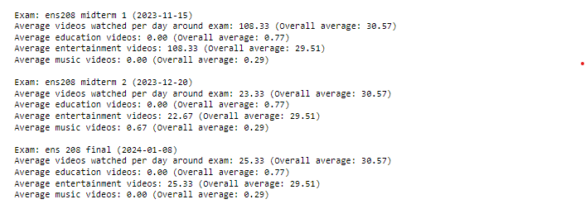

Slide 15
For finals I have watched more videos than overall average.
For every course’s midterm 1 I have also watched more videos than overall average.
For 2nd midterms i have watched significantly lower then overall average.
Espacially for cs303 and math 204 i have used youtube as a source.
For cs204 final and math 204 final, i have listened to Zeynep Bastık while studying.

Slide 16
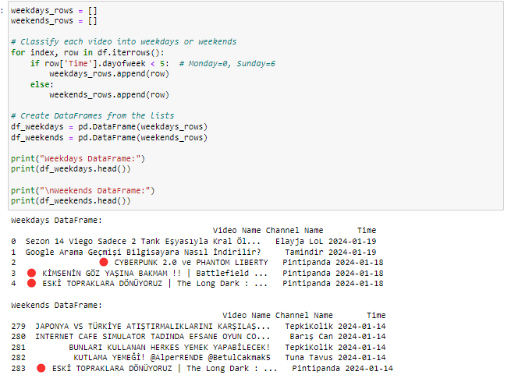
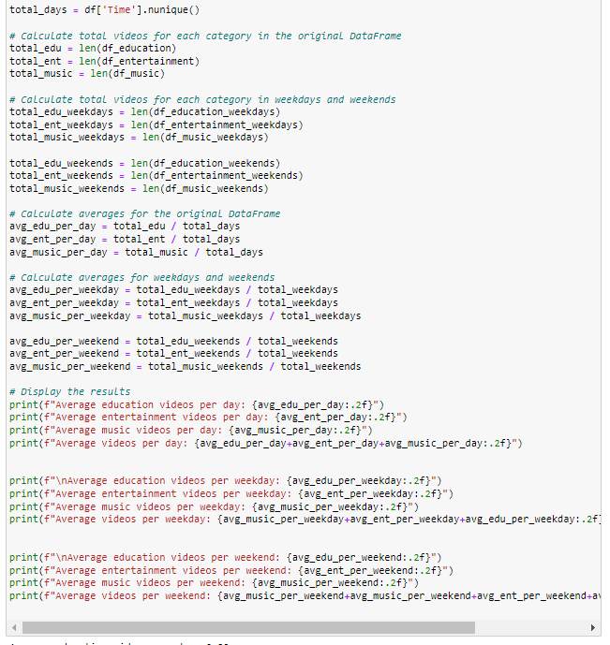
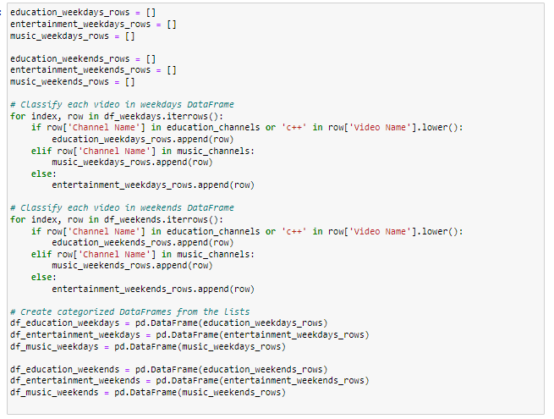

Slide 17
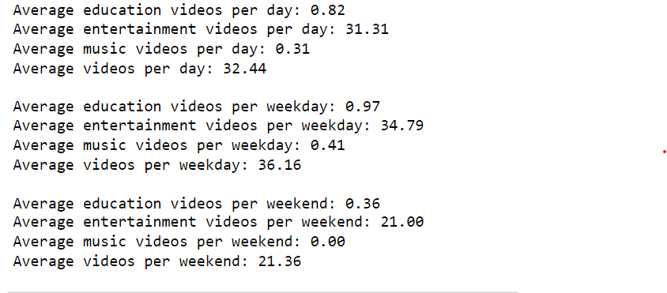
Lastly I wanted to analyze my watching habits with respect to if the day is weekday or weekend. I have seen that i worked mostly in weekdays. Also i can see that i have watched in weekends significantly less video than weekdays.

