Slide 1
AWS ROUTE 53
04.20.2020
OSVALDO

Slide 2






www.e-commerce...
S3
Publishing the website
EC2
Public IP: 52.87.192.40
Public DNS :ec2-52-87-192-40.compute-1.amazonaws.com
http://info.awsdevopsteam.net.s3-website-us-east-1.amazonaws.com

Slide 3

Public IP: 52.87.192.40
Public DNS :ec2-52-87-192-40.compute-1.amazonaws.com
http://info.awsdevopsteam.net.s3-website-us-east-1.amazonaws.com
S3
Not Human readable
Amazon Route 53

Slide 4

What does Route 53 do?
Value
Type
Buy and
Register a Domain
Create Domain Variations
via Sub Domains
Mapping
Value
Record Type
awsdevopsteam.net
xxxx.awsdevopsteam.net
A
AAA
IP of Server
1.2.3.4.5
(naked domain)
yyy.awsdevopsteam.net
Domain Name
www.xxxxx.com
CNAME
zzz.awsdevopsteam.net
Point out
End point
Alias
S3 Bucket url
Load Balancer
Mail Server hostname
MX
Value type determines the record type
Etc..

Slide 5
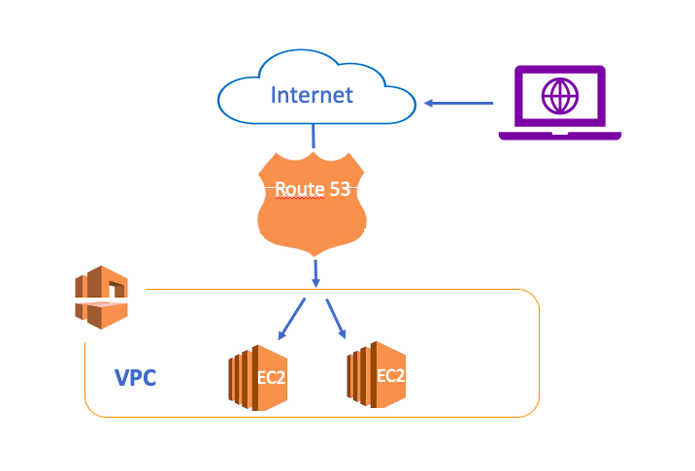


A record
CNAME
Alias
Hosted Zone is a component
where you locate the records
=
Database of the Route 53

Slide 6



A record =IP
1
2
A Record-1
A Record-2
help.osvaldo.com
www.osvaldo.com
A Record-1
server
IP:1.2.3.4
3
Server-1
IP:5.6.7.8
IP
A Record-1
www.osvaldo.com
A Record-3
IP:1.2.3.4
A Record-2
Server-2
Domanin
Name
IP:5.6.7.8

Slide 7
CNAME: DNS-URL
Website domain: www.awsdevopsteam.net
A record -Primary
A record -Primary
www.awsdevopsteam.net= 11.12.13.4
9.10.11.12
local.awsdevopsteam.net = 11.12.13.4
9.10.11.12
info.awsdevopsteam.net= 11.12.13.4
9.10.11.12
mobile.awsdevopsteam.net= 11.12.13.4
9.10.11.12
www.awsdevopsteam.net= 1.2.3.4
7.8..910
local.awsdevopsteam.net = www.awsdevopsteam.net
info.awsdevopsteam.net = www.awsdevopsteam.net
mobile.awsdevopsteam.net = www.awsdevopsteam.net
A record -2
3 Cname
CNAME = Refer the domain
A record -3
A record -4

Slide 8




CNAME: DNS-URL
Website domain: www.awsdevopsteam.net
Jonny
Honey
Social Security Number
BA1112345678-235
Jonathan
Daddy

Slide 9
Alias: DNS-URL
in AWS
Load balancer endpoint: dualstack.load2-2068187317.eu-west-1.elb.amazonaws.com
S3 bucket endpoint: http://www.awsdevopsteam.net.s3-website-us-east-1.amazonaws.com
Naked domain: awsdevopsteam.net
A record
Alias
CNAME
1- Alias is like an extension of the other record
It is not a standalone record
Alias
TXT
Alias
MX
Alias
2- Best practice:
Alias is used for AWS resources
Cname is used for domains

Slide 10
Sub Domain
Refers to
IP
A Record
Sub
Domain
Refers to
CNAME
Refers to
AWS Resource
Alias
www. clarusway.com

Slide 11


Failover
www.osvaldo.com
Primary
Secondary
www.osvaldo
www.osvaldo
IP:1.2.3.4
IP:1.2.3.4
S3 url
server
Server-2
Health Check
IP:1.2.3.4
IP:3.4.5.6
Static webHosting

Slide 12




Failover
Secondary
or
6
1
http://www...
S3
2
7
Primary
EC2
http://www
5
3
4
B
Unhealthy
Healthy
http://www
Health Check
A

Slide 13


Geolocation
x
others
3
2
1
1- Country
2- Continent
3- Default
It depends on where the user is
User

Slide 14

Weighted
90
10

Slide 15
