Slide 1
Python Environments

Slide 2
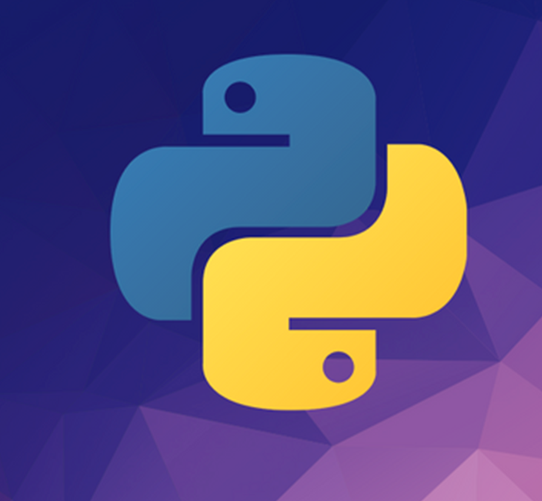
What is Python?
Python is an interpreted, high-level, general-purpose programming language.
Emphasizes code readability with its notable use of significant whitespace.
Python is dynamically typed and garbage-collected.
It supports multiple programming paradigms,
Structured,
Object-oriented
Functional programming
Often described as a "batteries included" language due to its comprehensive standard library

Slide 3
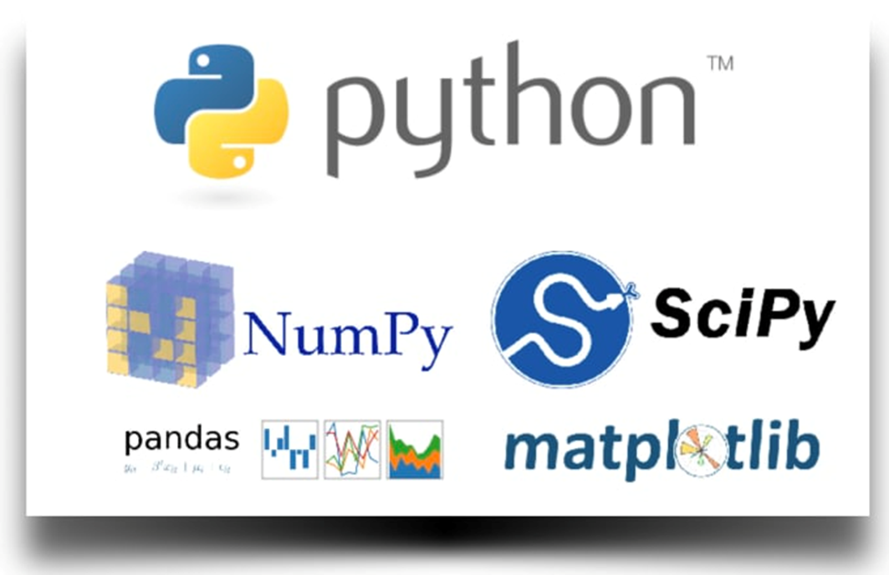


How to Setup Your Environment for DS
Solution 1:
Install Python and pip
Install and manage required libraries …
Solution 2:
Install Anaconda
Solution 3:
Use Google Colab

Slide 4
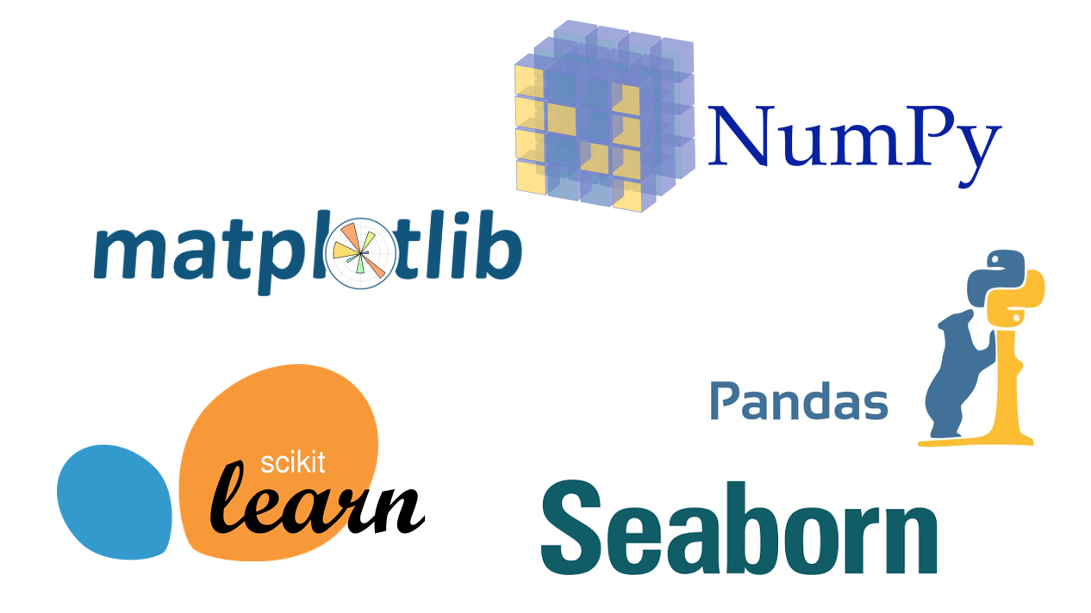
Python Packages
Python packages are roughly a collection of functions and/or data structures that works as and extension to python standard library
By installing and importing packages into your code, you can easily extend the capabilities of Python
Packages are often developed by the Python users and free to use

Slide 5
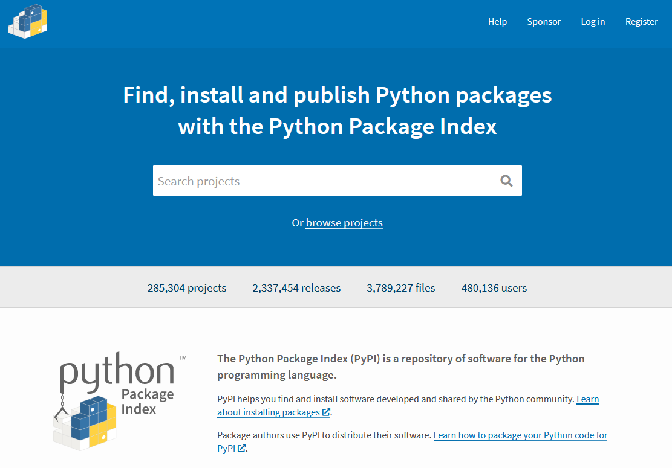
So where can we find these packages?
Python Package Index (PyPI) is the go to when you want to search/install new python packages
pypi.org
You can search through a vast amount of packages and find installation instructions

Slide 6

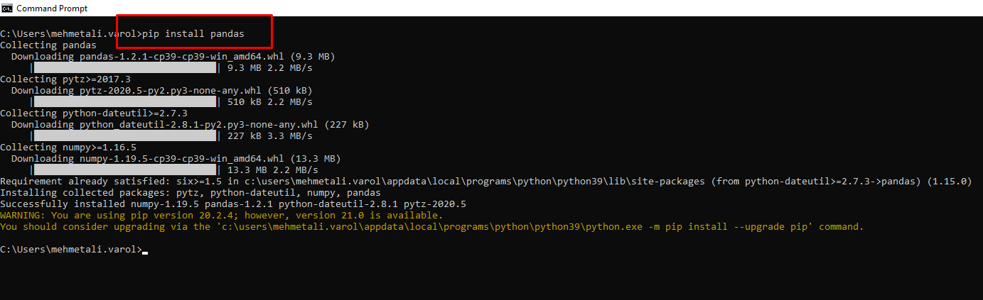
How to Install Python Packages?
Pip is the Python Packaging Authority (PyPA) recommended tool for installing Python packages.
By using pip, you can install packages from Python Package Index (PyPI) as well as other indexes
Comes with recent versions of python installation
Used via Command Line or Terminal (no user interface)

Slide 7
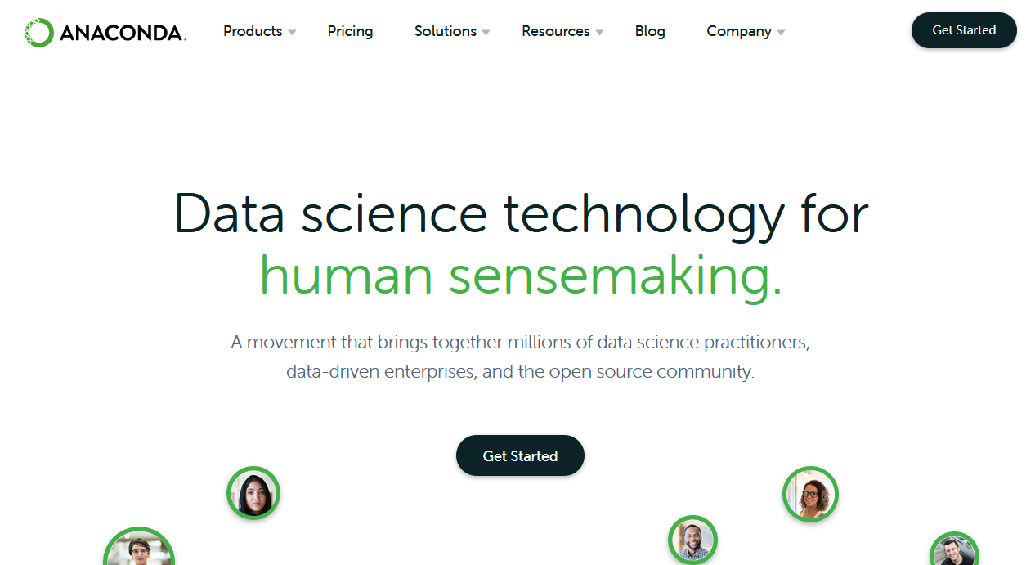
Anaconda
Anaconda is a free and open-source distribution of the Python and R programming languages for scientific computing (data science, machine learning applications, large-scale data processing, predictive analytics, etc.), that aims to simplify package management and deployment (Wikipedia)
Anaconda distribution comes with 1,500 packages selected from PyPI as well as the conda package and virtual environment manager.

Slide 8

Anaconda
It also comes with Jupyter Notebook, Spider and other IDEs that you may need
Anaconda manages packages in a way that the dependencies do not cause the problem
Drawback: You may not be able to use the latest version of all packages
Pip gives you more control and Anaconda comes with easy management

Slide 9
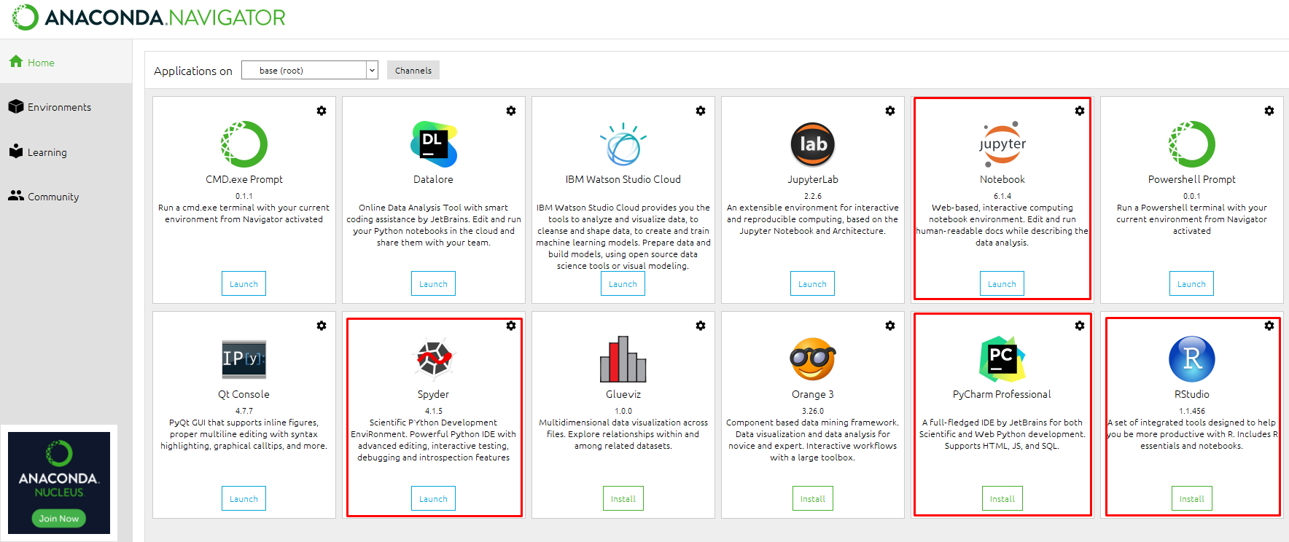
Anaconda Navigator

Slide 10

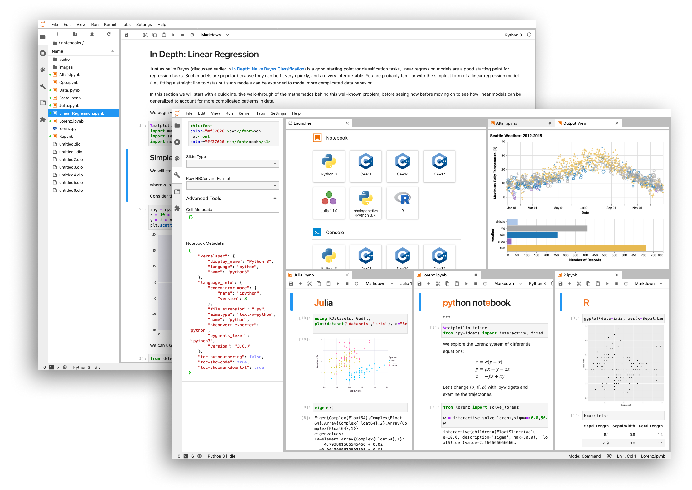
Jupyter Notebook
The Jupyter Notebook is an open-source web application that allows you to create and share documents that contain live code, equations, visualizations and narrative text
Let’s open and explore Jupyter Notebook…

Slide 11

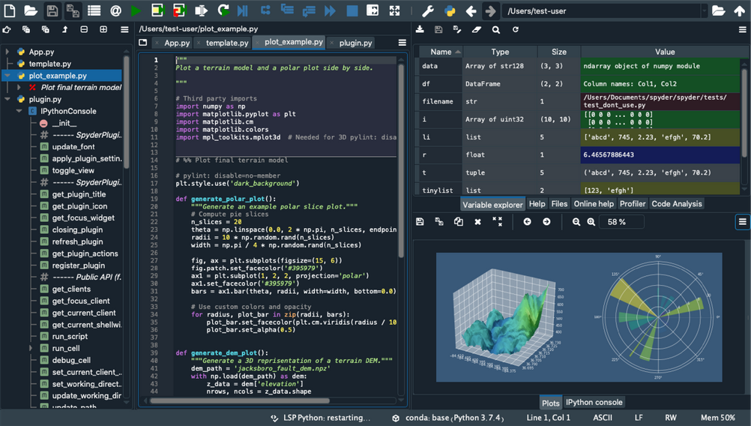
Spyder
Spyder is a scientific development environment written in Python, for Python, and designed by and for scientists, engineers and data analysts.
It offers a combination of the editing, analysis, debugging, and profiling functionality.

Slide 12
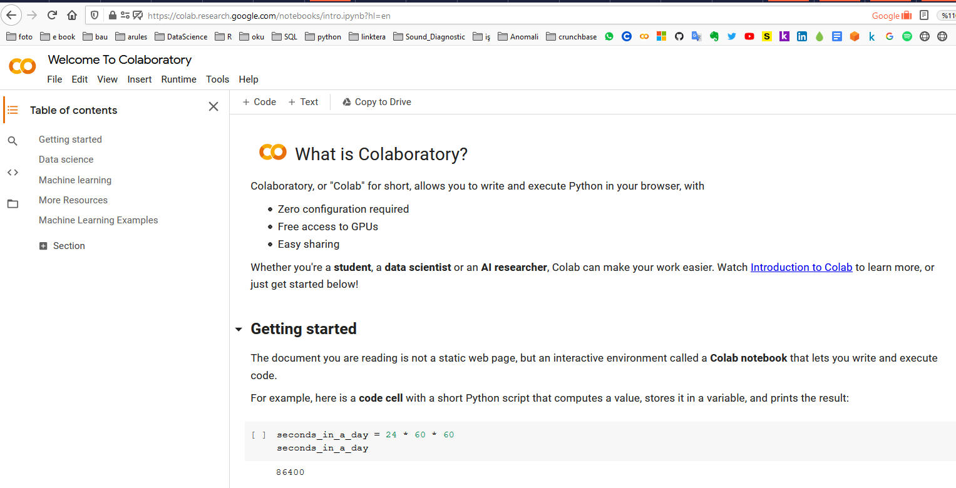
What is Google Colaboratory?
Colaboratory, or "Colab" for short, allows you to write and execute Python in your browser, with
Zero configuration required
Free access to GPUs
Easy sharing
Whether you're a student, a data scientist or an AI researcher, Colab can make your work easier. Watch Introduction to Colab to learn more, or just get started below!

Slide 13
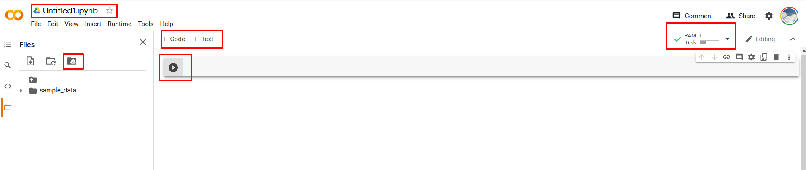
Google Colab
Write and execute code in Python
Document your code that supports mathematical equations
Create/Upload/Share notebooks
Import/Save notebooks from/to Google Drive
Import/Publish notebooks from GitHub
Import external datasets e.g. from Kaggle
Integrate PyTorch, TensorFlow, Keras, OpenCV
Free Cloud service with free GPU

Slide 14

Essential Python Libraries for Data Science
https://numpy.org/
NumPy, short for Numerical Python, is the foundational package for scientific computing in Python. It provides, among other things:
A fast and efficient multidimensional array object ndarray
Functions for performing element-wise computations with arrays or mathematical operations between arrays
Tools for reading and writing array-based data sets to disk
Linear algebra operations, Fourier transform, and random number generation

Slide 15

Essential Python Libraries for Data Science
https://pandas.pydata.org/
Pandas provides high-performance data structures and data analysis tools.
The key feature of Pandas is a fast and efficient DataFrame object for data manipulation with integrated indexing
The DataFrame structure can be seen as a spreadsheet which offers very flexible ways of working with it.
You can easily transform any dataset in the way you want, by reshaping it and adding or removing columns or rows.
Pandas also has tools for importing and exporting data from different formats: comma-separated value (CSV), text files, Microsoft Excel, SQL databases, and the fast HDF5 formats.
In many situations, the data you have in such formats will not be complete or totally structured. For such cases, Pandas offers handling of missing data and intelligent data alignments.

Slide 16


Essential Python Libraries for Data Science
https://matplotlib.org/
https://scikit-learn.org/stable/
Matplotlib is the most popular Python library for producing plots and other 2D data visualizations.
Scikit-learn offers quite powerful tools for machine learning.

