Slide 1


Club-8
Social Interest E-Club
Notes:
We are club-8 team.

Slide 2

The Problem
We are gathering people.
We are developing communities.
We unite people in common interests.
Notes:
We are developing a social interest e-club website which will be center of young minds and visionary ideas.

Slide 3

Notes:
Our site will have events that will bring people together and subclubs which will bring ideas together and will be a tool for developing common interests.

Slide 4
Community
Size
Market size in Club-8 is all humanity.
Source: Forbes
Notes:
We aim to grow rapidly in the market and serve all humanity.

Slide 5

Notes:
We have no limits on time, ideas or energy.

Slide 6

Notes:
We will serve the people slashing interface which based on quality.

Slide 7
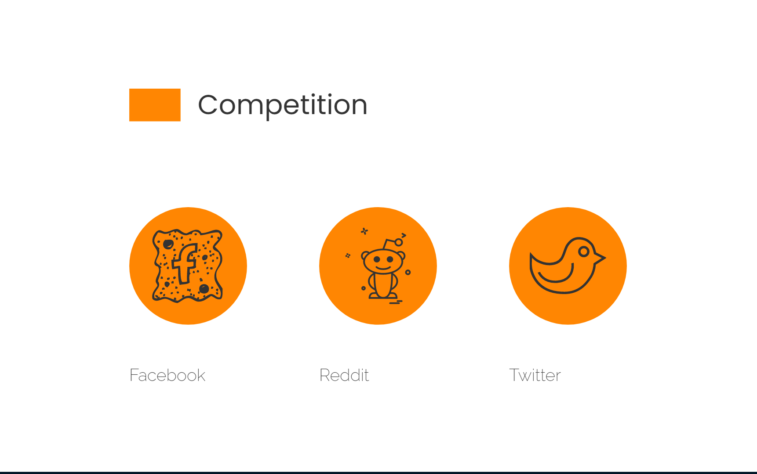
Facebook
Reddit
Twitter
Notes:
We are planning to beat these most used platforms. Because they are all have shortcomings if you dive into them.

Slide 8
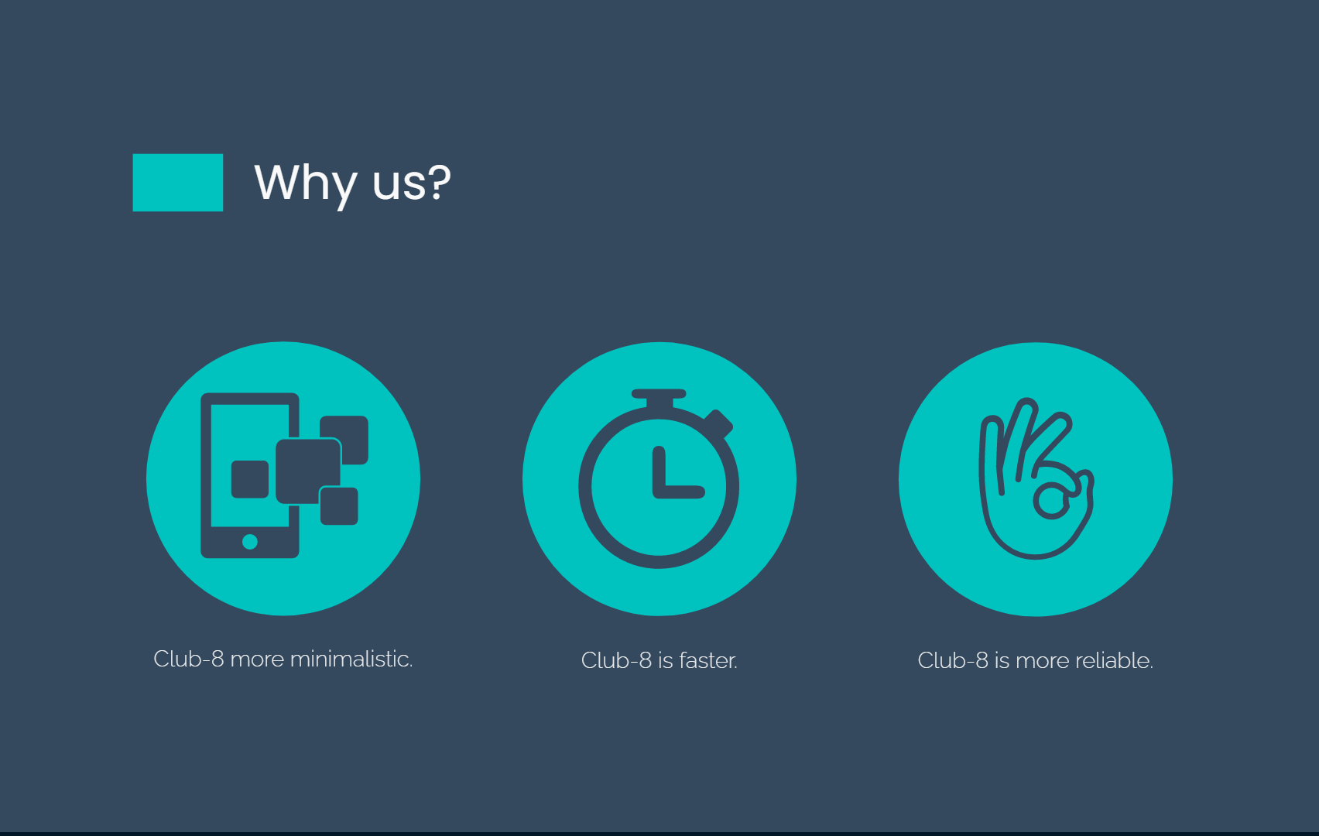
Notes:
Well, How do we do that? We are designing fast, minimalistic and reliable model that will compete with the others.

Slide 9

Notes:
To spread to the market, we contact with Hacettepe Societies and planning to continue with online advertising.

Slide 10

CLUB-8 TEAM
UMUR KILIÇ
CEM DOĞAN
TANSEL ALTINEL
UMUT BUĞRAHAN ÖZKAN
MEHMET ALİ KORKMAZ
Notes:
Thank you for giving us a chance represent ourselves.

