Slide 1
Gradient-Based Edge Detection
An Introduction to Signal Processing with Gradient-Based Edge Detection and Enhancement

Slide 2
What are Edges in Images?
• Edges are significant changes in pixel intensity
• They represent boundaries between objects
• Key features for:
- Object detection
- Image segmentation
- Pattern recognition
• Found where brightness changes sharply

Slide 3
Understanding Gradients in Images
• Gradients measure rate of intensity change
• Two components:
- Magnitude (strength of edge)
- Direction (orientation of edge)
• Calculated using operators:
- Sobel
- Prewitt

Slide 4
How Our Program Works
A Three-Step Process for Edge Detection

Slide 5
Step 1: Image Pre-processing
• Convert image to grayscale:
-A color photo contains a lot of information. Just like summarizing a text,
We also simplify the image. Each pixel is a black-and-white into value.
• Apply Gaussian Filter for smoothing:
Photographs always have small distortions (noise). Gaussian smoothing removes this noise.
- Reduces noise
- Kernel size: 5x5
- Adjustable sigma value
• Prepares image for gradient calculation

Slide 6
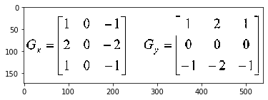
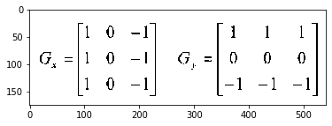
Step 2: Gradient Calculation
Sobel Operator:
• Calculates x and y derivatives
• 3x3 kernel size
• Emphasizes vertical and horizontal edges
Prewitt Operator:
• Alternative to Sobel
• Simpler calculations
• Uniform weight distribution

Slide 7
Step 3: Edge Enhancement
• Automatic threshold determination:
Threshold is a limit value that distinguishes between significant and insignificant changes.
- Otsu's method:
The Otsu method is an intelligent system that automatically finds the best threshold value.
- Adaptive thresholding:
It uses a separate threshold value for each zone. This works very well in a photo with sunny and shaded areas.

Slide 8
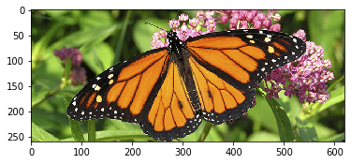
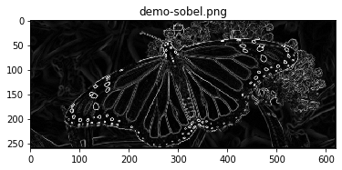
Results and Visual Examples
Demonstration of the effectiveness of our approach

Slide 9
Practical Applications
Industrial Applications
Research Applications
• Quality control
• Defect detection
• Pattern matching
• Robot vision
• Medical imaging
• Satellite imagery
• Document processing
• Face detection

Slide 10
Summary and References
• Successful implementation of gradient-based edge detection
• Key features:
- Automatic threshold determination
- Multiple gradient operators
- Noise reduction
•References:
- https://unsplash.com/
- https://github.com/snijesh/edge-detection
- https://handmap.github.io/gradients-and-edge-detection

