Slide 1

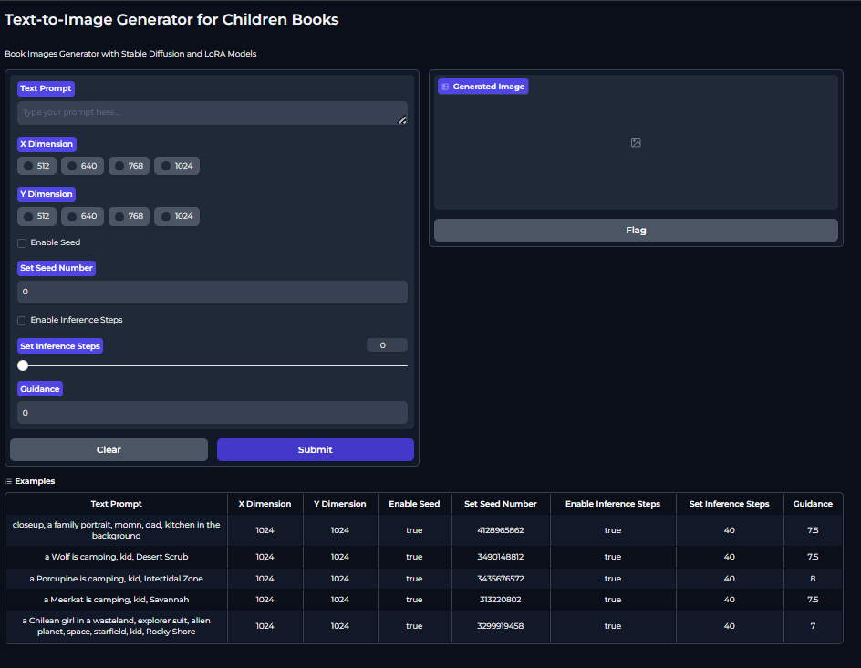
Text to Image for Children Books with Stable Diffusion and LoRA
Student: Mehmet Bayram Alpay
Supervisor: Doç. Dr. Gazi Erkan Bostancı
Ankara University, Computer Engineering Department, 2024
Abstract
Material and Method
Results and Conclusion
Visualizing stories or narratives is a significant challenge for book authors and publishers, especially for children's books where visual expression is crucial. Various solutions have been developed, and one important solution is artificial intelligence. However, AI mainly works with the English language. We offer a user-interactive application that supports over 80 languages. The Visual Generator application takes a book page as input and, converts it into an appropriate prompt to generate images using the advanced LoRA model. Users can produce multiple images with different parameters and prompts. Our goal is to make AI technology more accessible and provide the same service for books written in languages other than English.
Realistic_Vision_V2.0 and KIDS ILLUSTRATION LoRA model were used to produce visuals in this project. These models work as text to image and try to produce the most appropriate image for the given prompt. The prompt needed for these models is obtained using ChatGPT. The prompt entered into the user interactive interface is first pre-processed with ChatGPT and then the output is given to our visual generating models and the visual is produced. HuggingFace diffusers were used to call these models. In addition, a useful user interactive interface was designed for visualization using the Gradio library and interface. In this interface, the user can produce images by setting parameters such as prompt, resolution, guidance, inference steps, seed, or start working with the examples given in the examples section.
Our project currently works interactively, but it is based on the SD 1.5 model and other models can also be tried. Since this is an application created by the interaction of Google Colab and HuggingFace, the deficiencies provided by these sites may have prevented the development of the model. People who have quality hardware can directly set up their own stable diffusion computers and try the models for children's books, which can help them access more features, but our application has also been a useful application for people who currently have hardware and language problems.
References and Acknowledgments
Introduction
Wang, Chenghao, and Jeanhun Chung. "Research on AI Painting Generation Technology Based on the [Stable Diffusion]." International journal of advanced smart convergence 12.2 (2023): 90-95.
Levin, Artyom O., and Yuri S. Belov. "A Study on the Application of Using Hypernetwork and Low Rank Adaptation for Text-to-Image Generation Based on Diffusion Models." 2024 6th International Youth Conference on Radio Electronics, Electrical and Power Engineering (REEPE). IEEE, 2024.
The artificial intelligence sector has acquired many application areas today. Visual production is one of the most used subjects in this regard, and finding a solution to today's visual scarcity under the leadership of this technology seems to be a good solution. There are some concerns that need to be evaluated in terms of inappropriate photographs and photographs that have a bad effect in the production of visuals based on children's books. This is a factor that restricts or makes visual production difficult. That's why we're doing a project that produces user-interactive visuals. With the interactive interface, users have the right to produce images for any number of prompts they want and can obtain the images they want for the conditions they want.
Added Information
Email: mehmetcompeng@gmail.com
Phonenumber: +90 553 569 96 69

